Slide 1

Securator: A Fast and Secure Neural Processing Unit
The 29th IEEE International Symposium on High-Performance Computer Architecture (HPCA-29)
Nivedita Shrivastava, Smruti Ranjan Sarangi
Indian Institute of Technology, Delhi
Notes:
Good morning everybody. I'm Nivedita Shrivastave from IIT Delhi, so I'll be presenting a paper today titled, Securator A Fast and Secure Neural Processing Unit. This paper is about securing a neural network accelerator.

Slide 2


Outline
Background and Related Work
Characterization of Patterns
Securator
Results and Conclusion
Notes:
A quick outline of the presentation. We'll start with the background, discuss some unique features of the execution of neural networks, especially their memory access patterns. We'll discuss the design of our novel secure Neural network engine Securator and the results and conclusions.
So we'll start with a brief description of the background and related work.

Slide 3








Neural Network Models are Expensive
Data Acquisition
(Mechanical Turks)
Data pre-processing
Training
Trained Network
Data acquisition costs upwards of 100K USD.
Multi-million dollar investment with a significant amount of compute power.
Incorporates intellec-tual property of substantial value.
Security of neural network models is of vital importance.
Notes:
Neural networks, as we all know, are quite expensive to run, but they're even more expensive to train. So we ran a couple of numbers and Google searches. So what that yielded is that training a decent size neural network cost upwards of a hundred thousand USD dollars in current prices. And this would of course involve a lot of human effort that involves mechanical Turks and sometimes access to data that is not easily available.
And that would involve a fair amount of pre-processing and subsequent training. And the training algorithms themselves may be quite non-real and this, uh, and in fact the training costs themselves could also, uh, come up to, you know, several million dollars. So that's the reason. Ultimately, the neural network that is trained represents a lot of value in terms of the intellectual property that it embodies. And also in terms of all the research and all the know-how that has gone into fast and efficient training, as well as fast and efficient construction. So hence securing the neural network, which means securing the models as they are being processed by the neural network. And of course, securing an input, uh, securing the input as well as the parameters of the neural network is a vital importance. So the latter is more important.

Slide 4





How Powerful is the Adversary?
L1 Cache
Memory
LLC Cache
Core
CPU
Bus Snooping Attack
Adversary
Replay Attack
NPU
Cold Boot Attack
Tampering Attack
System Package
Camera (image generation)
Access to the off-chip memory and buses
NPU
Notes:
So let's look at a system that embodies a neural network accelerator and let's, uh, look at the threat model.
So what you see over here on the left is that you see a core and L1 cache and L2 cache, and then the neural processing unit. So this is all part of the system package. And the entire system package is expected to be secure. So that's the reason it's known as the TCB or the trusted computing base. This communicates with memory, and the image that is captured could be sent, uh, directly to memory, either raw or in an encrypted format. So basically, if you would assume a more powerful adversary, uh, then it's much better to transfer it in an encrypted format. So the adversary then has access to the contents of the memory itself,
Which means adversary can read as well as write. So let's, uh, think on the lines of a cold boot attack. And the adversary can also snoop all the memory traffic between the CPU and the dram. And of course, you know, this traffic, as we all know, is, uh, not separately encrypted unless it was encrypted by the cpu when the content was written to the memory for the first time. There are several attacks that are possible. You could snoop the bus, uh, you could replay old values. You could of course do a cold boot attack. You could tamper, you could do a bunch of things. And these are kind of well known in the security literature. But the main aim is that you have access to the off chip memory and the buses.

Slide 5
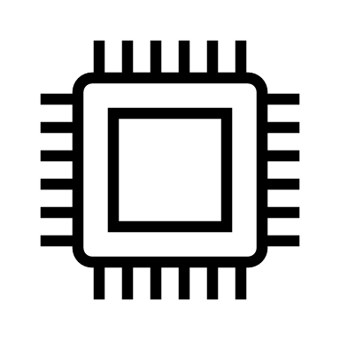
Securing Neural Network Models
Confidentiality
Encrypt the data with a secret key
Integrity
Trusted Computing Base (TCB)
Ensured using hashes
Subset of a system that provides all security guarantees and is believed to be secure.
Authenticity
Encrypted hashes
Message authentication code (MACs)
Freshness
Obsolete values are not re-sent
Notes:
So there are, uh, four important properties that all security models guarantee. So let's start with confidentiality. So data, needless to say, has to be encrypted with a secret key. We further furthermore, to ensure integrity and to ensure that it's not tampered, we have hashes, the hashes themselves could be encrypted. So encrypted hash is called a Mac. So that would, ensure both authenticity, which means that whoever is encrypting the hash is also the entity that can decrypt the hash and verify. And then of course, we have freshness, which is related to replay attacks, which means that it is not possible to replace current data with data that was seen in the past. The replay attacks, as it turns out, are actually the most, difficult class of attacks, that, a security engineer needs to deal with. But we will find, that solving all of them is, uh, equally hard or equally easy. So the TCB in a certain sense, is a subset of the system, which is basically the entire package, the CPU and NPU package, as we are assuming.

Slide 6

Traditional Solutions: Client-SGX and Scalable -SGX
Client-SGX
Issues
Solution
Scalable-SGX
Confidentiality
AES-CTR
AES-XTS
Client SGX is not ideal for neural networks
Managing counters and Merkle trees
Freshness
Counters
Integrity
Managing MACs for every 64-byte block
MAC-per-block
Scalable SGX is efficient, but not totally secure.
Secure Memory Size
256 MB
Limited size of the secure memory
512 GB
Notes:
So let's look at the traditional solution for general purpose computing. So Intel had, software guard extensions SGX for a long time now. So, they provide confidentiality using standard AES, augmented with counter mode encryption, and then they use the counters, which are essentially, a small augmentation to the keys, right, to ensure that successive blocks are in a sense encrypted by different keys. So, so that's the broad idea. They are, kept secure. Then we have integrity, which is a separate mac per block. The sad part is that there is a cost for doing all of this. And the cost is that the size of the secure memory is limited to 256 megabytes, which is actually not much.
Hence, Intel realized that there is a problem and this is not the only problem. So what happens is that, uh, in an SGX like system to ensure all of these security properties, it is important to, consider the fact that it's only the counters that need to be secured. So what is done is that they have a mekel tree. So mekel tree is basically a regulatory, the parent has the key to encrypt the children. That's the broad idea. If I were to summarize in one line, so you maintain the Merkel tree and maintaining and updating this Merkel tree is actually a huge overhead. And for every 64 white block, we also need to maintain a eight byte mac. But needless to say, the Mac computation is not on the critical path, but, the maintenance of the market tree is a big overhead.
And this, leads to the fact that the size of the secured memory is limited, mainly because it's limited by the size of the merkel tree. So Intel realize that it deprecated sgx. So in the latest version of Intel CPUs, which are generation 11 and 12, SGX has kind of been downgraded, so it's not as secure as it was. There is still confidentiality, but, uh, with regards to integrity and freshness, a lot of compromises have been made. So the secure memory size, of course, has increased to, half terabyte, but at the cost of security, right? So the security is not the same, hence using a general purpose mechanism for securing neural networks is not the way to go. And furthermore, if we are considering large neural models, SGX is anyway not very efficient. And this was also realized by Intel and AMD also provides a solution on similar lines.

Slide 7

Convolution Operation
Input feature map (ifmap)
Output feature maps (ofmap)
Weights
K
C
C
=
*
R
H
…..
H
S
W
K set of weights
W
Loop Nesting Order: k c  h  w  r  s
for (k=0; k< K; k++) # ofmaps
Example
for (c=0; c<C; c++) # ifmaps
Due to the limited memory of TCB, the data elements are organized into tiles
for (h=0; h<H; h++) Height of the ofmap
for (w=0; w<W; w++) Width of the ofmap
for (r=0; r<R; r++) Height of the filter
for (s=0; s<S; s++) Width of the filter
ofmap [k][h][w]+= ifmap[c][h+r][w+s] * weights[k][c][r][s]​

Slide 8

A Comparison with Related Work
Work | Venue/Year | Security (via encryption) | Freshness | Integrity (via MACs) | Model extraction attacks
Outsourcing computations | SoCC’20 | Partial | Block | Block | -
SGX + optimizations | AsianHost’20 | Full | Block | Block | -
Custom Accelerators
NPUFort | Computing Frontiers’19 | Partial | Block | - | Obscure compute time
Seal | DAC’21 | Partial | Tile | - | -
GuardNN | DAC’22 | Full | Tile | Block | -
TNPU | HPCA’22 | Full | Layer | Block | -
Securator | This work | Full | Layer | Layer | Layer widening
We exploit memory access patterns to establish layer-level security.
Notes:
So what a lot of related work, uh, has done is that they have basically had different ways of optimizing this computation, right? And, uh, they have said that, look, we'll do one thing we'll, maybe encrypt things partially, or we will keep encryption data at the granularity of blocks or tiles, right?
I'll explain in a second what a block, a tile and a layer is. But as you can see, uh, this has been a hot area of research for the last few years where, uh, of course we are considering a nearest competitors, which are, guard and, TNPU, which encrypt all of it, the inputs and the full model itself. And in this case, what they do is that if I consider a large layer, so if I, uh, can take some space here and uh, show a large layer, they break the layer itself into reasonably large tiles and encryption information is stored at the level of tiles and similarly in, but the integrity information for both is stored at the level of 64 by blocks. So that is at the level at which we check, uh, whether the hashes match or not.
So as you can see, uh, a neural network competition is reasonably deterministic. So our basic idea, which will come to gradually is that we reduce the amount of storage to kind of a theoretical minimum, where we only store encryption and integrity information per layer as opposed to to information at the level of tiles and blocks. So that saves us a fair amount of storage space, reduces the number of dram accesses that improves performance. But what is the key insight? So the key insight is that instead of storing, right? So, so basically you store when you want to retrieve later, and uh, why is that? The reason is because we have limited space, uh, we need to do a partial computation, write it to dram, read it back again later, again, write, read, so on and so forth. Instead of storing encryption information, we compute it, right? So because of the fact that we can compute it, this reduces our storage requirements, details follow.

Slide 9
Outline
Background and Related Work
Characterization of Patterns
Securator
Results and Conclusion
Notes:
Let us take a look what happens when we characterize the memory access patterns

Slide 10
Characterization of Patterns: An Example
Input Reuse : (c  h  w  k)
(C, K) = (3, 2)
ofmap tiles
1
3
3
2
2
TCB
1
A partial ofmap tile is assigned a version number (VN) which is updated as the tile leaves the TCB
Due to the highly deterministic nature of CNNs, the VN updates are highly predictable
Tile 1
Tile 2
VN
DRAM
3
Pattern 1², 2², 3²
Tile 1
Tile 2
2
1
Tile 1
Tile 2
Time
Notes:
We consider a tile of data. The data is partially computer, it's written back to dram. The next time it is read back, will be after another block of data is processed. But when you read it back, we would like to encrypt it with a different key, right? It is the same key. Then we are releasing some information. So we'd like to encrypt it with a different key. So that's the reason we kind of create a new version of it and send it back. Associating a different key means that we'll have to store 1 28 or 2 56 bits, which is a lot of storage. So what is typically done is that instead of a different key, we store a version number. The version number is concatenate with a real key to kind of generate a different virtual key, which for encryption purposes is good enough.
So as you can see over here, we, uh, do one round of processing. Then next time they are read again, a different version number is written back. So now if we kind of visualize the version numbers that an observer would see across, uh, time, what it would see is that for the first tile, first we, uh, access it with version number one, and then the second tile is version number one. Then we read the first tile back again. This time we write it back with version number two, so on and so forth. So the pattern that an observer would see is two ones, two twos and two threes, which can be captured like this.

Slide 11
Characterization of Patterns: Input Reuse
Tiling Style | Loop Order | Write Pattern | Read Pattern | Patterns
Partial channel Partial multi-channel | h_{T}  w_{T}  c_{T}  k_{T} h_{T}  w_{T}  c  k_{T} | (1^{η}, 2^{η}.... κ^{η}) ^{ρ} | (1^{η}, 2^{η}.... (κ-1) ^{η})^{ρ} | P1, P2, P3, P4, P5
Partial channel Partial multi-channel | c_{T}  h_{T}  w_{T}  k_{T} c  h_{T}  w_{T}  k_{T} | 1^{ηρ}, 2^{ηρ}.... κ^{ηρ} | 1^{ηρ}, 2^{ηρ}.... (κ-1) ^{ηρ} | P2, P3, P5
Channel-wise | c_{T}  k_{T} c  k_{T} | 1^{η}, 2^{η}.... κ^{η} | 1^{ηρ}, 2^{ηρ}.... (κ-1) ^{ηρ} | P2, P3, P5
Full-channel | h_{T}  w_{T}  k_{T} | 1^{ηρ} | - | P5
η = K/K_{T} ; κ = C/C_{T}; ρ = H.W/H_{T}.W_{T}
P1
P2
P3
P4
P5
(1^{η}, 2^{η}.... κ ^{η})^{ρ}
1^{ηρ}, 2^{ηρ}.... κ ^{ηρ}
1, 2.... κ
(1, 2....κ)^{ρ}
1^{ηρ}
Notes:
So what we did is we looked at all kinds of reuse patterns, right, which are known in the literature. And of course, we, uh, use the help of the time loop tool, which was generated by, uh, XYZ group in Princeton University.
So here, what we did is that we looked at different, uh, reuse patterns for the input is cashed, for instance. Then we looked at patterns where, uh, part of the input channel, uh, is read at one time or multiple channels or parts of multiple input channels are read at a time. So we looked at all possible data flows that are common and the ones that time loop supports. And for all of them with the help of a manual algorithm and later using a script, we were able to characterize their data flows in terms of regular expressions of this type. I'm not go into the details, but the details are in the paper.

Slide 12
Characterization of Patterns: Weight Reuse
Tiling Style | Loop Order | Write Pattern | Read Pattern | Patterns
Multi-channel wise | c_{T}  k_{T} | 1^{η}, 2^{η}.... κ^{η} | 1^{η}, 2^{η}.... (κ-1) ^{η} | P2, P3, P5
Channel-wise | k_{T}  c | 1^{η} | - | P5
Full filter | k_{T} | 1^{η} | - | P5
η = K/K_{T} ; κ = C/C_{T};
P2
P3
P5
1^{η}, 2^{η} ... κ ^{η}
1, 2.... κ
1^{η}
Notes:
And this was done for all kinds of common reuse patterns. And we did a thorough data mining of all neural network papers, and we found that these are by far the most common reuse patterns, and they're also not that many that you would actually require an algorithm per se.

Slide 13
Characterization of Patterns: Output Reuse
Tiling Style | Loop Order | Write Pattern | Read Pattern | Pattern
Partial channel Partial multi-channel | h_{T}  w_{T}  k_{T}  c_{T} h_{T}  w_{T}  k_{T}  c | 1^{ηρ} | - | P5
Channel-wise | h_{T}  w_{T}  k_{T} | 1^{ηρ} | - | P5
Full-channel | k_{T}  c_{T} k_{T}  c | 1^{η} | - | P5
P5
η = K/K_{T} ; ρ = H.W/H_{T}.W_{T}
1^{ηρ}
Notes:
Even the manual analysis does help, even though our approach, I would kind of characterize a semi-automated.

Slide 14

The Master Equation
The VN updates are
Highly deterministic
Quite similar across a range of operations.
The access patterns can be encoded using a sequence of numbers.
We can generate any VN pattern using a single master equation.
One equation to generate them all
(1^{α}, 2^{α} … k^{α} )^{β}
Securator generates VNs automatically using a programmable circuit
The equation is characterized by the triplet <α, β, k>
Reduces VN storage and management costs.
Notes:
The key idea is that it is possible to kind of represent the patterns that an observer would see as kind of as a regular expression. So we can create a master regular expression, which can be specialized into any one of the patterns. And that would look like something like this alpha times one, then alpha times two, right? So which means two repeated alpha times and then k repeated alpha times. So the hyper parameters of this regular expression are essentially three alpha, beta, and K here. And we can, uh, the only hardware that is required to generate this as a simple finite automatic, which is parametrized with alpha, beta and key. So a small circuit is all that is required, right?
designing this is not a big deal at all. So with this, we don't have to remember the version numbers, we don't have to store them, but what we have to do is that we need to create a circuit to auto generate them. And as you can see, this is very easy. So essentially we have replaced storage with a fast compute engine. It's no different from, let's say, if you take all, you know, fiche numbers instead of, uh, remembering all of them. A simple formula suffices.

Slide 15
Outline
Background and Related Work
Characterization of Patterns
Securator
Results and Conclusion

Slide 16

Securator Architecture
Compute Engine
Global Buffer
PE
PE
PE
240 kB doubly
buffered global buffers
A 32x32 systolic array architecture
ifmap
ofmap
wts
PE
PE
PE
Security Module
PE
PE
PE
AES Engine
Version No. Generator
MAC
Verifier
Memory Engine
Trusted Computing Base
Read
Observer
Write
Observer
Instructions
Last level cache
Unsecure Memory
L1 cache
Core
CPU
Notes:
So the architecture, architecture of secure is quite simple actually. Uh, we don't have, uh, there's nothing new here per se, other than the modules that we add. So we add this version number generator, which is what we described. We have another novelty here, which is the fact that, uh, the version number generator of course is one per layer. And also I'll show that in the Mac part, we don't again have to store information per block, but we have to store information per layer that, uh, the logic for that is quite similar to what I just described.

Slide 17

Using VNs in MAC Generation
For each 64-byte data-block
No tampering
Authorization
Freshness
Secret ID | Layer ID | fmap ID
Block index within the fmap | Data block content | Version number
VN acts as a proxy for the secret key
SHA
Engine
MAC_{B}

Slide 18
Layer-wise MAC Verification
MAC_{W} embodies everything that has been written
MAC_{R} embodies everything that has been read
Tampering check for the current layer is done in the next layer
First reads: Using MAC_{FR}
In layer 'i', we do not read the final output. It is read in the next layer 'i+1'.
If MAC_{W'} == MAC_{W} no tampering was done.
MAC_{B}
MAC_{B}
MAC_{FR}
MAC_{W}
MAC_{R}
MAC_{W'}
Verify that whatever is written, the same is read back without tampering.
Notes:
So what we did is that of course, along with the version numbers, uh, novelty, we created two Macs, a right Mac and a Read Mac. So this is an interesting property of the zar function that it's, uh, commutative and associative as well. So the first part is that everything that has been written in a layer, right? So so what happens? So, so the insight is that if we write data K times, right, uh, then we also read it back K times. So this is of course really true in a layer where if we write it K times, we will read it back at least K minus one times within that layer. But of course, in the next layer or in some consumer layer, we'll read it once more. So pretty much everything that is written, uh, written is also read back once. So what I can do is I can just keep on zing all the data that I write and I can keep on zing all the data that I read. And then pretty much for an entire layer I look at the full zar, right zar of a layer. And the reads are of a layer and they essentially need to match the probability of, uh, you know, a false positive is vanishingly small.
the important point here is that the read mac and the right mac need to match, which as you can see, every time that I write, write, if I am reading the subsequent time, then if I write K times, also read K times and the read mac and the right map for every single layer, right, should match. So using this key insight, what we were able to do is we eliminated block wise max, and we have a single layer wise Mac. So our aim of having layer wise storage by leveraging the special memory access patterns of neural networks was hens worth achieved.

Slide 19
Outline
Background and Related Work
Characterization of Patterns
Securator
Results and Conclusion
Notes:
So now, we don't have a lot of time, so we'll quickly go to the results and conclusion.

Slide 20


Designs Evaluated
Baseline Design – A vanilla neural network accelerator with no security guarantees
Configuration | Integrity (MAC) | Encryption | Anti-replay
Baseline
Secure | Per-block (on-chip) | AES - CTR | Counters
GuardNN | Per-block (off-chip) | AES - XTS | Version Numbers (per-tile)
TNPU | Per-block (on-chip) | AES - CTR | Version Numbers (per-tile)
Securator | Per-layer (on-chip) | AES - CTR | Version Numbers (per-layer)
Notes:
So the designs set we evaluated was of course a baseline design, are secure design that uses, uh, counter mode encryption similar to baseline SGX guard, and then N T N P U who are our nearest competitors. And what they do was described, uh, in an earlier slide.

Slide 21
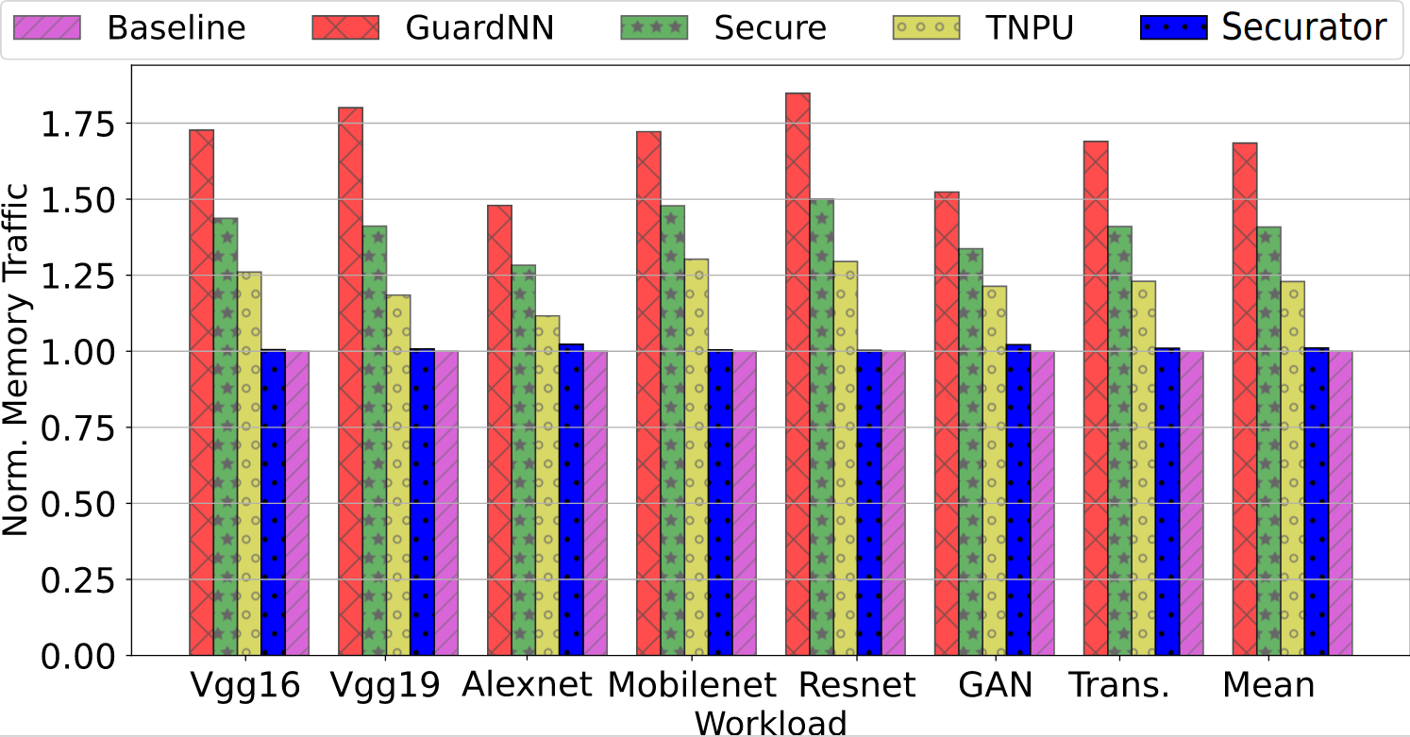
Results: Normalized memory traffic
The decreases demand for data storage subsequently reduces the DRAM traffic as compared to the nearest competing work, TNPU
Notes:
So basically if you look at the normalized memory traffic, our normalized traffic over here is quite close to what you would get for the baseline, right? And the reason for that is that, uh, we hardly have any additional memory accesses, and that's because we don't have these block wise max.

Slide 22
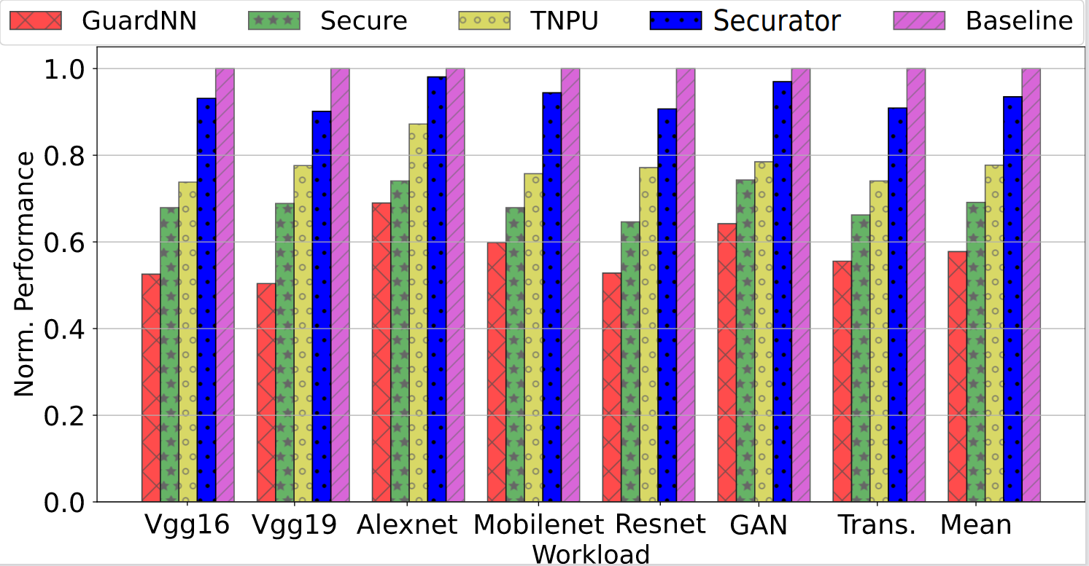
Results: Normalized performance
With reduced DRAM traffic, we achieve a 20.56% performance improvement in comparison to TNPU.
Notes:
This translates to a direct improvement in performance. Of course, it's not, uh, commensurate with the reduction in the memory traffic, which is expected, but as you can see, the reduction in performance for the garden and to T n P designs is of the order of 30 40%, but we are roughly within six to 7% of the baseline, which is pretty much as close as we could go. Speaker 2: (20:18)
This translates to a direct improvement in performance. Of course, it's not, uh, commensurate with the reduction in the memory traffic, which is expected, but as you can see, the reduction in performance for the garden and to T n P designs is of the order of 30 40%, but we are roughly within six to 7% of the baseline, which is pretty much as close as we could go.

Slide 23
Synthesis Results
Securator deploys three additional on-chip modules to ensure security.
Four parallel AES-128 engines
A SHA-256 engine
A fast and reconfigurable VN generator circuit
​Module | Area ​(µm²) | ​Power (µW)
​AES-128 | ​3900 | ​640
​SHA-256 | ​270 | ​40
​VN generator | ​40 | ​4.4
Tool | Cadence RTL compiler, 8 nm
The incorporated security modules leads to marginal overheads.
Notes:
Given the fact that that correlation is clear, we also synthesize all our designs, at least additional part that we added. So we synthesize four AEs engines, which anyway are a part of any secure design. So we would not consider that strictly a part of ours. But the s a a designs, uh, for the Mac part, the zing circuit and the VN generator, as you can see, the additional area requirement is minimal, is just 310 micron square. And the power requirement is also, you know, just about ne negligible 44 microwatts at eight nanometers. The incorporated security modules does lead to marginal overheads.

Slide 24
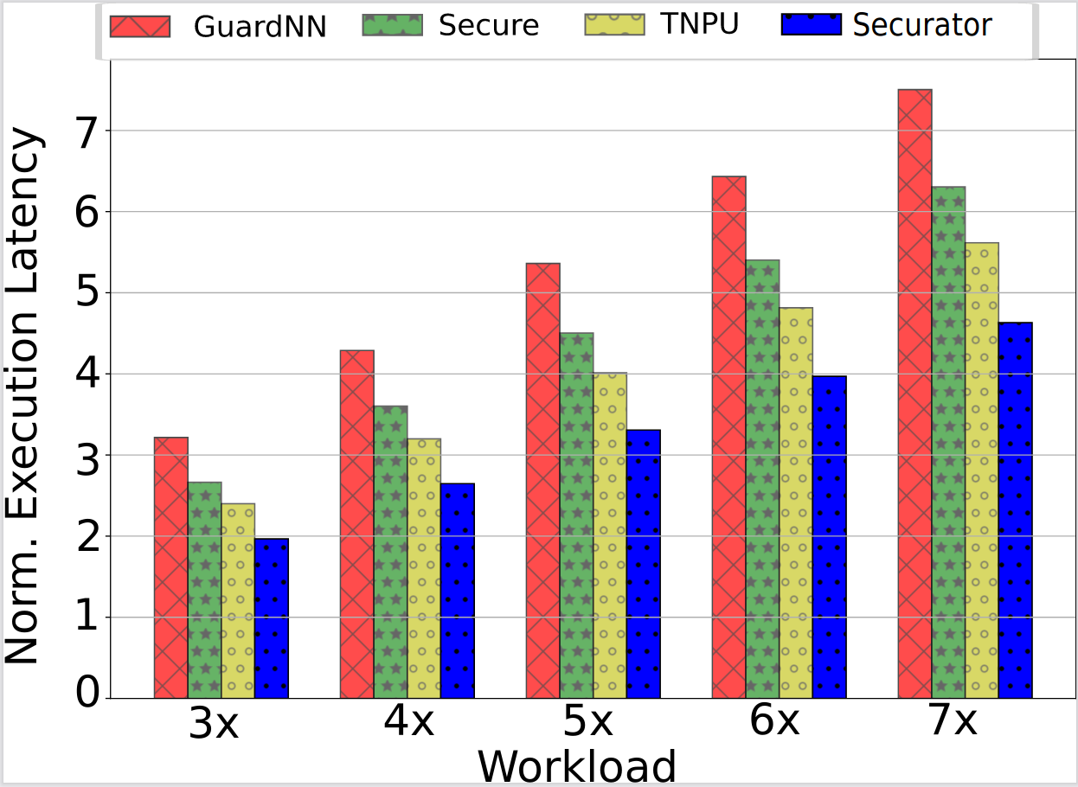

Protection Against Model Extraction Attacks
Model extraction attacks rely on side channels for extracting the dimensions of a model.
A popular countermeasure is layer-widening.
We scale up the base layer of MobileNet in order to assess the consequences of layer widening.
Securator is the most scalable. Its speed-up over TNPU increases from 3 to 7X.
Notes:
Doe to lack of time, I'm not describing a lot about what we did with model extraction attacks, but here again, the gold standard of model extraction attacks is a paper NeurObfuscator by Li et al
Further say that, you know, the sure shot way of defeating this is layer widening, which means make all layers the same size. We pretty much did that when it's, uh, in this case it's a scalability play. So what we show is that even if you increase our layer sizes by, you know, five, six x or seven x, we still continue to remain the most efficient. And that is why layer widening is something which is feasible for us and less feasible for others.

Slide 25
Conclusion
Due to the decreased demand for data storage and subsequently reduced DRAM traffic, Securator achieves a 20.56% performance improvement in comparison to TNPU.
Neural network (NN) models are expensive and should be protected.
NNs perform very systematic and predictable computations that can be leveraged to reduce security overheads.
Layer-level security checks can lower the costs involved with providing security guarantees.
To achieve layer-level security, we efficiently characterize and encode a wide variety of memory access patterns.
Notes:
So now let me quickly conclude. Uh, the factors and neural networks are, the models themselves are quite expensive and they need to be secure to secure them. A lot of storage was being used both at the block level and as well as the tile level for version numbers. And max, we eliminated all of that, primarily using and leveraging the special memory access patterns of neural networks and replacing what was a storage problem. Primarily we, that was converted to a compute problem where we showed that we can efficiently compute the version numbers and the max using, uh, the specialized formula that we showed and realized simple circuits, uh, for performance. And as you can see, our performance improvements are quite impressive. And they mainly stemmed from the fact that our memory traffic red reduced quite substantially.

Slide 26
Thank You
The 29th IEEE International Symposium on High-Performance Computer Architecture (HPCA-29)

