Slide 1

A Fast Leakage Aware Thermal Simulator for 3D Chips
Hameedah Sultan and Smruti R. sarangi
Computer Science and Engineering
Indian Institute of Technology Delhi, India

Slide 2
Outline
Background
Popular techniques
Motivation for our Work
Steady State Thermal Simulator
Transient Thermal Simulator
Results

Slide 3
Background

Slide 4
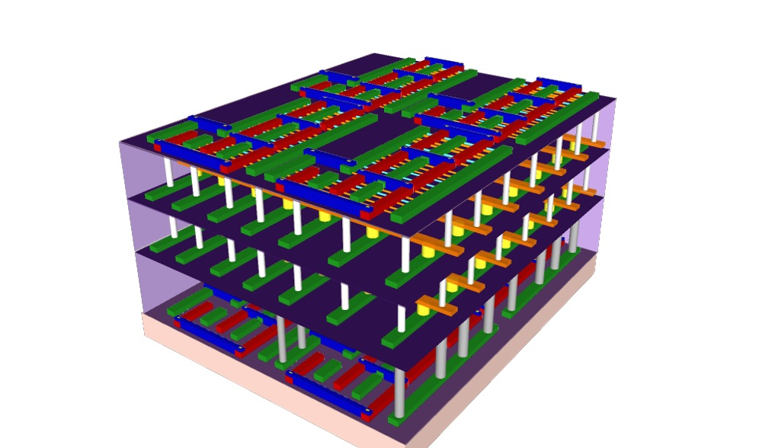
Introduction
Quantify harmful effects on chip
Mobility, speed
Lifetime, reliability
Interconnect Resistivity
Uses of
Thermal Simulator
Thermal Aware Design
Optimization
Floorplanning
Cell Placement
Cooling System Provisioning
Cabinet design and fan settings

Slide 5

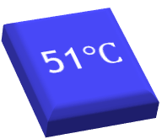




Thermal Simulator
Thermal Simulator
Floorplan
DynamicPower Profile
Temperature Profile
.55 W
2 W
3 W
47$℃$
51$℃$
58$℃$
1 W
1 W
52$℃$
52$℃$
5 W
65$℃$

Slide 6
Literature Survey
Computation time decreases, accuracy decreases
Finite Element
Finite Difference
Transform based
Galerkin Method
Approx. FEM
Thermo Electric Equivalence
Matrix Multiplication based
Computing the Green’s functions
Using pre-obtained Green’s fxn

Slide 7
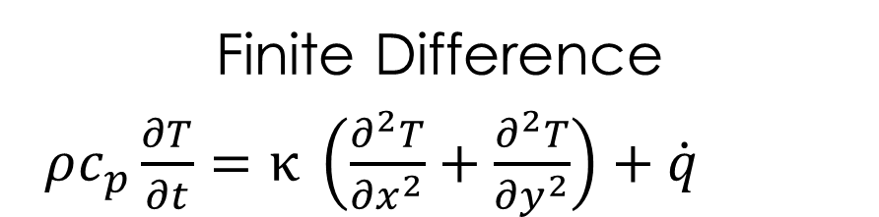
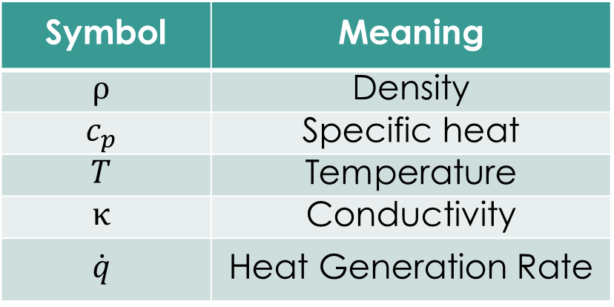
Finite Difference
Symbol | Meaning
$$ρ$$ | Density
$$c_{p}$$ | Specific heat
$$T$$ | Temperature
$$κ$$ | Conductivity
$$\dot{q}$$ | Heat Generation Rate
Finite Difference
$ρc_{p}\frac{∂T}{∂t}=κ \left(\frac{∂^{2}T}{{∂x}^{2}}+\frac{∂^{2}T}{{∂y}^{2}}\right)+\dot{q}$

Slide 8

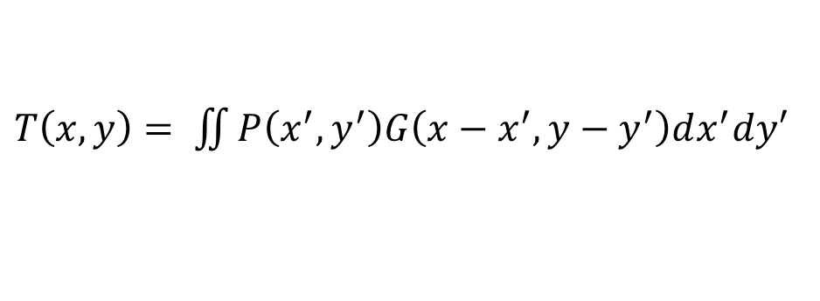
Green’s Function
Green’s function
Temperature field of a unit impulse power source
$T=G ⊛ P$
𝑇=𝐺 ⊛ 𝑃
$T\left(x,y\right)= \iint{P\left(x^{′}, y^{′}\right)G\left(x−x^{′}, y−y^{′}\right)dx^{′}dy′}$
$⊛$ convolution operation

Slide 9


Basic Idea
Power Profile Green’s Function
$⊛$
$$T= G⊛P$$
Temperature Profile

Slide 10

How to find the Green’s function ?

Slide 11
Transform based Approaches
Apply a unit power source
$$T=G ⊛ P$$
𝑻=𝑮 ⊛ 𝑷
Measure the Green’s function, G
Floorplan
DynamicPower Profile
Temperature Profile
Thermal Simulator

Slide 12

Power Profile
Power Profile
Dynamic Power
Leakage Power
$$P_{leak}∝T$$
$$P_{leak}−P_{leak0}=βT$$
$P_{leak0} :$leakage at
ambient temp

Slide 13
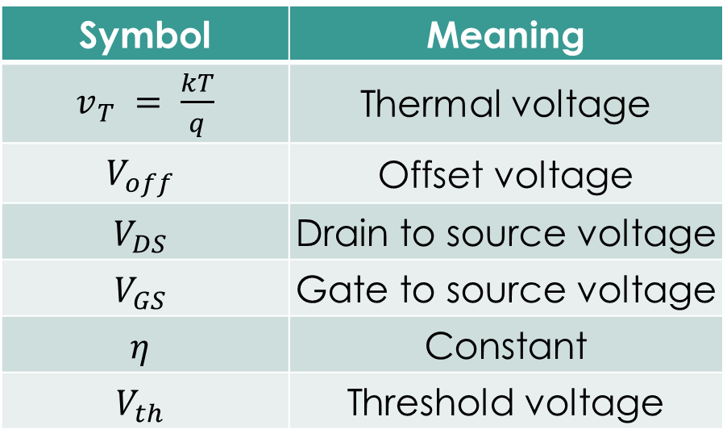

Leakage Power Modeling
BSIM4 Model:
$P_{leak}∝ v_{T}^{2} ∗ e^{\frac{V_{GS} −V_{th} − V_{off}}{η ∗ v_{T}}}\left(1 − e^{\frac{−V_{DS}}{v_{T}}}\right)$
$$v_{T}= \frac{kT}{q}$$
$P_{leak} ⇄T$
Symbol | Meaning
$v_{T}^{}= \frac{kT}{q}$ | Thermal voltage
$$V_{off}$$ | Offset voltage
$$V_{DS}$$ | Drain to source voltage
$$V_{GS}$$ | Gate to source voltage
$$η$$ | Constant
$$V_{th}$$ | Threshold voltage

Slide 14




Popular Simulators – Hotspot ^{[2]}, 3D–ICE ^{[3]}
Floorplan
Temperature
Trace
Solve
${P=P_{dyn}+P}_{leak}$
.55 W
2 W
3 W
1 W
1 W
Thermal Simulator
`
5 W
.55
3
2
0.3
.05
0.2
Calculate $P_{leak}$
using BSIM eqn
0.1
1
1
0.1
0.5
5

Slide 15
Motivation for our work
Our focus: simulation speed in 3D chips
Very few techniques exist for 3D chips
Leakage power handled analytically
Prior work handles leakage iteratively
Transient temperature profile including leakage
No such transform based technique exists for 3D chips

Slide 16
Work Done
Leakage Aware Thermal Simulator for 3D Chips
Steady State Simulator
Transient Simulator

Slide 17
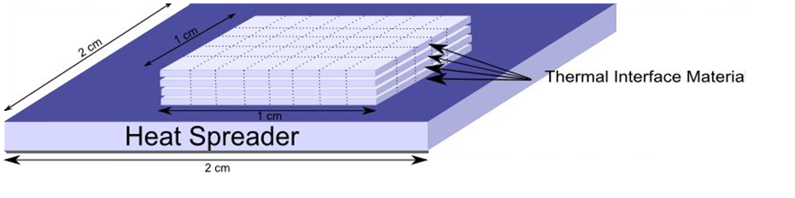
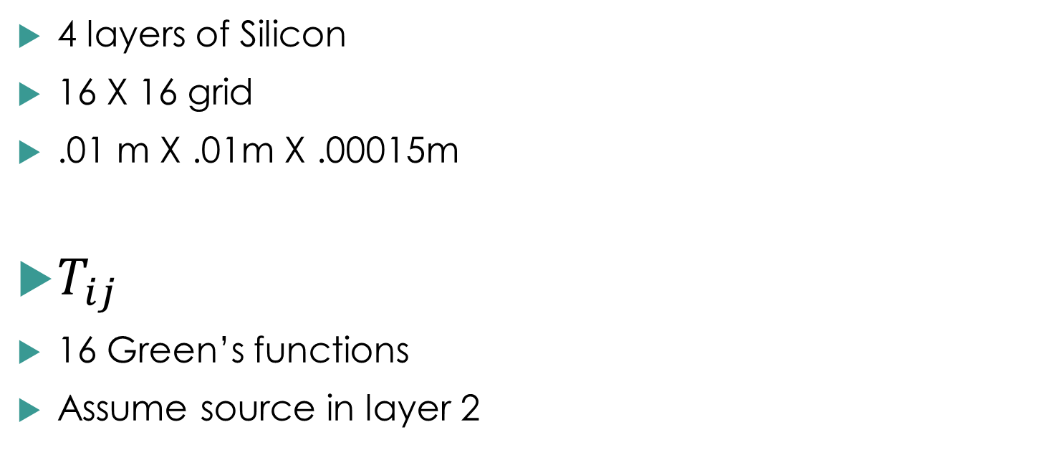
Floorplan of the chip
4 layers of Silicon
16 X 16 grid
.01 m X .01m X .00015m
$T_{ij}$
16 Green’s functions
Assume source in layer 2
Effect in layer i
Source in layer j

Slide 18
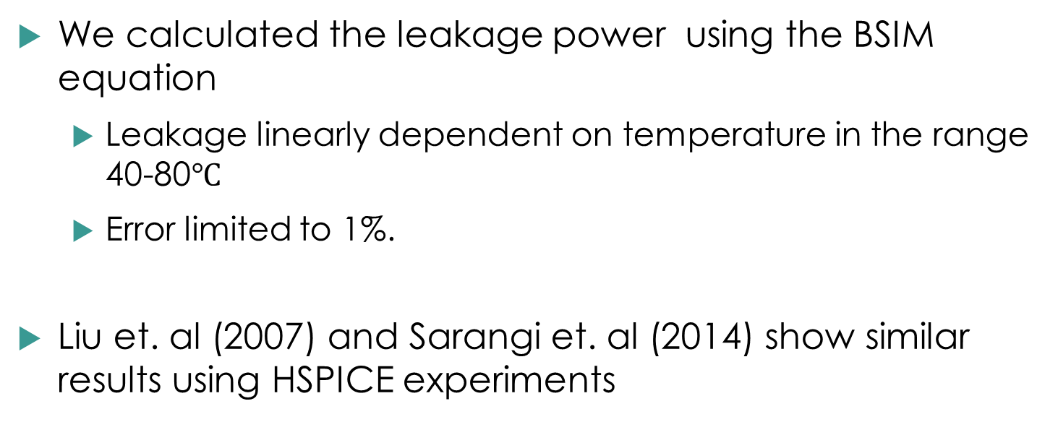
Linearity of leakage
We calculated the leakage power using the BSIM equation
Leakage linearly dependent on temperature in the range 40-80$℃$
Error limited to 1%.
Liu et. al (2007) and Sarangi et. al (2014) show similar results using HSPICE experiments

Slide 19
Basic Idea of our Approach
Apply a unit power source
$$T=G ⊛ P$$
𝑻=𝑮 ⊛ 𝑷
Measure the Green’s function, G
Compute leakage aware Green’s functions
Floorplan
Dynamic Power Profile
Temperature Profile
Offline
Online
Thermal Simulator

Slide 20

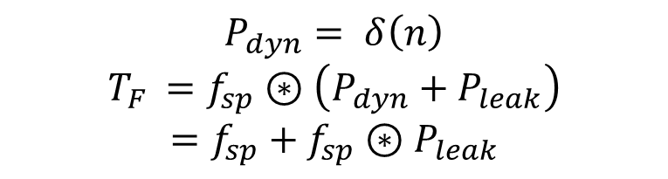
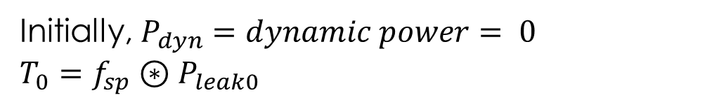
Computing the Leakage Aware Green’s Functions
$$T=T_{F }−T_{0} =f_{sp}+f_{sp}⊛ΔP_{leak}$$
$= f_{sp}+βf_{sp}⊛T$
Apply impulse power source
Initially, $P_{dyn}=dynamic power= 0$
$$T_{0}=f_{sp}⊛P_{leak0}$$
$$P_{dyn}= δ\left(n\right)$$
$$T_{F }=f_{sp}⊛\left(P_{dyn}+P_{leak}\right)=f_{sp}+f_{sp}⊛P_{leak}$$
Traditional approaches use 2D FFT
We convert 2D to 1D
Sarangi, S.R. et al., “LightSim : A Leakage Aware Ultrafast Temperature Simulator,” ASP-DAC, pp. 855-860, 2014.
Notes:
$T=f_{silic}+κ+βf_{silic}∗T+κ_{1}$ (2)

Slide 21
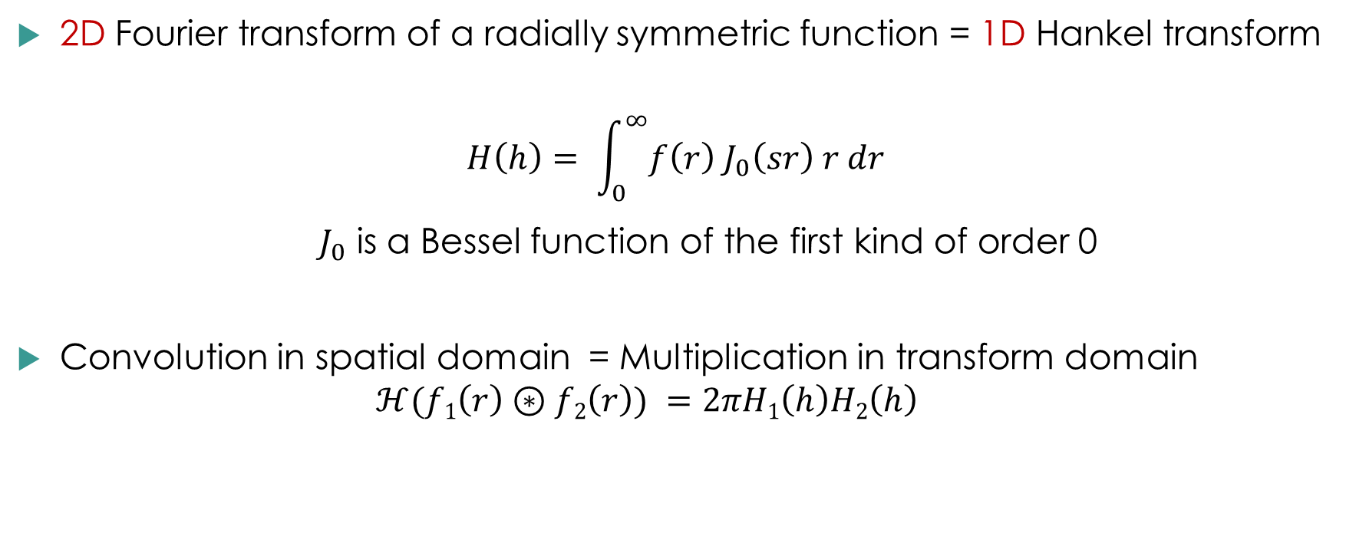
Hankel Transform
2D Fourier transform of a radially symmetric function = 1D Hankel transform
$$H\left(h\right)= \int_{0}^{∞}{f\left(r\right){ J}_{0}\left(sr\right) r dr}$$
${ J}_{0}$ is a Bessel function of the first kind of order 0
Convolution in spatial domain = Multiplication in transform domain
$$ℋ(f1\left(r\right)⊛f2\left(r\right)) =2πH1\left(h\right)H2\left(h\right)$$

Slide 22

2D Leakage Modified Green’s Function
$T= f_{sp}+βf_{sp}⊛T$
$H(T)=H(f_{sp})+2πβH\left(f_{sp}\right)H\left(T\right)$
$T=f_{leaksp}=H^{−1}\left(\frac{H\left(f_{sp}\right)}{1−2πβH(f_{sp})}\right)$
Notes:
Modified Green’s Functions With Leakage for 2D

Slide 23


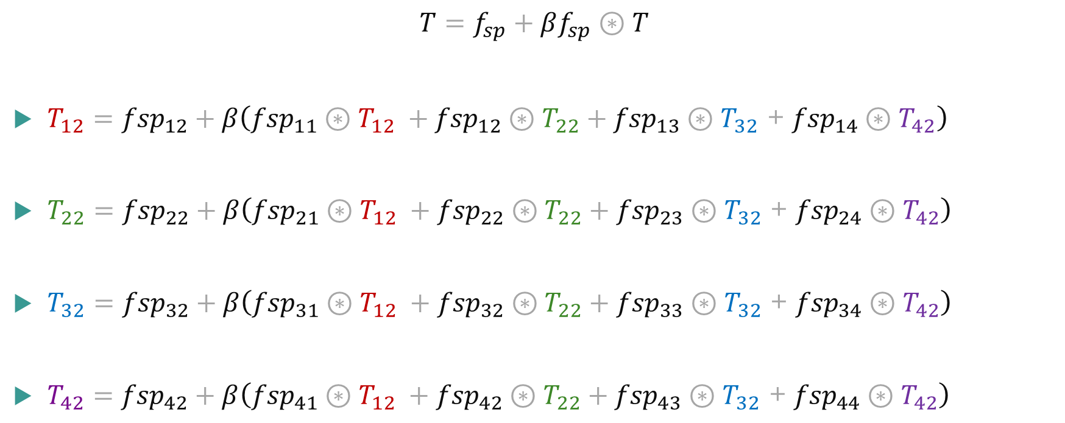



The Fundamental 3D Steady State Equations
$$T=f_{sp}+βf_{sp}⊛T$$
$T_{12}={fsp}_{12}+β\left({fsp}_{11}⊛T_{12} +{fsp}_{12}⊛T_{22}+{fsp}_{13}⊛T_{32} \text{+} {fsp}_{14}⊛T_{42}\right)$
$T_{22}={fsp}_{22}+β\left({fsp}_{21}⊛T_{12} +{fsp}_{22}⊛T_{22}+{fsp}_{23}⊛T_{32} \text{+} {fsp}_{24}⊛T_{42}\right)$
$T_{32}={fsp}_{32}+β\left({fsp}_{31}⊛T_{12} +{fsp}_{32}⊛T_{22}+{fsp}_{33}⊛T_{32} \text{+} {fsp}_{34}⊛T_{42}\right)$
$T_{42}={fsp}_{42}+β\left({fsp}_{41}⊛T_{12} +{fsp}_{42}⊛T_{22}+{fsp}_{43}⊛T_{32} \text{+} {fsp}_{44}⊛T_{42}\right)$
$$T_{12}$$
$$T_{22}$$
$$T_{32}$$
$$T_{42}$$
Notes:
= Temperature in layer i, because of source in layer j

Slide 24
The Fundamental 3D Steady State Equations – Solution
Notes:
= Temperature in layer i, because of source in layer j

Slide 25
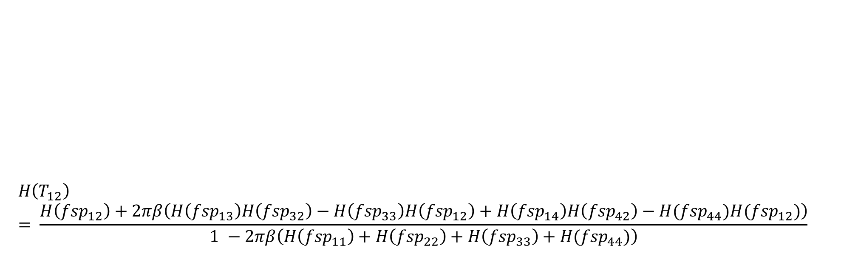
3D Leakage Modified Green’s Functions
Compute the Hankel transform
Simplify and solve for H(T)
- Mathematica
Ignore second order effects
Compute the inverse Hankel transform
$$H\left(T_{12}\right)= \frac{H\left({fsp}_{12}\right)+2πβ\left(H\left({fsp}_{13}\right)H\left({fsp}_{32}\right)−H\left({fsp}_{33}\right)H\left({fsp}_{12}\right)+H\left({fsp}_{14}\right)H\left({fsp}_{42}\right)−H({fsp}_{44})H({fsp}_{12})\right)}{1 −2πβ\left(H\left({fsp}_{11}\right)+H\left({fsp}_{22}\right)+H\left({fsp}_{33}\right)+H({fsp}_{44})\right)}$$

Slide 26
Corrections for Edges and Corners

Slide 27
Final Temperature Profile
Traditional approach:
$$T=G ⊛ P$$
𝑇=𝐺 ⊛ 𝑃
$$F\left(T\right)=F\left(G\right)F\left(P\right)$$
𝐹(𝑇)=𝐹(𝐺)𝐹(𝑃)
We save the Leakage modified Green’s functions in the transform domain itself
$$H\left(T\right)=H\left(G\right)H\left(P\right)$$
𝐻(𝑇)=𝐻(𝐺)𝐻(𝑃)
$$H\left(T\right)=H\left(T_{12}\right)H\left(P_{1}\right)+H\left(T_{22}\right)H\left(P_{2}\right)+H\left(T_{32}\right)H\left(P_{3}\right)+H\left(T_{42}\right)H\left(P_{4}\right)$$
𝐻(𝑇)=𝐻(𝑇_12 )𝐻(𝑃_1 )+𝐻(𝑇_22 )𝐻(𝑃_2 )+𝐻(𝑇_32 )𝐻(𝑃_3 )+𝐻(𝑇_42 )𝐻(𝑃_4 )

Slide 28
Other Techniques used for Edges and Corners
Some recent techniques ^{[2]} use the method of images
Our method achieves the same task without increasing the size of the P matrix.
Time taken for a convolution operation depends on the size of the matrices
Extend power dissipation matrix 9 times with mirror images.
Significant savings in the online part
A. Ziabari et al., “Power blurring: Fast static and transient thermal analysis method for packaged integrated circuits and power devices," VLSI Systems, IEEE Transactions on, vol. 22, no. 11, pp. 2366-2379, 2014.

Slide 29
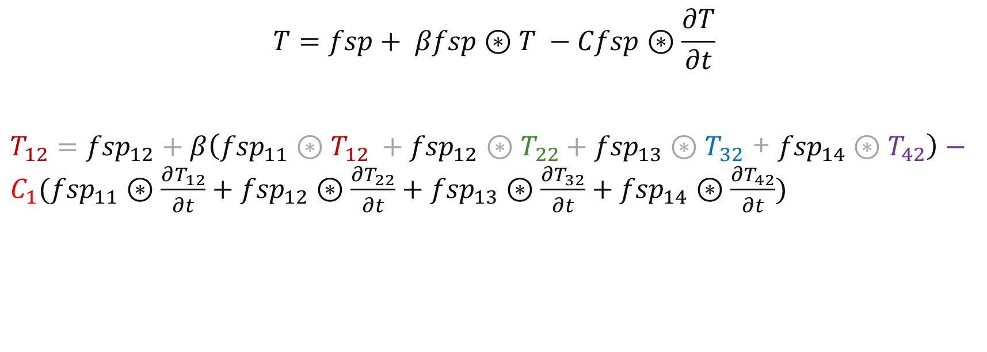
The Fundamental 3D Transient Equations
$$T=fsp+ βfsp⊛T −Cfsp⊛\frac{∂T}{∂t}$$
$T_{12}={fsp}_{12}+β\left({fsp}_{11}⊛T_{12} +{fsp}_{12}⊛T_{22}+{fsp}_{13}⊛T_{32} \text{+} {fsp}_{14}⊛T_{42}\right)−C_{1}({fsp}_{11}⊛\frac{∂T_{12}}{∂t}+{fsp}_{12}⊛\frac{∂T_{22}}{∂t}+{fsp}_{13}⊛\frac{∂T_{32}}{∂t}+{fsp}_{14}⊛\frac{∂T_{42}}{∂t})$

Slide 30
The Fundamental 3D Transient Equations
We take the Hankel transform of the formulated set of equations and simplify.
Simplify
Take Laplace transform, interchange Hankel and Laplace transforms.
Formulate equations
The first few terms of the resulting equation correspond with the steady state temperature profile ${(T}_{12ss})$
The first few terms of the resulting equation correspond with the steady state temperature profile 〖(𝑇〗_12𝑠𝑠)
Perform further operations
Use transform properties

Slide 31
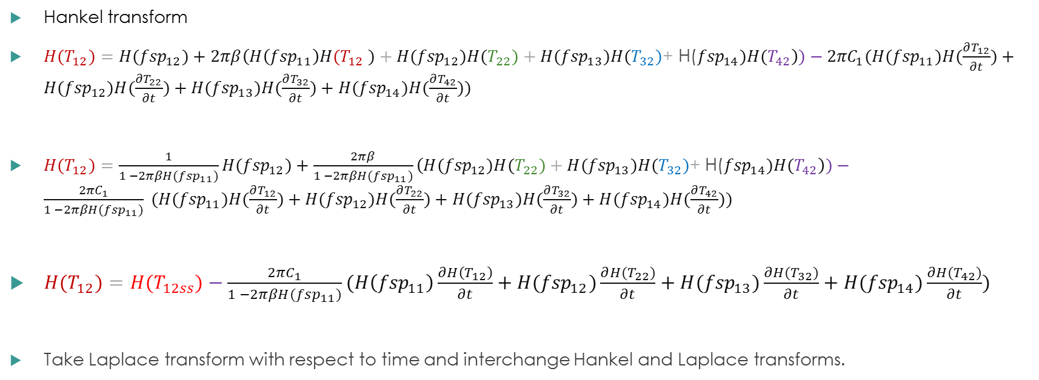

The Fundamental 3D Transient Equations
Hankel transform
$H(T_{12})={H(fsp}_{12})+2πβ\left(H\left({fsp}_{11}\right)H{(T}_{12} )+{H(fsp}_{12})H(T_{22})+{H(fsp}_{13})H(T_{32})\text{+} \text{H}\text{(}{fsp}_{14})H(T_{42}\right))−{2πC}_{1}({H(fsp}_{11})H(\frac{∂T_{12}}{∂t})+{H(fsp}_{12})H(\frac{∂T_{22}}{∂t})+H({fsp}_{13})H(\frac{∂T_{32}}{∂t})+{H(fsp}_{14})H(\frac{∂T_{42}}{∂t}))$
$H(T_{12})={\frac{1}{1 −2πβH({fsp}_{11})}H(fsp}_{12})+\frac{2πβ}{1 −2πβH({fsp}_{11})}\left({H(fsp}_{12})H(T_{22})+{H(fsp}_{13})H(T_{32})\text{+} \text{H}\text{(}{fsp}_{14})H(T_{42}\right))−\frac{{2πC}_{1}}{1 −2πβH({fsp}_{11})} ({H(fsp}_{11})H(\frac{∂T_{12}}{∂t})+{H(fsp}_{12})H(\frac{∂T_{22}}{∂t})+H({fsp}_{13})H(\frac{∂T_{32}}{∂t})+{H(fsp}_{14})H(\frac{∂T_{42}}{∂t}))$
${H(T}_{12})={H(T}_{12ss})−\frac{{2πC}_{1}}{1 −2πβH({fsp}_{11})}(H\left({fsp}_{11}\right)\frac{∂H\left(T_{12}\right)}{∂t}+{H(fsp}_{12})\frac{∂{H(T}_{22})}{∂t}+{H(fsp}_{13})\frac{∂{H(T}_{32})}{∂t}+{H(fsp}_{14})\frac{∂H(T_{42})}{∂t})$
Take Laplace transform with respect to time and interchange Hankel and Laplace transforms.
$$T_{12ss}$$

Slide 32

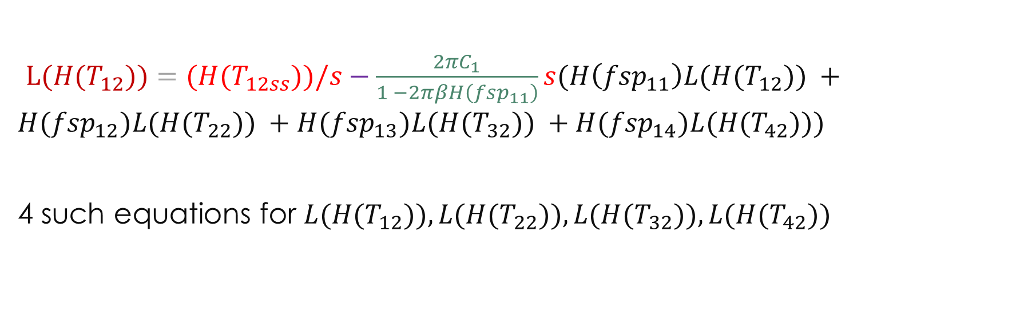
Transient Analysis
$L({H(T}_{12}))={(H(T}_{12ss}))/s−\frac{{2πC}_{1}}{1 −2πβH\left({fsp}_{11}\right)}s(H\left({fsp}_{11}\right)L(H(T_{12})) +{H(fsp}_{12})L(H(T_{22})) +{H(fsp}_{13})L(H(T_{32})) +{H(fsp}_{14})L(H(T_{42})))$
4 such equations for ${L(H(T}_{12})),{L(H(T}_{22})),{L(H(T}_{32})),{L(H(T}_{42}))$
$$f_{11}$$

Slide 33
Approximations for transient analysis
Solve for ${L(H(T}_{12}))$, … ${L(H(T}_{42}))$ and keep the effect of neighbouring layer only
Solve for 〖𝐿(𝐻(𝑇〗_12)), … 〖𝐿(𝐻(𝑇〗_42)) and keep the effect of neighbouring layer only
${H(T}_{12})={H(T}_{12ss}) − \frac{{H(T}_{22ss})f_{11}{H(fsp}_{12})e^{−t/(f_{22}H({fsp}_{22}))}}{f_{22} H({fsp}_{22})}$
〖𝐻(𝑇〗_12)=〖𝐻(𝑇〗_12𝑠𝑠) − (〖𝐻(𝑇〗_22𝑠𝑠)𝑓_11 〖𝐻(𝑓𝑠𝑝〗_12)𝑒^(−𝑡/(𝑓_22 𝐻(〖𝑓𝑠𝑝〗_22))))/(𝑓_22 𝐻(〖𝑓𝑠𝑝〗_22))
Calculate the inverse transform of the above equation using the following approximations:
At high h, $\frac{f_{11}{H(fsp}_{12})}{f_{22}{H(fsp}_{22})} ≃1.1$
At high h, (𝑓_11 〖𝐻(𝑓𝑠𝑝〗_12))/(𝑓_22 〖𝐻(𝑓𝑠𝑝〗_22)) ≃1.1
At low h, we neglect the leakage terms and assume $f_{22 }=f_{22 0}$
At low h, we neglect the leakage terms and assume 𝑓_(22 )=𝑓_(22 0)

Slide 34

Further speedup
Continuous Hankel transform involves performing costly integration operations.
We use the fast Discrete Hankel Transform algorithm proposed by Johnson ^{[3]} .
$$H\left(j_{0,k }\right)≈\frac{1}{{j_{0,N+1 }}^{2}}\sum_{n=1}^{N}{\frac{2}{{J_{1}^{2}(j}_{0,n)}}f\left(\frac{j_{0,n }}{j_{0,N+1 }}\right)J_{0}\left({\frac{j_{0,k }j_{0,n }}{j0,N+1}}_{}\right)}$$
where $j_{0,k }$is the k^{th} root of the Bessel function, and N is the defined range of the function whose Hankel transform has to be computed.
H. F. Johnson, “An improved method for computing a discrete hankel transform," Computer physics communications, vol. 43, no. 2, pp. 181-202, 1987.

Slide 35
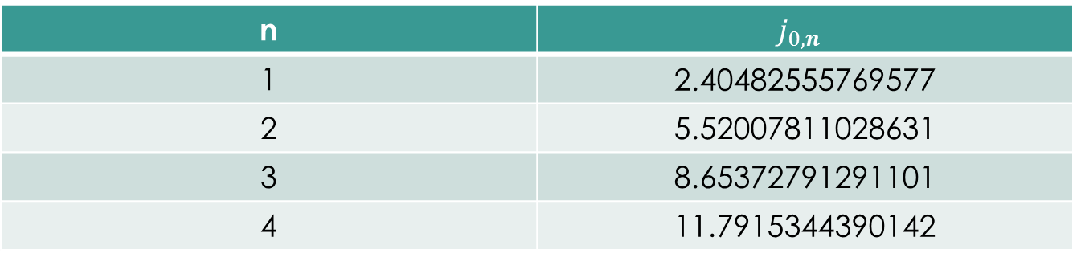
Further speedup: lookup table
To save computation time, we pre-compute all the roots of the Bessel function needed, and store it in a lookup table.
n | $$j_{0,n }$$
1 | 2.40482555769577
2 | 5.52007811028631
3 | 8.65372791291101
4 | 11.7915344390142

Slide 36
Leakage Converged Transient Temperature Profile
Temperature changes at continuously with time => leakage power changes at every instant
To calculate leakage converged temperature profile in traditional simulators, we have to update leakage values at each instant, apply equivalent additional power and re-run the simulation.
We need to run a simulation for every time instant at which temperature values are needed => a very expensive process.

Slide 37
Steady State Results
Steady state
Simulator | Execution time | Error (K) (From papers)
Ansys | 2-4 hours | --
Hotspot (HS3D) | 1.1s | 1.4
3D ICE | 1.1s ^{[3]} | 1.6
Our method | 0.016s | 1.5
Notes:
Average error: 3.5%
Hankel transform of Green’s functions: $0.96s$
Calculation of leakage aware Green’s functions: $85μs$
Online temperature profile calculation: $16ms$

Slide 38
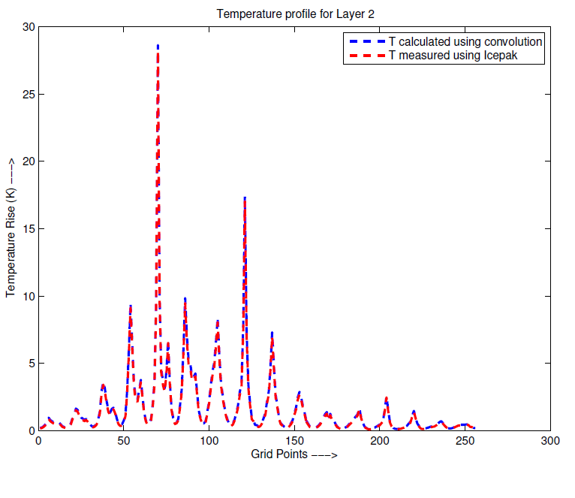
Steady State Temperature Profile

Slide 39
Transient Results
Error: <6%
Time for 100 points: 3.5s
71X speedup over 3D ICE

Slide 40
Conclusion

Slide 41
Thank you

Slide 42
References
Sarangi, S.R. , Ananthanarayanan, G. and M. Balakrishnan, “LightSim : A Leakage Aware Ultrafast Temperature Simulator,” ASP-DAC, pp. 855-860, 2014.
Huang, Wei, Shougata Ghosh, Sivakumar Velusamy, Karthik Sankaranarayanan, Kevin Skadron, and Mircea R. Stan. "HotSpot: A compact thermal modeling methodology for early-stage VLSI design." Very Large Scale Integration (VLSI) Systems, IEEE Transactions on , vol. 14, no. 5, pp. 501-513, 2006.
A. Sridhar, A. Vincenzi, M. Ruggiero, T. Brunschwiler, and D. Atienza, “3D-ICE: Fast compact transient thermal modeling for 3D ICs with inter-tier liquid cooling," in ICCAD, 2010.
Zhang, Yufu, Ankur Srivastava, and Mohamed Zahran, "Chip level thermal profile estimation using on-chip temperature sensors." Computer Design, IEEE International Conference on. IEEE, pp. 432-437, 2008.
Zhan, Yong, and Sachin S. Sapatnekar. "High-efficiency Green function-based thermal simulation algorithms," Computer-Aided Design of Integrated Circuits and Systems, IEEE Transactions on, vol. 26, no. 9, pp. 1661-1675, 2007.
Francisco J. Mesa-Martínez,Joseph Nayfach-Battilana, Jose Renau ,”Power Model Validation Through Thermal Measurements,” In Proceedings of the 34th annual international symposium on Computer architecture (ISCA '07). ACM, New York, NY, USA, pp. 302-311,2007.
ANSYS ICEPAK 12.1, "User’s Guide." Fluent Inc (2009).
A. Ziabari, J.-H. Park, E. K. Ardestani, J. Renau, S.-M. Kang, and A. Shakouri, “Power blurring: Fast static and transient thermal analysis method for packaged integrated circuits and power devices," VLSI Systems, IEEE Transactions on, vol. 22, no. 11, pp. 2366-2379, 2014.

Slide 43
References contd…
H. F. Johnson, “An improved method for computing a discrete hankel transform," Computer physics communications, vol. 43, no. 2, pp. 181-202, 1987.
I. Wolfram Research, “Mathematica," Illinios, 2012.

Slide 44
Flow of our Algorithm
Obtain the temperature field by applying a unit power source ≡ Green’s functions
Modify the initial Green’s functions to obtain leakage aware Green’s functions
Convolve the Green’s functions with the power profile to obtain the temperature profile.

