Slide 1
PowerPoint Slides
Basic Computer Architecture
Prof. Smruti Ranjan Sarangi IIT Delhi
Chapter 8: Computer Arithmetic (Part I)

Slide 2




2nd version
www.basiccomparch.com
Download the pdf of the book
videos
Slides, software, solution manual
The pdf version of the book and all the learning resources can be freely downloaded from the website: www.basiccomparch.com
Print version
(Publisher: WhiteFalcon, 2021)
Available on e-commerce sites.

Slide 3

Outline
Addition
Multiplication
Division
Floating Point Addition
Floating Point Multiplication
Floating Point Division

Slide 4
Adding Two 1 bit Numbers
Let us add two 1 bit numbers – a and b
0 + 0 = 00
1 + 0 = 01
0 + 1 = 01
1 + 1 = 10
The lsb of the result is known, as the sum, and the msb is known as the carry

Slide 5

Sum and Carry
a
a
a
b
carry
sum
a
b
s
c
$$S=a ⊕b=\overline{a}.b+a.\overline{b}$$
0
0
0
0
0
1
1
0
c = a.b
1
0
1
0
1
1
0
1
Truth Table

Slide 6
Half Adder
Adds two 1 bit numbers to produce a 2 bit result
a
Half
S
b
adder
C
a
b
S
a
b
C

Slide 7

Full Adder
Add three 1 bit numbers to produce a 2 bit output
$$a+b+ c_{in}=2 ∗ c_{out}+s$$
a | b | c_{in} | s | c_{out}
0 | 0 | 0 | 0 | 0
0 | 1 | 0 | 1 | 0
1 | 0 | 0 | 1 | 0
1 | 1 | 0 | 0 | 1
0 | 0 | 1 | 1 | 0
0 | 1 | 1 | 0 | 1
1 | 0 | 1 | 0 | 1
1 | 1 | 1 | 1 | 1

Slide 8
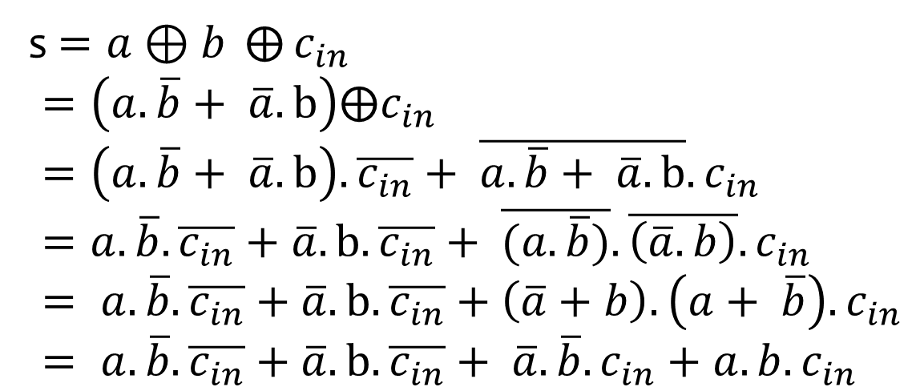

Equations for the Full Adder
s$=a⊕b ⨁{c_{in}}$ $$=\left(a.\overline{b}+ \overline{a}.b\right)⨁c_{in} \\ =\left(a.\overline{b}+ \overline{a}.b\right).\overline{c_{in}}+ \overline{a.\overline{b}+ \overline{a}.b}.c_{in} \\ =a.\overline{b}.\overline{c_{in}}+\overline{a}.b.\overline{c_{in}}+ \overline{(a.\overline{b})}.\overline{\left(\overline{a}.b\right)}.c_{in} \\ = a.\overline{b}.\overline{c_{in}}+\overline{a}.b.\overline{c_{in}}+\left(\overline{a}+b\right).\left(a+ \overline{b}\right).c_{in} \\ = a.\overline{b}.\overline{c_{in}}+\overline{a}.b.\overline{c_{in}}+ \overline{a}.\overline{b}.c_{in}+a.b.c_{in}$$
$$c_{out} =a.b+a.c_{in}+b.c_{in}$$

Slide 9
Circuit for the Full Adder
a
Full
S
b
adder
c
c
out
in
a
a
b
a
c
b
c
in
out
c
c
in
in
b
s

Slide 10
Addition of two n bit numbers
1
1
1
1
1 0 1 1
0 1 0 1
1 0 0 0 0
We start from the lsb
Add the corresponding pair of bits and the carry in
Produce a sum bit and a carry out

Slide 11
Observations
We keep adding pairs of bits, and proceed from the lsb to the msb
If a carry is generated, we add it to the next pair of bits
At the last step, if a carry is generated, then it becomes the msb of the result
The carry effectively ripples through the bits

Slide 12
Ripple Carry Adder
Full
Half
c
carry
adder
adder
A
B
A
B
A
B
A
B
n
n
c
3
3
c
2
2
c
1
1
Result

Slide 13
Operation of the Ripple Carry Adder
Problem : Add A + B
Number the bits : A₁ to A_{n} and B₁ to B_{n}
lsb → A₁ and B₁
msb → A_{n} and B_{n}
Use a half adder to add A₁ and B₁
Send the carry(c) to a full adder that adds : A₂ + B₂ + c
Proceed in a similar manner till the msb

Slide 14
How long does the Ripple Carry Adder take ?
Time :
Time of half adder : t_{h}
Time of full adder : t_{f}
Total Time : t_{h} + (n-1)t_{f}

Slide 15
Asymptotic Time Complexity
Most of the time, we are primarily interested in the order of the function
For example : we are only interested in the n² term in (2n² + 3n + 4)
We do not care about the constants, and terms with smaller exponents
3n and 4
We can thus say that :
2n² + 3n + 4 is order of (n²)

Slide 16
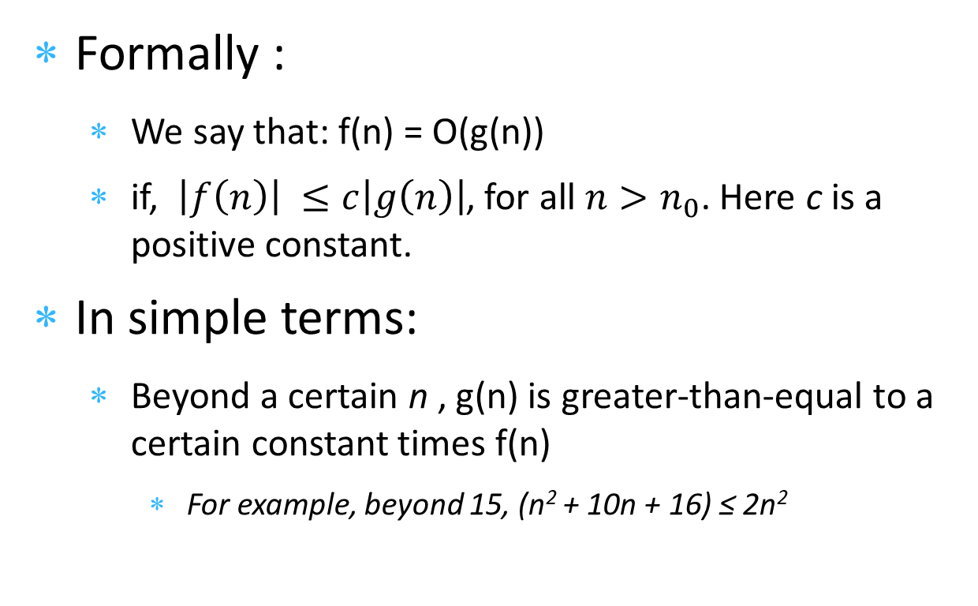
The O notation
Formally :
We say that: f(n) = O(g(n))
if, $\left|f\left(n\right)\right| ≤c\left|g\left(n\right)\right|$, for all $n>n_{0}$. Here c is a positive constant.
In simple terms:
Beyond a certain n , g(n) is greater-than-equal to a certain constant times f(n)
For example, beyond 15, (n² + 10n + 16) ≤ 2n²

Slide 17
Example of the big O Notation
f(n) = 3n² + 2n + 3. Find its asymptotic time complexity.
Answer:
f(n) = 3n² + 2n + 3
≤ 3n² + 2n² + 3n² (n > 1)
≤ 8(n²)
Hence, f(n) = O(n²).
800
f(n)
700
8n^2
600
500
time
400
300
200
100
0
0
2
4
6
8
10
n
8n² is a strict upper bound on f(n) as shown in the figure.

Slide 18
Big O Notation - II
Example:
f(n) = 0.00001n¹⁰⁰ + 10000n⁹⁹ + 234344. Find its asymptotic time complexity.
Answer: f(n) = O(n¹⁰⁰)
We shall use the asymptotic time complexity metric (big O notation) to characterize the time taken by different adders

Slide 19


Ripple Carry Adders and Beyond
Time complexity of a ripple carry adder :
O(n)
Can we do better than O(n) ?
Yes

Slide 20
Carry Select Adder O(√n) time
Group bits into blocks of size (k)
If we are adding two 32 bit numbers A and B, and k = 4, then the blocks are :
Produce the result of each block with a small ripple carry adder
Carry propagating
across blocks
A
A
A
A
A
A
A
A
A
A
A
A
32
31
30
29
8
7
6
5
4
3
2
1
B
B
B
B
B
B
B
B
B
B
B
B
32
31
30
29
8
7
6
5
4
3
2
1

Slide 21

Carry Select Adder - II
In this case, the carry propagates across blocks
Time complexity is O(n)
Idea :
Add the numbers in each block in parallel
Stage I : For each block, produce two results
Assuming an input carry of 0
Assuming an input carry of 1

Slide 22
Carry Select Adder – Stage II
For each block we have two results available
Result → (k sum bits), and 1 carry out bit
Stage II
Start at the least significant block
The input carry is 0
Choose the appropriate result from stage I
We now know the input carry for the second block
Choose the appropriate result
Result contains the input carry for the third block

Slide 23
Carry Select Adder – Stage II
Given the result of the second block
Compute the carry in for the third block
Choose the appropriate result
Proceed till the last block
At the last block (most significant positions)
Choose the correct result
The carry out value, is equal to the carry out of the entire computation.

Slide 24

How much time did we take ?
Our block size is k
Stage I takes k units of time
There are n/k blocks
Stage II takes (n/k) units of time
Total time : (k + n/k)
$$\frac{∂ (k+n/k)}{∂k}=0 \\ ⟹1 − \frac{n}{k^{2}}=0$$ $⟹k= \sqrt{n}$

Slide 25
Time Complexity of the Carry Select Adder
T = O(√n + √n) = O(√n)
Thus, we have a √n time adder
Can we do better ?
Yes

Slide 26
Carry Lookahead Adder (O(log n))
The main problem in addition is the carry
If we have a mechanism to compute the carry quickly, we are done
Let us thus focus on computing the carry without actually performing an addition

Slide 27


Generate and Propagate Functions
Let us consider two corresponding bits of A and B
A_{i} and B_{i}
Generate function : A new carry is generated (C_{out} = 1)
Propagate function : C_{out} = C_{in}
Generate and Propagate Functions are :
$$g_{i}= A_{i}. B_{i}$$
$$p_{i}= A_{i}⨁B_{i}$$

Slide 28
Using the G and P Functions
If we have the generate and propagate values for a bit pair, we can determine the carry out
C_{out =} g_{i} + p_{i}.C_{in}

Slide 29
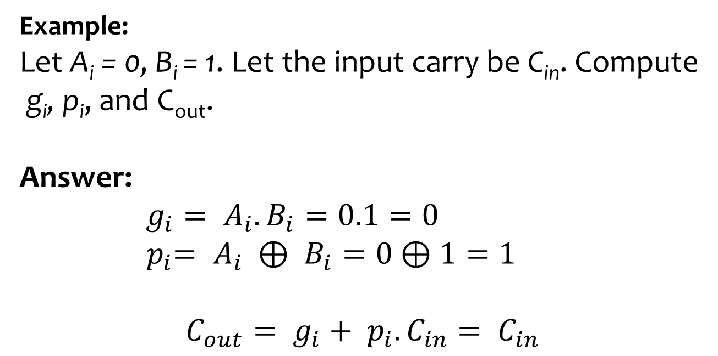
Example
Example:
Let A_{i} = 0, B_{i} = 1. Let the input carry be C_{in}. Compute
g_{i}, p_{i}, and C_{out}.
Answer:
$g_{i}= A_{i}.B_{i}=0.1=0$ ${ p}_{i}= A_{i} ⊕ B_{i}=0$ $⊕1=1$
$$C_{out}= g_{i}+ p_{i}.C_{in}= C_{in}$$

Slide 30
G and P for Multi-bit Systems
C_{out}^{i} → output carry for i^{th} bit pair
C_{in}^{i} → input carry for i^{th} bit pair
g_{i} → generate value for i^{th} bit pair
p_{i} → propagate value for i^{th} bit pair

Slide 31
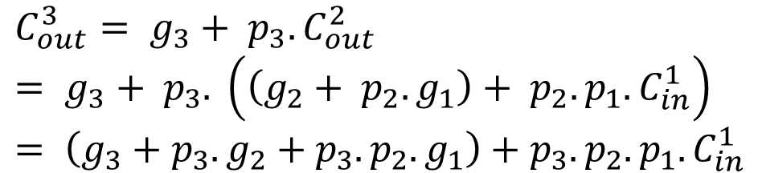

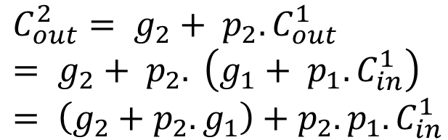
G and P for Multibit Systems - II
$$C_{out}^{1}= g_{1}+ p_{1}.C_{in}^{1}$$
$$C_{out}^{2}= g_{2}+ p_{2}.C_{out}^{1} \\ = g_{2}+ p_{2}. \left(g_{1}+ p_{1}.C_{in}^{1}\right) \\ = \left(g_{2}+{p_{2}.g}_{1}\right)+p_{2}.p_{1}.C_{in}^{1}$$
$$C_{out}^{3}= g_{3}+ p_{3}.C_{out}^{2} \\ = g_{3}+ p_{3}. \left(\left(g_{2}+ p_{2}.g_{1}\right)+ p_{2}.p_{1}.C_{in}^{1}\right) \\ = \left(g_{3}+{p_{3}.g}_{2}+p_{3}.p_{2}.g_{1}\right)+p_{3}.p_{2}.p_{1}.C_{in}^{1}$$

Slide 32
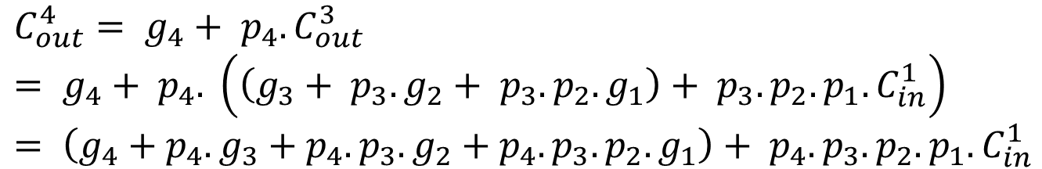
G and P for multibit Systems - III
$$C_{out}^{4}= g_{4}+ p_{4}.C_{out}^{3} \\ = g_{4}+ p_{4}. \left(\left(g_{3}+ p_{3}.g_{2}+ p_{3}.p_{2}.g_{1}\right)+ p_{3}.p_{2}.p_{1}.C_{in}^{1}\right) \\ = \left(g_{4}+{p_{4}.g}_{3}+p_{4}.p_{3}.g_{2}+p_{4}.p_{3}.p_{2}.g_{1}\right)+ p_{4}.p_{3}.p_{2}.p_{1}.C_{in}^{1}$$

Slide 33



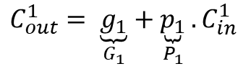
Patterns
1 bit
$$C_{out}^{1}= \underset{G_{1}}{\underbrace{g_{1}}}+\underset{P_{1}}{\underbrace{p_{1}}}.C_{in}^{1}$$
2 bit
$$C_{out}^{2}= \underset{G_{2}}{\underbrace{g_{2}+ p_{2}.g_{1}}}+\underset{P_{2}}{\underbrace{p_{2}.p_{1}}}.C_{in}^{1}$$
3 bit
$$C_{out}^{3}= \underset{G_{3}}{\underbrace{g_{3}+ p_{3}.g_{2}+ p_{3}.p_{2}.g_{1}}}+\underset{P_{3}}{\underbrace{p_{3}.p_{2}.p_{1}}}.C_{in}^{1}$$
4 bit
$$C_{out}^{4}= \underset{G_{4}}{\underbrace{g_{4}+ p_{4}.g_{3}+ p_{4}.p_{3}.g_{2 }+p_{4}.p_{3}.p_{2}.g_{1} }}+\underset{P_{4}}{\underbrace{p_{4}.p_{3}.p_{2}.p_{1}}}.C_{in}^{1}$$
n bit
$$C_{out}^{n}= G_{n}+ P_{n}.C_{in}^{1}$$

Slide 34
Computing G and P Quickly
Let us divide a block of n bits into two parts
Let the carry out and carry in be : C_{out} and C_{in}
We want to find the relationship between
G_{1,n}, P_{1,n} and (G_{m+1,n}, G_{1,m}, P_{m+1,n}, P_{1,m})
C
n
sub
C
C
out
in
m+1,n
1,m

Slide 35
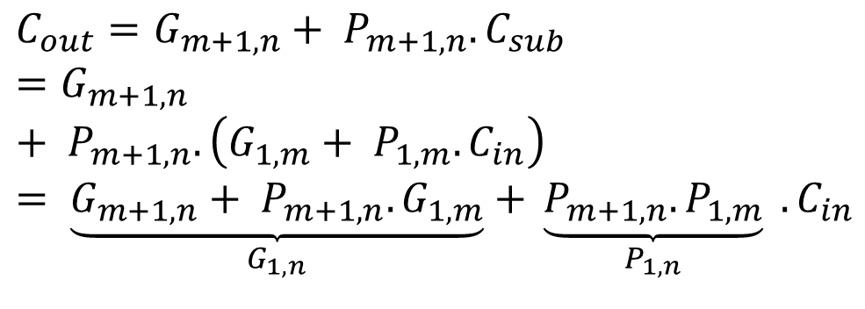

Computing G and P Quickly - II
$$C_{out}=G_{m+1,n}+ P_{m+1,n}. C_{sub} \\ =G_{m+1,n}+ P_{m+1,n}. \left(G_{1,m}+ P_{1,m}. C_{in}\right) \\ = \underset{G_{1,n}}{\underbrace{G_{m+1,n}+ P_{m+1,n}.G_{1,m}}}\underset{}{+ \underset{P_{1,n}}{\underbrace{P_{m+1,n}. P_{1,m}}} \underset{}{.C_{in}}}$$
$$C_{out}=G_{1,n}+ P_{1,n}.C_{in}$$
G_{1,n} = G_{m+1,n} + P_{m+1,n}.G_{1,m}
P_{1,n} = P_{m+1,n}.P_{1,m}

Slide 36
Insight into Computing G and P quickly
Insight :
We can compute G and P for a large block
By first computing G and P for smaller sub-blocks
And, then combining the solutions to find the value of G and P for the larger block
Fast algorithm to compute G and P
Use divide-and-conquer
Compute G and P functions in O (log (n)) time

Slide 37
Carry Lookahead Adder – Stage I
Compute G and P functions for all the blocks
Combine the solutions to find G and P functions for sets of 2 blocks
Combine the solutions fo find G and P functions for sets of 4 blocks
….
….
Find the G and P functions for a block of size : 32 bits

Slide 38
Carry Lookahead Adder – Stage I
Block 16
Block 1
32
31
30
29
4
3
2
1
level 0
G,P
G,P
G,P
G,P
level 1
32-31
30-29
4-3
2-1
Computation
G,P
G,P
level 2
32-29
4-1
G,P
G,P
G,P
G,P
level 3
32-25
24-17
16-9
8-1
G,P
G,P
level 4
32-17
16-1
G,P
level 5
32-1

Slide 39
CLA Adder – Stage I
Compute G, P for increasing sizes of blocks in a tree like fashion
Time taken :
Total : log(n) levels
Time per level : O(1)
Total Time : O(log(n))

Slide 40
CLA Adder – Stage II
Result Bits
2-bit RC Adder
2-bit RC Adder
2-bit RC Adder
2-bit RC Adder
2-bit RC Adder
32
31
30
29
18
17
4
3
2
1
level 0
G,P
G,P
G,P
G,P
G,P
c
1
level 1
32-31
30-29
18-17
4-3
2-1
in
G,P
G,P
G,P
G,P
c
1
level 2
Computation
32-29
28-25
20-17
4-1
in
G,P
G,P
G,P
G,P
c
1
level 3
32-25
24-17
16-9
8-1
in
G,P block
G,P
G,P
c
1
level 4
c
c
32-17
16-1
in
out
G,P
in
r1- r2
c
32
G,P
c
1
level 5
out
32-1
in

Slide 41
Connection of the G,P Blocks
Each G,P block represents a range of bits (r2, r1) (r2 > r1)
The (r2, r1) G,P block is connected to all the blocks of the form (r3, r2+1)
The carry out of one block is an input to all the blocks that it is connected with
Each block is connected to another block at the same level, and to blocks at lower levels

Slide 42
Operation of CLA – Stage II
We start at the leftmost blocks in each level
We feed an input carry value of C_{in}¹
Each such block computes the output carry, and sends it to the all the blocks that it is connected to
Each connected block
Computes the output carry
Sends it to all the blocks that it is connected to
The carry propagates to all the 2 bit RC adders

Slide 43
CLA Adder – Stage II
Result Bits
2-bit RC Adder
2-bit RC Adder
2-bit RC Adder
2-bit RC Adder
2-bit RC Adder
32
31
30
29
18
17
4
3
21
level 0
G,P
G,P
G,P
G,P
G,P
c
1
level 1
32-31
30-29
18-17
4-3
2-1
in
G,P
G,P
G,P
G,P
c
1
level 2
Computation
32-29
28-25
20-17
4-1
in
G,P
G,P
G,P
G,P
c
1
level 3
32-25
24-17
16-9
8-1
in
G,P block
G,P
G,P
c
1
level 4
c
c
32-17
16-1
in
out
G,P
in
r1- r2
c
32
G,P
c
1
level 5
out
32-1
in

Slide 44
Time Complexity
In a similar manner, the carry propagates to all the RC adders at the zeroth level
Each of them compute the correct result
Time taken by Stage II :
Time taken for a carry to propagate from the (16,1) node to the RC adders
O(log(n))
Total time : O(log(n) + log(n)) = O(log(n))

Slide 45
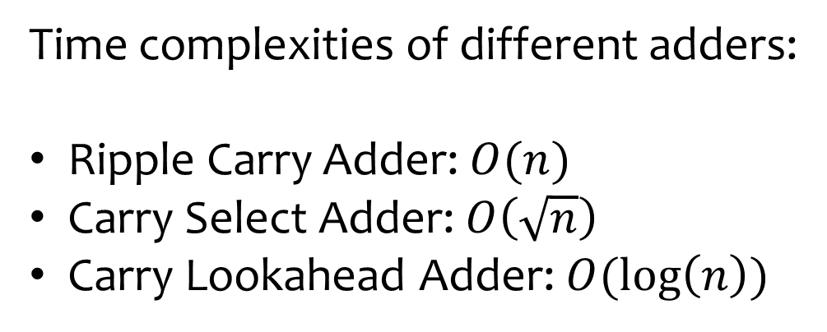
Time complexities of different adders:
Ripple Carry Adder: $O(n)$
Carry Select Adder: $O\left(\sqrt{n}\right)$
Carry Lookahead Adder: $O(\log\left(n\right))$

Slide 46
Outline
Addition
Multiplication
Division
Floating Point Addition
Floating Point Multiplication
Floating Point Division

Slide 47
Multiplicands
1 3
1 1 0 1
9
1 0 0 1
1 1 7
1 1 0 1
0 0 0 0
(a)
Partial sums
0 0 0 0
1 1 0 1
1 1 1 0 1 0 1
(b)
13 → Multiplicand
9 → Multiplier
117 → Product

Slide 48
Basic Multiplication
Consider the lsb of the multiplier
If it is 1, write the value of the multiplicand
If it is 0, write 0
For the next bit of the multiplier
If it is 1, write the value of the multiplicand shifted by 1 position to the left
If it is 0, write 0
Keep going ….

Slide 49
Definitions
Partial sum: It is equal to the value of the multiplicand left
shifted by a certain number of bits, or it is equal to 0.
Partial product: It is the sum of a set of partial sums.
If the multiplier has m bits, and the multiplicand has n bits
The product requires (m+n) bits

Slide 50
Multiplying 32 bit numbers
Let us design an iterative multiplier that multiplies two 32 bit signed values to produce a 64 bit result
What did we prove before
Multiplying two signed 32 bit numbers, and saving the result as a 32 bit number is the same as
Multiplying two unsigned 32 bit numbers (assuming no overflows)
We did not prove any result regarding saving the result as a 64 bit number

Slide 51

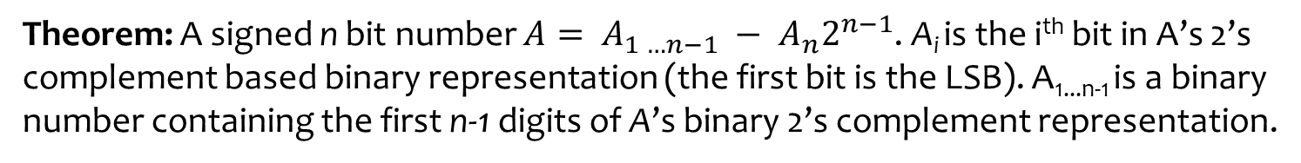
Class Work
Theorem: A signed n bit number $A= A_{1 …n−1} − A_{n}2^{n−1}$. A_{i} is the i^{th} bit in A’s 2’s
complement based binary representation (the first bit is the LSB). A_{1...n-1} is a binary
number containing the first n-1 digits of A’s binary 2’s complement representation.

Slide 52
Iterative Multiplier
Multiplicand
U
V
Multiplicand (N), Multiplier (M), Product(P) = MN
U is a 33 bit register and V is a 32 bit register
beginning : V contains the multiplier, U = 0
UV is one register for the purpose of shifting

Slide 53
Algorithm
Algorithm 1: Algorithm to multiply two 32 bit numbers and produce a 64 bit result
Data: Multiplier in V , U = 0, Multiplicand in N
Result: The lower 64 bits of UV contains the product
i ← 0
for i < 32 do
i ← i + 1
if LSB of V is 1 then
if i < 32 then
U ← U + N
end
else
U ← U − N
end
end
UV ← UV >> 1 (arithmetic right shift)
end

Slide 54
Example
Multiplicand (N)
0010
2
Multiplier (M)
0011
3
U
V
beginning:
00000
0011
1 add 2
before shift:
00010
0011
1
after shift:
00001
0001
1 add 2
before shift:
00011
0001
2
after shift:
00001
1000
0 --
before shift:
00001
1000
3
after shift:
00000
1100
0 --
before shift:
00000
1100
4
after shift:
00000
0110
Product(P)
0110
6

Slide 55
3 * (-2)
Multiplicand (N)
0011
3
Multiplier (M)
1110
-2
U
V
beginning:
00000
1110
0 --
before shift:
00000
1110
1
after shift:
00000
0111
1 add 3
before shift:
00011
0111
2
after shift:
00001
1011
1 add 3
before shift:
00100
1011
3
after shift:
00010
0101
1 sub 3
before shift:
11111
0101
4
after shift:
11111
1010
Product(P)
1010
-6

Slide 56
Operation of the Algorithm
Take a look at the lsb of V
If it is 0 → do nothing
If it is 1 → Add N (multiplicand) to U
Right shift
Right shifting the partial product is the same as left shifting the multiplicand, which
Needs to be done in every step
Last step is different

Slide 57
The Last Step ...
In the last step
lsb of V = msb of M (multiplier)
If it is 0 → do nothing
If it is 1
Multiplier is negative
Recall : A = A_{1 .. n-1} - 2^{n-1}A_{n}
Hence, we need to subtract the multiplicand if the msb of the multiplier is 1

Slide 58
Time Complexity
There are n loops
Each loop takes log(n) time
Total time : O(n log(n))

Slide 59


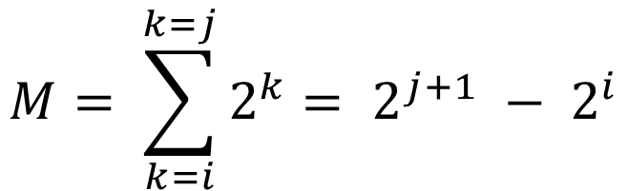
Booth Multiplier
We can make our iterative multiplier faster
If there are a continuous sequence of 0s in the multiplier
do nothing
If there is a continous sequnce of 1s
do something smart
$$M= \sum_{k=i}^{k=j}{2^{k}}= 2^{j+1} − 2^{i}$$

Slide 60

For a Sequence of 1s
Sequence of 1s from position i to j
Perform (j – i + 1) additions
New method
Subtract the multiplicand when we scan bit i ( ! count starts from 0)
Keep shifting the partial product
Add the multiplicand(N), when we scan bit (j+1)
This process, effectively adds (2^{j+1} – 2^{i}) * N to the partial product
Exactly, what we wanted to do …
$$A=\sum_{k=i}^{k=j}{2^{k}}$$

Slide 61
Operation of the Algorithm
Consider bit pairs in the multiplier
(current bit, previous bit)
Take actions based on the bit pair
Action table
(current value, previous value)
Action
0,0
-
1,0
subtract multiplicand from U
1,1
-
0,1
add multiplicand to U

Slide 62
Booth's Algorithm
Algorithm 2: Booth’s Algorithm to multiply two 32 bit numbers to produce a 64 bit result
Data: Multiplier in V , U = 0, Multiplicand in N
Result: The lower 64 bits of UV contain the result
i ← 0
prevBit ← 0
for i < 32 do
i ← i + 1
currBit ← LSB of V
if (currBit,prevBit) = (1,0) then
U ← U − N
end
else if (currBit,prevBit) = (0,1) then
U ← U + N
end
prevBit ← currBit
UV ← UV >> 1 (arithmetic right shift)
end

Slide 63
Outline of a Proof
Multiplier (M) is positive
msb = 0
Divide the multiplier into a sequence of continuous 0s and 1s
01100110111000 → 0,11, 00, 11, 0, 111, 000
For sequence of 0s
Both the algorithms (iterative, Booth) do not add the multiplicand
For a run of 1s (length k)
The iterative algorithm performs k additions
Booth's algorithm does one addition, and one subtraction.
The result is the same

Slide 64
Outline of a Proof - II
Negative multipliers
msb = 1
M = -2^{n-1} + Σ_{(i=1 to n-1)}M_{i}2^{n-1} = -2^{n-1} + M'
M' = Σ_{(i=1 to n-1)}M_{i}2^{n-1}
Consider two cases
The two msb bits of M are 10
The two msb bits of M are 11

Slide 65
Outline of a Proof - III
Case 10
Till the (n-1)^{th} iteration both the algorithms have no idea if the multiplier is equal to M or M'
At the end of the (n-1)^{th} iteration, the partial product is:
Iterative algorithm : M'N
Booth's algorithm : M'N
If we were multiplying (M' * N), no action would have been taken in the last iteration. The two msb bits would have been 00. There is no way to differentiate this case from that of computing MN in the first (n-1) iterations.

Slide 66
Outline of a Proof - IV
Last step
Iterative algorithm :
Subtract 2^{n-1}N from U
Booth's algorithm
The last two bits are 10 (0 → 1 transition)
Subtract 2^{n-1}N from U
Both the algorithms compute :
MN = M'N – 2^{n-1}N
in the last iteration

Slide 67
Outline of a Proof - V
Case 11
Suppose we were multiplying M' with N
Since (M' > 0), the Booth multiplier will correctly compute the product as M'N
The two msb bits of M' are (01)
In the last iteration (currBit, prevBit) is 01
We would thus add 2^{n-1}N in the Booth's algorithm to the partial product in the last iteration
The value of the partial product at the end of the (n-1)^{th} iteration is thus :
M'N - 2^{n-1}N

Slide 68
Outline of a Proof - VI
When we multiply M with N
In the (n-1)^{th} iteration, the value of the partial product is : M'N – 2^{n-1}N
Because, we have no way of knowing if the multiplier is M or M' at the end of the (n-1)^{th} iteration
In the last iteration the msb bits are 11
no action is taken
Final product : M'N – 2^{n-1}N = MN (correct)

Slide 69
Multiplicand (N)
00011
3
Multiplier (M)
0010
2
U
V
beginning:
00000
0010
00 --
before shift:
00000
0010
1
after shift:
00000
0001
10 add -3
before shift:
11101
0001
2
after shift:
11110
1000
01 add 3
before shift:
00001
1000
3
after shift:
00000
1100
00 --
before shift:
00000
1100
4
after shift:
00000
0110
Product(P)
0110
6

Slide 70
Multiplicand (N)
00011
3
Multiplier (M)
1110
-2
U
V
beginning:
00000
1110
before shift:
00000
1110
00 --
1
after shift:
00000
0111
10 add -3
before shift:
11101
0111
2
after shift:
11110
1011
11 --
before shift:
11110
1011
3
after shift:
11111
0101
11 --
before shift:
11111
0101
4
after shift:
11111
1010
Product(P)
1010
-6

Slide 71
Time Complexity
O(n log(n))
Worst case input
Multiplier = 10101010... 10

Slide 72
O(log(n)²) Multiplier
Consider an n bit multiplier and multiplicand
Let us create n partial sums
1 0 0 1
1 1 0 1
1 0 0 1
0 0 0 0 0
partial sums
1 0 0 1 0 0
1 0 0 1 0 0 0

Slide 73
Tree-Based Adder for Partial Sums
P
n
P
n-1
P
n-2
P
n-3
P
4
P
3
P
2
P
1
log(n) levels
Final product

Slide 74
Time Complexity
There are log(n) levels
Each level takes
Maximum log(2n) time
Adds two 2n bit numbers
Total time :
O(log(n) * log(n)) = O(log (n)²)

Slide 75
Carry Save Adder
A
D’
Carry
B
save
adder
E
C
A + B + C = D’ + E
Takes three numbers and produces two numbers

Slide 76
1 bit CSA Adder
Add three bits – a, b, and c
such that a + b + c = 2d + e
d and e are also single bits
We can conveniently set
e to the sum bit
d to the carry bit

Slide 77


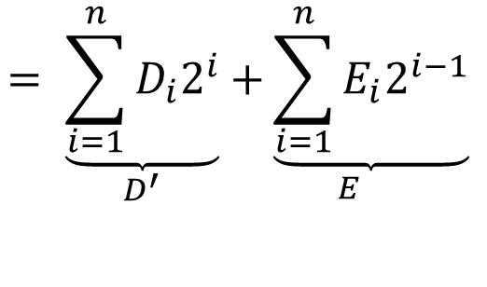
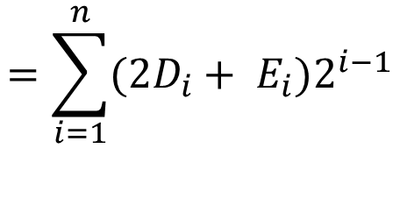
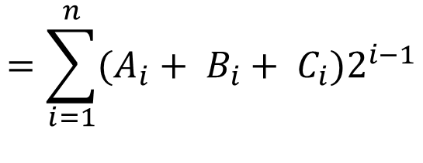

n-bit CSA Adder
$A+B+C= \sum_{i=1}^{n}{A_{i}2^{i−1} }+ \sum_{i=1}^{n}{B_{i}2^{i−1} }$ + $\sum_{i=1}^{n}{C_{i}2^{i−1} }$
$$=\sum_{i=1}^{n}{(A_{i}+ B_{i}+ C_{i})2^{i−1}}$$
$$A_{i}+B_{i}+C_{i}=2D_{i}+E_{i}$$
$$=\sum_{i=1}^{n}{(2D_{i}+ E_{i})2^{i−1}}$$
$$= \underset{}{\underset{D^{′}}{\underbrace{\sum_{i=1}^{n}{D_{i}2^{i}}}}\underset{E}{+\underbrace{\sum_{i=1}^{n}{E_{i}2^{i−1}}}}}$$
$$D^{′}=2D$$
$$=D^{′}+E$$

Slide 78
n-bit CSA Adder - II
How to generate D’ and E ?
Add all the corresponding sets of bits (A_{i}, B_{i}, and C_{i}) independently
set D_{i} to the carry bit produced by adding (A_{i}, B_{i}, and C_{i})
set E_{i} to the sum bit produced by adding (A_{i}, B_{i}, and C_{i})
Time Complexity :
All the additions are done in parallel
This takes O(1) time

Slide 79
Wallace Tree Multiplier
Basic Idea
Generate n partial sums
Partial sum : P_{i} = 0, if the i^{th} bit in the multiplier is 0
P_{i} = N << (i-1), if the the i^{th} bit in the multiplier is 1
Can be done in parallel : O(1) time
Add all the n partial sums
Use a tree based adder

Slide 80
Tree of CSA Adders
P
n
P
n-1
P
n-2
P
n-3
P
n-4
P
n-5
P
6
P
5
P
4
P
3
P
2
P
1
CSA
CSA
CSA
CSA
CSA
CSA
log (n) levels
3/2
CSA
Carry Lookahead
Adder
Final product

Slide 81
Tree of CSA Adders
Group the partial sums into sets of 3
Use an array of CSA adders to add 3 numbers (A,B,C) to produce two numbers (D,E)
Hence, reduce the set of numbers by 2/3 in each level
After log_{3/2}(n) levels, we are left with only two numbers
Use a CLA adder to add them

Slide 82
Time Complexity
Time to generate all the partials sums → O(1)
Time to reduce n partial sums to sum of two numbers
Number of levels → O(log(n))
Time per level → O(1)
Total time for this stage → O(log(n))
Last step
Size of the inputs to the CLA adder → (2n-1) bits
Time taken → O(log(n))
Total Time : O(log(n))

Slide 83
Outline
Addition
Multiplication
Division
Floating Point Addition
Floating Point Multiplication
Floating Point Division

Slide 84
THE END

