Slide 1

FaaSImage: An Efficient Image Manager for FaaS
Abhisek Panda
Advisor: Prof. Smruti R. Sarangi
Computer science and Engineering
Indian Institute of Technology Delhi, India
26th ACM/IFIP International Middleware Conference
Notes:
Hello everyone, I am Abhisek Panda, a PhD student in the department of computer science and engineering at IIT Delhi. Today I will be presenting our work on “FaaSImage: An efficient image manager for FaaS (Function as a Service)”. This work was done under the supervision of Prof. Smruti R. Sarangi.

Slide 2
OUTLINE
Problem Statement
Motivation and Prior Work
Design of FaaSImage
Results
Conclusion
Problem Statement
Notes:
This is the outline of our presentation. Let us start by discussing the problem statement.

Slide 3



COLD START PROBLEM
Cost of spawning a sanbox environment.
Extra Ops : Image fetch + Sandbox init
F₃
F₂
F₁
F₁
F₂
F₃
Remote Storage
F₁
F₃
F₁
F₂
F₃
F₂
DRAM
Sandbox Image
Disk
Sandbox
Environment
Notes:
Let me first explain how a typical serverless platform operates. When a user submits requests for three functions—F1, F2, and F3—the platform retrieves the sandbox image for each function from a remote registry. It then launches a sandbox in which the function is executed, and the response is returned to the user. The same process is repeated independently for F2 and F3.
Compared to conventional cloud platforms, sandbox creation lies on the critical path of request execution in serverless systems. This process involves two main steps: fetching the function image from a remote registry and creating the sandbox. To reduce sandbox initialization latency, prior work has explored techniques such as sandbox reuse, sandbox sharing, lightweight isolation mechanisms, and snapshot-and-restore approaches. In this paper, however, we focus specifically on the image fetch operation.

Slide 4
PROBLEM STATEMENT
F₄
Observations:
A recent study by Microsoft has shown that 50% of serverless workloads exhibit substantial variation in the inter-arrival times of requests.
In Alibaba Cloud, 86% of image pull operations in the Shanghai region take at least 80 seconds.
F₄
Remote Storage Service
F₄
DRAM
Goal: Design an efficient function image manager that fetches a function image faster.
Disk
F₁
F₂
F₃
Notes:
Let us now look at some observations reported by commercial cloud providers. A recent study by Microsoft shows that nearly 50% of serverless functions exhibit significant variability in their inter-arrival times. As a result, the likelihood of a function’s disk image being available locally is low, since images are frequently evicted and replaced.
In such a scenario, when the platform needs to execute a new function, say F4, it must first evict an existing image, then fetch the required image, and finally initialize a sandbox. Alibaba Cloud has reported that, in the Shanghai region, 86% of image pull operations take at least 86 seconds.
These observations motivate the need for a more efficient image management system that can significantly reduce image pull latency.

Slide 5
OUTLINE
Problem Statement
Motivation and Prior Work
Design of FaaSImage
Results
Conclusion
Motivation and Prior Work
Notes:
Let us discuss the motivation and drawbacks of prior work.

Slide 6
FUNCTION IMAGE PIPELINE
FROM DEBIAN:v12
Parallel Tasks
D
D
RUN APT INSTALL <Packages>
BASE SEGMENT
D
D
RUN APT INSTALL RUNTIME
D
D
RUN APT INSTALL FUNC DEPS
U
U
U
U
U
U
RUN APT INSTALL FUNC LIBS
APP SEGMENT
Time
COPY FUNC_CODE /APP
For the functions listed in FunctionBench benchmark suite, the image pull latency ranges between 2.03 sec to 43.85 sec, given that the base segment is already present on the host.
CMD [START FUNC]
Notes:
Before discussing the motivation, let us first understand what a function image looks like. In Docker, an image is organized as a stack of layers, where each layer contains a portion of the disk image. These layers can be broadly divided into two segments: the base segment and the application segment.
The base segment includes the operating system, runtime, and essential packages, and is shared across function images that use the same runtime environment. The application segment contains function-specific libraries, dependencies, and code.
Next, let us examine how the image pull pipeline works. When an image is pulled from a Docker registry, two main operations are performed: download and untar. The download phase fetches compressed layers from the remote registry, while the untar phase decompresses these layers. In Docker, downloads occur in parallel, but the untar process is performed sequentially to avoid excessive CPU usage.
Our characterization shows that image pull latency for functions in FunctionBench ranges from 2 to 43 seconds. Since serverless functions typically execute in sub-second time scales, image pull latencies on the order of seconds can significantly degrade overall performance.

Slide 7
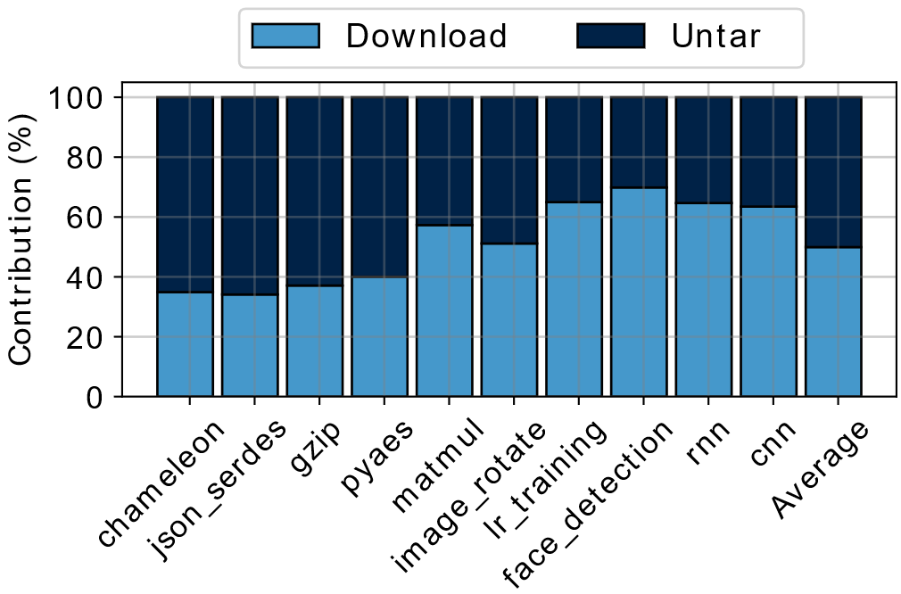
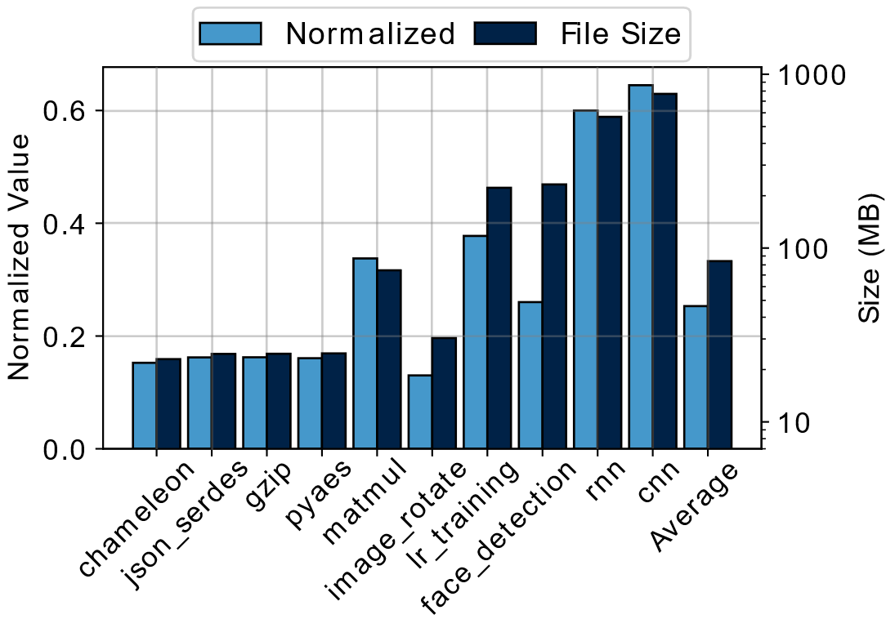
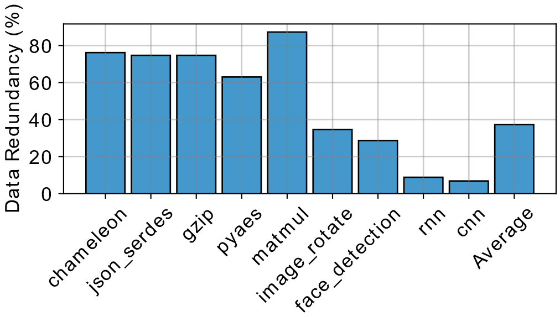
CHARACTERIZATION OF FUNCTION IMAGES
Pull operation of function images.
File analysis of function images.
Redundancy across library layers
As an image’s size increases, the cost of layer download operation dominates that of layer untarring operations.
A container accesses about 12.5% to 64.7% of the image size during function during function startup. The set of files accessed during the function execution is nearly the same.
For the functions listed in FunctionBench, the redundancy between library layers is 37.3% on average.
Notes:
While characterizing function images, we focus on three key questions.
First, what is the relative contribution of the download and untar phases to overall image pull latency? We observe that for smaller images, the untar phase dominates the pull latency. However, as image size increases, the download cost becomes the dominant factor.
Second, how much of an image is actually accessed by a function during execution? Our analysis shows that functions typically access only about 12.5% to 64.7% of the image during the startup phase. For example, in a face detection workload using OpenCV’s Haar cascade classifier, only the files related to the classifier and image preprocessing are accessed, while the remaining OpenCV components are unused. During execution, the function continues to access largely the same set of files. This observation motivates storing only the required subset of files initially and fetching the remaining files on demand.
Finally, we examine redundancy across image layers. We find that approximately 37.3% of library files are redundant across images, which motivates the use of a shared library layer to reduce redundant data transfer.

Slide 8
PRIOR WORK
Layer Fusion (Break(INFOCOM’24))
The idea of packaging all the files in an image leads to wastage of resources.
On Demand Download [Gear (ICDCS’ 21), DADI (ATC’20)]
The fraction of an image utilized by a container depends on the characteristics of a function. Larger the fraction more is the cold start latency.
Notes:
Let us now discuss the limitations of prior approaches.
In layer fusion techniques, the goal is to maximize the number of shared layers across function images. However, this approach still requires fetching all files in an image, which leads to unnecessary data transfer and inefficient resource utilization.
In contrast, on-demand download techniques fetch files only when they are accessed. While this reduces upfront transfer, it can significantly increase cold-start latency when a serverless function accesses a large fraction of the image during execution.

Slide 9
OUTLINE
Problem Statement
Motivation and Prior Work
Design of FaaSImage
Results
Conclusion
Design of FaaSImage
Notes:
Now let us discuss the design of FaaSImage.

Slide 10

ARCHITECTURE
Platform
Image builder
Refactor engine
Serverless node
Image buffer
Refactored image + Trace file
Library
Image + Trace file
Notes:
In a typical serverless platform, the user submits the function code along with details of the required runtime environment. The platform forwards this information to an image builder, which constructs the function image.
We extend the image builder with a profiler that identifies the set of files accessed by the function during the startup phase. The generated image, together with this file access profile, is then passed to a refactor engine.
The refactor engine separates the library files and stores them in a shared library partition, while the remaining files are packaged into a refactored image that complies with OCI standards.
The serverless platform then pulls both the refactored image and needed library files from the remote registry in parallel.
We now proceed to discuss the refactor engine in more detail.

Slide 11
IMAGE REFACTORING
FAC(X) = {A ⊂ X} U P({X \ A}) ; P(Y) = {y → link(y) | y ϵ Y}
Refactored Image
F₁ CODE
F₂ CODE
Func₁
Func₂
F₁ LIBS
F₂ LIBS
FAC (F₁ DEPS U F₁ CODE)
FAC (F₂ DEPS U F₂ CODE)
FAC (BASE SEGMENT)
F₁ DEPS
F₂ DEPS
BASE SEGMENT
BASE SEGMENT
(F₁ LIBS U F₂ LIBS)
Func₁
Func₂
Function Images
Library Partition
Notes:
In this slide, we illustrate the refactoring of two function images, Func1 and Func2. The refactor engine first extracts the shared library files and stores them in a common library partition.
Next, we apply a FAC module that determines file placement. Files that are accessed during function startup are retained within the image, while files that are not required at startup are replaced with remote references that allow them to be fetched from a remote server on demand.
Using this process, we then generate the refactored images for Func1 and Func2.

Slide 12
IMAGE PULL OVERVIEW
Func₁
FAC (F₁ DEPS U F₁ CODE)
Node
Refactored Images
Func₁
Func₂
FAC (BASE SEGMENT)
1. Pull Request (Func₁)
FAC (F₁ DEPS U F₁ CODE)
FAC (F₂ DEPS U F₂ CODE)
lib_layer U lib
2. Resp(trace, img_data)
3. Fetch(layer_IDs, lib_args)
FAC (BASE SEGMENT)
4. Layers, lib
FAC (BASE SEGMENT)
FAC (F₁ DEPS U F₁ CODE)
(F₁ LIBS U F₂ LIBS)
Th-1
Th-2
lib
Library Partition
Time
Registry
Notes:
The refactored image and the shared library partition are stored in the registry. When a node needs to pull a function image, such as Func1, it first sends a request to the registry.
In response, the registry returns two components: a trace file, which lists the files required during function startup, and image metadata, which contains the layer IDs of the image along with the libraries needed by the function.
The node then determines which layers and library files are missing locally and sends this information back to the registry. The registry responds by transferring only the required components.
During this process, two parallel threads are used: one responsible for downloading image layers, and the other for downloading library files. Once these downloads complete, the Func1 image is fully available on the node.

Slide 13
OUTLINE
Problem Statement
Motivation and Prior Work
Design of FaaSImage
Results
Conclusion
Results
Notes:
Now we will see the result of evaluating FaaSImage against the baseline systems.

Slide 14
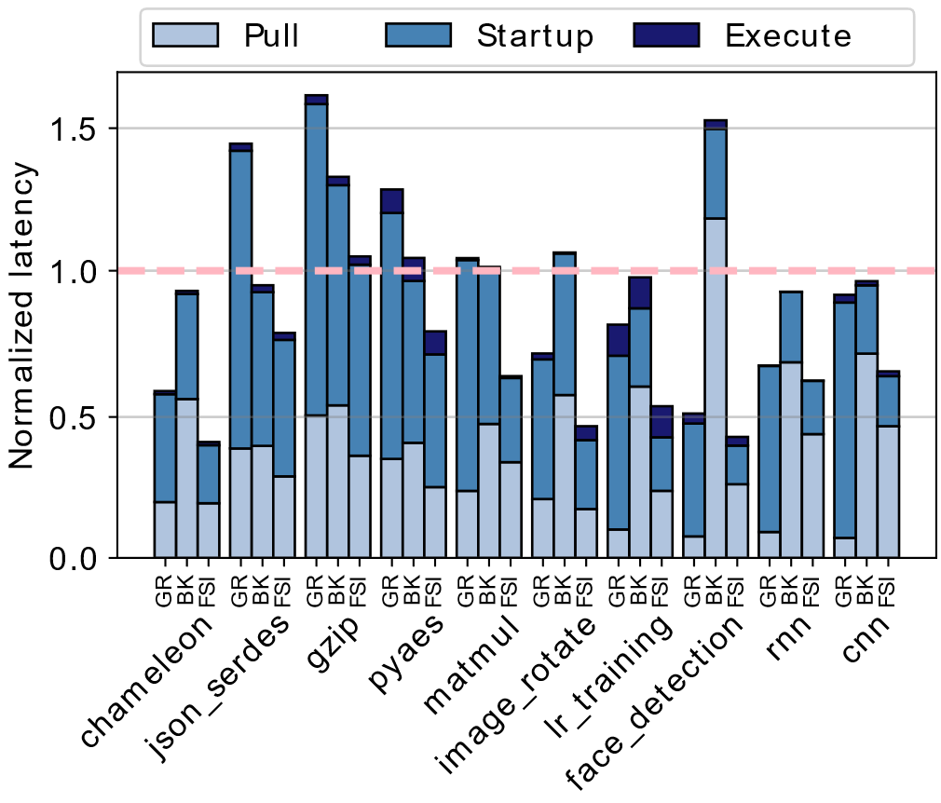
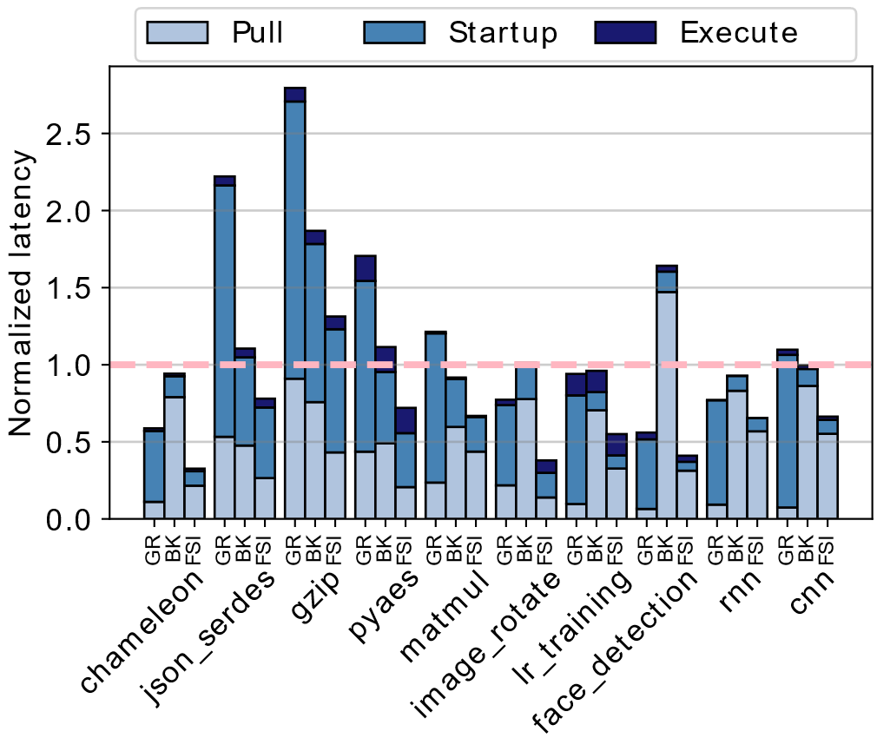
EVALUATION
Cold start latency on HDDs
Cold start latency on SSDs
FaaSImage improves the cold start latency by 38.7% on HDDs and 39.8% on SSDs when compared against Docker and state of the art techniques on average (resp.).
Notes:
We evaluate cold-start latency, which comprises three components: image pull latency, container initialization time, and function execution time. In this graph, we compare FaaSImage (FSI) against two baseline systems: Gear (GR), which uses on-demand downloading, and Break (BK), which relies on layer fusion.
Our results show that FaaSImage reduces cold-start latency by 38.7% on HDDs and 39.8% on SSDs. For the image rotation and CNN workloads, we observe that FaaSImage downloads up to 32 files during execution.
In addition, our evaluation extends across multiple runtime environments, including Node.js, Ruby, and PHP.

Slide 15
OUTLINE
Problem Statement
Motivation and Prior Work
Design of FaaSImage
Results
Conclusion
Conclusion
Notes:
Now let us conclude our paper.

Slide 16
CONCLUSION
A container accesses about 12.5% to 64.7% of the image size during function during function startup.
There exists redundancy across the library layers of serverless functions.
FaaSImage + OpenFaaS improves the cold start latency of serverless functions by up to 39.8% along with up to 45% reduction in the storage space and the download traffic over state-of-the-art solutions.
Notes:
The paper makes the following key observations. First, a container accesses only a subset of its image during execution, and significant redundancy exists across the library layers of serverless functions. By integrating FaaSImage with OpenFaaS, a state-of-the-art serverless platform, we achieve up to a 39.8% reduction in cold-start latency, along with up to 45% savings in storage space and download traffic.

Slide 17

Thank You
Contact:
Abhisek Panda: abhisek.panda@cse.iitd.ac.in
Smruti Ranjan Sarangi: srsarangi@cse.iitd.ac.in

