Slide 1

ALPHASYNTH INTELLIGENCE
Business momentum
with an evidence trail
A research system that detects changes in business momentum and preserves the evidence behind each signal.
WHAT IT DOES
Highlights where company momentum may be strengthening or weakening.
WHAT IT DOES NOT CLAIM
It does not predict multibaggers, replace due diligence or recommend trades.
BMS V1
Notes:
AlphaSynth highlights where a company's business momentum may be strengthening or weakening and preserves the evidence behind that reading. It helps users decide where deeper research may be worthwhile. It does not predict multibaggers, replace due diligence or recommend trades.

Slide 2
ALPHASYNTH BMS V1
Financial data is abundant. Early interpretation remains difficult
Revenue, profit and valuation ratios are available on many platforms.
The harder questions
Is the change new or persistent?
Is management delivering what it previously said?
Does the available evidence justify deeper research?
AlphaSynth organises these questions before a user commits time to a full company review.
AlphaSynth Intelligence
02
Notes:
AlphaSynth does not try to duplicate screeners. Its purpose is to organise the harder judgement: whether a change is early, whether it persists, and whether management and measurable outcomes support it.

Slide 3
ALPHASYNTH BMS V1
The Business Momentum Score
Five evidence categories describe the direction of fundamental change.
25%
25%
25%
15%
10%
EARNINGS
ECONOMICS
EXECUTION
BALANCE SHEET
MANAGEMENT
SCORE
CONFIDENCE
Direction and strength of measured change
Completeness and comparability of supporting evidence
A high score can still carry medium confidence.
AlphaSynth Intelligence
03
Notes:
BMS uses five factors. Earnings, economics and execution receive twenty-five percent each. Balance sheet receives fifteen percent and management delivery receives ten percent. The score describes direction. Confidence describes how complete and comparable the evidence is.

Slide 4
ALPHASYNTH BMS V1
The momentum lifecycle
Successive results determine whether an early change broadens, persists or fades.
01
WATCH
First evidence
02
EMERGING
New signal
03
BUILDING
Broader confirmation
04
ESTABLISHED
Persistent delivery
05
FADING
Momentum weakens
Lifecycle classifies momentum. It does not rate company quality or recommend a trade.
AlphaSynth Intelligence
04
Notes:
Lifecycle adds time to the score. Watch captures early evidence. Emerging marks a new signal. Building and Established require broader persistence. Fading warns that momentum has weakened. The lifecycle is not an investment recommendation.

Slide 5
ALPHASYNTH BMS V1
The confirmation overlay
After we record a lifecycle, we check later results to see whether the earlier reading still holds. We keep the original reading as history and use the new check to set today's research priority.
MEASURABLE DELIVERY
Previous reading compared with current results
BUSINESS QUALITY CHECKS
Meets check, concern found, unavailable or not due
MANAGEMENT HISTORY
Commitments, revisions and reported outcomes
Output
Qualified Qualified with caution Not qualified Insufficient evidence
AlphaSynth Intelligence
05
Notes:
After AlphaSynth records a lifecycle, it checks later results to see whether the earlier reading still holds. The original lifecycle remains part of the historical record. The new evidence can raise, lower or leave today's research priority unchanged.

Slide 6
ALPHASYNTH BMS V1
Management guidance and delivery history
Quarterly commentary becomes useful only when the system remembers what management said before.
1
Commitment
A measurable statement with a target date
2
Outcome
The reported result after the target date
3
Revision discipline
Whether guidance changed before delivery
4
Reliability record
A score only after enough commitments mature
Insufficient history remains a valid result. Unknown never becomes a pass.
AlphaSynth Intelligence
06
Notes:
The management ledger stores commitments quarter by quarter. A reliability score appears only after at least three commitments mature with verifiable outcomes. Until then, the system says insufficient history rather than guessing.

Slide 7
ALPHASYNTH BMS V1
What happened when we tested 25 companies
We applied the same evidence process to five companies from each lifecycle category.
96%
96%
8%
EVIDENCE PROCESS
COMPLETED
RESULTS COMPARISON
AVAILABLE
FULL REPORT
STANDARD MET
24 of 25
2 of 25
evidence workflows completed
met the full report standard
These figures measure system coverage and evidence handling, not investment accuracy.
AlphaSynth Intelligence
07
Notes:
The twenty-five-company test measured whether the evidence workflow completed and whether later results could be compared without inventing missing values. Twenty-four companies completed both steps. Two met the stricter full-report standard. These figures measure system coverage and evidence handling. They do not claim that the lifecycle signal predicts returns with ninety-six percent accuracy.

Slide 8
ALPHASYNTH BMS V1
What the user sees
Progressive detail keeps the main tracker readable while preserving the evidence trail.
01
02
03
SIGNAL TRACKER
EVIDENCE WORKSPACE
SELECTIVE PDF
Lifecycle, BMS score and market context
Methodology, delivery, business quality, management and sources
Available only after every report-readiness check passes
The on-screen view remains available when evidence is incomplete. Missing values stay visible as missing.
AlphaSynth Intelligence
08
Notes:
The tracker remains compact. A separate evidence workspace provides the full explanation. Every company can show what is available on screen, while the PDF remains selective. Missing evidence stays visible instead of being filled with estimates.

Slide 9
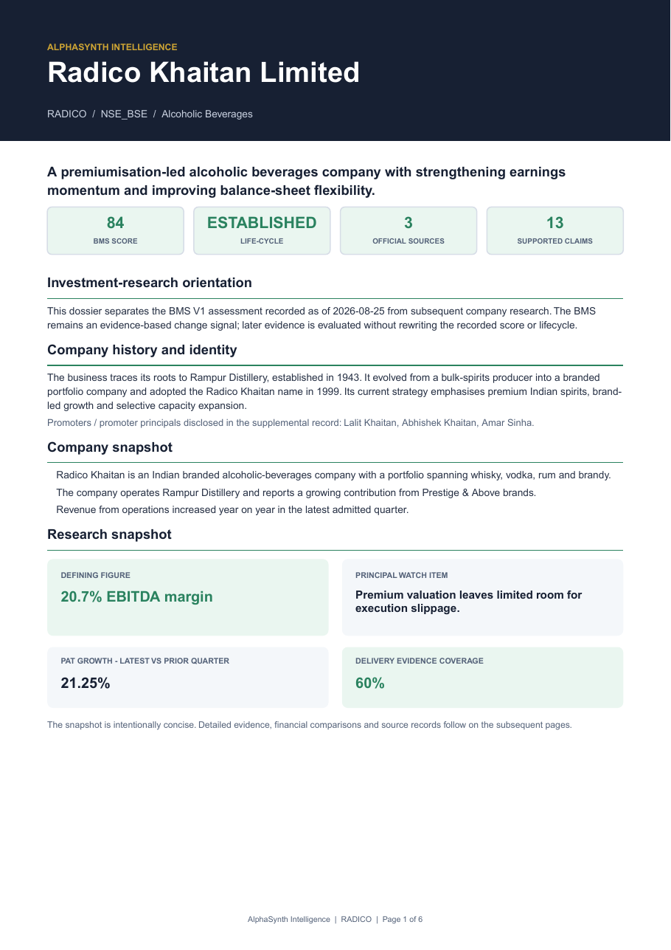
ALPHASYNTH BMS V1
A sample downloadable report
The PDF appears only when the supporting evidence meets the full-report standard.
COMPANY SNAPSHOT
A concise description of the business and its principal watch item.
LIFECYCLE AND BMS
The recorded lifecycle, score and evidence coverage appear together.
SUPPORTING EXPLANATION
Later pages explain the factors, subsequent result checks, management history and source evidence.
Illustrative sample: Radico Khaitan. Research aid only. No buy or sell recommendation.
AlphaSynth Intelligence
09
Notes:
This is the first page of the six-page AlphaSynth Professional Dossier sample for Radico Khaitan. It shows the format a user can expect when the available evidence meets the full-report standard. Later pages explain the BMS factors, later-results check, management history and sources. The dossier remains a research aid rather than a trading recommendation.

