Slide 1
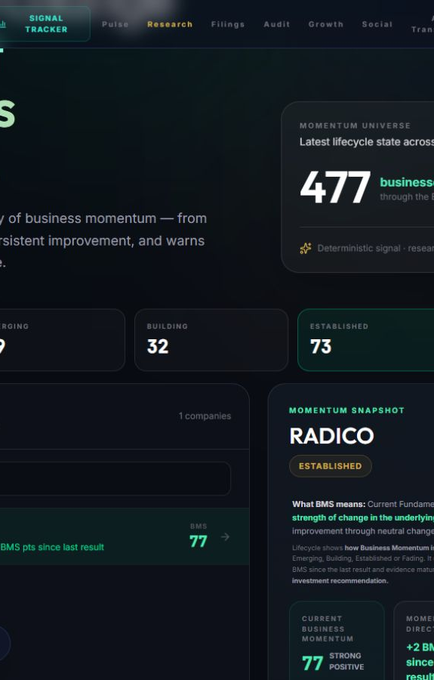
ALPHASYNTH INTELLIGENCE
Find business change
before it becomes obvious
A live research workflow that tracks fundamental momentum, preserves the evidence and opens a deeper company review.
WHAT IT DOES
Prioritises where further research may be worthwhile.
WHAT IT DOES NOT CLAIM
It does not predict multibaggers, replace due diligence or recommend trades.
Notes:
Opening message for both peer developers and market users. The right side is a live AlphaSynth Signal Tracker capture from 15 September 2026. The text below each slide in PowerPoint is a presenter note, not a voice-over track. Source: live pilot URL, captured 2026-09-15.

Slide 2
ALPHASYNTH PRODUCT WALKTHROUGH
Start with a monitored signal universe
The tracker turns 477 company histories into a compact research queue.
1
Choose a lifecycle
2
Inspect the signal
3
Choose the next action
Watch, Emerging, Building, Established or Fading.
Read the score, direction, evidence maturity and market context.
Open the evidence report or move into Deep Dive.
AlphaSynth Intelligence
02
Notes:
Live Signal Tracker capture, RADICO selected, 15 September 2026. The 477-company number refers to the monitored BMS universe, not the broader on-demand Deep Dive search universe.

Slide 3
ALPHASYNTH PRODUCT WALKTHROUGH
Lifecycle adds time to the score
One quarter can create a signal. Repeated evidence determines whether it broadens, persists or fades.
01
WATCH
First evidence; gather a baseline
02
EMERGING
A new positive inflection appears
03
BUILDING
More factors and periods confirm it
04
ESTABLISHED
Improvement persists across results
05
FADING
The earlier momentum is weakening
Lifecycle describes business-momentum history — not company quality, valuation or a buy/sell view.
AlphaSynth Intelligence
03
Notes:
Lifecycle is a time-based classification layered on the current BMS reading. It remains separate from valuation and investment recommendations.

Slide 4
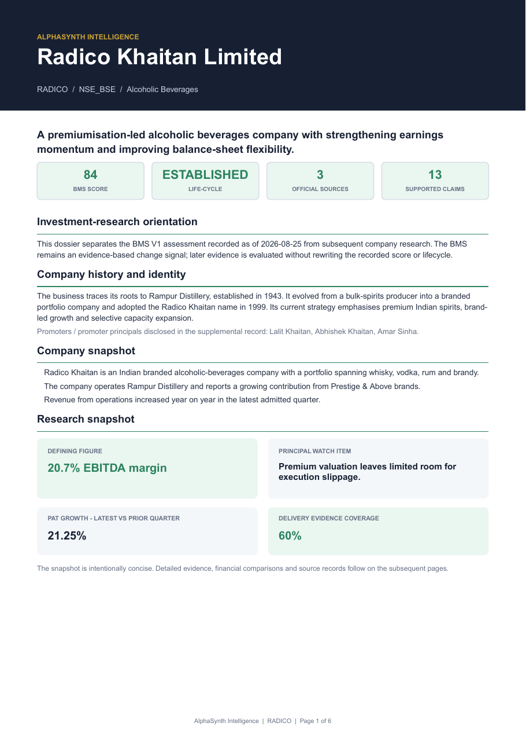
ALPHASYNTH PRODUCT WALKTHROUGH
Open ‘Why this signal?’ for the evidence trail
The main tracker stays concise. The evidence layer explains what the score means and what remains uncertain.
THE USER CAN SEE
Recorded lifecycle
The original BMS V1 state is preserved as history.
Evidence coverage
Official sources and supported claims are counted.
Principal watch item
The report surfaces uncertainty rather than hiding it.
Research readiness
The on-screen layer can remain useful even when a PDF is withheld.
AlphaSynth Intelligence
04
Notes:
The screenshot is page 1 of the generated RADICO evidence dossier. In the live application the same information is reached through View Evidence Report. Missing evidence remains visible; it is not backfilled with invented values. Source: generated sample dossier, September 2026.

Slide 5
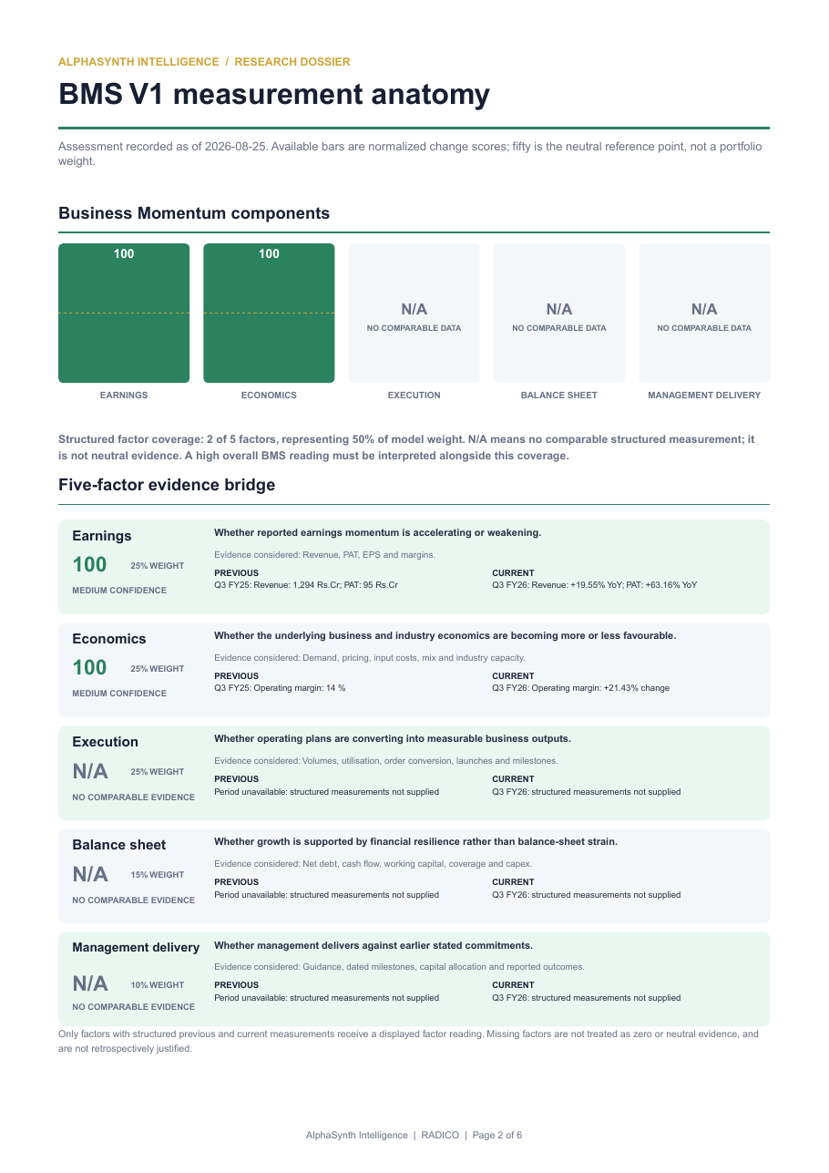
ALPHASYNTH PRODUCT WALKTHROUGH
See how the score was formed — and how confident it is
Score describes the measured direction. Confidence describes evidence completeness. They answer different questions.
SCORE ≠ CONFIDENCE
100
Momentum score
A strong change reading in the available comparison.
MEDIUM
Evidence confidence
Some required factors are not yet comparable. N/A is not treated as zero or neutral.
Units stay explicit: ₹ crore, %, EPS and score /100.
AlphaSynth Intelligence
05
Notes:
Generated RADICO dossier, page 2. The apparent 100 versus medium-confidence tension is intentional: the first measures momentum in the supplied comparable factors; the second states how complete the evidence set is. Source: generated sample dossier, September 2026.

Slide 6
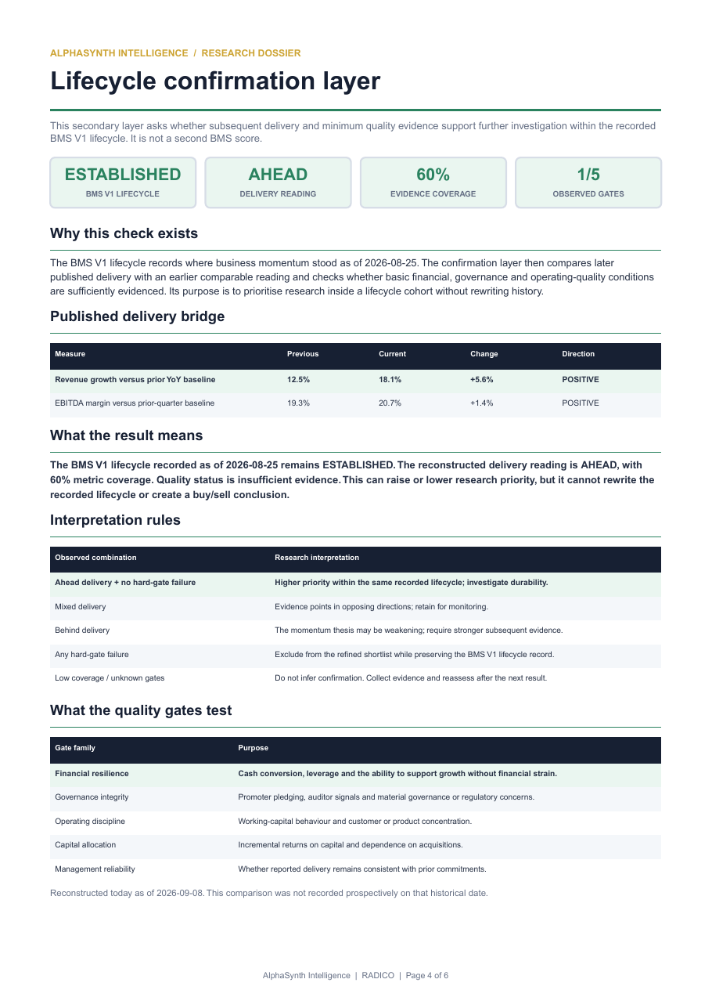
ALPHASYNTH PRODUCT WALKTHROUGH
Later results test whether the earlier lifecycle still holds
The historical lifecycle is preserved. New results change today’s research priority, not yesterday’s record.
1
Compare delivery
Previous reading versus the next published result.
2
Check business quality
Financial resilience, governance, operating discipline and allocation.
3
Set research priority
Qualified, caution, not qualified or more evidence needed.
This is confirmation — not retrospective rewriting.
AlphaSynth Intelligence
06
Notes:
Generated RADICO dossier, page 4. The confirmation overlay compares subsequent published evidence with the recorded lifecycle. It can raise or lower research priority while preserving the original classification as an auditable historical record.

Slide 7
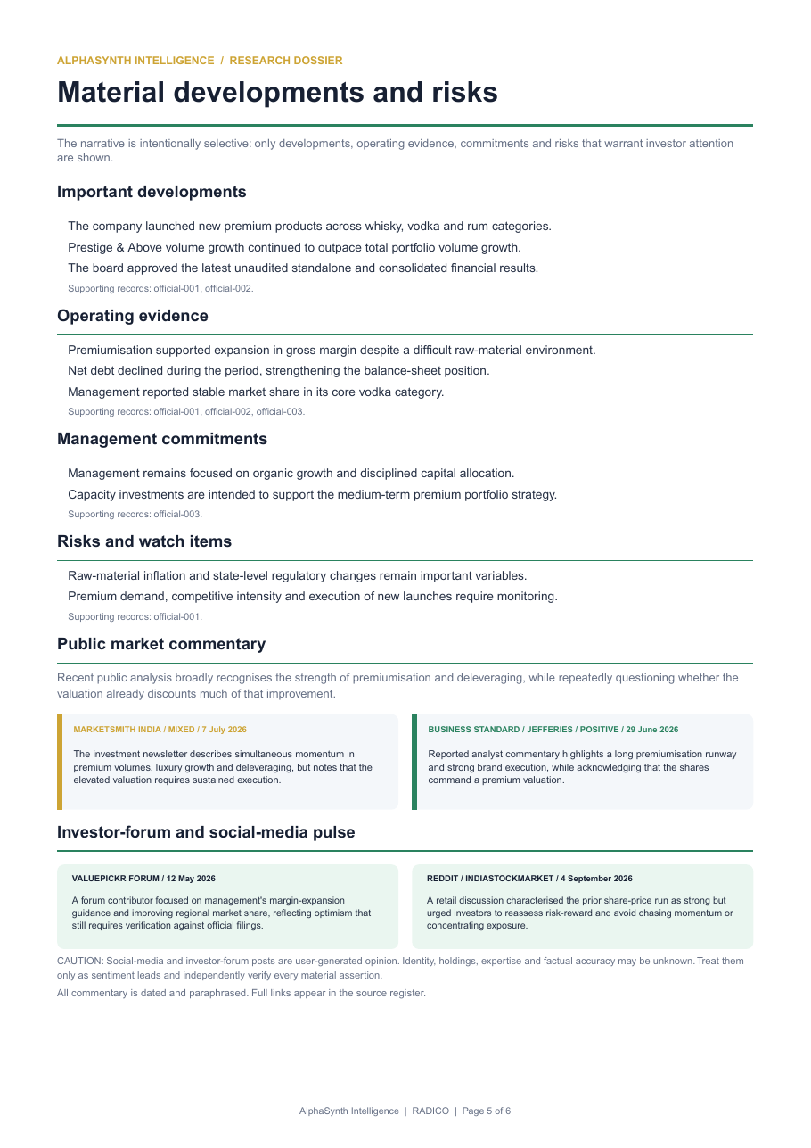
ALPHASYNTH PRODUCT WALKTHROUGH
Management commentary becomes evidence only when remembered
AlphaSynth separates what management says now from whether earlier measurable commitments were delivered.
1
Record
Capture a dated, measurable commitment.
2
Wait
Keep it pending until its target date.
3
Verify
Compare the reported outcome and any revisions.
4
Score
Create a reliability band only after enough commitments mature.
‘Insufficient history’ is a valid outcome. Unknown never becomes a pass.
AlphaSynth Intelligence
07
Notes:
Generated RADICO dossier, page 5, alongside the implemented management-guidance ledger methodology. Commentary and delivery are related but separate: commentary records tone and commitments; delivery scores only matured commitments with verifiable outcomes.

Slide 8
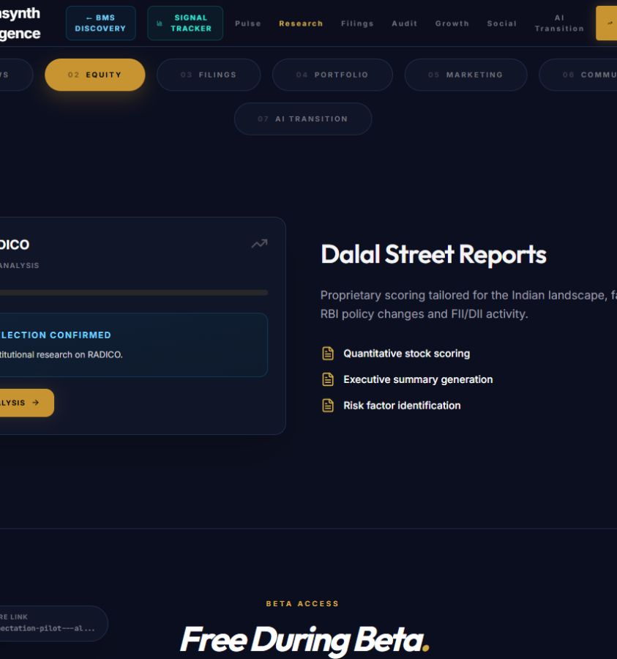
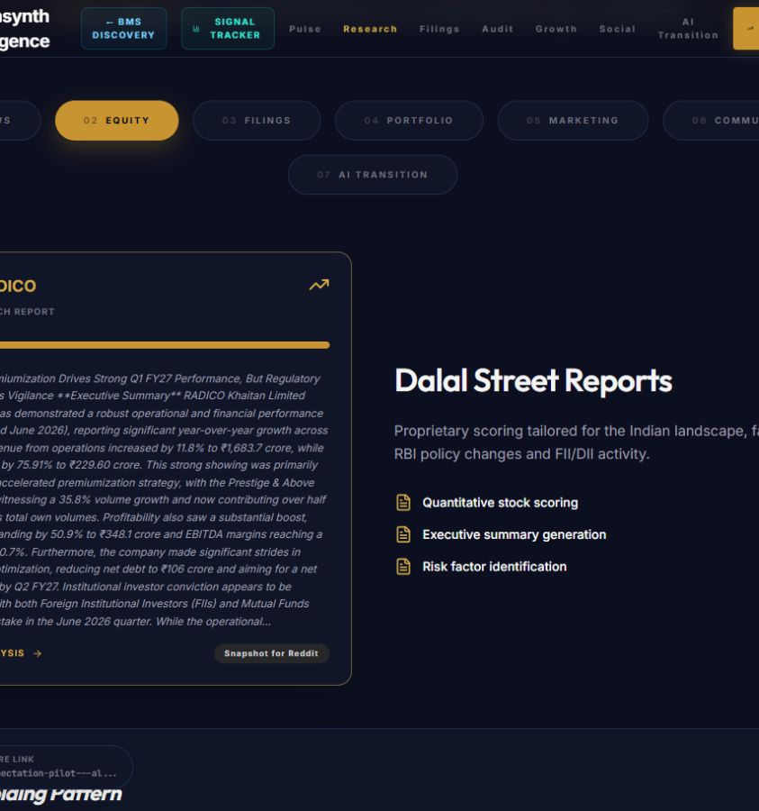
ALPHASYNTH PRODUCT WALKTHROUGH
Move from a signal to a full company Deep Dive
The Signal Tracker finds where to look. Deep Dive investigates valuation, sector, earnings, ownership and risks.
1 HANDOFF
2 RESEARCH OUTPUT
The selected company carries into the research workflow.
A fuller report adds bull and bear cases, valuation context and supporting tables.
Deep Dive supports a broader on-demand universe, including additional small and mid caps — subject to data availability. Coverage does not imply a BMS lifecycle.
AlphaSynth Intelligence
08
Notes:
Both images are live pilot captures from 15 September 2026. Deep Dive can research a broader on-demand universe than the 477-company BMS tracker. A company found through Deep Dive should not be described as having a BMS lifecycle unless it is actually included in the monitored BMS universe.

Slide 9
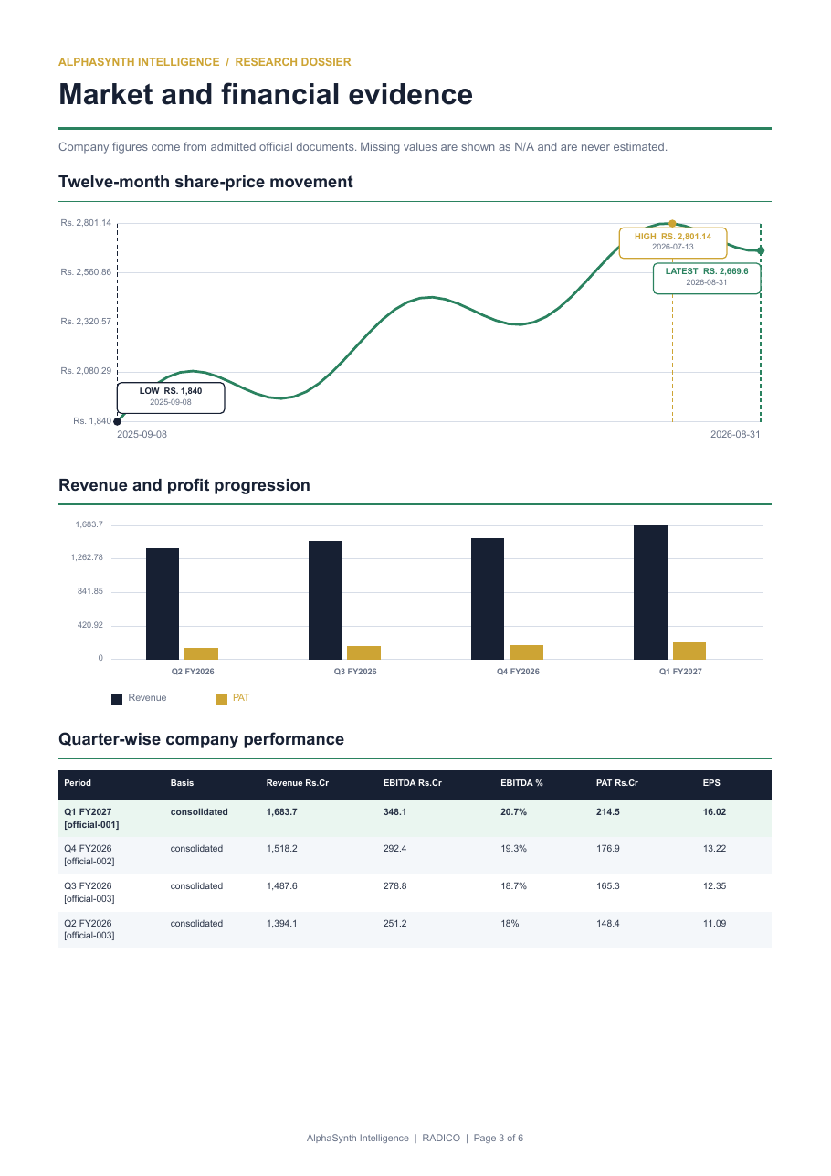
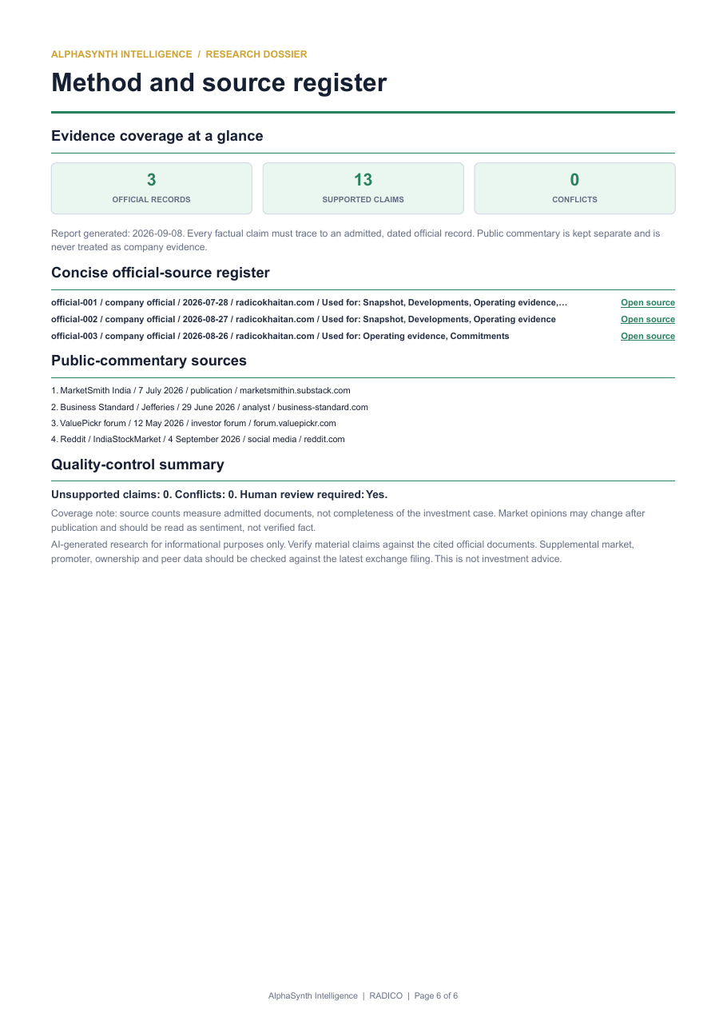
ALPHASYNTH PRODUCT WALKTHROUGH
The full report is selective by design
On-screen evidence remains available. A downloadable PDF appears only when stricter report-readiness checks pass.
Company view
Financial evidence
Source register
24 of 25
2 of 25
Evidence workflows completed in the bounded test.
Met the stricter full-PDF readiness standard.
Coverage evidence — not predictive accuracy.
AlphaSynth Intelligence
09
Notes:
The three images are pages 1, 3 and 6 from the generated RADICO dossier. The bounded 25-company test measured system completion and PDF readiness, not stock-return accuracy: 24 workflows completed; 2 met the full report standard.

Slide 10
ALPHASYNTH PRODUCT WALKTHROUGH
One journey, two depths of research
Use BMS to decide where to look. Use the evidence layer and Deep Dive to decide what deserves further work.
1
2
3
4
SIGNAL TRACKER
→
EVIDENCE REPORT
→
DEEP DIVE
→
SELECTIVE PDF
477 monitored companies
Lifecycle + BMS
Factors + confidence
Later-results confirmation
Broader on-demand universe
Company + valuation + risks
Downloaded only when
report-ready
OPEN THE LIVE PILOT
expectation-pilot---alphasynth-equity-oqc2y4ogda-uc.a.run.app
Research aid only · no buy/sell recommendation · verify material claims against cited filings
AlphaSynth Intelligence
10
Notes:
Closing slide. Suggested live demonstration: choose a lifecycle, select one company, open View Evidence Report, then use Deep Dive. The pilot URL is shown for the peer-review session. The application is a research aid and does not replace due diligence or provide investment advice.

