Slide 1
ALPHASYNTH INTELLIGENCE
Business momentum with an evidence trail
A product walkthrough for AI builders and market researchers
AlphaSynth monitors a 477-company BMS universe, explains why a signal appeared, checks later results and opens a broader company review when more research is needed.
What it does
What it does not claim
Prioritises companies whose reported business momentum may deserve further research.
It does not predict returns, set a target price or provide a buy or sell recommendation.
Live pilot: expectation-pilot---alphasynth-equity-oqc2y4ogda-uc.a.run.app
Notes:
Opening. State the product boundary before demonstrating it. The URL points to the current AlphaSynth pilot.

Slide 2
ALPHASYNTH PRODUCT WALKTHROUGH
The research journey
Each layer answers a separate question. A user can stop after any layer.
1
Signal Tracker
Which companies show a change in reported business momentum?
2
Evidence Report
What inputs support the signal and where is the evidence incomplete?
3
Later Results
Do subsequent results still support the earlier lifecycle reading?
4
Deep Dive
What does a broader company, valuation and risk review reveal?
The 477-company BMS tracker and the broader on-demand Deep Dive have different coverage. A Deep Dive result does not create a BMS lifecycle by itself.
AlphaSynth Intelligence
02
Notes:
The tracker, evidence workspace, later-results check and Deep Dive form one research journey. Coverage differs between the BMS tracker and the wider Deep Dive workflow.

Slide 3
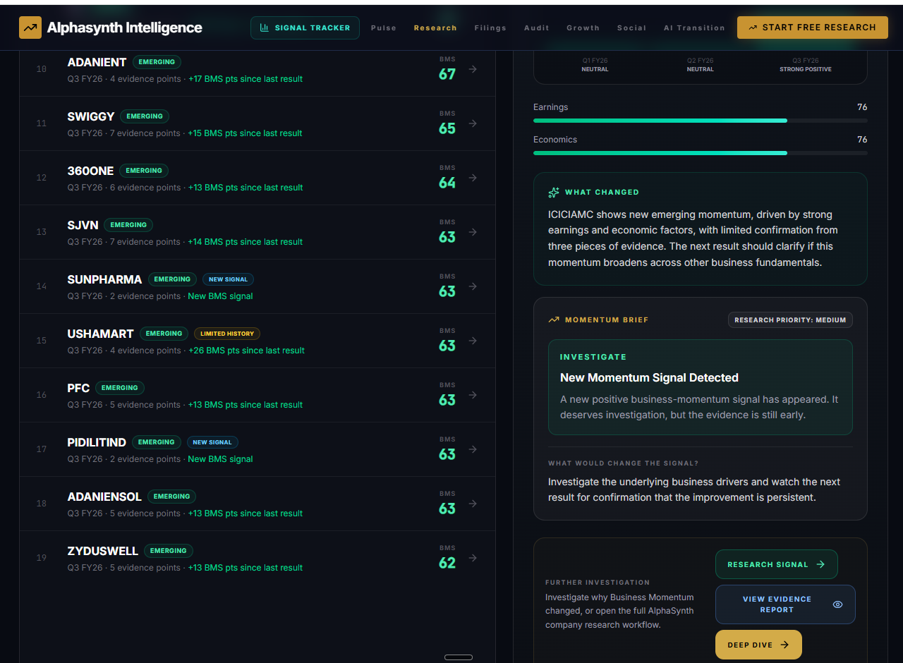
ALPHASYNTH PRODUCT WALKTHROUGH
Signal Tracker
A lifecycle filter and company list turn the universe into a research queue.
What the user sees
Several companies remain visible while the selected company shows its current BMS reading, change since the previous result and a plain-language research brief.
AlphaSynth Intelligence
03
Notes:
User-supplied live app capture from 15 September 2026. The redundant Research Signal action shown in this capture has been removed from the final code. Evidence Report and Deep Dive remain the two clear next actions.

Slide 4
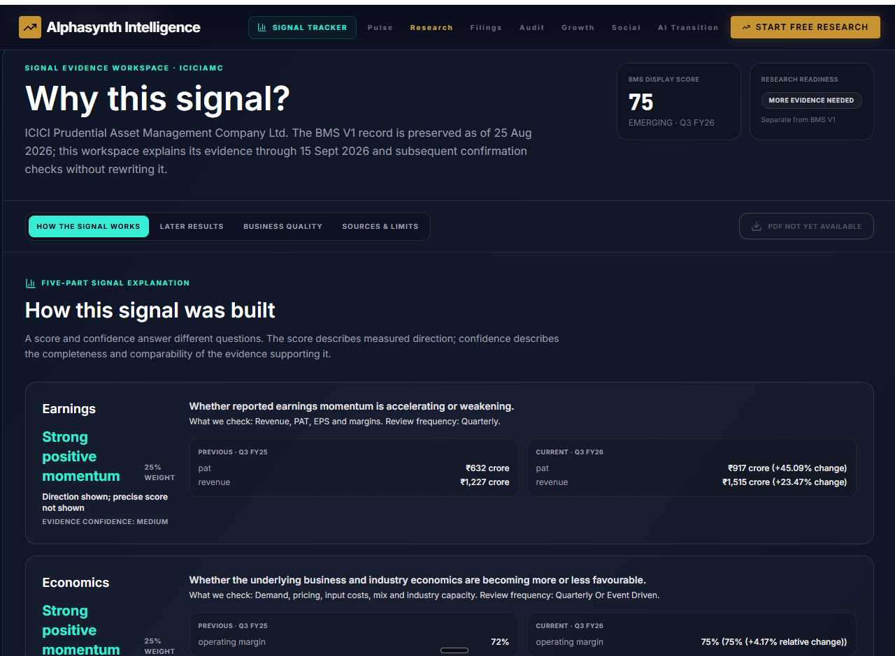
ALPHASYNTH PRODUCT WALKTHROUGH
Why this signal?
The evidence workspace separates the recorded BMS score from the strength of evidence supporting it.
Inspectable inputs
Previous and current periods, rupee crore units, percentages and evidence confidence remain visible. Missing factors stay unavailable rather than becoming neutral scores.
AlphaSynth Intelligence
04
Notes:
User-supplied live app capture. Explain that score direction and evidence confidence answer different questions.

Slide 5
ALPHASYNTH PRODUCT WALKTHROUGH
How to read the lifecycle
A score describes the measured direction. A lifecycle describes how that evidence has behaved over successive results.
WATCH
EMERGING
BUILDING
ESTABLISHED
FADING
A baseline or early reading
A positive inflection begins
More results or factors confirm it
The improvement persists
Earlier momentum is weakening
Score
Evidence confidence
Direction within the factors that have comparable previous and current evidence.
Completeness, comparability and source quality. Medium confidence can accompany strong direction when only part of the model is populated.
N/A means no comparable evidence. It never means zero, neutral or poor performance.
AlphaSynth Intelligence
05
Notes:
Use this slide to explain the former 100 score and medium-confidence confusion. Direction and confidence must remain visibly separate.

Slide 6
ALPHASYNTH PRODUCT WALKTHROUGH
Later results and management delivery
The confirmation layer tests an earlier lifecycle without rewriting the historical record.
1
Record
Store the original lifecycle, period and supporting evidence.
2
Remember
Save dated, measurable management commitments quarter by quarter.
3
Compare
Check later reported outcomes against financial factors and matured commitments.
4
Qualify
Raise, lower or defer today’s research priority according to evidence coverage.
Management commentary records what was said. Management delivery checks what happened after the commitment matured.
AlphaSynth Intelligence
06
Notes:
Management commentary and delivery remain separate but connected. The ledger needs at least three matured, verifiable commitments before producing a reliability score.

Slide 7
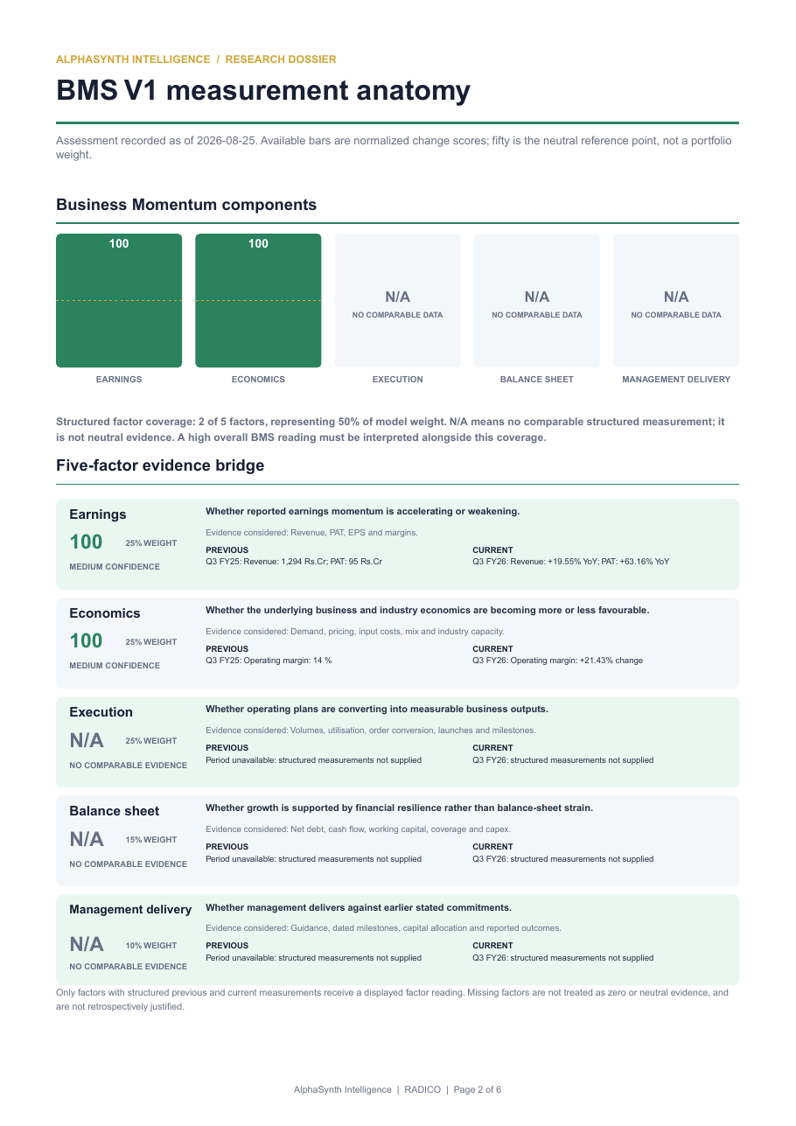
ALPHASYNTH PRODUCT WALKTHROUGH
Selective PDF output
A downloadable report appears only when the evidence-readiness checks pass.
What this page demonstrates
The five BMS factors
Previous and current evidence
Factor weight and evidence confidence
Unavailable evidence shown honestly
When evidence is too thin, the on-screen report remains available but the PDF is withheld.
AlphaSynth Intelligence
07
Notes:
This is the only PDF sample in the carousel. The PDF remains a selective output, not the main product experience.

Slide 8
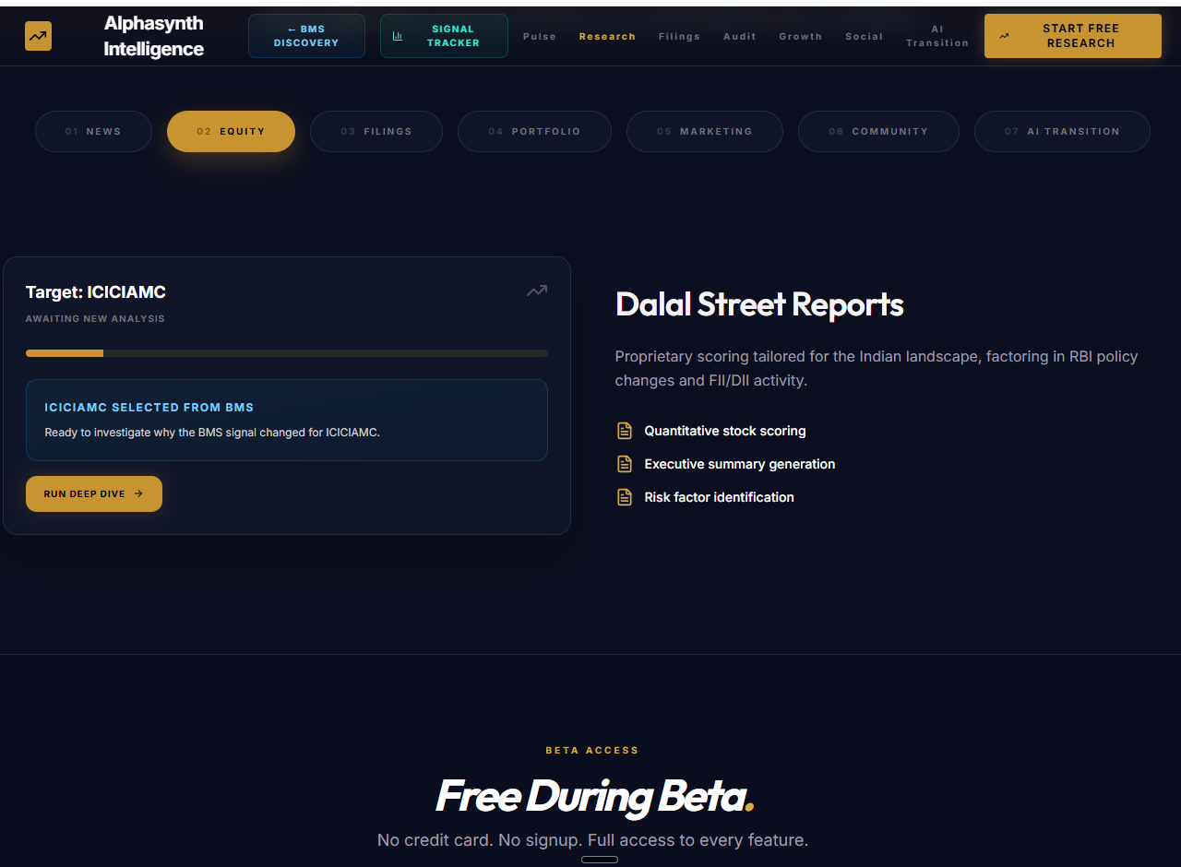
ALPHASYNTH PRODUCT WALKTHROUGH
Deep Dive handoff
The chosen company carries from the BMS tracker into the broader AlphaSynth research workflow.
A deliberate next step
The user decides whether the signal deserves a fuller company review. Deep Dive covers a broader universe, including additional small and mid-cap companies when data is available.
AlphaSynth Intelligence
08
Notes:
User-supplied live app capture. Deep Dive coverage exceeds the 477-company BMS universe, but the research result does not itself assign a BMS lifecycle.

Slide 9
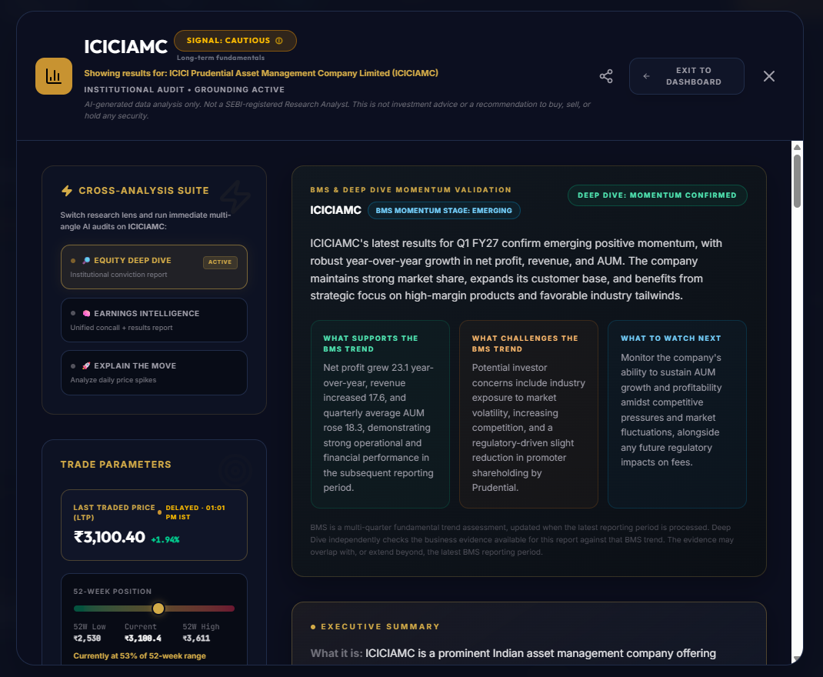
ALPHASYNTH PRODUCT WALKTHROUGH
Broader company review
The full report adds company context, risks and an independent check against the recorded BMS direction.
Two readings stay separate
BMS preserves the multi-quarter momentum record. Deep Dive examines the company using the latest evidence and states whether that evidence supports or challenges the earlier direction.
AlphaSynth Intelligence
09
Notes:
User-supplied live app capture. The code now uses plainer research-review terminology and removes unsupported decorative metrics.

Slide 10
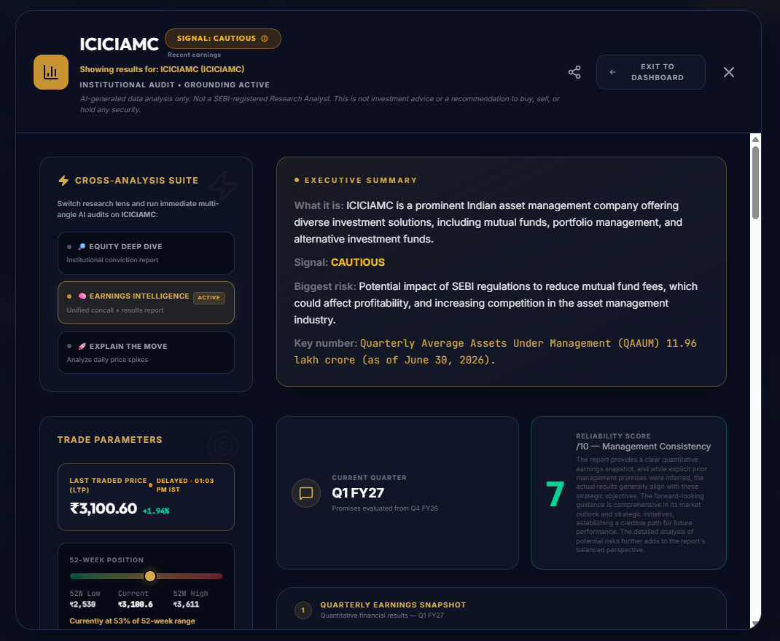
ALPHASYNTH PRODUCT WALKTHROUGH
Earnings and management commentary
The earnings view brings quarterly results, management statements and analyst questions into one review.
A history-dependent score
Management reliability should appear only after enough dated commitments have matured and can be checked against reported outcomes. Otherwise the app shows insufficient history.
AlphaSynth Intelligence
10
Notes:
User-supplied live app capture. Do not interpret a single call or quarter as a management reliability record.

Slide 11
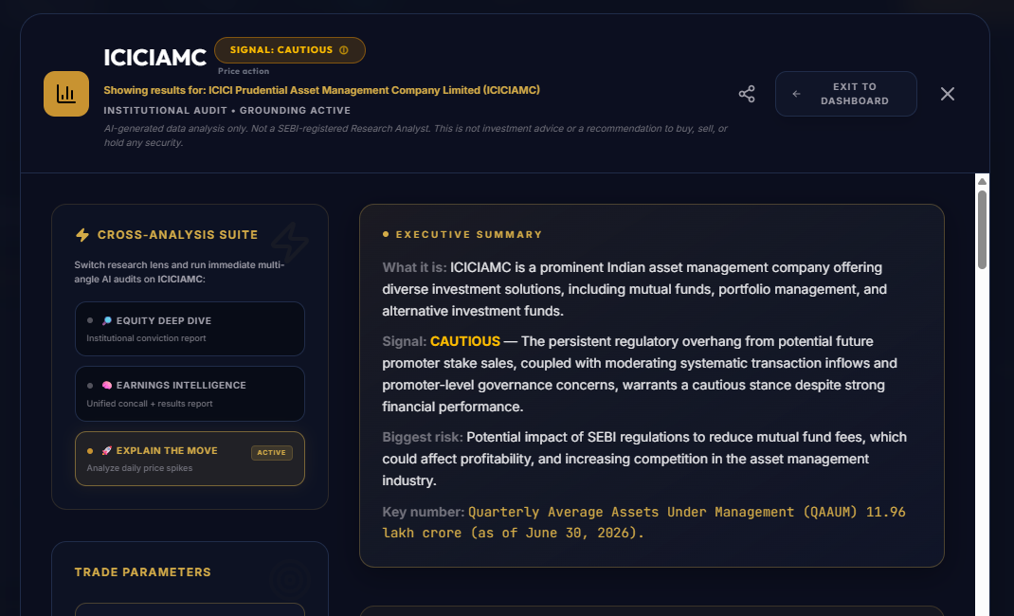
ALPHASYNTH PRODUCT WALKTHROUGH
Explain the Move
This research view asks what public catalysts and market context may explain a recent price move.
Evidence before labels
The final code removes the previous fixed RSI, delivery-ratio and breakout cards. The screen now relies on retrieved report evidence instead of reusable placeholder values.
AlphaSynth Intelligence
11
Notes:
User-supplied capture cropped before the obsolete fixed metric cards. Those cards were not company-specific and have been removed from the application.

Slide 12
ALPHASYNTH PRODUCT WALKTHROUGH
Filings and management commentary
The filings view reviews dated disclosures and tracks whether management language changes over time.
Transcript clarity
Disclosure completeness
Did management answer material analyst questions directly?
Are the required facts and periods available in dated filings?
Guidance realism
Governance evidence
Are outlook statements measurable and consistent with later outcomes?
What do dated filings support—and what remains unverified?
Missing evidence remains unavailable. The app does not turn a missing disclosure into a favourable or neutral score.
AlphaSynth Intelligence
12
Notes:
The supplied filing screenshot used older technical terminology, so this slide presents the final user-facing labels directly. Replace it with a fresh live capture after the corrected build is deployed.

Slide 13
ALPHASYNTH PRODUCT WALKTHROUGH
When AlphaSynth withholds a report
A successful workflow can still decide that the evidence is not strong enough for a downloadable PDF.
On-screen evidence report
Downloadable PDF
Available when the workflow has enough evidence to explain what it found and what remains missing.
Available only after stricter checks for official sources, supported claims, narrative coverage, comparable BMS factors and later-results evidence.
Bounded validation cohort
24 of 25 workflows completed. Only 2 of 25 met the stricter PDF-readiness standard. Withholding the other PDFs was an intended safety result.
Live pilot: expectation-pilot---alphasynth-equity-oqc2y4ogda-uc.a.run.app
AlphaSynth Intelligence
13
Notes:
Close with a live demonstration rather than a separate ready-for-peer-review claim. The cohort measured workflow completion and evidence readiness, not investment performance.

