Slide 1
ALPHASYNTH INTELLIGENCE
Find business change
before it becomes obvious
A guided product walkthrough
From a monitored momentum signal to its evidence trail, later-results check and full company Deep Dive.
477-company BMS tracker
Evidence-first explanation
Broader on-demand Deep Dive
Research aid only · no buy/sell recommendation · verify material claims against cited filings
Notes:
Opening slide for AI peers and market users. AlphaSynth is a research workflow, not a prediction claim or investment recommendation. The presentation notes are presenter prompts, not an embedded voice-over.

Slide 2
ALPHASYNTH PRODUCT WALKTHROUGH
The product has one simple research journey
Each layer answers a different question. The user can stop as soon as they have enough evidence.
1
FIND
Which company’s business momentum is changing?
2
EXPLAIN
What evidence produced the lifecycle and score?
3
CONFIRM
Do later results support the earlier reading?
4
INVESTIGATE
What does a fuller company review reveal?
AlphaSynth Intelligence
02
Notes:
The four layers are Signal Tracker, Evidence Report, later-results confirmation, and Deep Dive. PDF is an optional output within the evidence layer, not a required step for every company.

Slide 3
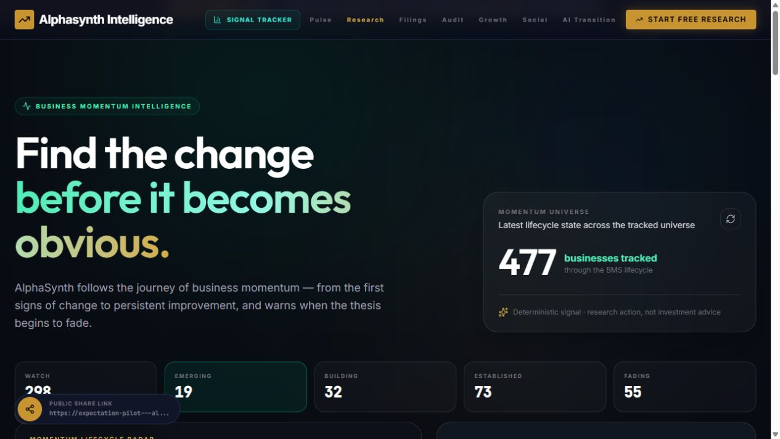
ALPHASYNTH PRODUCT WALKTHROUGH
The monitored BMS universe
The opening screen shows the product purpose, total coverage and distribution across five lifecycle stages.
WATCH
EMERGING
BUILDING
ESTABLISHED
FADING
298
19
32
73
55
These brighter labels repeat the live categories so they remain legible when the carousel is viewed on a phone.
AlphaSynth Intelligence
03
Notes:
Complete live pilot capture from 15 September 2026. The five lifecycle labels are repeated below the screenshot at presentation size for legibility. The 477-company count refers specifically to the monitored BMS universe.

Slide 4
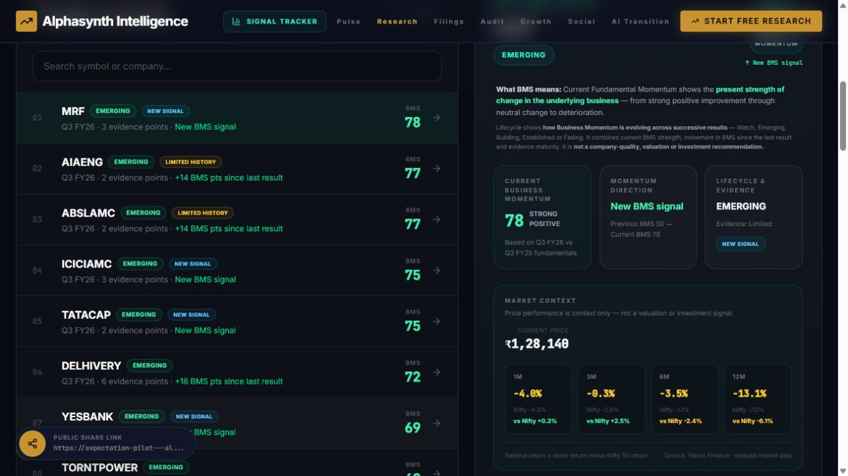
ALPHASYNTH PRODUCT WALKTHROUGH
The company list and selected signal
The full list remains visible in the carousel. The selected company appears beside its momentum and market context.
1
Several companies stay visible
2
The selected company stays in context
The capture shows the ranked research queue instead of an empty filtered panel.
The right side explains the lifecycle, score direction and available market context.
AlphaSynth Intelligence
04
Notes:
Complete live pilot capture from 15 September 2026. The screenshot shows multiple Emerging companies and the selected MRF signal without cropping the list.

Slide 5
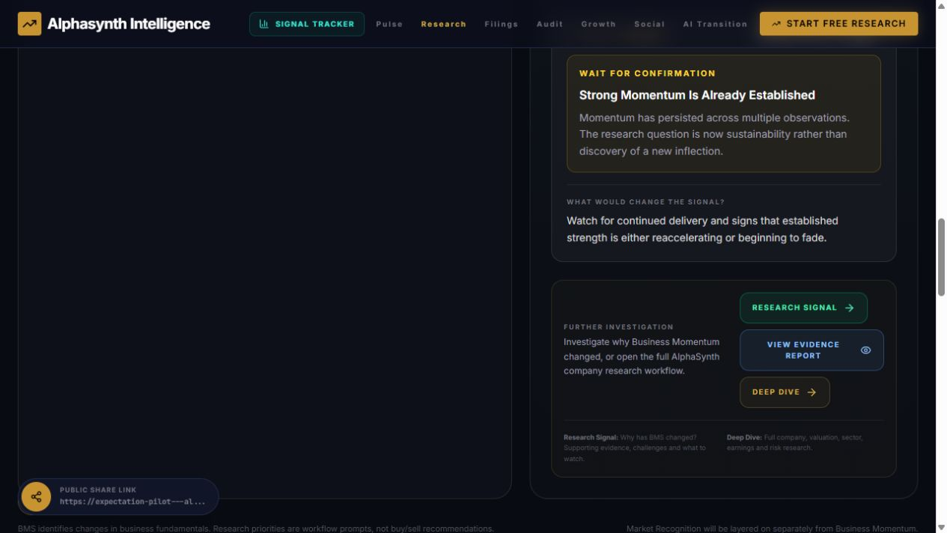
ALPHASYNTH PRODUCT WALKTHROUGH
The signal and next research action
The lower part of the selected-company screen shows the human interpretation and the three research actions.
1
Research Signal
2
Evidence Report
3
Deep Dive
Understand what changed and what would change the signal again.
Open the supporting factors, confidence and confirmation checks.
Move into a broader company, valuation and risk review.
AlphaSynth Intelligence
05
Notes:
Live pilot capture from 15 September 2026. The Evidence Report and Deep Dive are separate layers; the tracker remains deliberately concise.

Slide 6
ALPHASYNTH PRODUCT WALKTHROUGH
Lifecycle adds history to a single score
One result can create a signal. Repeated evidence shows whether it broadens, persists or fades.
01
WATCH
First evidence; establish a baseline
02
EMERGING
A positive inflection begins
03
BUILDING
More factors or periods confirm it
04
ESTABLISHED
Improvement persists through results
05
FADING
Earlier momentum is weakening
Lifecycle is not company quality, valuation, price direction or a buy/sell view.
AlphaSynth Intelligence
06
Notes:
Lifecycle is the time-based history of the BMS reading. It must stay separate from valuation and investment recommendations.

Slide 7
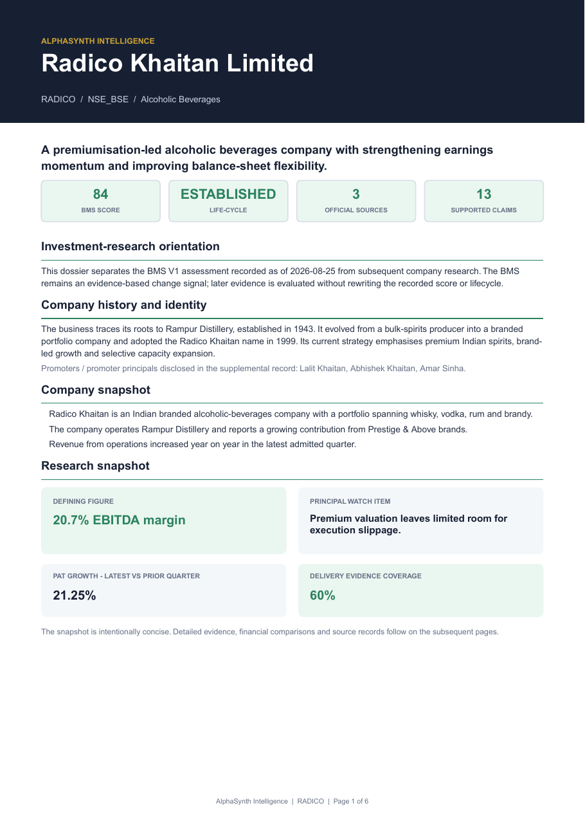
ALPHASYNTH PRODUCT WALKTHROUGH
A selective PDF begins with the decision context
The cover preserves the recorded lifecycle, evidence coverage, central watch item and research-readiness status.
SAMPLE PDF · PAGE 1
1
Recorded history
The original BMS V1 lifecycle remains auditable.
2
Evidence coverage
Sources and supported claims are counted.
3
Visible uncertainty
A watch item is shown rather than concealed.
PDF appears only when report-readiness checks pass.
AlphaSynth Intelligence
07
Notes:
Complete page 1 of the generated RADICO professional dossier sample, September 2026. No portion of the page has been cropped.

Slide 8
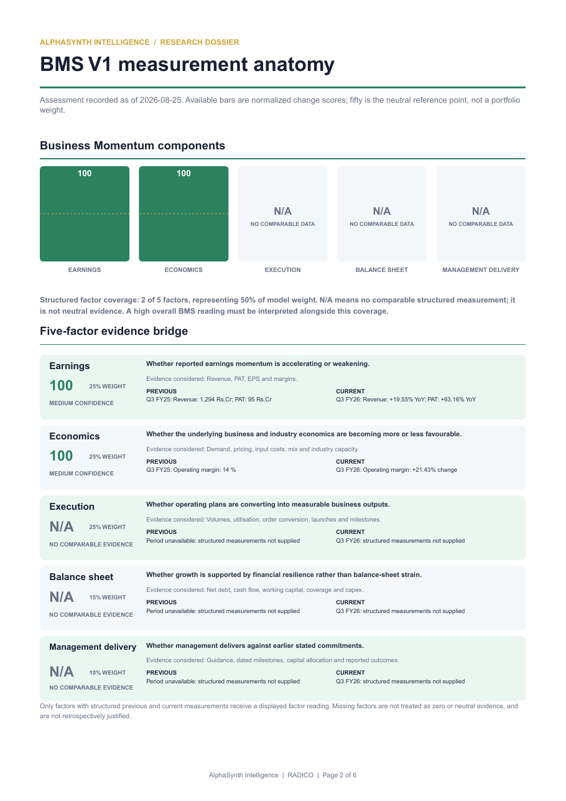
ALPHASYNTH PRODUCT WALKTHROUGH
Score and confidence answer different questions
The factor score measures direction within available comparisons. Confidence measures how complete that evidence is.
SAMPLE PDF · PAGE 2
1
100 / 100
Strong measured momentum in the factors supplied.
2
Medium confidence
Only part of the five-factor model is comparable.
3
N/A stays N/A
Missing evidence is never converted into zero or neutral.
Complete page shown without cropping.
AlphaSynth Intelligence
08
Notes:
Complete page 2 of the generated RADICO professional dossier sample, September 2026. No portion of the page has been cropped.

Slide 9
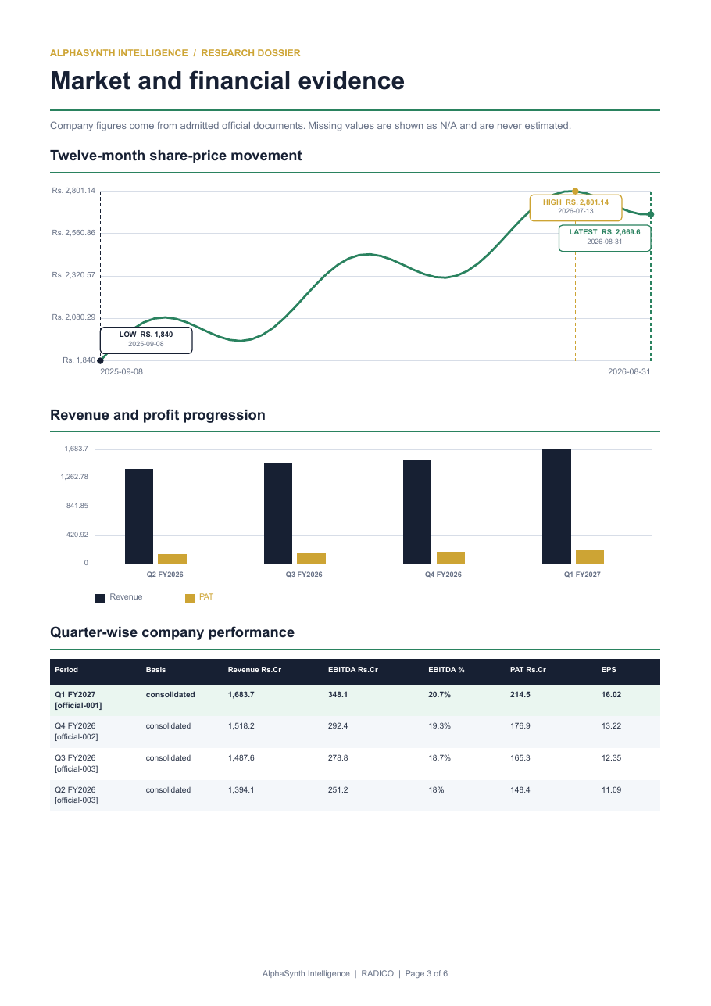
ALPHASYNTH PRODUCT WALKTHROUGH
Financial evidence makes the comparison inspectable
The report shows prices, quarterly financials and the periods used for comparison, with explicit units.
SAMPLE PDF · PAGE 3
1
Comparable periods
Previous and current readings are labelled.
2
Explicit units
₹ crore, percentages, EPS and score /100.
3
Source-linked
Quantitative inputs remain traceable to their source.
Complete page shown without cropping.
AlphaSynth Intelligence
09
Notes:
Complete page 3 of the generated RADICO professional dossier sample, September 2026. No portion of the page has been cropped.

Slide 10
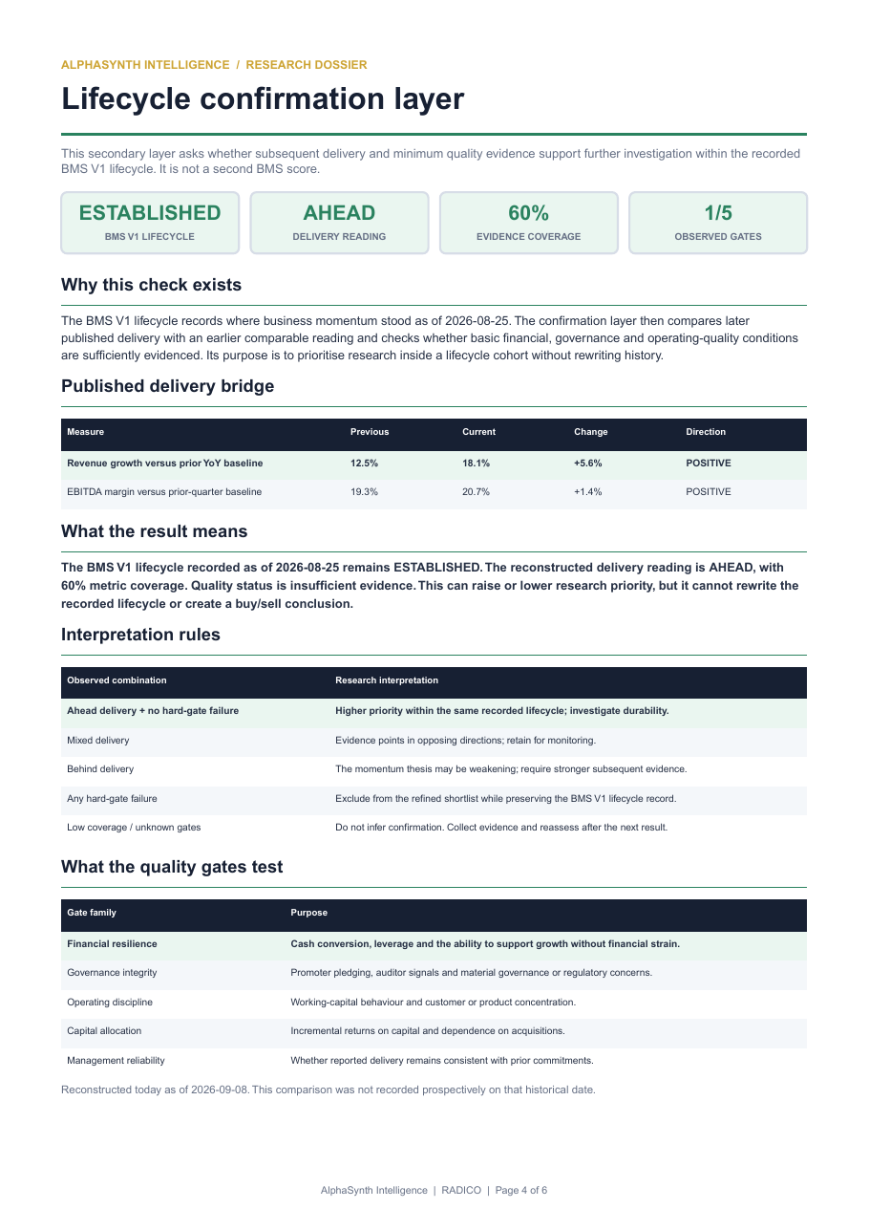
ALPHASYNTH PRODUCT WALKTHROUGH
Later results test the earlier lifecycle
After a lifecycle is recorded, subsequent evidence checks whether that earlier reading still appears valid.
SAMPLE PDF · PAGE 4
1
Preserve
Do not rewrite the historical classification.
2
Compare
Test delivery and business-quality evidence.
3
Prioritise
Raise, lower or defer today’s research priority.
Complete page shown without cropping.
AlphaSynth Intelligence
10
Notes:
Complete page 4 of the generated RADICO professional dossier sample, September 2026. No portion of the page has been cropped.

Slide 11
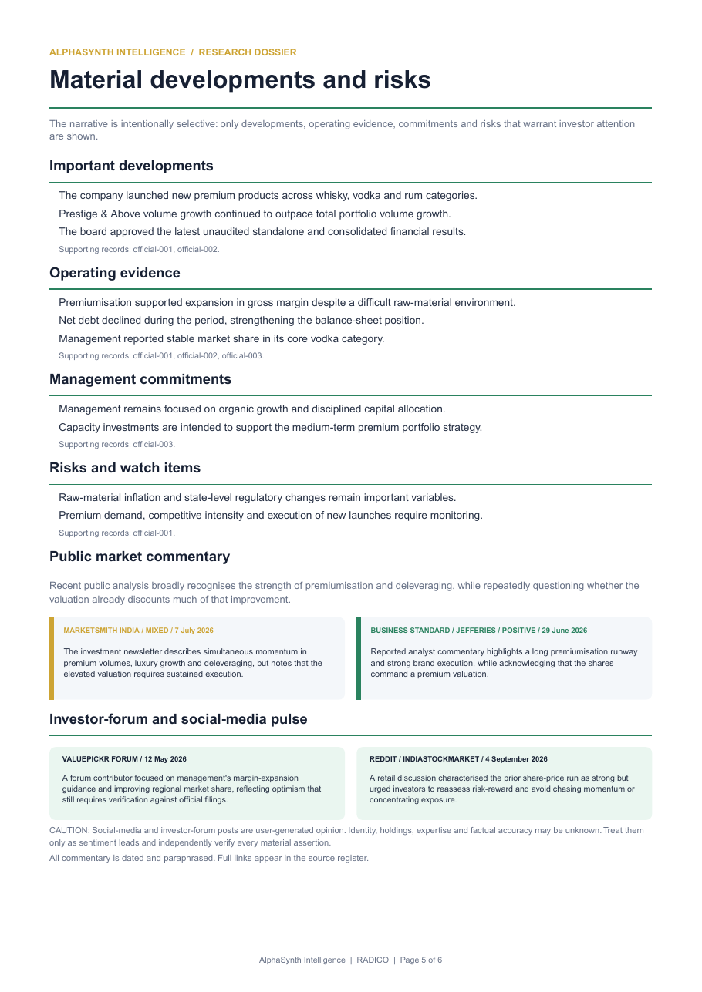
ALPHASYNTH PRODUCT WALKTHROUGH
Management claims need memory before they need a score
A statement becomes useful only when it is dated, measurable, remembered and checked against a later outcome.
SAMPLE PDF · PAGE 5
1
Record
Capture a measurable commitment and source.
2
Mature
Wait until the target date or outcome exists.
3
Verify
Assess delivery, revision discipline and disclosure quality.
Complete page shown without cropping.
AlphaSynth Intelligence
11
Notes:
Complete page 5 of the generated RADICO professional dossier sample, September 2026. No portion of the page has been cropped.

Slide 12
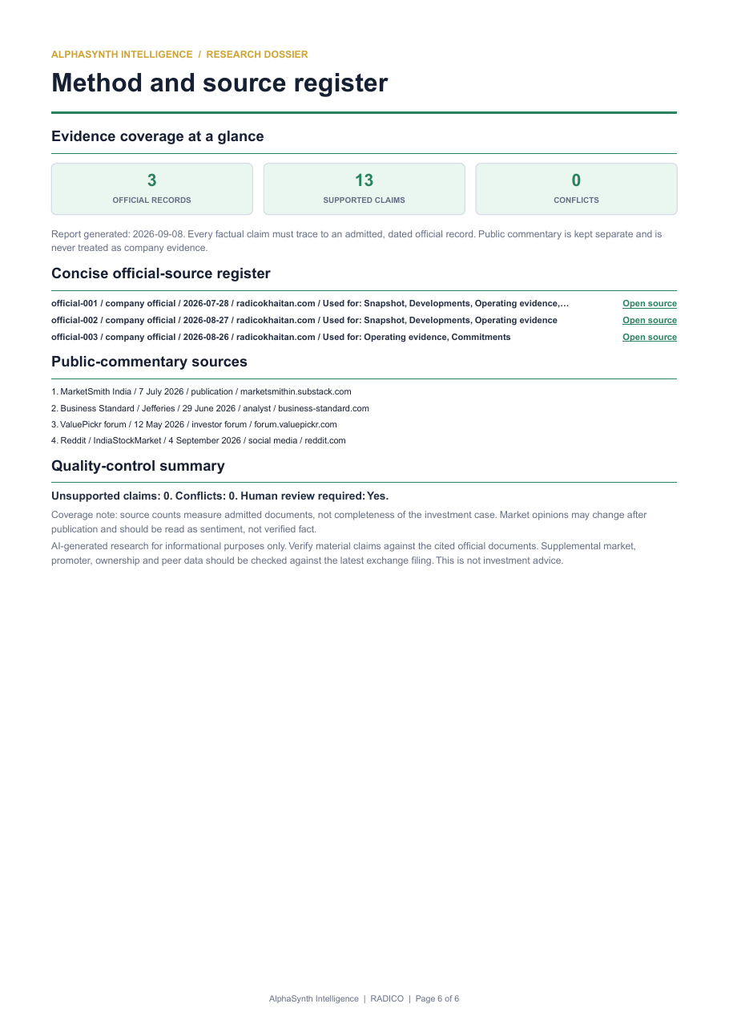
ALPHASYNTH PRODUCT WALKTHROUGH
The methodology preserves the source trail
The final page explains the method, limitations and source register so the conclusion can be challenged.
SAMPLE PDF · PAGE 6
1
Official-first
Company and exchange evidence lead admission.
2
Bounded fallbacks
Alternative evidence is labelled and constrained.
3
No invention
Unknown or incomplete evidence remains visible.
Complete page shown without cropping.
AlphaSynth Intelligence
12
Notes:
Complete page 6 of the generated RADICO professional dossier sample, September 2026. No portion of the page has been cropped.

Slide 13
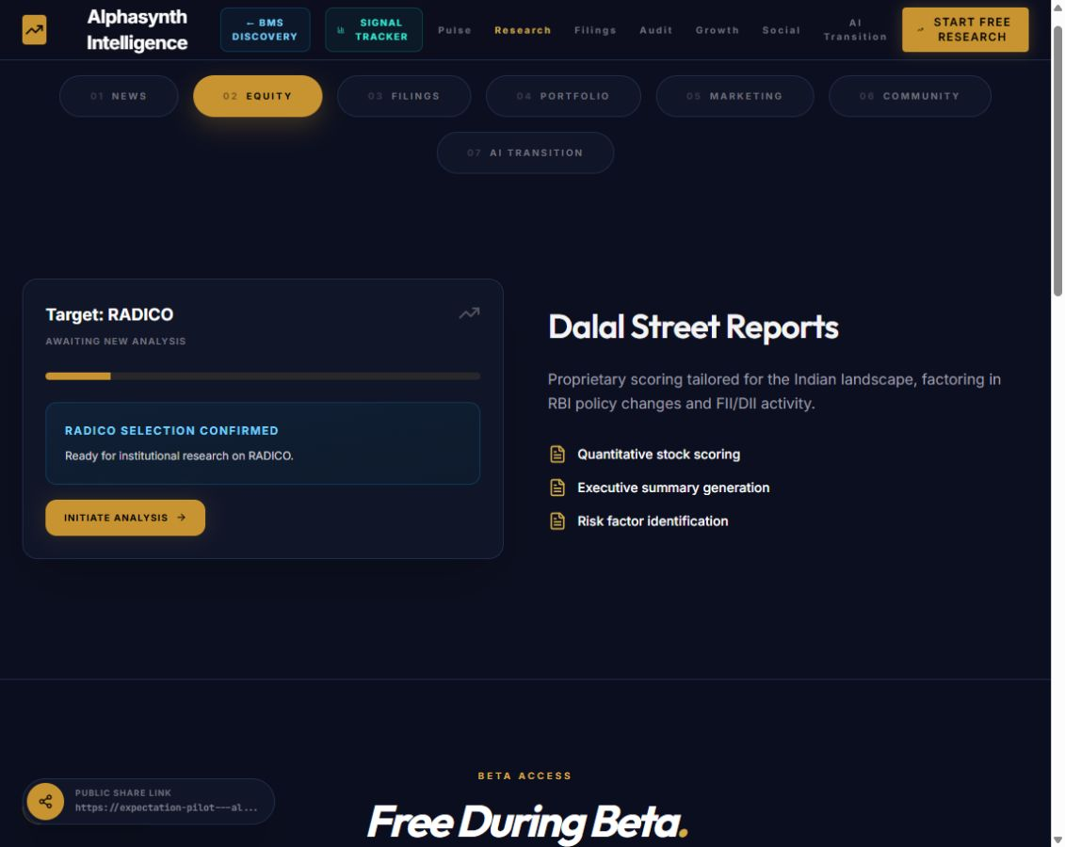
ALPHASYNTH PRODUCT WALKTHROUGH
Deep Dive begins with a deliberate handoff
The selected company carries from the BMS experience into the broader research workflow.
SELECT COMPANY
The user initiates the fuller analysis only when the signal deserves additional work.
AlphaSynth Intelligence
13
Notes:
Complete live pilot capture from 15 September 2026. Deep Dive is a deliberate next action, not an automatic claim attached to every signal.

Slide 14
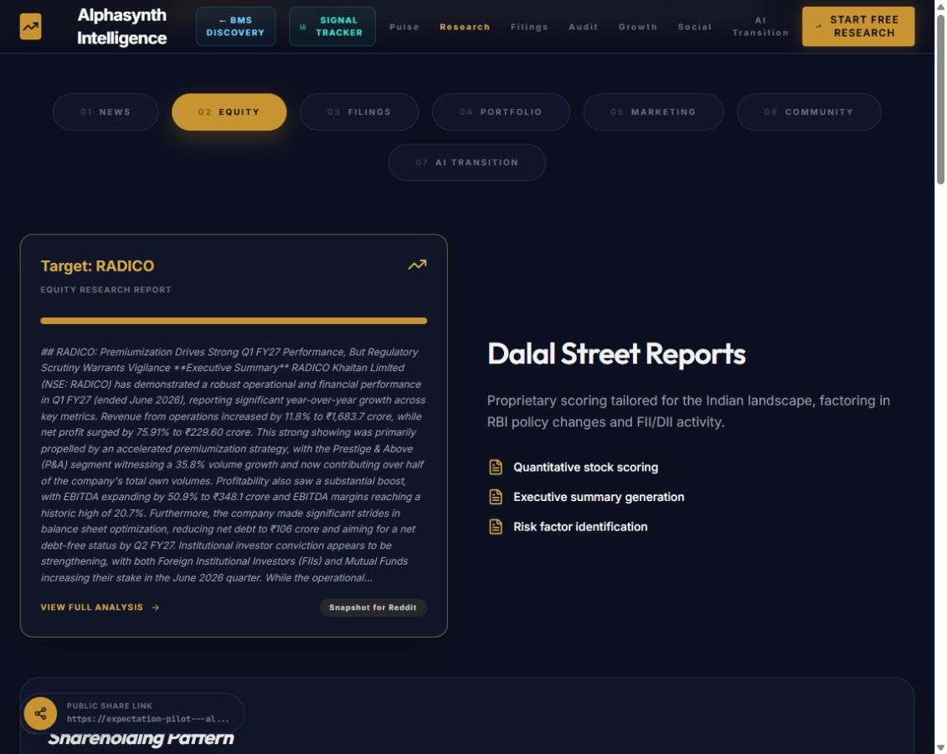
ALPHASYNTH PRODUCT WALKTHROUGH
Deep Dive returns a broader company review
The output adds an executive narrative, quantitative scoring and risk identification beyond the concise tracker.
BROADER ON-DEMAND COVERAGE
Additional small and mid caps may be researched subject to data availability. Deep Dive coverage does not itself confer a BMS lifecycle.
AlphaSynth Intelligence
14
Notes:
Complete live pilot capture from 15 September 2026. The on-demand Deep Dive universe is broader than the 477-company BMS tracker; those two coverage claims must not be conflated.

Slide 15
ALPHASYNTH PRODUCT WALKTHROUGH
Evidence discipline and validation
The build is ready for demonstration when the workflow completes reliably and weak evidence is stopped visibly.
24 of 25
2 of 25
Evidence workflows completed in the bounded validation cohort.
Met the stricter standard for a downloadable full PDF.
WHAT THIS PROVES
The workflow can finish, expose limitations, and selectively withhold a report when evidence is too thin.
WHAT THIS DOES NOT PROVE
It is not predictive-accuracy evidence and it does not replace due diligence or provide an investment recommendation.
expectation-pilot---alphasynth-equity-oqc2y4ogda-uc.a.run.app
AlphaSynth Intelligence
15
Notes:
Closing slide. The bounded cohort measured technical completion and report readiness, not stock-return prediction. Suggested live demo: select a lifecycle, choose a company, open Evidence Report, then open Deep Dive.

