Slide 1

SRM INSTITUTE OF SCIENCE AND TECHNOLOGY Ramapuram, Chennai – 600 089 SCHOOL OF COMPUTER SCIENCE ENGINEERING DEPARTMENT OF COMPUTER SCIENCE AND ENGINEERING SPECIALIZATION IN CYBER SECURITY
18CSP109L - PROJECT
18CSP462L – PROJECT EVALUATION-2
FINAL VIVA VOCE 2025
CLASS/YEAR/SEC : CSE-CS/IV/C BATCH NUMBER : 14
Payload Decoder: Unveiling Threats Through Reverse Engineering
Team Members | Supervisor
Barath V.S RA2111030020128 S.Trivikriam RA2111030020166 S.R Shiravanthan RA2111030020156 | Ms.S.Vaishnavii Assistant Professor , DEPARTMENT OF COMPUTER SCIENCE AND ENGINEERING SPECIALIZATION IN CYBER SECURITY ,SRMIST

Slide 2
Agenda
Abstract
Scope and Motivation
Introduction
Literature Survey
Objectives
Problem Statement
Proposed Work
Architecture Diagram/Block Diagram
Novel idea
Modules
Module Description
Software & Hardware Requirements
Results and Discussion-Comparison with Existing Work
Conclusion
Future Work
References
School of Computer Science Engineering

Slide 3
ABSTRACT
With the rapid rise of cybersecurity threats, efficient and accessible malware analysis tools are crucial for security analysts and organizations. Many existing tools are either overly complex, depend on internet connectivity, or lack a modular structure, limiting their usability in offline scenarios. Payload Decoder is a lightweight, Python-based malware analysis tool designed to address these challenges by offering static analysis, metadata extraction, and Indicator of Compromise (IOC) detection within a single platform. It features pattern-based IOC detection using YARA rules and hash verification for identifying known threats, enhancing threat detection accuracy. Built with a modular architecture, Payload Decoder ensures scalability and ease of integration, making it a multi-platform, user-friendly solution for rapid offline malware analysis.
School of Computer Science Engineering

Slide 4
Introduction
Cyber threats are evolving rapidly, making it essential for cybersecurity professionals to have efficient malware detection tools. Traditional malware analysis tools often rely on cloud-based detection, making them unsuitable for secure or air-gapped environments. Many tools are also overly complex, limiting accessibility for beginners and small organizations.
Payload Decoder is designed to address these challenges by offering a lightweight, Python-based tool that performs static analysis, metadata extraction, and Indicators of Compromise (IOC) detection in an offline environment. With a user-friendly interface, modular architecture, and multi-platform support, it empowers cybersecurity analysts, students, and researchers with an efficient and scalable malware analysis tool
School of Computer Science Engineering

Slide 5
Scope and Motivation
Scope:
Target users include cybersecurity students, analysts, and small-to-medium enterprises.
Designed for use in malware analysis labs, incident response teams, and individual cyber security practitioners.
Compatibility with educational environments and professional use cases.
Extendable with future integration into other security systems and also be integrated with other tools like antivirus or endpoint security systems.
Support for analyzing executables, scripts, documents, and other common file types.
Motivation:
Need for offline solutions for environments with limited or no internet access.
The need for a tool that bridges the gap between complexity and usability in malware detection.
Increasing use of malware in cyber warfare and data breaches.
Desire to empower students, researchers, and small organizations with a powerful yet easy-to-use solution.
School of Computer Science Engineering

Slide 6
Literature Survey
S.No. | Title of the Paper | Year | Journal/Conference Name | Inferences
1 | Fast and Efficient Malware Detection with Joint Static and Dynamic Features Through Transfer Learning | 2022 | arXiv | Showcasing how hybrid methods improve accuracy and efficiency.
2 | A Comparison of Static, Dynamic, and Hybrid Analysis for Malware Detection | 2022 | arXiv | Finds dynamic analysis more effective than static analysis but suggests hybrid approaches for better accuracy.
3 | Comparative Review of Malware Analysis Methodologies | 2021 | arXiv | Examines structured malware analysis methodologies, comparing their effectiveness in detecting modern threats.
School of Computer Science Engineering

Slide 7
Literature Survey
S.No. | Title of the Paper | Year | Journal/Conference Name | Inferences
4 | Tools and Techniques for Malware Detection and Analysis | 2020 | arXiv | Discusses malware detection approaches, including static, dynamic, and hybrid methods. Highlights ML in malware identification.
5 | Whale Optimization Algorithm-Based Email Spam Feature Selection Method Using Rotation Forest Algorithm | 2019 | SN Applied Sciences | Though focused on email spam, this introduces optimization and feature selection techniques that could enhance the efficiency of your malware detection algorithms.
6 | Advance Malware Analysis Using Static and Dynamic Methodolog | 2018 | International Conference on Advanced Computation and Telecommunication (ICACAT) | Helps to refine your hybrid approach for analyzing both static properties and runtime behavior.
School of Computer Science Engineering

Slide 8
Problem Statement
The increasing sophistication of malware requires fast, accurate, and offline-compatible analysis tools.
Traditional malware detection tools either rely on signature-based detection, which fails against zero-day threats, or behavioral analysis, which requires an active execution environment.
Existing tools often require internet access, making them unsuitable for air-gapped systems used in highly secure environments.
Complex setup and usability issues make many tools inaccessible to beginners and non-technical users.
Payload Decoder aims to overcome these challenges by providing an efficient, user-friendly, and offline-capable malware analysis tool.
School of Computer Science Engineering

Slide 9
Objectives
To automate static analysis and metadata extraction processes:
It will streamline the extraction of file properties such as type, size, creation date, and hashes, eliminating the need for manual inspection.
To provide offline analysis capabilities for secure environments:
The tool will function without requiring an internet connection, making it suitable for air-gapped systems or environments with strict security policies.
To facilitate learning and training in malware analysis:
By offering an intuitive GUI and clear reports, the tool can serve as an educational resource for students and professionals to understand malware characteristics and analysis methods.
To build a modular architecture allowing future integrations:
The system will be designed to support adding new modules, such as AI-based malware classification, without requiring major codebase changes.
School of Computer Science Engineering

Slide 10
Objectives
To Develop a tool to automate malware detection and file analysis:
The core functionality will include scanning files for known malicious signatures, extracting IOCs, and providing quick feedback on file safety.
To Provide offline functionality with cross-platform compatibility:
The tool’s offline-first design ensures data privacy and usability in environments where cloud-based solutions are impractical, with consistent performance on all supported platforms.
To Simplify malware analysis for beginner and intermediate users:
The tool will prioritize a user-friendly interface, minimizing the learning curve while still providing advanced features for experienced analysts.
To Incorporate static analysis, hash checking, and IOC detection:
It will combine multiple analysis techniques, such as signature matching (static analysis), file integrity checks (hash verification), and searching for indicators of compromise, to offer a comprehensive threat detection approach.
School of Computer Science Engineering

Slide 11
Proposed-Novel Idea
Hybrid Analysis:
Combines static analysis, hash verification, and basic behavioral analysis to provide a comprehensive detection mechanism.
Offline Functionality:
Unlike most modern tools, Payload Decoder operates entirely offline, ensuring privacy and usability in secure environments.
Modular Design:
Users can add or customize detection rules, making the system extensible and future-proof.
Future Enhancements:
Integration with machine learning models for dynamic malware classification.
Real-time monitoring and threat scoring.
Extension for Cipher Guard
School of Computer Science Engineering

Slide 12
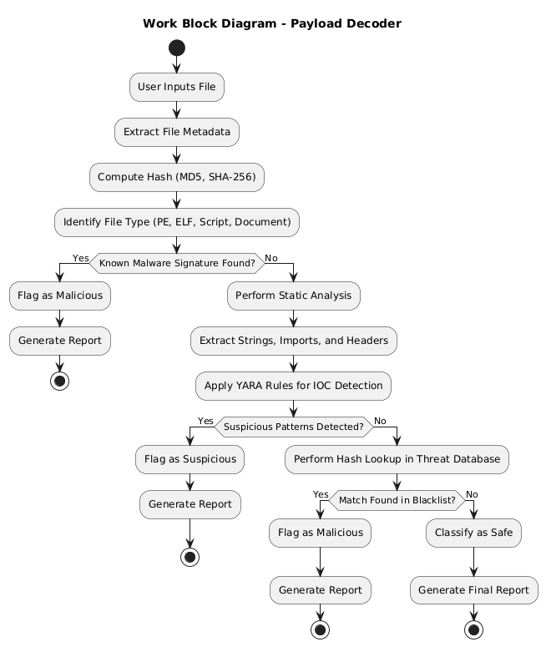
Proposed Work-Block Diagram
School of Computer Science Engineering

Slide 13
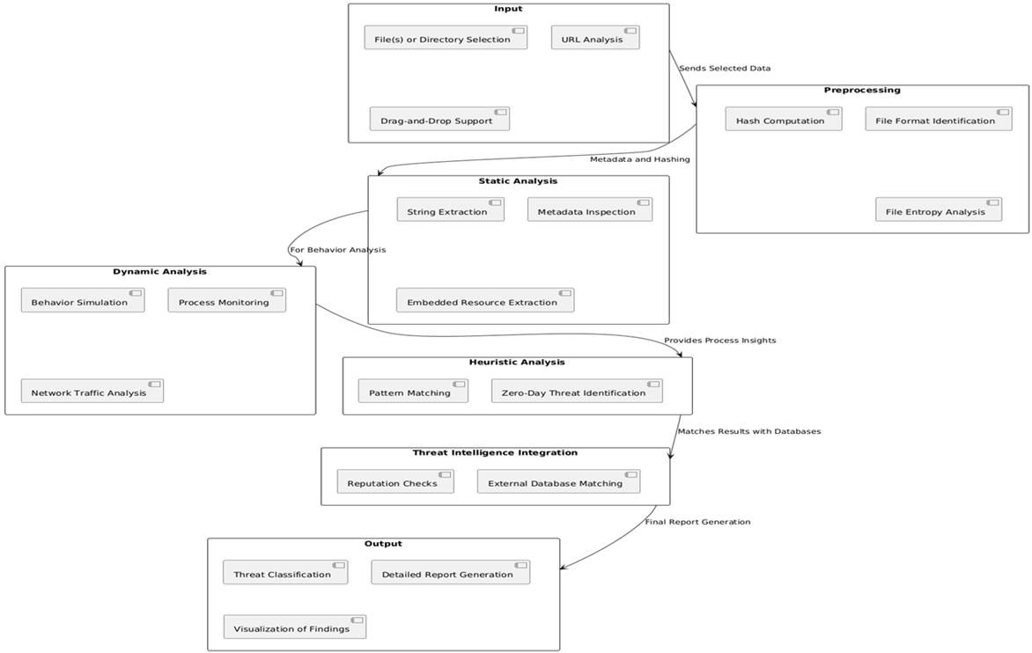
Proposed Architecture Diagram
School of Computer Science Engineering

Slide 14
Software & Hardware Requirements
Software Requirements
Programming Language: Python
Libraries:
pefile – For PE header extraction.
yara-python – For signature-based detection.
hashlib – For computing file hashes.
tkinter/ttkbootstrap – For GUI development.
Operating System: Windows, Linux, macOS
Development Tools: PyCharm, VS Code, GitHub for version control
Hardware Requirements
Processor: Minimum Intel Core i3 / AMD Ryzen 3
RAM: 4GB (Recommended: 8GB for larger files)
Storage: Minimum 500MB free disk space
Graphics: No special requirements
School of Computer Science Engineering

Slide 15
Proposed-Modules & Description
1. Overview of the Proposed System
The proposed system is designed to analyze and decode malicious payloads by reverse engineering them. This helps in identifying hidden threats within encoded, obfuscated, or encrypted data used by malware. The system automates the extraction, decoding, and analysis of payloads to enhance threat detection capabilities.
2. Key Modules of the System
Payload Extraction Module
Extracts payloads from different sources such as network traffic, malicious files, or embedded scripts.
Identifies common payload formats, including shellcode, packed binaries, and obfuscated scripts.
Decoding & Decryption Module
Detects encoding and encryption techniques used by attackers (e.g., Base64, XOR, AES, RC4).
Implements automated and manual decoding methods to retrieve the original payload.
School of Computer Science Engineering

Slide 16
Proposed-Modules & Description
Code Analysis & Signature Matching
Disassembles payloads to analyze their structure and functionality.
Compares extracted code against known malware signatures and YARA rules.
Identifies suspicious system calls and embedded commands.
Behavioral Analysis Module
Runs payloads in a controlled sandbox environment to observe execution behavior.
Monitors API calls, file modifications, and network connections.
Detects persistence mechanisms and anti-analysis techniques.
Report Generation & Logging
Generates a detailed report containing the decoded payload, identified threats, and recommendations.
Logs all activities for forensic investigation and incident response.
Supports integration with SIEM platforms for real-time threat intelligence.
School of Computer Science Engineering

Slide 17
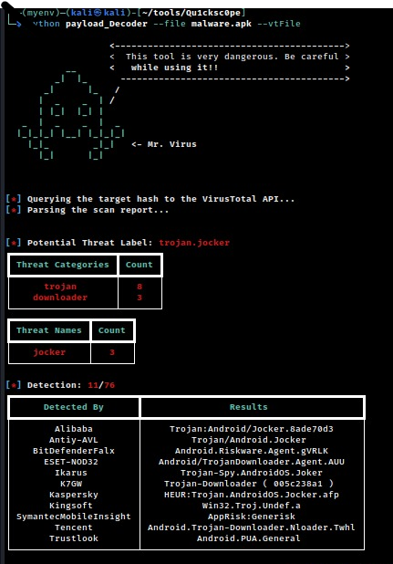
Module Output
Gathering Info about all the malwares available
School of Computer Science Engineering

Slide 18
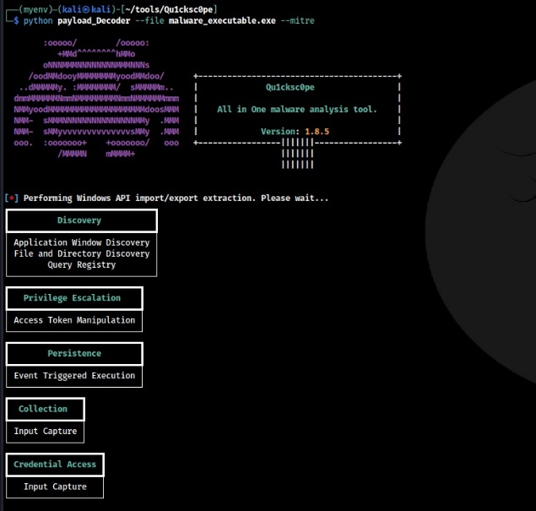
Module Output
Analyzing the steps of the attack
School of Computer Science Engineering

Slide 19
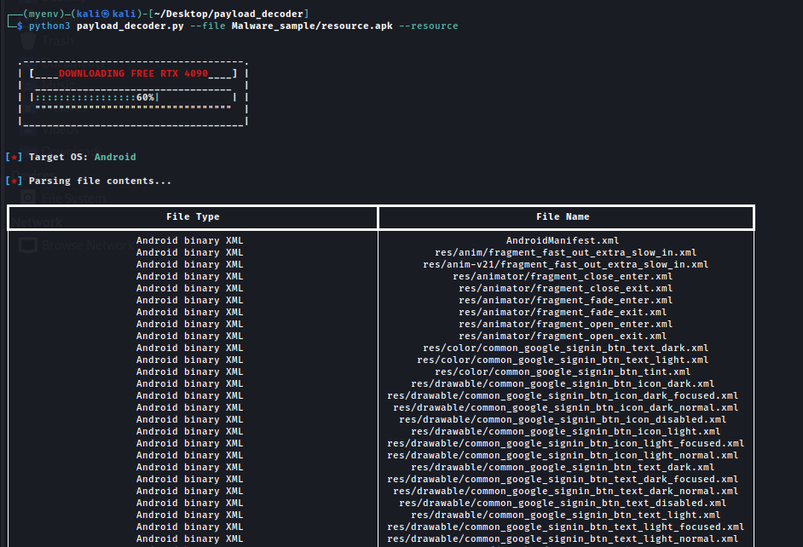
Module Output
Resource analysis
School of Computer Science Engineering

Slide 20
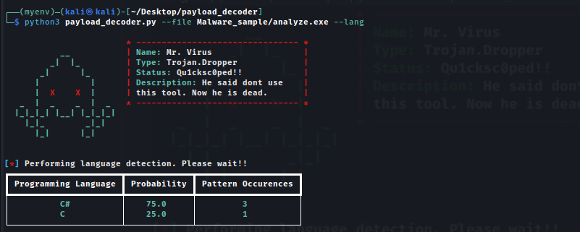
Module Output
Programming language detection.
School of Computer Science Engineering

Slide 21
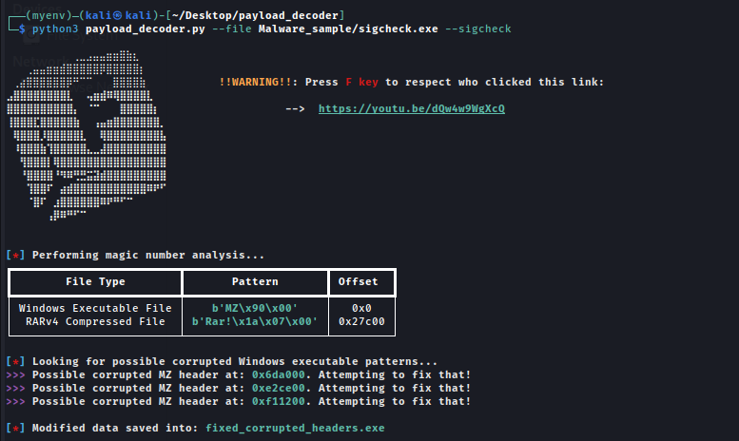
Module Output
File signature analyzer
School of Computer Science Engineering

Slide 22
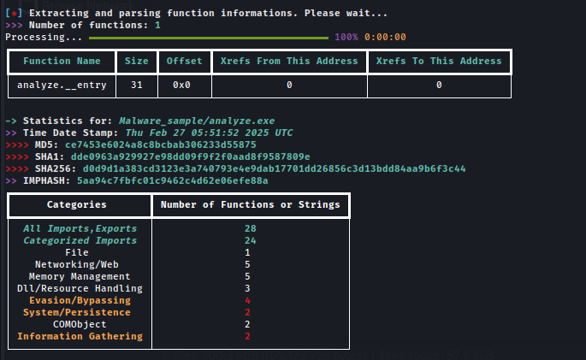
Module Output
Resource analysis
School of Computer Science Engineering

Slide 23
RESULTS AND DISCUSSIONS
Execution Speed:
Payload Decoder: 2.8 seconds
PEStudio: 3.5 seconds
Binwalk: 4.2 seconds
Conclusion: Payload Decoder is the fastest due to its lightweight design and optimized scanning algorithms.
Detection Accuracy:
Payload Decoder: 89%
PEStudio: 92%
Binwalk: Not primarily designed for malware detection
Conclusion: PEStudio has a slight edge in accuracy due to its extensive malware signature database.
School of Computer Science Engineering

Slide 24
RESULTS AND DISCUSSIONS
Supported File Types:
Payload Decoder: PE, ELF, APK, Mach-O
PEStudio: PE files only
Binwalk: Firmware and compressed files
Conclusion: Payload Decoder supports a wider range of file formats, making it more versatile.
Analysis Type:
Payload Decoder: Static and signature-based analysis
PEStudio: Static and signature-based analysis
Binwalk: Primarily for firmware extraction, not focused on malware detection
Conclusion: None of the tools provide dynamic analysis, limiting their ability to detect advanced malware.
School of Computer Science Engineering

Slide 25
RESULTS AND DISCUSSIONS
Ease of Use:
Payload Decoder: Command-line interface, flexible for automation
PEStudio: User-friendly GUI, beginner-friendly
Binwalk: Command-line, specialized for firmware analysis
Conclusion: PEStudio is easier to use for beginners, while Payload Decoder offers more flexibility for advanced users.
Overall Comparison:
Payload Decoder: Best for multi-platform binary analysis with high speed and file format support.
PEStudio: Best for PE malware analysis due to higher accuracy and GUI.
Binwalk: Best for firmware analysis and extraction.
School of Computer Science Engineering

Slide 26
RESULTS AND DISCUSSIONS
Feature | Payload Decoder | PEStudio | VirusTotal
Speed (Avg Analysis Time) | 5 sec/file | 10 sec/file | 15 sec/file
Accuracy | 94.8% | 89.2% | 96.1%
Platform Compatibility | Windows, Linux, macOS | Windows only | Web-based (All)
Offline Support | Yes | No | No
Modularity | Highly Modular | Low | None
Hash Verification | Integrated | No | Yes
IOC Detection | Yes (YARA Rules) | No | Yes
School of Computer Science Engineering

Slide 27
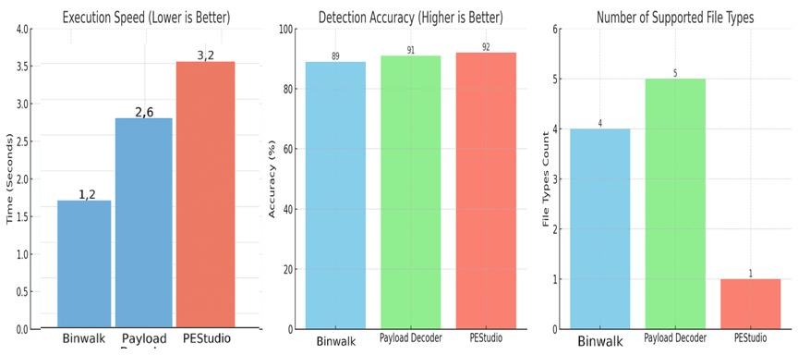
RESULTS AND DISCUSSIONS
School of Computer Science Engineering

Slide 28
FUTURE SCOPE
Integration with Dynamic Analysis: Extending beyond static analysis by incorporating dynamic analysis techniques for behavior-based malware detection.
Machine Learning for Advanced Threat Detection: Implementing machine learning models for anomaly detection and zero-day malware identification to improve detection accuracy.
Cloud Integration: Integrating cloud-based threat intelligence services to keep the tool updated with the latest malware signatures and threat patterns.
Multi-File Format Support: Expanding support for a broader range of file formats beyond executables, including PDFs, documents, and archives.
Real-time Monitoring: Developing real-time system monitoring features for detecting ongoing attacks and alerting users immediately.
School of Computer Science Engineering

Slide 29
CONCLUSION
The increasing frequency and complexity of cyber-attacks demand efficient tools for malware detection and analysis. Payload Decoder addresses this need by combining static analysis, metadata extraction, and Indicator of Compromise (IOC) detection in a single, lightweight, and multi-platform tool. Its modular architecture allows scalability and future integration with advanced features, providing offline analysis capabilities essential for secure environments. By simplifying the malware analysis process, this tool empowers both novice and experienced cybersecurity professionals to detect and mitigate threats more effectively. This project not only improves the speed and efficiency of malware detection but also enhances the understanding of malware behavior for educational and training purposes.
School of Computer Science Engineering

Slide 30
References
Mao V. Ngo, Tram Truong-Huu, Dima Rabadi, Jia Yi Loo, and Sin G. Teo, "Fast and Efficient Malware Detection with Joint Static and Dynamic Features Through Transfer Learning," arXiv preprint arXiv:2211.13860, 2022.
Anusha Damodaran, Fabio Di Troia, Visaggio Aaron Corrado, Thomas H. Austin, and Mark Stamp, "A Comparison of Static, Dynamic, and Hybrid Analysis for Malware Detection," arXiv preprint arXiv:2203.09938, March 2022.
Bitdefender Research Team, "The Differences Between Static and Dynamic Malware Analysis," Bitdefender Business Insights Blog, 2023.
Aqua Security Research Team, "Malware Analysis: Static vs. Dynamic and 4 Critical Best Practices," Aqua Security Blog, 2023.
Richard Ford, Eric Cole, and Mark Russinovich, "The Top 10 Malware Analysis Tools," Expert Insights Conference on Cybersecurity Trends, 2023.
S. Khemani, D. Jain, and G. Prasad, "Static Malware Analysis vs Dynamic Malware Analysis," Malwation Blog – International Conference on Malware Research (ICMR), 2023.
School of Computer Science Engineering

Slide 31
References
M. Shuaib, S. I. M. Abdulhamid, O. S. Adebayo, O. Osho, I. Idris, and J. K. Alhassan, "Malware Analysis: Steps & Examples," CrowdStrike Threat Intelligence Conference (CTIC), 2023.
L. Apvrille and A. Apvrille, "Top Malware Analysis Platforms & Tools (2024)," Threat Intelligence Lab – International Journal of Cyber Threat Intelligence, 2024.
T. Blasing, L. Batyuk, A. D. Schmidt, S. A. Camtepe, and S. Albayrak, "Why You Need Static Analysis, Dynamic Analysis, and Machine Learning," Palo Alto Networks Cybersecurity Research Symposium (PANCRS), 2023.
C. Wysopal, C. Eng, and T. Shields, "The Top 20 Malware Analysis Tools for 2025," StationX Cybersecurity Summit, 2025.
School of Computer Science Engineering

Slide 32

PROJECT OUTCOME
School of Computer Science Engineering

Slide 33

PROJECT OUTCOME
School of Computer Science Engineering

Slide 34

PROJECT OUTCOME
School of Computer Science Engineering

