Slide 1
BD BLOOD CENTER
Mini Project
CSE489
Sec:01
Fall2021

Slide 2

Submitted By:
SHAHRIAR CHOWDHURY ID:2018-2-60-021
SAMIUN RAHMAN SIZAN
ID:2018-2-60-124
RABEA AKHTER
ID:2019-1-60-073
Submitted To:
Md Mostofa Kamal Rasel
Assistant Professor,
Department of Computer Science and Engineering
East West University

Slide 3
Project Description:
BD BLOOD CENTER application provides a reliable platform to connect local blood donors with patients.Our application creates a communication platform whenever a patient needs blood donation.

Slide 4
Objective:
Blood donation saves lives, and the communication between patients and donors plays a vital role in this.
Designed to fit the users’ needs and preferences.
The aim was to identify the features and preferences of a blood donation smartphone app .
To identify the features and preferences of a blood donation smartphone app for blood donors all over the Bangladesh.

Slide 5
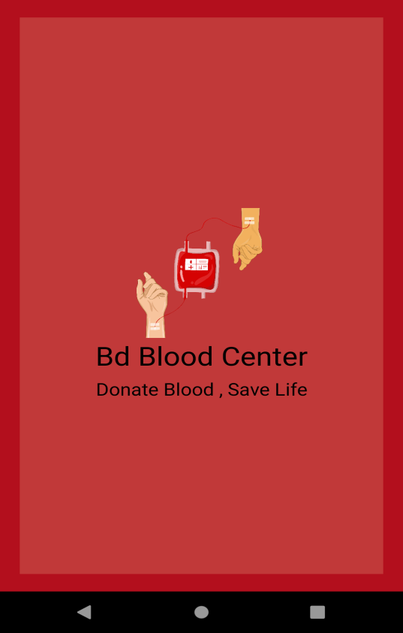
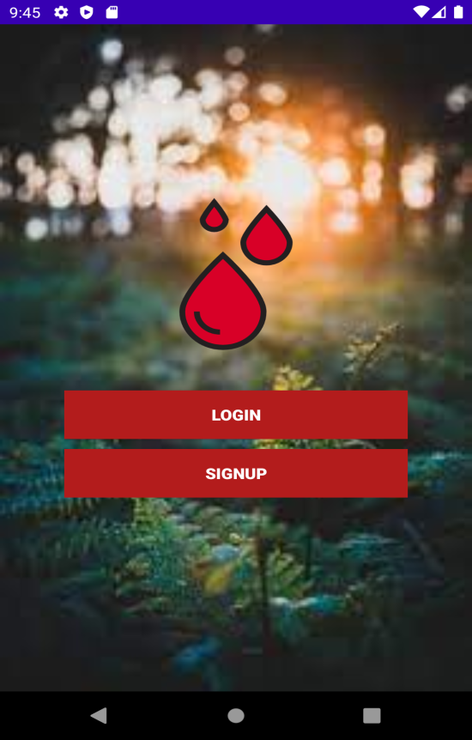
Features:
Main Activity page: here we can log in if already registered or can sign up if we don’t have an account.
Splash Screen: It is a small animation.

Slide 6
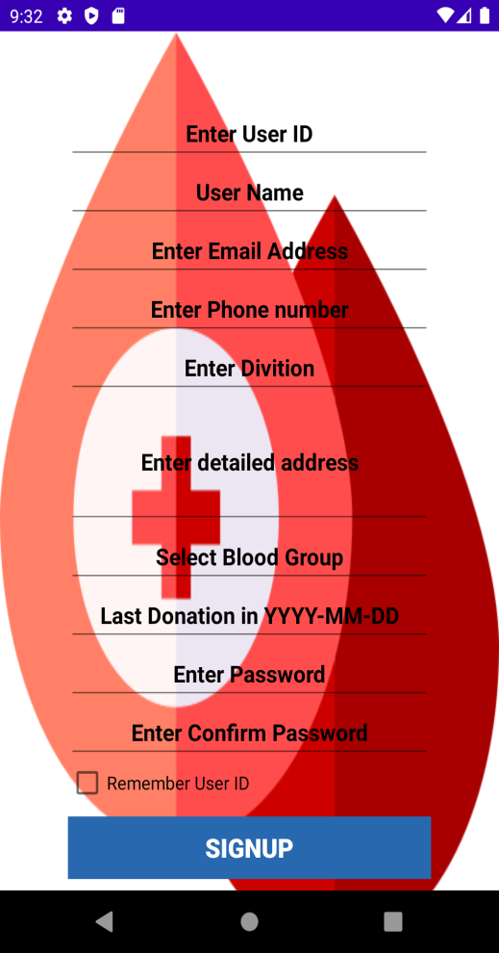
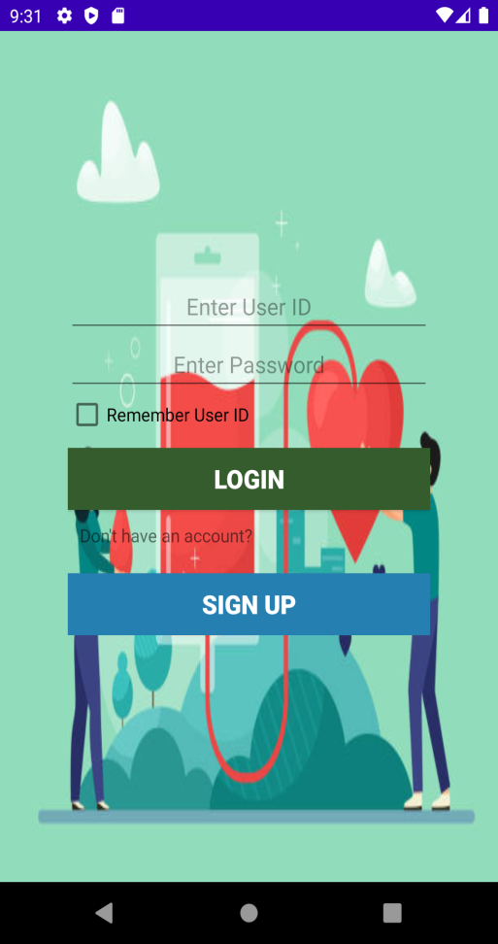
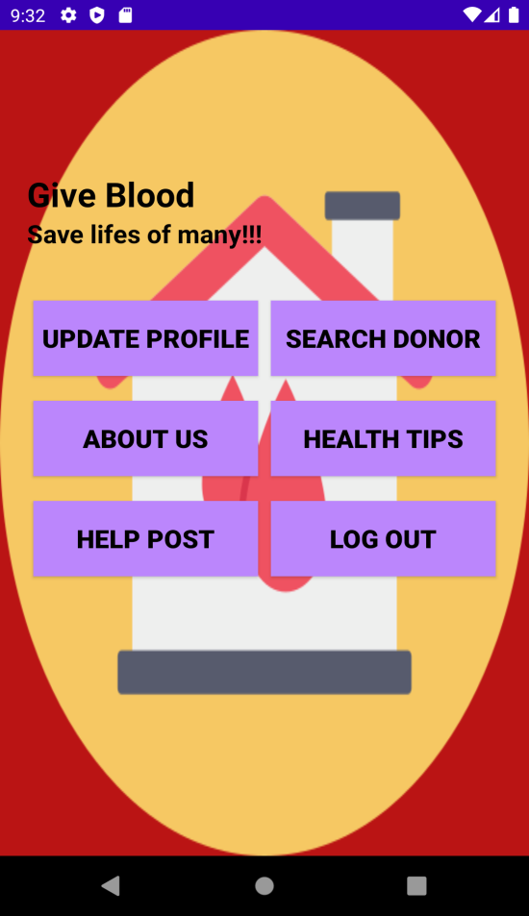
Sign Up page:
By filling this form we can register in our app.
Login page: Here we can log in as a registered user.
Home page: This is our home page.

Slide 7
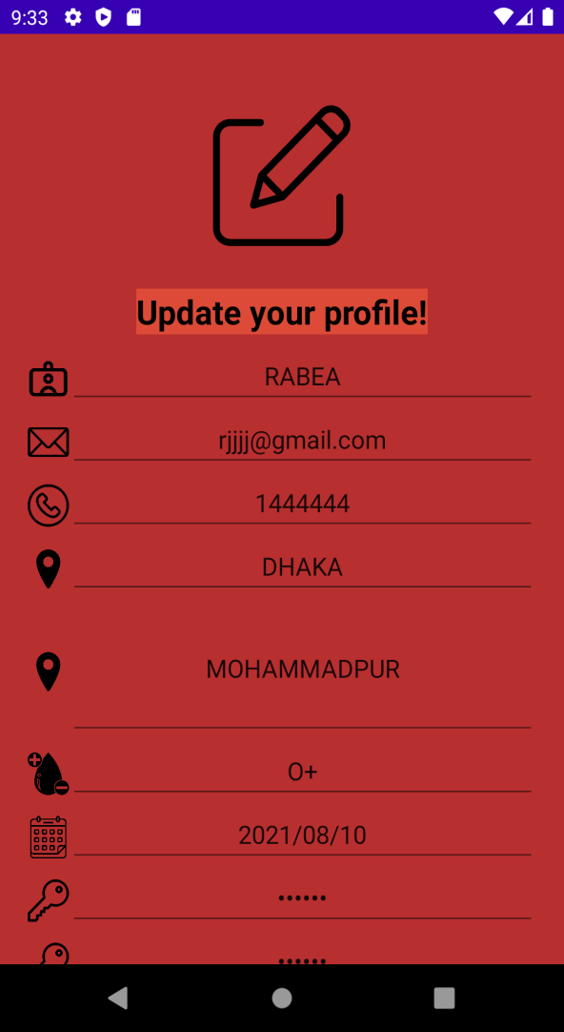
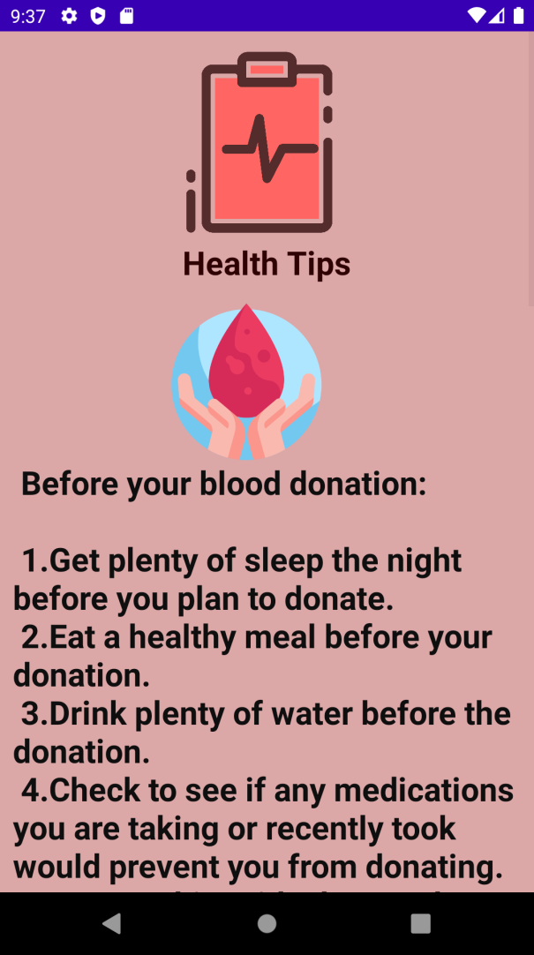
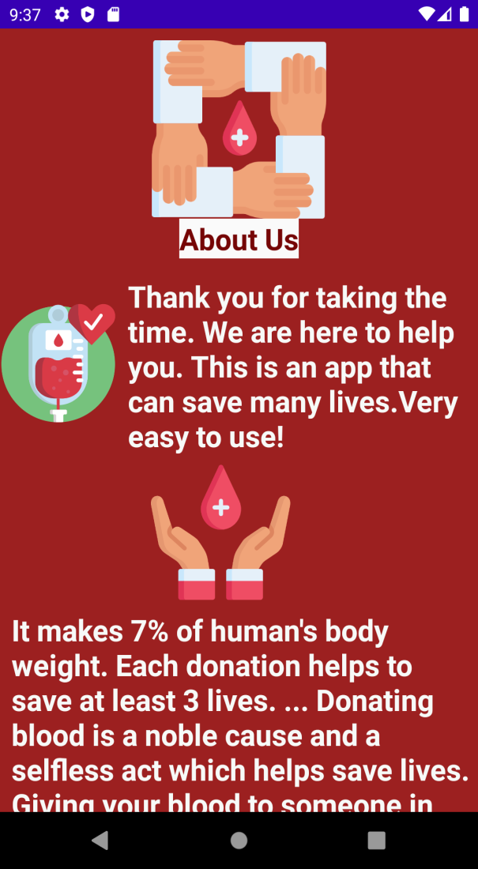
Update Profile page: Here we can update our information, password, last donation date if necessary.
Health tips page: Here is some necessary tips before and after donation.
About us page:
This is a page about some information about our app.

Slide 8
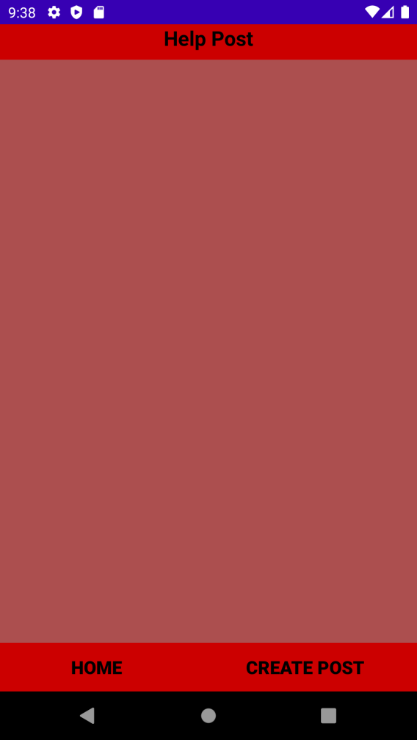
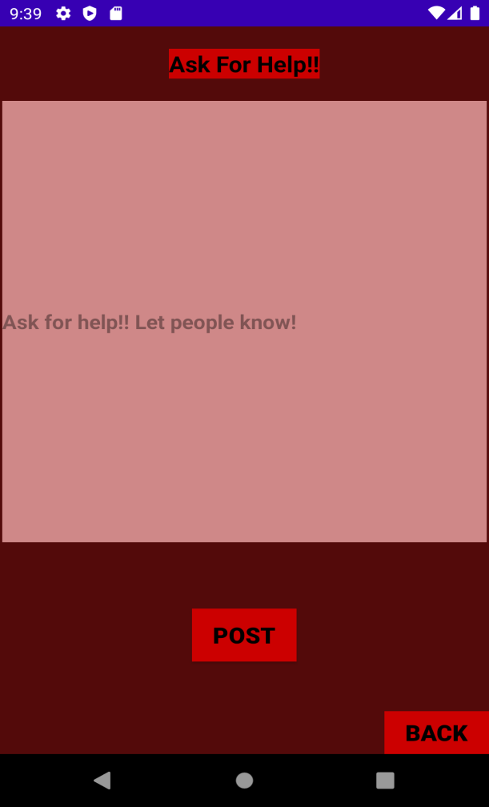
Help post feature: This is a feature where we will be able to create post if we need help. And people will see it on their help post newsfeed as a list. We could not implement this feature now. But we are working on this. Hope to implement this in future and it will make our app more efficient.

Slide 9
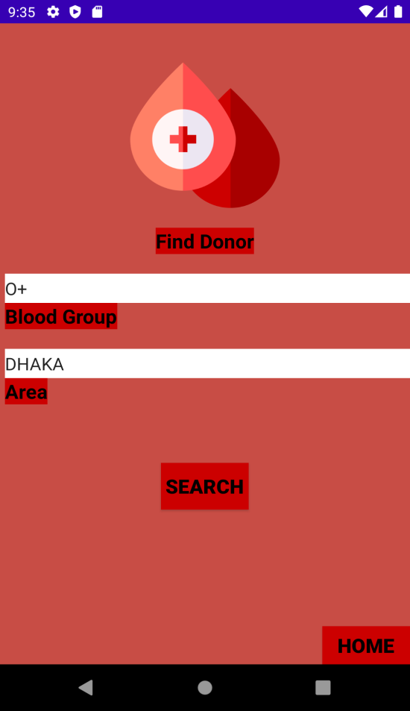
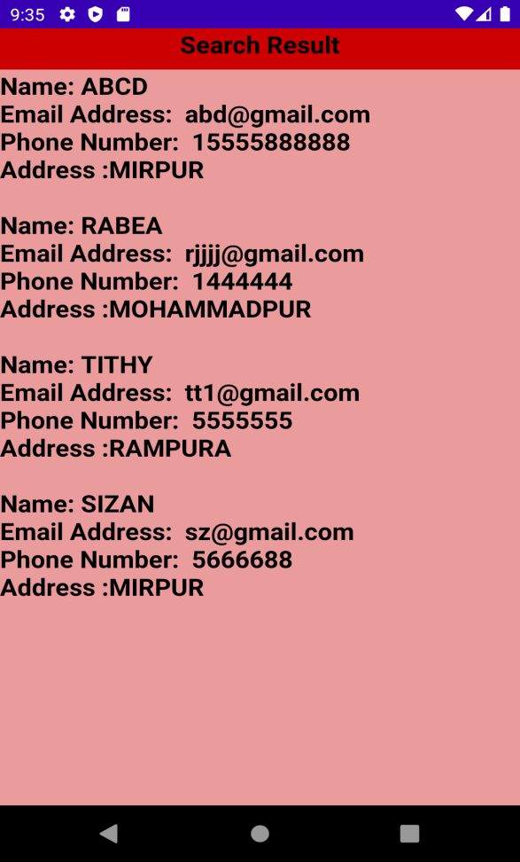
Find Donor page:
Here we can search donor by required blood group and division.
Search Result page:
Here we can see the list of donors of our required blood group and division with their contact details and location. We can contact with them using their contact info.

Slide 10
Conclusion:
It can create a community of blood donors and patient if deployed in the play store.
Basically this application is not a business app but in order to earn maintance cost of this application we can use advertisement in app or donation page so that the users can donate to run this application.
We can use remote database so that user able to do their works from any where in the word, we can use authenticator to check phone number or email address is not false. We also need to figure out the way we can ensure users privacy.

Slide 11
THANK YOU

