Slide 1
Diabetes detection through eyes
A Non-Invasive Approach Using AI and Retinal Imaging

Slide 2
Presenters names
Sanskar Saxena - partial coding and ppt Developer
Rishabh Kumar - co developer and report writing
Rishi Jain - Project Developer(frontend and backend)

Slide 3
Introduction
What is Diabetes?
A chronic condition affecting millions worldwide.
Types: Type 1, Type 2, and gestational diabetes.
Why Early Detection Matters:
Prevents complications like vision loss, heart disease, and organ failure.
Overview of the Presentation:
The role of AI in detecting diabetes through retinal images.

Slide 4
Traditional Detection Methods
Current Diagnostic Techniques:
Fundus photography.
Optical Coherence Tomography (OCT).
Fluorescein angiography.
Limitations:
Costly equipment.
Requires specialized expertise.
Limited availability in remote areas.

Slide 5
Role of Artificial Intelligence (AI)
Why Use AI?
Automates detection and diagnosis.
Reduces reliance on specialists.
Scalable and accessible for remote areas.
How AI Works in Retinal Analysis:
AI analyzes images for abnormalities like:
Microaneurysms - small, saccular outpouchings in the walls of retinal capillaries that are a sign of Diabetic retinopathy
Hemorrhages - A hemorrhage is a medical term for excessive bleeding from a damaged blood vessel.
Exudates - Exudate is a fluid, cells, or other cellular substances that leak out of blood vessels and into nearby tissues.
Neovascularization - Neovascularization is the process of new blood vessels forming in the body, usually in response to poor perfusion or ischemia

Slide 6
AI Modules for Diabetes Detection
Deep Learning Models:
Use Convolutional neural networks (CNN) for image recognition.
Train on large datasets of retinal images.
Examples of AI Modules:
Google’s DeepMind: Detects diabetic retinopathy with high accuracy.
IDx-DR: FDA-approved AI system for retinal screening.
Steps in AI Workflow:
Image preprocessing.
Feature extraction.
Abnormality detection.
Diagnosis report generation.

Slide 7
Advantages of AI in Detection
Non-Invasive and Fast:
Requires only retinal images.
Cost-Effective:
Reduces the need for expensive diagnostic procedures.
Accessibility:
Portable devices for use in rural or underserved areas.
Accuracy and Efficiency:
Detects subtle patterns missed by the human eye.

Slide 8
Challenges and Limitations
Data Requirements:
AI needs a large and diverse dataset to perform well.
Ethical Concerns:
Data privacy and security.
Interpretability:
Black-box nature of AI models.
Equipment Costs:
High initial cost for acquiring AI-enabled diagnostic tools.

Slide 9
Case Studies and Real-World Applications
Successful Implementations:
Google's AI model achieving over 90% accuracy in detecting retinopathy.
Screening programs in rural India using portable AI devices.
Results:
Early diagnosis rates improved by 40%.
Reduced burden on healthcare systems.

Slide 10
Future Perspectives
Advancements in AI:
Improved algorithms for better detection accuracy.
Integration with Telemedicine:
Remote consultations and diagnosis.
Wearable Technology:
Smart contact lenses for glucose monitoring.
Global Initiatives:
AI-based screening programs to combat diabetes in developing countries.

Slide 11
Conclusion
Summary:
Diabetes can cause severe eye damage if undetected.
AI modules provide a revolutionary approach to early and accurate diagnosis.
Call to Action:
Encourage regular screenings and adoption of AI-based diagnostics.
Increase awareness and investment in AI healthcare solutions.

Slide 12
References
Retinal Imaging
Artificial Intelligence (AI) Models
Eye Bio markers
Tear Analysis
Vascular Changes
References to Explore
Research Articles:
Organizations:

Slide 13
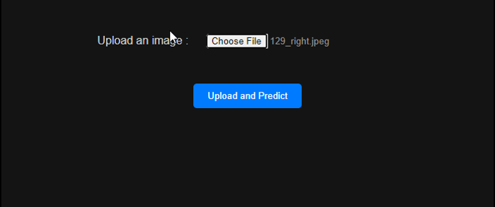
Screenshot of working project

Slide 14
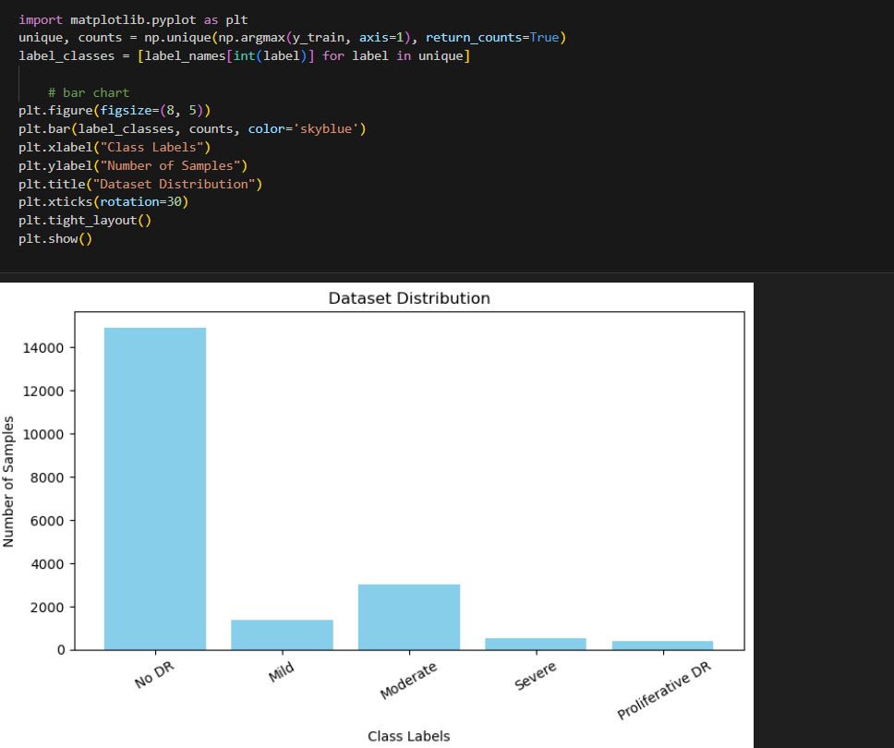
Graph distribution

