Slide 1
Is anaemia at 34 weeks of pregnancy linked to higher anxiety and lower well-being in pregnant women in Jaipur
Asha Verma (demo student), MA Psychology, Jaipur

Slide 2
Abstract
Background. A search of OpenAlex and PubMed for 2010 to 2025 found studies of anaemia and of anxiety in pregnancy, but none in Rajasthan that measured haemoglobin and validated anxiety, self-esteem…

Slide 3
1. Introduction
Anaemia is one of the most common health problems of pregnancy, and the burden is highest in South Asia (Kassebaum et al., 2014).
Anxiety is also common in pregnancy.
A search of OpenAlex and PubMed for 2010 to 2025 found studies of anaemia and of anxiety in pregnancy, but none in Rajasthan that measured haemoglobin and validated anxiety, self-esteem and…
The present study asked: Is anaemia at 34 weeks of pregnancy linked to higher anxiety and lower well-being in pregnant women in Jaipur?
H1: Women with anaemia at 34 weeks will have higher GAD-7 scores than women without anaemia.
H2: Higher self-esteem will go with higher life satisfaction, and higher anxiety with lower life satisfaction.

Slide 4
1. Introduction (continued)
H3: Haemoglobin will rise between 16 and 34 weeks with iron-folic acid tablets.

Slide 5
2. Materials and Methods

Slide 6
2.1 Design
This was a cross-sectional survey.

Slide 7
2.2 Participants
Pregnant women aged 18 or over enrolled at 12 to 16 weeks at two government hospitals in Jaipur (the simulated Janani cohort).

Slide 8
2.3 Measures
Anxiety. Generalized Anxiety Disorder 7-item scale (GAD-7, 7 items) (Spitzer et al., 2006).
Life satisfaction. Satisfaction With Life Scale (SWLS, 5 items) (Diener et al., 1985).
Self-esteem. Rosenberg Self-Esteem Scale (RSES, 10 items) (Rosenberg, 1965).
Anaemia at 34 weeks. Recorded as yes or no.
Haemoglobin at 34 weeks. Measured with the instrument or laboratory method described in section 2.4.
Parity. Recorded as: First pregnancy, Second or later.

Slide 9
2.3 Measures (continued)
Age. Taken from the hospital laboratory report or the antenatal card.
Residence. Recorded as: Urban, Rural.

Slide 10
2.4 Instruments and laboratory methods
Haemoglobin at 34 weeks. Venous blood (EDTA) was run on an automated five-part haematology analyser (model Sysmex XN-550) and haemoglobin was reported in g/dL.

Slide 11
2.5 Procedure and ethics
The study was approved by the Institutional Ethics Committee, Department of Psychology, Demo College, Jaipur (reference IEC/PSY/2026/A, 20 October 2026). [how consent was taken, where and when data…

Slide 12
2.6 Analysis
The main hypothesis was tested with an independent-samples t-test.

Slide 13
3. Results
Results for each hypothesis follow.
An independent-samples Welch t-test showed that GAD-7 score differed significantly between women with anaemia (M = 7.26, SD = 5.12) and women without anaemia (M = 5.33, SD = 4.24), t(986.89) = 7.03, p < .001, g = 0.42, 95% CI of the difference [1.39, 2.47].
There was a moderate positive correlation between self-esteem (RSES) and life satisfaction (SWLS), which was statistically significant, r(1238) = .45, p < .001, 95% CI [.40, .49].
There was a moderate negative correlation between GAD-7 score and life satisfaction (SWLS), which was statistically significant, r(1238) = -.35, p < .001, 95% CI [-.39, -.30].
A paired-samples t-test showed a significant difference between haemoglobin at 16 weeks and haemoglobin at 34 weeks (M diff = -0.39, SD = 0.64), t(1239) = -21.50, p < .001, 95% CI [-0.43, -0.36], d = -0.61.
A multiple linear regression with age, haemoglobin at 34 weeks, parity: First pregnancy (vs Second or later) as predictors of GAD-7 score was significant, F(3, 1236) = 11.24, p < .001, R² = .03, adjusted R² = .02. Individual predictors: age (β = .04, p = .120); haemoglobin at 34 weeks (β = -.16, p < .001); parity: First pregnancy (vs Second or later) (b = 0.23, p = .393).

Slide 14
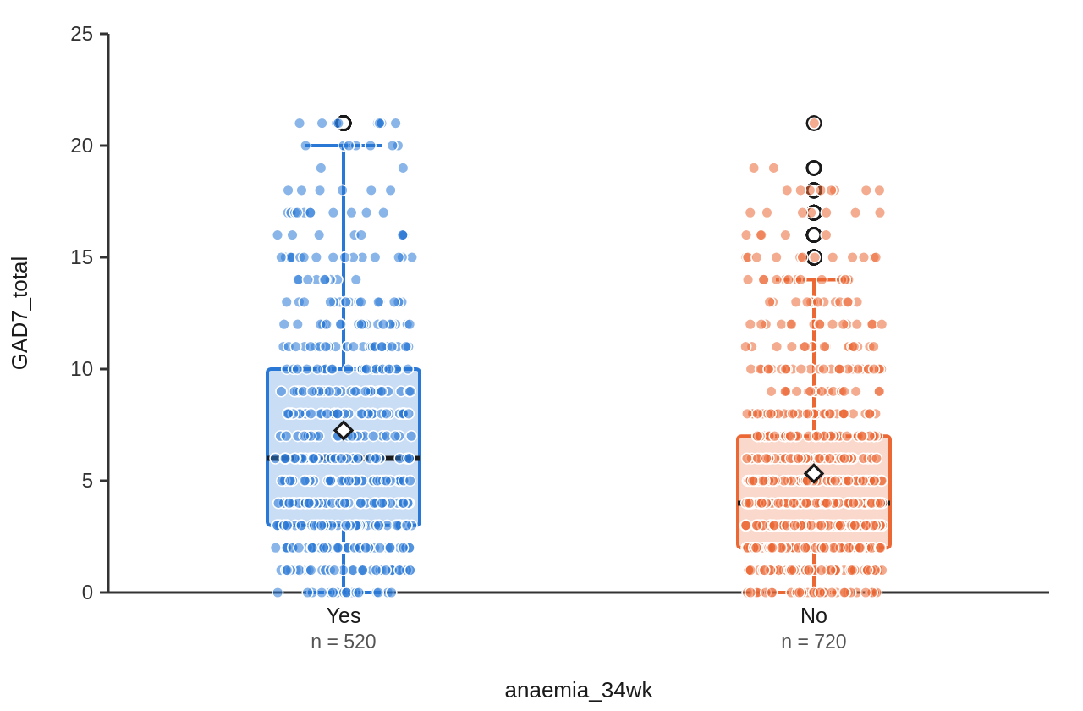
3. Results (continued)
Internal consistency was α = .89, 95% CI [.88, .90], and McDonald's ω = .89, 95% CI [.88, .90] (k = 7 items, N = 1240).
A chi-square test of independence showed no significant association between anaemia at 34 weeks and parity, χ²(1, N = 1240) = 3.29, p = .070, Cramér's V = 0.05.
A paired-samples t-test showed a significant difference between the mothers' GAD-7 scores and the fathers' GAD-7 scores (M diff = 1.58, SD = 4.82), t(611) = 8.12, p < .001, 95% CI [1.20, 1.97], d = 0.33.
Figure 1
Distribution of GAD-7 score by anaemia at 34 weeks
Note. Boxes show the median and interquartile range. Whiskers reach the most extreme values within 1.5 times the interquartile range. Each point is one participant.

Slide 15
4. Discussion
In this simulated cohort, women who were anaemic at 34 weeks reported more anxiety than women who were not, with a small-to-moderate difference, so H1 was supported.
Haemoglobin rose between 16 and 34 weeks, supporting H3 and in line with trials of daily iron in pregnancy, but four women in ten were still anaemic at 34 weeks.
The correlation of r = .45 between self-esteem and life satisfaction means the two measures share about 20% of their variation (r² = .20); the other 80% comes from other things.

Slide 16
5. Conclusion
Anaemia and anxiety met in the same women in the third trimester.

Slide 17
References
Antony, A. C., Vora, R. M., & Karmarkar, S. J. (2022). The silent tragic reality of Hidden Hunger, anaemia, and neural-tube defects (NTDs) in India. The Lancet Regional Health - Southeast Asia, 6, 100071. https://doi.org/10.1016/j.lansea.2022.100071
Dennis, C. L., Falah-Hassani, K., & Shiri, R. (2017). Prevalence of antenatal and postnatal anxiety: Systematic review and meta-analysis. British Journal of Psychiatry, 210(5), 315–323. https://doi.org/10.1192/bjp.bp.116.187179
Diener, E., Emmons, R. A., Larsen, R. J., & Griffin, S. (1985). The Satisfaction With Life Scale. Journal of Personality Assessment, 49(1), 71–75. https://doi.org/10.1207/s15327752jpa4901_13
Francis, S., Jagadeesh, N. S., Singaravelu, R., & Subramaniam, A. (2022). The influence of pica practice on nutritional status, stress and anxiety of pregnant women. Clinical Epidemiology and Global Health, 17, 101133. h…
Grigoriadis, S., Graves, L., Peer, M., Mamisashvili, L., Tomlinson, G., Vigod, S. N., Dennis, C. L., Steiner, M., Brown, C., Cheung, A., Dawson, H., Rector, N. A., Guenette, M., & Richter, M. (2018). Maternal Anxiety During Pregnancy and the Association With…
Kassebaum, N. J., Jasrasaria, R., Naghavi, M., Wulf, S. K., Johns, N., Lozano, R., Regan, M., Weatherall, D., Chou, D. P., Eisele, T. P., Flaxman, S. R., Pullan, R. L., Brooker, S. J., & Murray, C. J. L. (2014). A systematic analysis of global anemia burden…
… and 4 more references

