Slide 1
Does paracetamol given after the measles-rubella vaccine lower the antibody response in nine-month-old infants in Jaipur
Asha Verma (demo student), MA Psychology, Jaipur

Slide 2
Abstract
Background. Trials in Europe found lower antibody responses when infants were given paracetamol at vaccination, but a search of OpenAlex and PubMed for 2009 to 2025 found no Indian study of measles…

Slide 3
1. Introduction
Measles still kills children where vaccine coverage is low, and two doses of a measles-containing vaccine prevent almost all cases (Moss & Griffin, 2012).
In a randomised trial, infants given prophylactic paracetamol at vaccination had lower antibody responses to several vaccines (Prymula et al., 2009).
Trials in Europe found lower antibody responses when infants were given paracetamol at vaccination, but a search of OpenAlex and PubMed for 2009 to 2025 found no Indian study of measles antibody…
The present study asked: Does paracetamol given after the measles-rubella vaccine lower the antibody response in nine-month-old infants in Jaipur?
H1: Infants given paracetamol after MR1 will seroconvert less often than infants not given paracetamol.
H2: Seroconversion will not differ between boys and girls.

Slide 4
2. Materials and Methods

Slide 5
2.1 Design
This was a cohort study.

Slide 6
2.2 Participants
Infants born in the simulated Janani cohort, Jaipur, who received the first measles-rubella dose (MR1) at 9 months.

Slide 7
2.3 Measures
Seroconversion. Recorded as yes or no.
Paracetamol after MR1. Recorded as yes or no.
Infant sex. Recorded as: Boy, Girl.
Birth weight. Measured with the instrument or laboratory method described in section 2.4.
Low birth weight. Recorded as: Yes, No.

Slide 8
2.4 Instruments and laboratory methods
Birth weight. Babies were weighed undressed within 24 hours of birth on a digital infant scale (model Seca 334) to the nearest 10 g.

Slide 9
2.5 Procedure and ethics
The study was approved by the Institutional Ethics Committee, Department of Psychology, Demo College, Jaipur (reference IEC/PSY/2026/B, 20 October 2026). [how consent was taken, where and when data…

Slide 10
2.6 Analysis
The main hypothesis was tested with a logistic regression.

Slide 11
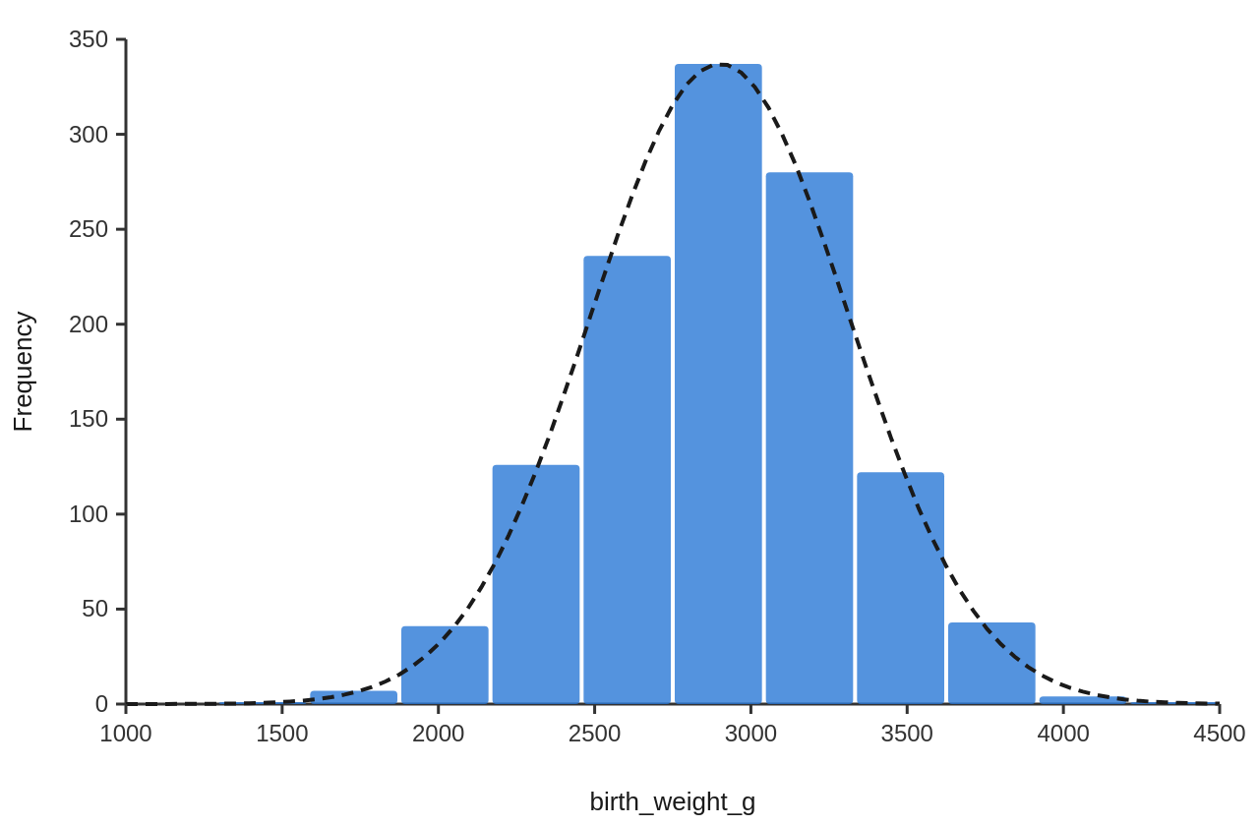
3. Results
Results for each hypothesis follow.
A chi-square test of independence showed a significant association between paracetamol after MR1 and seroconversion, χ²(1, N = 1133) = 11.42, p < .001, Cramér's V = 0.10.
A chi-square test of independence showed no significant association between infant sex and seroconversion, χ²(1, N = 1133) = 0.05, p = .827, Cramér's V = 0.01.
A logistic regression with birth weight (g), infant sex: Girl (vs Boy), paracetamol after MR1: Yes (vs No) as predictors of seroconversion (Yes versus No) was significant, χ²(3, N = 1133) = 10.72, p = .013, Nagelkerke R² = .021. The model classified 91.4% of cases correctly (AUC = .59). Odds ratios: birth weight (g) (OR = 1.00, 95% CI [1.00, 1.00], p = .474); infant sex: Girl (vs Boy) (OR = 0.97, 95% CI [0.64, 1.48], p = .902); paracetamol after MR1: Yes (vs No) (OR = 0.46, 95% CI [0.29, 0.73], p < .001).
There was a moderate positive correlation between the mother's haemoglobin at 34 weeks and birth weight (g), which was statistically significant, r(1196) = .31, p < .001, 95% CI [.26, .36].
An independent-samples Welch t-test showed that birth weight (g) differed significantly between boys (M = 2955.67, SD = 404.24) and girls (M = 2840.56, SD = 415.40), t(1183.18) = 4.85, p < .001, g = 0.28, 95% CI of the difference [68.59, 161.64].

Slide 12
3. Results (continued)
Figure 1
Distribution of birth weight (g)
Note. The dashed curve is a normal distribution with the same mean and standard deviation as the data.

Slide 13
4. Discussion
Infants whose parents gave paracetamol after MR1 seroconverted less often, which supports H1 and follows the same direction as the trial of prophylactic paracetamol (Prymula et al., 2009).
Paracetamol was given more often to infants with fever, so fever itself or a stronger reaction may explain part of the link. The data are simulated, and paracetamol use was reported by parents.
Birth weight rose with the mother's haemoglobin at 34 weeks (r = .31).

Slide 14
5. Conclusion
Paracetamol given after MR1 went with lower seroconversion. Advice at the vaccination session should say to give it for fever, not to every infant.

Slide 15
References
Homme, J. H., & Fischer, P. R. (2010). Prophylactic paracetamol at the time of infant vaccination reduces the risk of fever but also reduces antibody response. BMJ Evidence-Based Medicine, 15(2), 50–51. https://doi.org/10.1136/ebm1049
Moss, W. J., & Griffin, D. E. (2012). Measles. The Lancet, 379(9811), 153–164. https://doi.org/10.1016/s0140-6736(10)62352-5
Prymula, R., Siegrist, C. A., Chlibek, R., Zemlickova, H., Vackova, M., Smetana, J., Lommel, P., Kaliskova, E., Borys, D., & Schuerman, L. (2009). Effect of prophylactic paracetamol administration at time of vaccination on febrile reactions and antibody…
Sil, A., Ravi, M. D., Patnaik, B. N., Dhingra, M. S., Dupuy, M., Gandhi, D. J., Dhaded, S. M., Dubey, A. P., Kundu, R., Lalwani, S. K., Chhatwal, J., Mathew, L. G., Gupta, M., Sharma, S. D., Bavdekar, S. B., Rout, S. P., Midde, V. J., D’Cor, N. A., Mangarule,…

