Slide 1

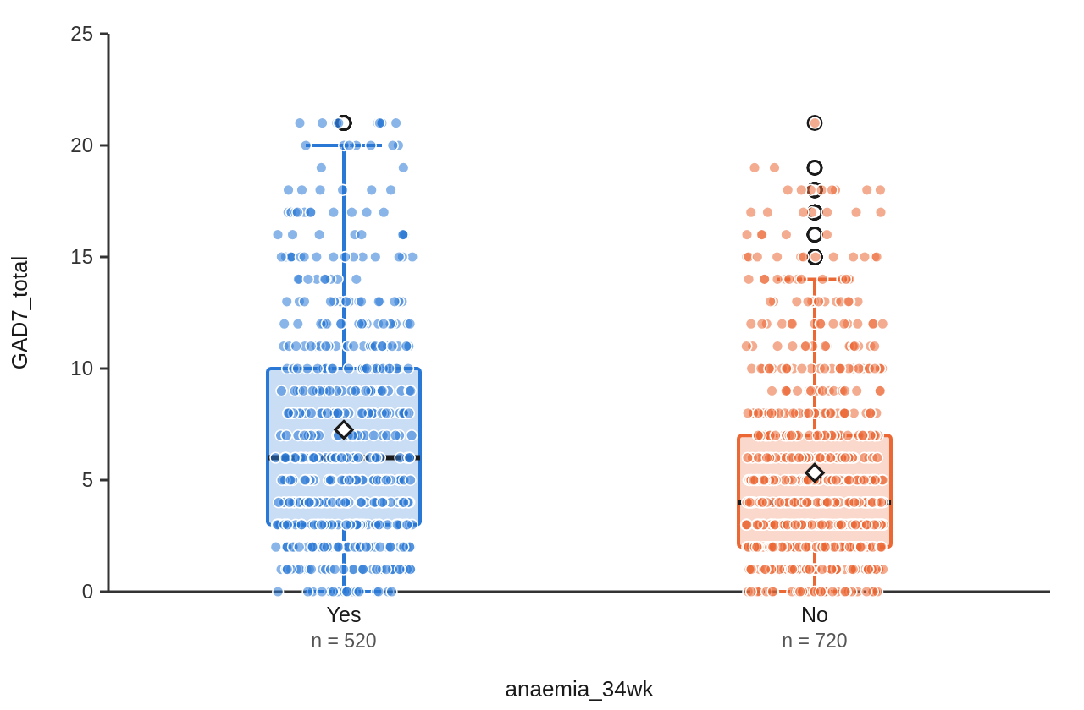
Anaemia and anxiety in the third trimester: 1,240 women in Jaipur
Asha Verma¹, MA Psychology (final year) (Student) · Dr. Meena Sharma¹, PhD, Professor of Psychology (Supervisor) · Dr. R. K. Gupta², MD (Obstetrics and Gynaecology) (Co-supervisor)
¹ Department of Psychology, Demo College, Jaipur ² Department of Obstetrics, Demo Medical College, Jaipur
Demo National Conference of Psychology, Jaipur, 2026
Introduction
Results
Conclusion
Anaemia is one of the most common health problems of pregnancy, and the burden is highest in South Asia (Kassebaum et al., 2014).
A search of OpenAlex and PubMed for 2010 to 2025 found studies of anaemia and of anxiety in pregnancy, but none in Rajasthan that measured haemoglobin and validated anxiety, self-esteem and…
The present study asked: Is anaemia at 34 weeks of pregnancy linked to higher anxiety and lower well-being in pregnant women in Jaipur?
H1: Women with anaemia at 34 weeks will have higher GAD-7 scores than women without anaemia.
H2: Higher self-esteem will go with higher life satisfaction, and higher anxiety with lower life satisfaction.
H3: Haemoglobin will rise between 16 and 34 weeks with iron-folic acid tablets.
An independent-samples Welch t-test showed that GAD-7 score differed significantly between women with anaemia (M = 7.26, SD = 5.12) and women without anaemia (M = 5.33, SD = 4.24), t(986.89) = 7.03, p < .001, g = 0.42, 95% CI of the difference [1.39, 2.47].
There was a moderate positive correlation between self-esteem (RSES) and life satisfaction (SWLS), which was statistically significant, r(1238) = .45, p < .001, 95% CI [.40, .49].
There was a moderate negative correlation between GAD-7 score and life satisfaction (SWLS), which was statistically significant, r(1238) = -.35, p < .001, 95% CI [-.39, -.30].
A paired-samples t-test showed a significant difference between haemoglobin at 16 weeks and haemoglobin at 34 weeks (M diff = -0.39, SD = 0.64), t(1239) = -21.50, p < .001, 95% CI [-0.43, -0.36], d = -0.61.
A multiple linear regression with age, haemoglobin at 34 weeks, parity: First pregnancy (vs Second or later) as predictors of GAD-7 score was significant, F(3, 1236) = 11.24, p < .001, R² = .03, adjusted R² = .02. Individual predictors: age (β = .04, p = .120); haemoglobin at 34 weeks (β = -.16, p < .001); parity: First pregnancy (vs Second or later) (b = 0.23, p = .393).
Internal consistency was α = .89, 95% CI [.88, .90], and McDonald's ω = .89, 95% CI [.88, .90] (k = 7 items, N = 1240).
A paired-samples t-test showed a significant difference between the mothers' GAD-7 scores and the fathers' GAD-7 scores (M diff = 1.58, SD = 4.82), t(611) = 8.12, p < .001, 95% CI [1.20, 1.97], d = 0.33.
Anaemic women carried more anxiety in the third trimester; clinics that test haemoglobin can screen them with the GAD-7.
Discussion
In this simulated cohort, women who were anaemic at 34 weeks reported more anxiety than women who were not, with a small-to-moderate difference, so H1 was supported.
Haemoglobin rose between 16 and 34 weeks, supporting H3 and in line with trials of daily iron in pregnancy, but four women in ten were still anaemic at 34 weeks.
The correlation of r = .45 between self-esteem and life satisfaction means the two measures share about 20% of their variation (r² = .20); the other 80% comes from other things.
References
Materials and Methods
Antony, A. C., Vora, R. M., & Karmarkar, S. J. (2022). The silent tragic reality of Hidden Hunger, anaemia, and neural-tube defects (NTDs) in India. The Lancet Regional Health - Southeast Asia, 6, 100071. https://doi.org/10.1016/j.lansea.2022.100071
Dennis, C. L., Falah-Hassani, K., & Shiri, R. (2017). Prevalence of antenatal and postnatal anxiety: Systematic review and meta-analysis. British Journal of Psychiatry, 210(5), 315–323. https://doi.org/10.1192/bjp.bp.116.187179
Diener, E., Emmons, R. A., Larsen, R. J., & Griffin, S. (1985). The Satisfaction With Life Scale. Journal of Personality Assessment, 49(1), 71–75. https://doi.org/10.1207/s15327752jpa4901_13
Francis, S., Jagadeesh, N. S., Singaravelu, R., & Subramaniam, A. (2022). The influence of pica practice on nutritional status, stress and anxiety of pregnant women. Clinical Epidemiology and Global Health, 17, 101133. https://doi.org/10.1016/j.cegh.2022.101133
Grigoriadis, S., Graves, L., Peer, M., Mamisashvili, L., Tomlinson, G., Vigod, S. N., Dennis, C. L., Steiner, M., Brown, C., Cheung, A., Dawson, H., Rector, N. A., Guenette, M., & Richter, M. (2018). Maternal Anxiety During Pregnancy and the Association With Adverse Perinatal Outcomes: Systematic Review and Meta-Analysis. The Journal of Clinical Psychiatry, 79(5). https://doi.org/10.4088/jcp.17r12011
Kassebaum, N. J., Jasrasaria, R., Naghavi, M., Wulf, S. K., Johns, N., Lozano, R., Regan, M., Weatherall, D., Chou, D. P., Eisele, T. P., Flaxman, S. R., Pullan, R. L., Brooker, S. J., & Murray, C. J. L. (2014). A systematic analysis of global anemia burden from 1990 to 2010. Blood, 123(5), 615–624. https://doi.org/10.1182/blood-2013-06-508325
Peña-Rosas, J. P., De-Regil, L. M., Garcia-Casal, M. N., & Dowswell, T. (2015). Daily oral iron supplementation during pregnancy. Cochrane Database of Systematic Reviews, 2015(7). https://doi.org/10.1002/14651858.cd004736.pub5
Rahman, M. M., Abe, S. K., Rahman, M. S., Kanda, M., Narita, S., Bilano, V., Ota, E., Gilmour, S., & Shibuya, K. (2016). Maternal anemia and risk of adverse birth and health outcomes in low- and middle-income countries: systematic review and meta-analysis. The American Journal of Clinical Nutrition, 103(2), 495–504. https://doi.org/10.3945/ajcn.115.107896
Rosenberg, M. (1965). Society and the adolescent self-image. Princeton University Press.
Spitzer, R. L., Kroenke, K., Williams, J. B. W., & Löwe, B. (2006). A Brief Measure for Assessing Generalized Anxiety Disorder: The GAD-7. Archives of Internal Medicine, 166(10), 1092. https://doi.org/10.1001/archinte.166.10.1092
Design. This was a cross-sectional survey.
Participants. Pregnant women aged 18 or over enrolled at 12 to 16 weeks at two government hospitals in Jaipur (the simulated Janani cohort).
Measures. Anxiety. Generalized Anxiety Disorder 7-item scale (GAD-7, 7 items) (Spitzer et al., 2006).
Life satisfaction. Satisfaction With Life Scale (SWLS, 5 items) (Diener et al., 1985).
Self-esteem. Rosenberg Self-Esteem Scale (RSES, 10 items) (Rosenberg, 1965).
Haemoglobin at 34 weeks. Measured with the instrument or laboratory method described in section 2.4.
Instruments and laboratory methods. Haemoglobin at 34 weeks. Venous blood (EDTA) was run on an automated five-part haematology analyser (model Sysmex XN-550) and haemoglobin was reported in g/dL.
Procedure and ethics. The study was approved by the Institutional Ethics Committee, Department of Psychology, Demo College, Jaipur (reference IEC/PSY/2026/A, 20 October 2026). [how consent was taken, where and when data…
Analysis. The main hypothesis was tested with an independent-samples t-test.
Acknowledgements
e.g. We thank all participants, the hospital staff and the department. Funding: …
Made with Appuscholar

