Slide 1

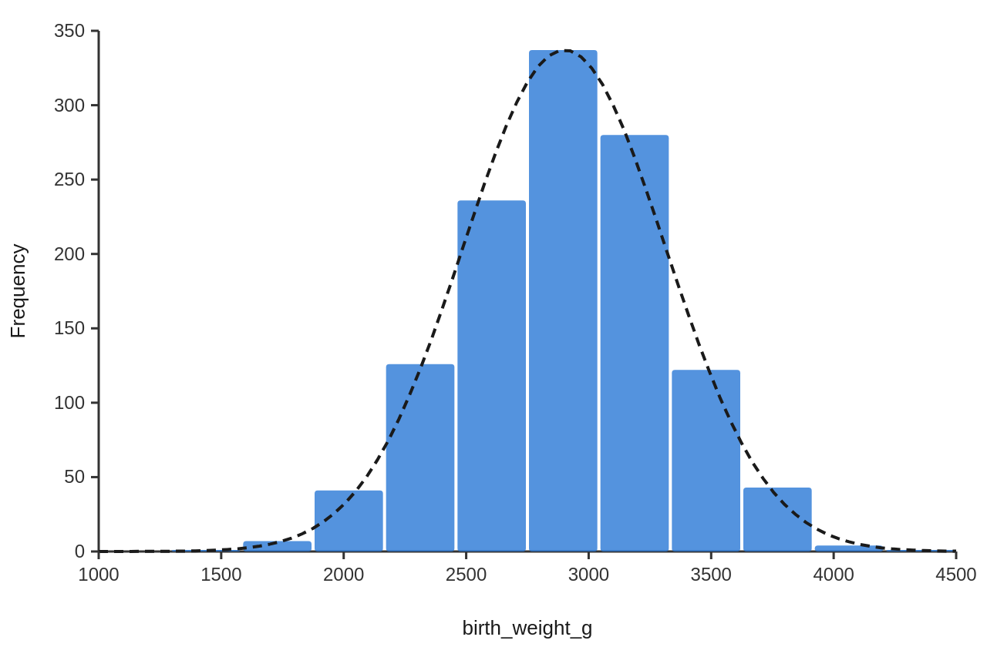
Paracetamol after the MR vaccine and the infant antibody response
Asha Verma¹, MA Psychology (final year) (Student) · Dr. Meena Sharma¹, PhD, Professor of Psychology (Supervisor) · Dr. S. Khan², MD (Paediatrics) (Co-supervisor)
¹ Department of Psychology, Demo College, Jaipur ² Department of Paediatrics, Demo Medical College, Jaipur
Demo Paediatrics and Behaviour Meet, Jaipur, 2026
Introduction
Results
Conclusion
Measles still kills children where vaccine coverage is low, and two doses of a measles-containing vaccine prevent almost all cases (Moss & Griffin, 2012).
In a randomised trial, infants given prophylactic paracetamol at vaccination had lower antibody responses to several vaccines (Prymula et al., 2009).
Trials in Europe found lower antibody responses when infants were given paracetamol at vaccination, but a search of OpenAlex and PubMed for 2009 to 2025 found no Indian study of measles antibody…
The present study asked: Does paracetamol given after the measles-rubella vaccine lower the antibody response in nine-month-old infants in Jaipur?
H1: Infants given paracetamol after MR1 will seroconvert less often than infants not given paracetamol.
H2: Seroconversion will not differ between boys and girls.
A chi-square test of independence showed a significant association between paracetamol after MR1 and seroconversion, χ²(1, N = 1133) = 11.42, p < .001, Cramér's V = 0.10.
A chi-square test of independence showed no significant association between infant sex and seroconversion, χ²(1, N = 1133) = 0.05, p = .827, Cramér's V = 0.01.
A logistic regression with birth weight (g), infant sex: Girl (vs Boy), paracetamol after MR1: Yes (vs No) as predictors of seroconversion (Yes versus No) was significant, χ²(3, N = 1133) = 10.72, p = .013, Nagelkerke R² = .021. The model classified 91.4% of cases correctly (AUC = .59). Odds ratios: birth weight (g) (OR = 1.00, 95% CI [1.00, 1.00], p = .474); infant sex: Girl (vs Boy) (OR = 0.97, 95% CI [0.64, 1.48], p = .902); paracetamol after MR1: Yes (vs No) (OR = 0.46, 95% CI [0.29, 0.73], p < .001).
There was a moderate positive correlation between the mother's haemoglobin at 34 weeks and birth weight (g), which was statistically significant, r(1196) = .31, p < .001, 95% CI [.26, .36].
An independent-samples Welch t-test showed that birth weight (g) differed significantly between boys (M = 2955.67, SD = 404.24) and girls (M = 2840.56, SD = 415.40), t(1183.18) = 4.85, p < .001, g = 0.28, 95% CI of the difference [68.59, 161.64].
Give paracetamol after MR1 for fever only; routine doses went with lower seroconversion.
Discussion
Infants whose parents gave paracetamol after MR1 seroconverted less often, which supports H1 and follows the same direction as the trial of prophylactic paracetamol (Prymula et al., 2009).
Paracetamol was given more often to infants with fever, so fever itself or a stronger reaction may explain part of the link. The data are simulated, and paracetamol use was reported by parents.
Birth weight rose with the mother's haemoglobin at 34 weeks (r = .31).
References
Homme, J. H., & Fischer, P. R. (2010). Prophylactic paracetamol at the time of infant vaccination reduces the risk of fever but also reduces antibody response. BMJ Evidence-Based Medicine, 15(2), 50–51. https://doi.org/10.1136/ebm1049
Moss, W. J., & Griffin, D. E. (2012). Measles. The Lancet, 379(9811), 153–164. https://doi.org/10.1016/s0140-6736(10)62352-5
Prymula, R., Siegrist, C. A., Chlibek, R., Zemlickova, H., Vackova, M., Smetana, J., Lommel, P., Kaliskova, E., Borys, D., & Schuerman, L. (2009). Effect of prophylactic paracetamol administration at time of vaccination on febrile reactions and antibody responses in children: two open-label, randomised controlled trials. The Lancet, 374(9698), 1339–1350. https://doi.org/10.1016/s0140-6736(09)61208-3
Sil, A., Ravi, M. D., Patnaik, B. N., Dhingra, M. S., Dupuy, M., Gandhi, D. J., Dhaded, S. M., Dubey, A. P., Kundu, R., Lalwani, S. K., Chhatwal, J., Mathew, L. G., Gupta, M., Sharma, S. D., Bavdekar, S. B., Rout, S. P., Midde, V. J., D’Cor, N. A., Mangarule, S., . . . E, J. R. (2017). Effect of prophylactic or therapeutic administration of paracetamol on immune response to DTwP-HepB-Hib combination vaccine in Indian infants. Vaccine, 35(22), 2999–3006. https://doi.org/10.1016/j.vaccine.2017.03.009
Materials and Methods
Design. This was a cohort study.
Participants. Infants born in the simulated Janani cohort, Jaipur, who received the first measles-rubella dose (MR1) at 9 months.
Measures. Seroconversion. Recorded as yes or no.
Paracetamol after MR1. Recorded as yes or no.
Birth weight. Measured with the instrument or laboratory method described in section 2.4.
Instruments and laboratory methods. Birth weight. Babies were weighed undressed within 24 hours of birth on a digital infant scale (model Seca 334) to the nearest 10 g.
Procedure and ethics. The study was approved by the Institutional Ethics Committee, Department of Psychology, Demo College, Jaipur (reference IEC/PSY/2026/B, 20 October 2026). [how consent was taken, where and when data…
Analysis. The main hypothesis was tested with a logistic regression.
Acknowledgements
e.g. We thank all participants, the hospital staff and the department. Funding: …
Made with Appuscholar

