Slide 1
Android Primer
Sam Sudar
April 4, 2014
https://github.com/srsudar/android-primer
Notes:
Who has used Eclipse?
Who has done Android programming?
--Might be too basic for people that have done Android before
Android Studio is the new way to write apps, but support isn’t as good, and it’s not worth switching yet imo.

Slide 2
Building an app: Say my name. Demo.

Slide 3
1: Configuration
2: Android at a glance

Slide 4
1: Configuration
Notes:
Show them the logcat
Show them a console.log
Show them the “what is this support library”.
Mention it’s preferred over actionbarsherlock

Slide 5
Installing Android
You’re on your own. Google it.
Nothing is more frustrating than not being able to get started. I’ve fixed a lot of Android builds. Email me if you’re stuck and we’ll figure it out:
sudar.sam@gmail.com

Slide 6
Plunge into Eclipse
res/
xml
Logcat
Log.e(“MainActivity”, “hello”);
Support Library over ABS
Notes:
Src, gen, res, libs
Show them the logcat
Show them a console.log
Show them the “what is this support library”.
Mention it’s preferred over actionbarsherlock

Slide 7
adb
Your friend. Put it on your PATH.
$ adb devices
$ adb shell
$ adb push
$ adb pull
Notes:
Demo the commands.

Slide 8
2: Android at a glance

Slide 9
Activities
Views and Fragments
R.java
Intents

Slide 10
Activities
A unit of user interaction.
Notes:
Show the two screens on the device
Show the back button manipulating the back stack

Slide 11
Lifecycle
Android Manifest
Actionbar
Views and Fragments

Slide 12
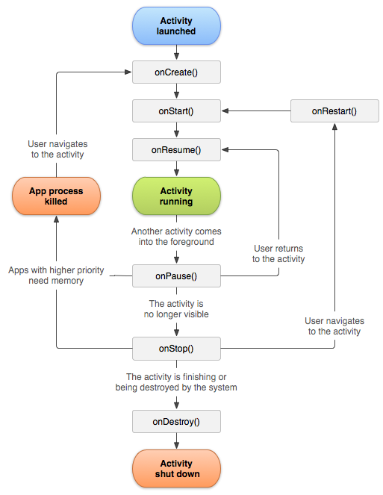
http://developer.android.com /reference/android/app /Activity.html#ProcessLifecycle
Notes:
Never call “new” activity. Just do your initialization in the callbacks.
Show the log messages in the life cycle methods.

Slide 13
Activity Gotchas
Didn’t add to AndroidManifest.xml
Respect the lifecycle!
Rotation / Lock / Phonecall

Slide 14
Views
Something that is displayed to the user.

Slide 15
View
TextView
Button
EditText (text entry)
Spinner (dropdown)
etc
ViewGroup: holds views
LinearLayout
ScrollView
RelativeLayout
etc

Slide 16
Can configure statically (xml) or programmatically (java)
Usually specified in res/layout
Redrawn on rotation, those with ids are saved by the system
Notes:
Resize the text in the say name activity using both xml and java.
Edit text, textview, and the buttons in the app
Walk them through the ViewTree.

Slide 17
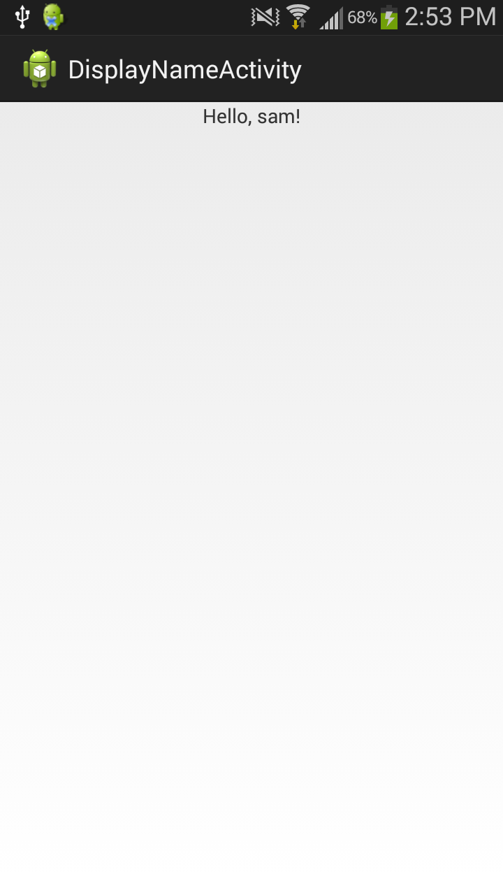
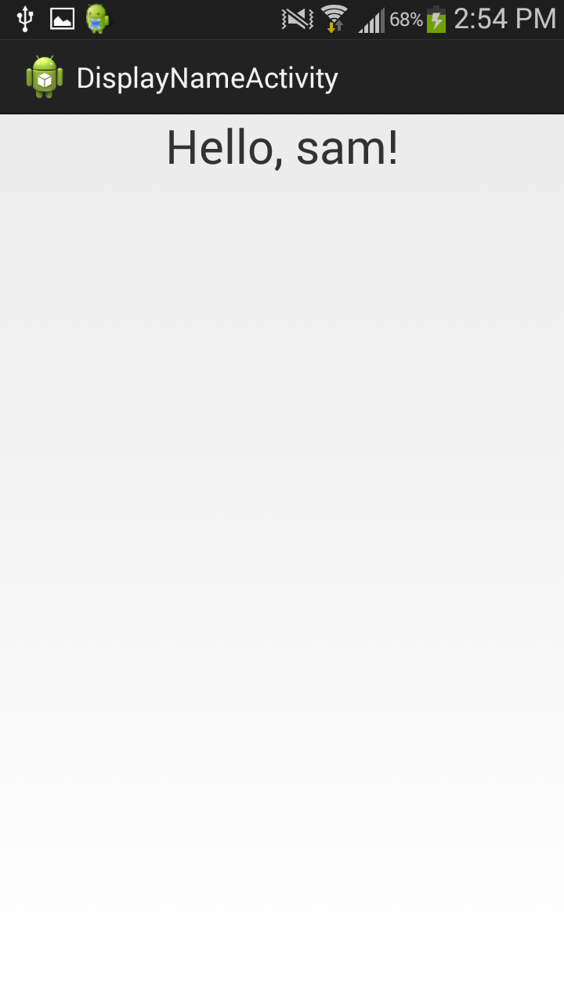
Java xml default mNameView.setTextSize(30) android:textSize=“30sp”

Slide 18
View Gotchas
.findViewById() must follow view tree
Some attributes required (e.g. layout_width)
Wrap everything in a ScrollView or else you can’t scroll
match_parent vs wrap_content
Let eclipse suggest things

Slide 19
Fragments
A mini activity inside an activity.
Lets you resize for big screens easily.
Not talked about here for time reasons, but you should use them.

Slide 20
Fragment Gotchas
They have their own life cycle!
Activity doesn’t attach immediately, so getActivity() will return null through the first few lifecycle methods
TWO CLASSES—support and standard, for all Fragment-related things.

Slide 21
R.java
A bunch of int ids.
Built automatically!!! Don’t edit it.

Slide 22
R.Java Gotchas
DO NOT edit it. Overwritten.
Cannot find R.java—not your main problem.
Two R.java files—yours and Android’s
Using the wrong id.

Slide 23
Intents
How you launch other apps and activities.
How activities communicate.

Slide 24
A Bundle is a map
An intent (may) have a Bundle
Can return information as well
startActivityForResult()

Slide 25
If we have time
Protected vs external storage
adb backup
ContentProvider—imagine a web endpoint

