Slide 1
Multivariate Causal Models
From Book : Elements of causal inference
Chapter 6 up to section 6.5.2
Sara Taheri

Slide 2

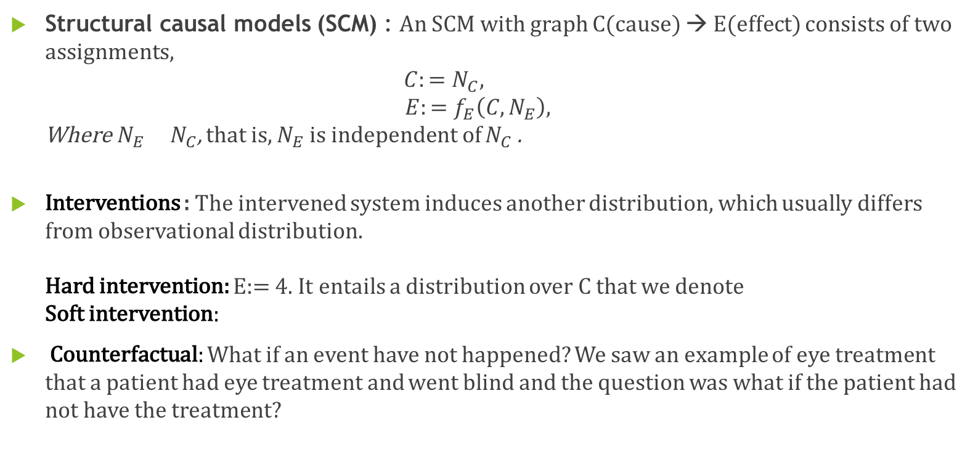
Recap (From chapter 3)
Structural causal models (SCM) : An SCM with graph C(cause) → E(effect) consists of two assignments, $C:=N_{C},$ $E:=f_{E}\left(C,N_{E}\right),$ Where${ N}_{E}{ N}_{C}$, that is, $N_{E}$ is independent of $N_{C}$.
Interventions : The intervened system induces another distribution, which usually differs from observational distribution. Hard intervention: E:= 4. It entails a distribution over C that we denote Soft intervention:
Counterfactual: What if an event have not happened? We saw an example of eye treatment that a patient had eye treatment and went blind and the question was what if the patient had not have the treatment?

Slide 3
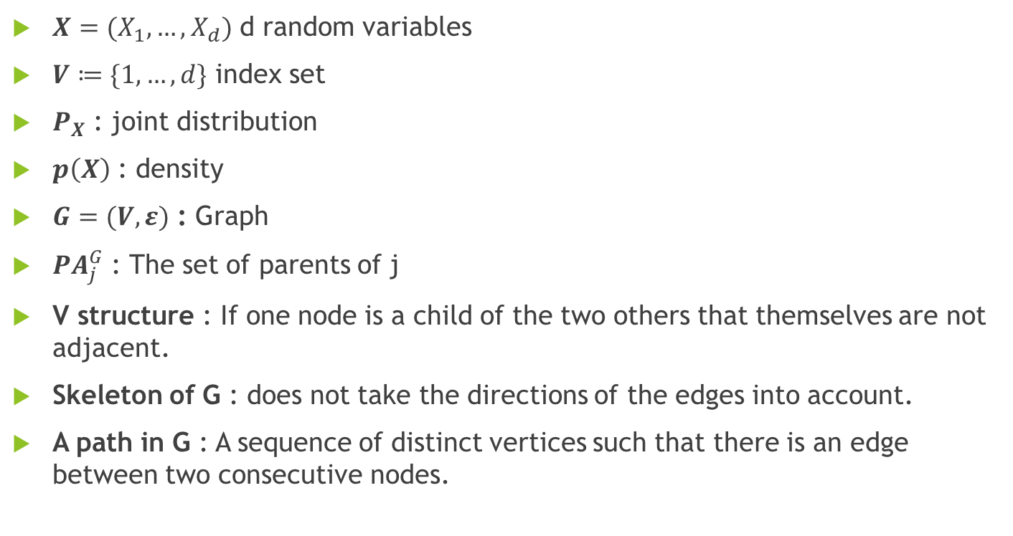
Graph Terminology
$X=(X_{1},…,X_{d})$ d random variables
$V≔\{1,…,d\}$ index set
$P_{X}$ : joint distribution
$p\left(X\right)$ : density
$G=(V,ε)$ : Graph
${PA}_{j}^{G}$ : The set of parents of j
V structure : If one node is a child of the two others that themselves are not adjacent.
Skeleton of G : does not take the directions of the edges into account.
A path in G : A sequence of distinct vertices such that there is an edge between two consecutive nodes.

Slide 4

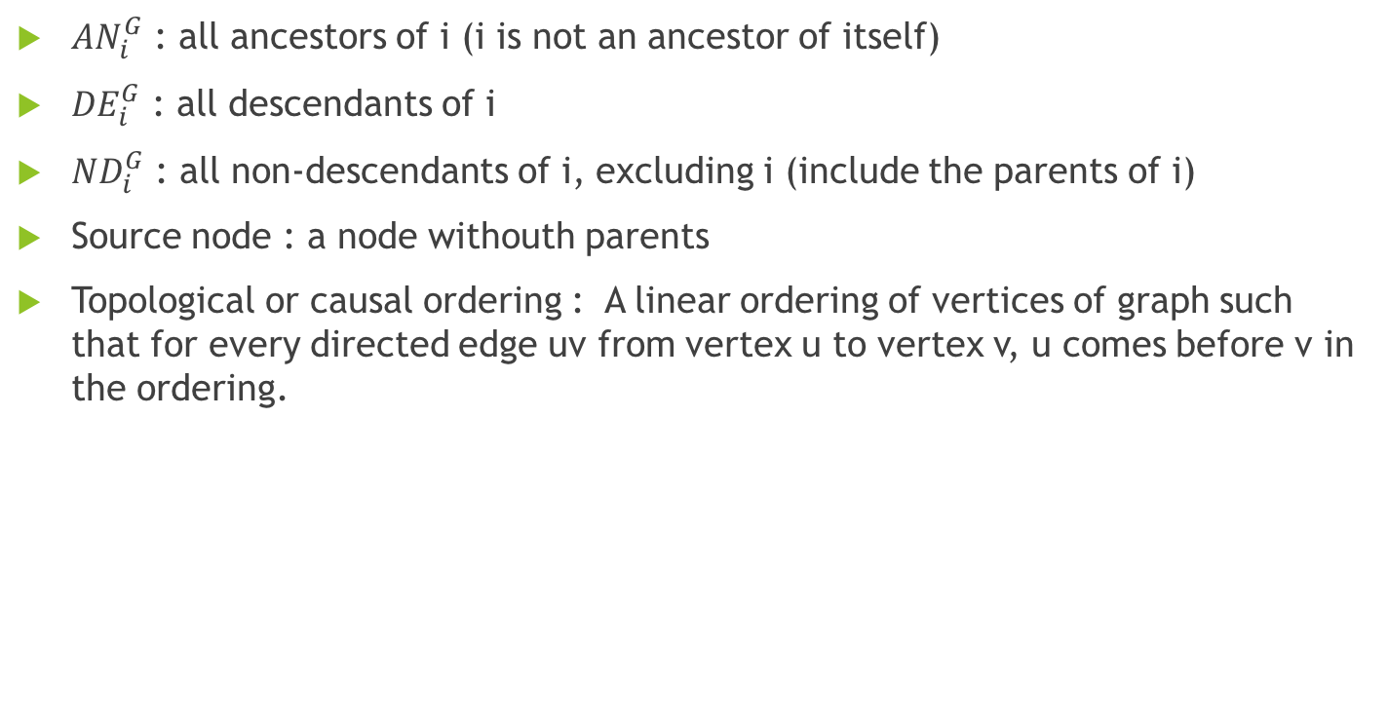
Graph Terminology
${AN}_{i}^{G}$ : all ancestors of i (i is not an ancestor of itself)
${DE}_{i}^{G}$ : all descendants of i
${ND}_{i}^{G}$ : all non-descendants of i, excluding i (include the parents of i)
Source node : a node withouth parents
Topological or causal ordering : A linear ordering of vertices of graph such that for every directed edge uv from vertex u to vertex v, u comes before v in the ordering.

Slide 5
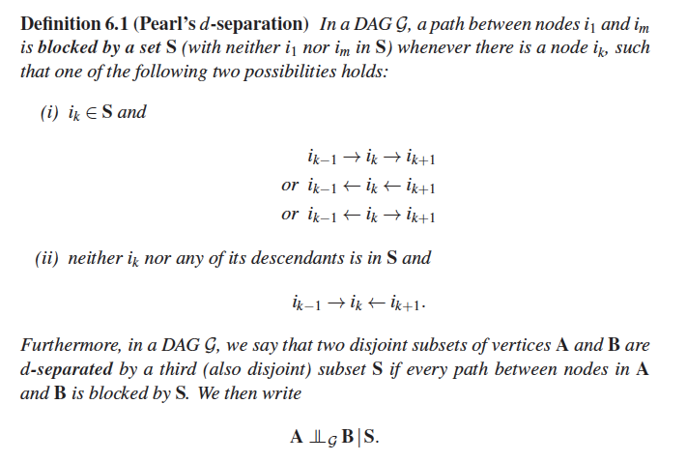
Pearl’s d-separation
S
V
W
P
M
- Path btw S,P is not blocked by W - Path btw S,P is is Blocked by V

Slide 6
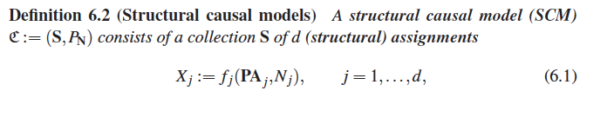
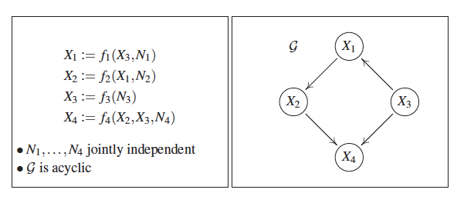
Structural Causal Models (SCM)

Slide 7
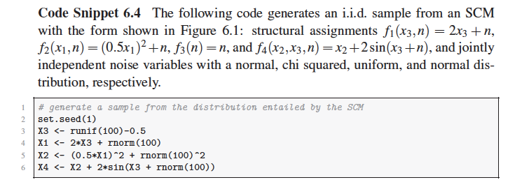
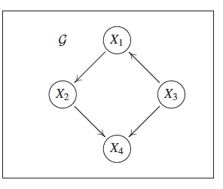
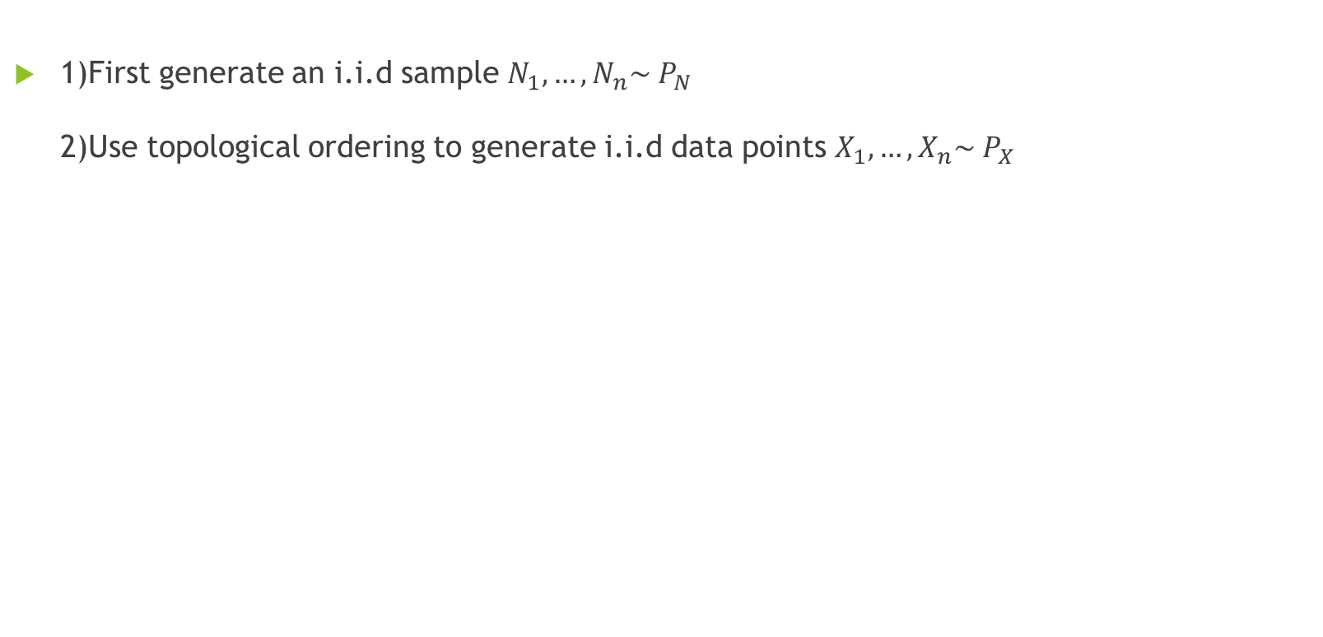
Sample n data points from the joint distribution (ancestral sampling)
1)First generate an i.i.d sample $N_{1},…,N_{n}\sim P_{N}$ 2)Use topological ordering to generate i.i.d data points $X_{1},…,X_{n}\sim P_{X}$

Slide 8

Entailed distributions
It shows that each SCM entails a distribution. What about the other direction? We will see later that each distribution can be induced by any SCM whose graph structure is a complete DAG.

Slide 9
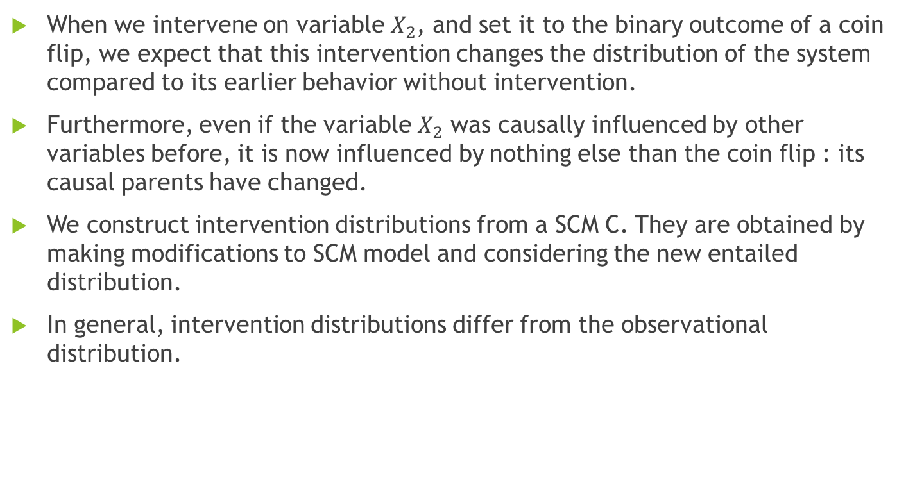
Interventions
When we intervene on variable $X_{2}$, and set it to the binary outcome of a coin flip, we expect that this intervention changes the distribution of the system compared to its earlier behavior without intervention.
Furthermore, even if the variable $X_{2}$ was causally influenced by other variables before, it is now influenced by nothing else than the coin flip : its causal parents have changed.
We construct intervention distributions from a SCM C. They are obtained by making modifications to SCM model and considering the new entailed distribution.
In general, intervention distributions differ from the observational distribution.

Slide 10
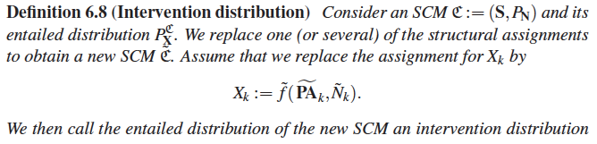
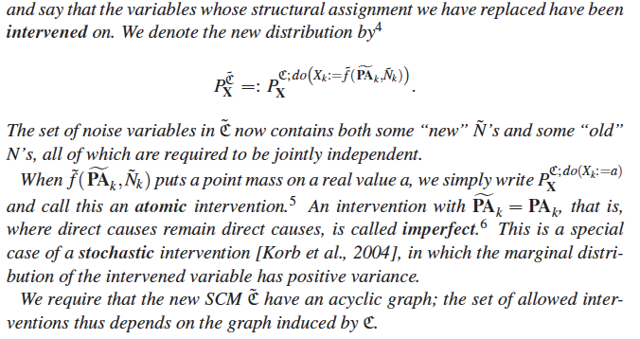
Intervention distribution

Slide 11
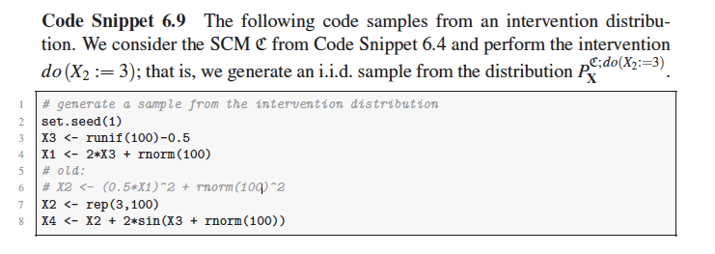
Intervention distribution

Slide 12
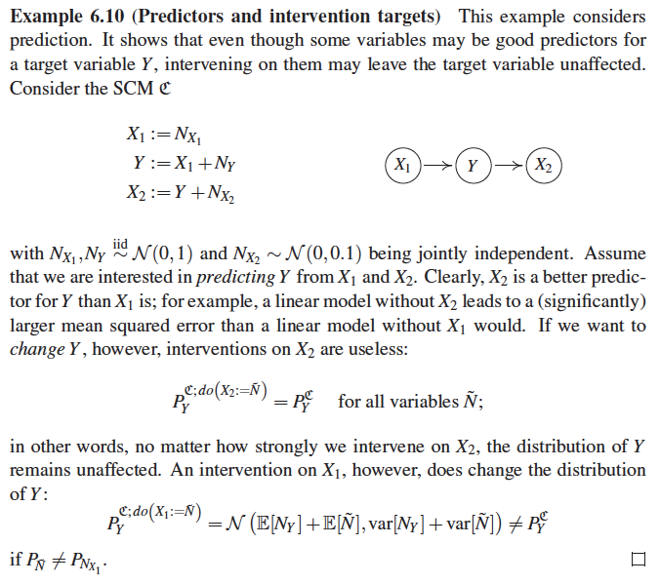
Example (Predictors and intervention targets)

Slide 13
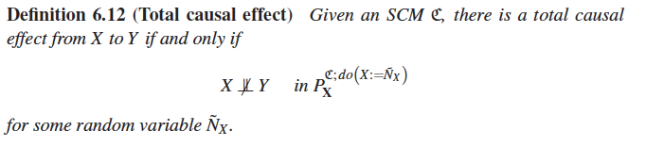
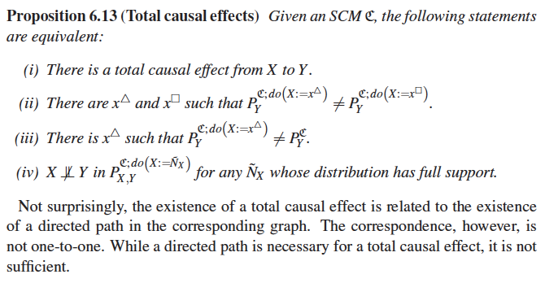
Total Causal effect

Slide 14
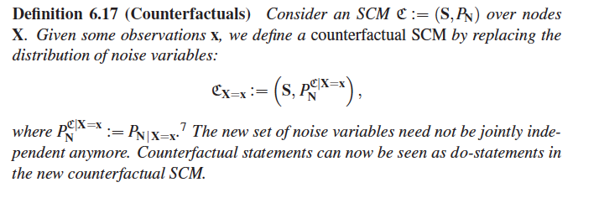
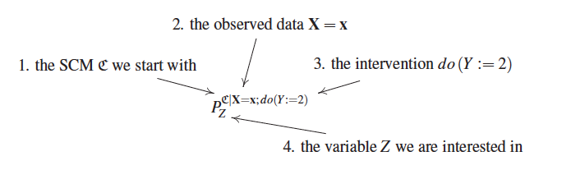
Counterfactuals

Slide 15
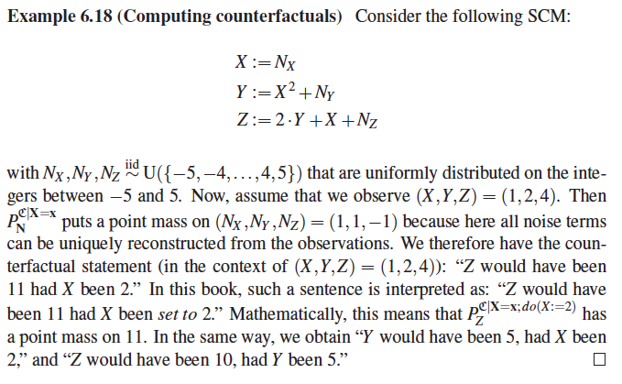
Counterfactual examples
Counterfactual statements depend on the structure of the SCM. Next example shows two SCMs that induce the same graph, observational distributions, and intervention distributions but entail different counterfactual statement.

Slide 16
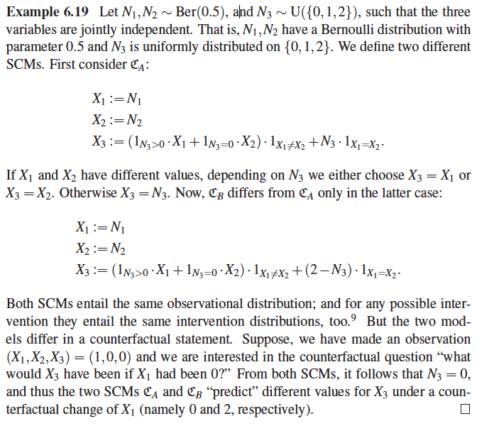

Slide 17
Markov Property
The Markov property is a commonly used assumption that forms the basis of graphical models.
When a distribution is Markovian with respect to a graph, this graph encodes certain independences in the distribution that we can exploit for efficient computation or data storage.
The Markov property exists for both directed and undirected graphs, and the two classes encode different sets of independences.

Slide 18
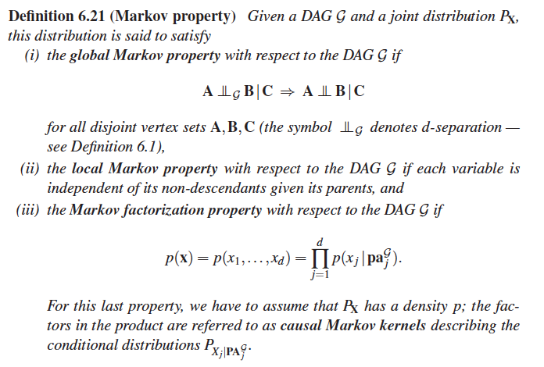
Markov property definition

Slide 19
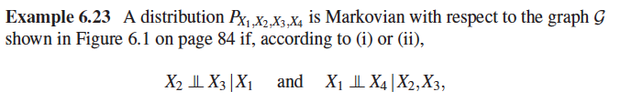
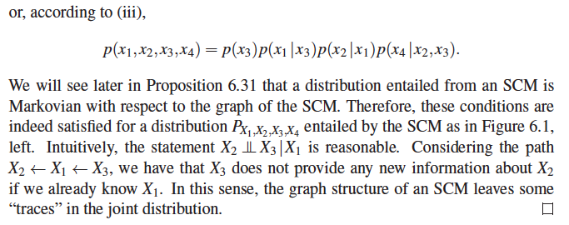
Example

Slide 20
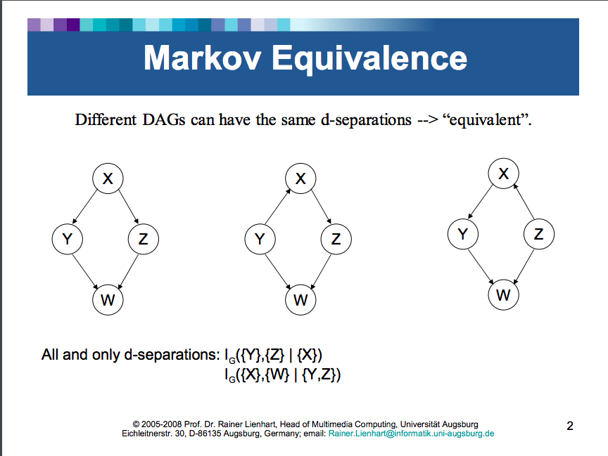

Slide 21
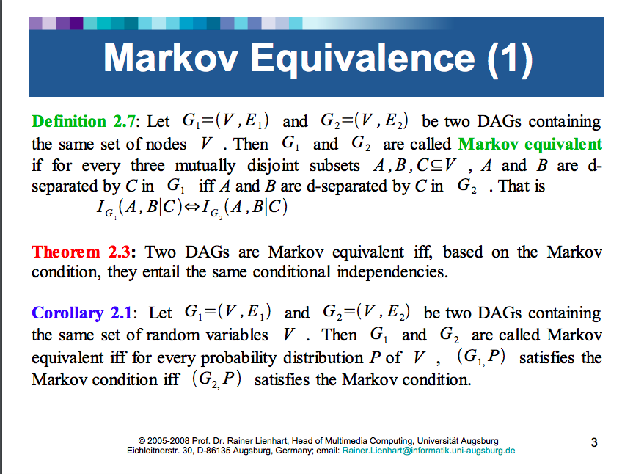

Slide 22

Graphical criteria for Markov equivalence
Immortalities = v-structure

Slide 23
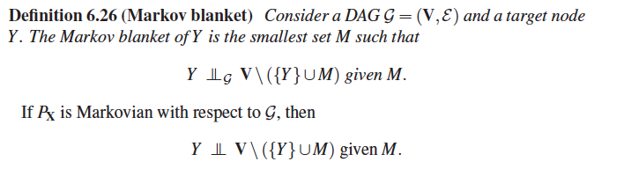
Markov Blanket

Slide 24
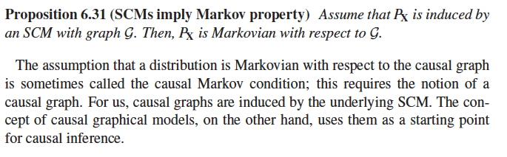
SCMs imply Markov property

