Slide 1
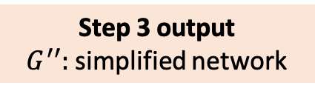

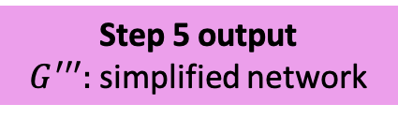
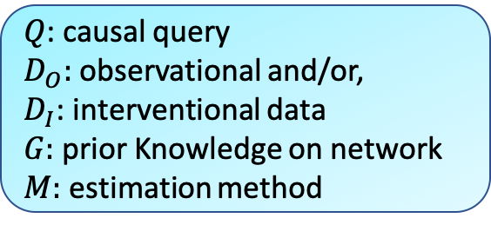
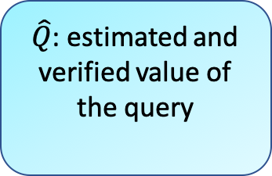

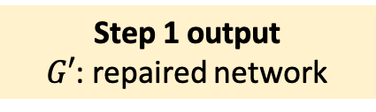
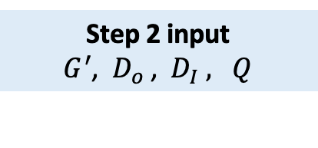
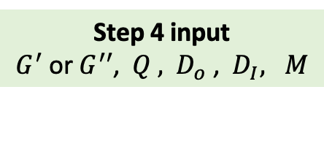
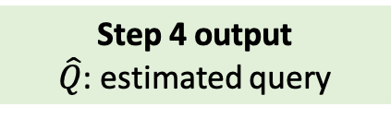
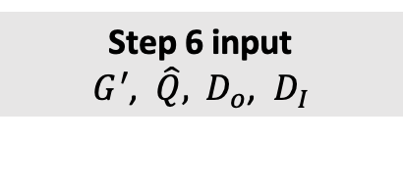


Overall Input
Overall Output
$Q$: causal query
$D_{O}:$ observational and/or,
$D_{I}$: interventional data
$G:$prior Knowledge on network
$M:$ estimation method
$\hat{Q}$: estimated and verified value of the query
Causal workflow
Step 1 input
$D_{O}$ and/or $D_{I}, G$
Step 1 output
$G′$: repaired network
Step 1 : Repair the network structure Add a bi-directed edge between variables when conditional independencies implied by the prior network contradicts with the ones indicated by data.
Step 2 input
$G^{′}$, $D_{o}$, $D_{I} , Q$
Step 2 output
True or False
Step 2 : Check query identifiability
If query is identifiable proceed to the following steps.
Step 3 input
$G^{′}$, $Q$
Step 3 output
$G^{′′}:$ simplified network
Step 3 (optional): Simplify the network
Mark all the nuisance variables that cannot be part of the query estimation (e.g., descendants of the outcome) as latent. Apply simplification rules.
Step 4 input
$G^{′}$ or $G^{′′}$, $Q ,$ $D_{o}$ , $D_{I}, M$
Step 4 output
$\hat{Q}$: estimated query
Step 4 : Estimate the query
Generate the estimand and proceed to estimate the query using the selected estimation method.
Step 5 input
$G^{′}$ or $G^{′′}$, $Q$
Step 5 output
$G^{′′′}:$ simplified network
Step 5 (optional): Further simplify the network
Mark rest of the nuisance variables that are not part of the estimand as latent. Apply simplification rules.
Step 6 input
$G^{′}$, $\hat{Q},$ $D_{o}$, $D_{I}$
Step 6 output
verified $\hat{Q}$
Step : Verify the correctness of the result with respect to external evidence

Slide 2
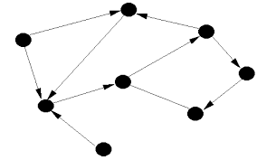
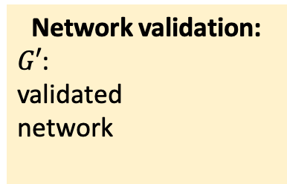
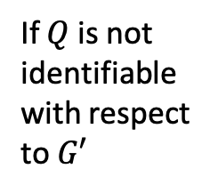
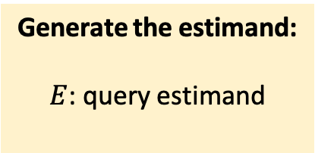
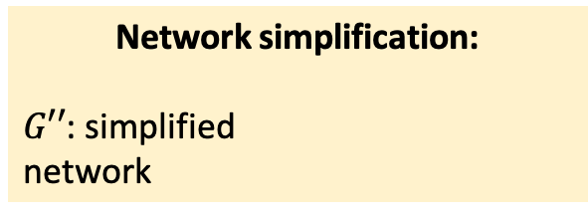
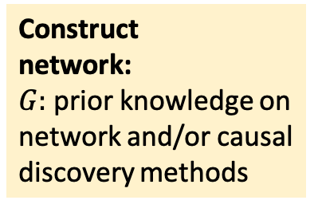
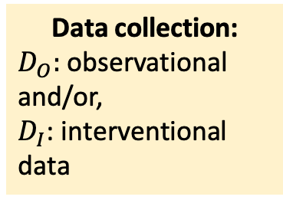
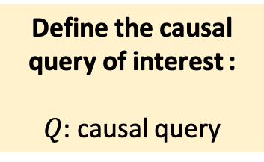
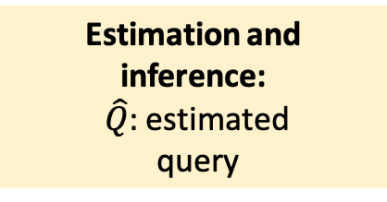
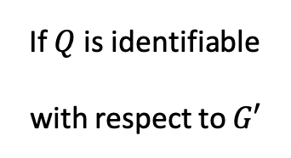
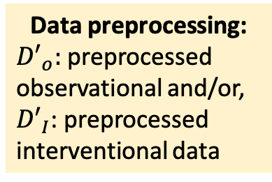
Data collection:
$D_{O}:$ observational and/or,
$D_{I}$: interventional data
Data preprocessing:
${D′}_{o}:$ preprocessed observational and/or,
${D′}_{I}$: preprocessed interventional data
Construct network:
$G:$prior knowledge on network and/or causal discovery methods
Network validation:
$G′$: validated network
1
2
3
4
Define the causal query of interest :
$Q$: causal query
If $Q$ is identifiable
with respect to $G′$
Generate the estimand:
$E$: query estimand
Network simplification:
$G′′$: simplified network
5
6
7
If $Q$ is not identifiable
with respect to $G′$
Experimental design
Perform new experiments. Follow steps 1-5
Estimation and inference: $\hat{Q}$: estimated query
Validation and interpretation of the estimate
8
9

