Slide 1
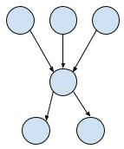
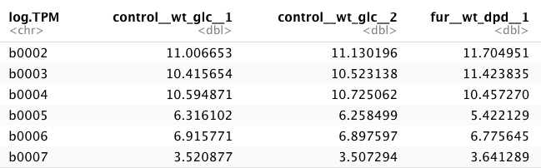
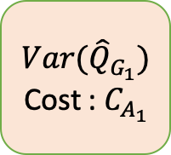
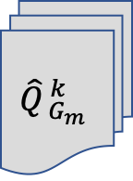






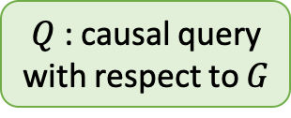
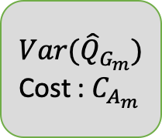


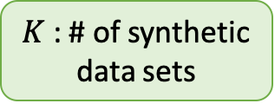
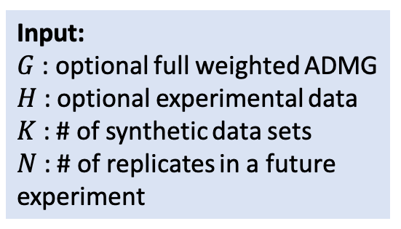
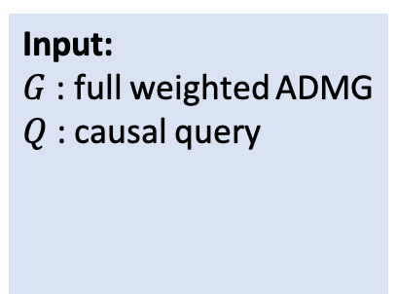
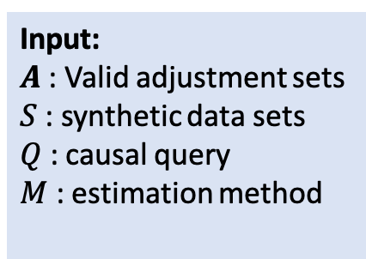
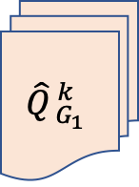
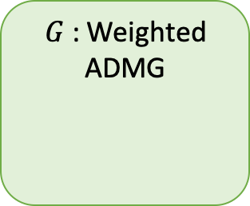
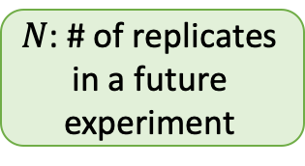

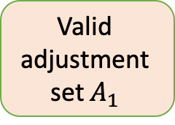
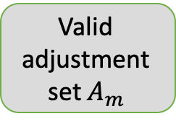
$Q$ : causal query with respect to $G$
Input: $G$: optional full weighted ADMG
$H$ : optional experimental data
$K$ : # of synthetic data sets
$N$ : # of replicates in a future experiment
Input: $G$: full weighted ADMG
$Q$ : causal query
Input: $A$: Valid adjustment sets
$S$: synthetic data sets
$Q$ : causal query
$M$ : estimation method
$G$ : Weighted ADMG
Valid adjustment set $A_{1}$
Causal
$${\hat{Q}}_{{ G}_{1}}^{ k}$$
$${Var(\hat{Q}}_{G_{1}})$$
Cost : $C_{A_{1}}$
$S$ : synthetic data sets
query estimation
$$k=1$$
Variance- ranked adjustment sets
$K$ : # of synthetic data sets
$$k=2$$
. . .
. . .
. . .
$$k=K$$
$$k=1$$
Valid adjustment set $A_{m}$
$${\hat{Q}}_{{ G}_{m}}^{ k}$$
$${Var(\hat{Q}}_{G_{m}})$$
Cost : $C_{A_{m}}$
$$k=2$$
$N$: # of replicates in a future experiment
. . .
$$k=K$$
$$k=1$$
$$k=2$$
. . .
$$k=K$$
Step 1
Step 2
Step 3
Input Section 3.1
Simulating future datasets Section 3.2
Exploring valid adjustment sets Section 3.3
Estimating causal query Section 3.4
Output
Section 3.1

