Slide 1
Getting Academics Coding in LAMMPS
The Good, The Bad, and The User Journey Shern Ren Tee

Slide 2
Introduction: LAMMPS as a Community MD Code

Slide 3
Molecular Dynamics: Bigger…

Slide 4
Molecular Dynamics: … and weirder

Slide 5
A Case Study: ELECTRODE for Conductive Molecular Dynamics

Slide 6
Method Development Cycle in Molecular Dynamics
Implementation
Benchmarking
Documentation
Distribution
Notes:
Implementation: theory, algorithms, code
Benchmarking: measuring performance or accuracy gains
Documentation: setting up user interfaces
Distribution: getting code onto people’s machines and HPCs

Slide 7
LAMMPS’s successes
Code originally
LAMMPS has been a great community code platform for method development!
A large community: 20-30k user downloads per year
50k LOC (2004) to 1 million LOC (2023 – several hundred contributors)

Slide 8
Lessons: ASAP and AMAP

Slide 9
Lessons Learned from Developing LAMMPS [Plimpton 2019]
ASAP: Make your code as simple as possible to understand and extend
AMAP: Enable it to be used in as many as possible ways
Licensing: LGPL can be a good compromise
Notes:
GPL: derivative works must also be open sourced
LGPL: use-by-linking is not considered derivative
BSD: “do whatever” (good for companies, bad for OSS devs)

Slide 10
ASAP and AMAP in LAMMPS
Drop a .cpp and .h into lammps/src and compile, and you get an add-on!
LAMMPS can be called as a library:
Interfaces: C-style, Python, SWIG
Internally-implemented fix external
Caller can start multiple LAMMPS instances and coordinate messages between them

Slide 11
ASAP 1: Simple, Clear Coding
LAMMPS uses “C with classes”:
Very little overloading, templating, STL (slowly increasing)
Low-level structs and kernels are C-style (e.g. n-dim arrays)
Detailed comments wherever needed

Slide 12
ASAP 2-4: Straightforward extensibility
What do you think this code does?
// ... int FixJumble::setmask() { int mask = 0; mask |= FixConst::PRE_REVERSE; // enum'ed in parent class Fix return mask; } void FixJumble::pre_reverse(int, int) { double f** = atom->f; // forces for (int i = 0; i < nlocal; ++i) { f[i][0] += rand(); // x-direction f[i][1] += rand(); // y f[i][2] += rand(); // z } } // ...

Slide 13
ASAP 2: Robust core, clear “sockets”
Timestep loop:
timestep initialization
fix->initial()
(sometimes) rebuild neighbor list
or send ghost atoms
force initialization
fix->pre_force()
compute forces
fix->pre_reverse()
receive ghost forces
fix->post_force()
finalize and output
// ... int FixJumble::setmask() { int mask = 0; mask |= FixConst::PRE_REVERSE; // enum'ed in parent class Fix return mask; } void FixJumble::pre_reverse(int, int) { double f** = atom->f; // forces for (int i = 0; i < nlocal; ++i) { f[i][0] += rand(); // x-direction f[i][1] += rand(); // y f[i][2] += rand(); // z } } // ...

Slide 14
ASAP 3: Good parenting, easy children
Parent “styles” define interfaces:
pair for MD potentials
compute for diagnostics (temperature, pressure)
fix for doing anything
Children styles inherit interface from parents; just override specific parent virtual functions as needed
// ... int FixJumble::setmask() { int mask = 0; mask |= FixConst::PRE_REVERSE; // enum'ed in parent class Fix return mask; } void FixJumble::pre_reverse(int, int) { double f** = atom->f; // forces for (int i = 0; i < nlocal; ++i) { f[i][0] += rand(); // x-direction f[i][1] += rand(); // y f[i][2] += rand(); // z } } // ...

Slide 15
ASAP 3: Parenting Pointers
Pointers class makes shared data “quasi-static”:
class Pointers { protected: LAMMPS *lmp; // ... Atom *&atom; // ... public: Pointers(LAMMPS *ptr) : lmp(ptr), // ... atom(ptr->atom),// ... }
Now anything inheriting Pointers auto-gets references to the necessary data contained in lmp!
// ... int FixJumble::setmask() { int mask = 0; mask |= FixConst::PRE_REVERSE; // enum'ed in parent class Fix return mask; } void FixJumble::pre_reverse(int, int) { double f** = atom->f; // forces for (int i = 0; i < nlocal; ++i) { f[i][0] += rand(); // x-direction f[i][1] += rand(); // y f[i][2] += rand(); // z } } // ...

Slide 16
ASAP 4: Style Factories
Factory pattern creates a derived FixJumble and returns a Fix pointer to LAMMPS:
// ... #define FIX_CLASS #define FixStyle(_key, _Class) (*fix_map)[#_key] = &style_creator<Fix, _Class>; // C/Make'd list of fixes #include "style_fix.h" // IWYU pragma: keep #undef FixStyle #undef FIX_CLASS // ...
// ... #ifdef FIX_CLASS FixStyle(jumble,FixJumble); #else // ...
// ... int FixJumble::setmask() { int mask = 0; mask |= FixConst::PRE_REVERSE; // enum'ed in parent class Fix return mask; } void FixJumble::pre_reverse(int, int) { double f** = atom->f; // forces for (int i = 0; i < nlocal; ++i) { f[i][0] += rand(); // x-direction f[i][1] += rand(); // y f[i][2] += rand(); // z } } // ...

Slide 17
AMAP: Making LAMMPS a Library
LAMMPS_NS namespace prevents code collisions
Global (static) variables replaced with Pointer class
MPI_COMM_WORLD replaced with communicator used to initialize LAMMPS
LAMMPS *lammps = new LAMMPS(argc, argv, lammps_comm); lammps->input->file(); delete lammps;

Slide 18
Challenges: Can Academics Learn To Code?

Slide 19
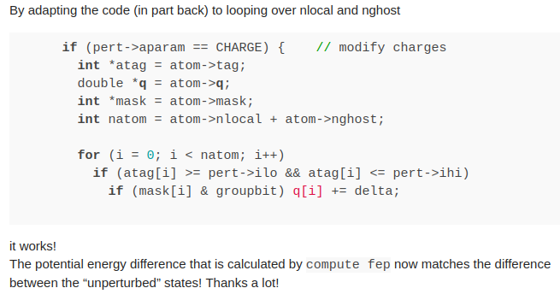
Successes …
User almost completely modified code on their own, made a suitable test, and was just missing some technical details on atom indexing in LAMMPS:

Slide 20
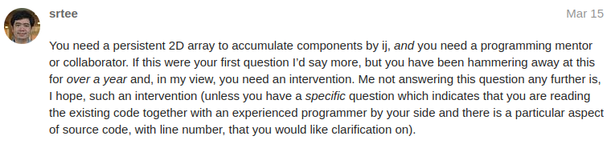
… and Failures
User had an idea for a complicated compute to be used in evaluating a potential, and was asking basic and strange questions a year after his original post:

Slide 21
The Future: LAMMPS as a Coding Community

