Slide 1

Online Chef Booking
HashedIn by Deloitte
- by
Ankita Shrivastava
Akash Kumar
Vikash Deep
Sarthak Nagpal
Akash Konnur

Slide 2
HashedIn by Deloitte
Use case
Application
Cook and Chef
Customer
Cook is Booked for slots for one multiple days
Chef is booked only for one day and serves whole day

Slide 3
HashedIn by Deloitte
Overview
This web application brings together Chef and Customer by acting as bridge between both the stakeholders.
Application helps Chef and Customer find one another.
The application is designed to handle booking of cooks who can visit on daily basis for specified time.
The application provides seamless and elegant experience right from onboarding.

Slide 4
Assumptions
Chef and Cook are not one and the same.
A person will either be Chef or Customer but not both.
A customer will have only one Address.
Chef is booked for a whole day irrespective of timings.
Time required for cook to move from one customer to another is not taken into consideration.

Slide 5
HashedIn by Deloitte
Major modules
Authentication and Authorization module
Chef Registration Module
Customer Registration Module
Order Processing Module
Payments Module

Slide 6
HashedIn by Deloitte
Technologies Used
Java-11
Spring boot
Rest api
Stripe api payment gateway
React with material and bootstrap
Junit -5
RDBMS with MySql
Hibernate ORM tool
Monolith Architecture

Slide 7
HashedIn by Deloitte
Use case for customer
Email and password
Food and Chef Preference
Authorizes payment
Customer
Authentication
Module
Request and Allocation
Module
Payments
Module
Receives Details Of Chef
Login fails
Booking fails

Slide 8
HashedIn by Deloitte
Use Case for Chef
Email and password
View upcoming bookings
Chef
Authentication
Module
Respond to existing bookings
Serves customer and collects payment
Login Fails
Set unavailable on future dates

Slide 9
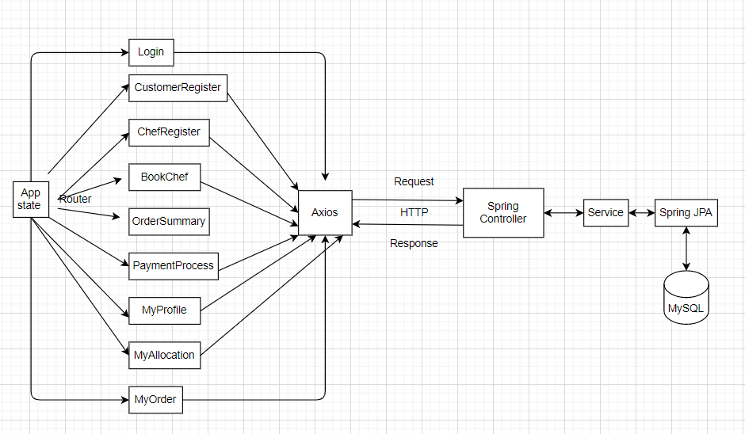
HashedIn by Deloitte
Architectural diagram

Slide 10
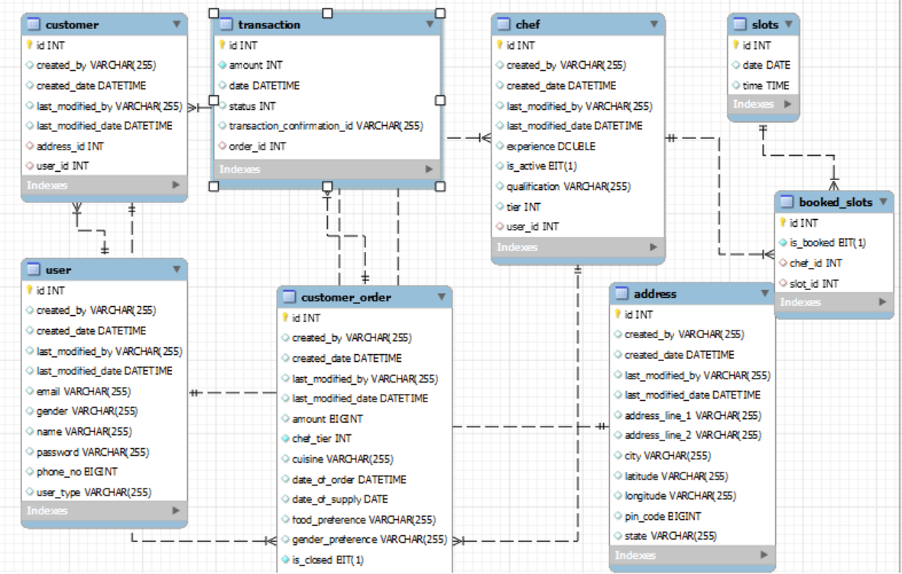
HashedIn by Deloitte
Entity relation diagram

Slide 11
HashedIn by Deloitte
Practices with core values
Test driven approach
Best git practices for version control
Peer review
Learn and share
Work fun
Customer delight

Slide 12
Version control flow
Production
CI/CD pipeline and Deployment on Staging
Master
Master
development
development
development

Slide 13
HashedIn by Deloitte
Additional functional requirements added
Email integration to share notifications
Option to view previous orders for customer
Option to view previous orders for chef
Option to recover password using registered email
Option to change password
Auditor aware recording
Swagger integration
Payment gateway Integration
Backend for handling booking cooks *

Slide 14
Product backlog on customer delight and possible Enhancements
User interface for change password
User Interface for forgot password
Options to Update profile
Caching for performance enhancement
Reinitiating failed transactions
Running discount offers
OTP based login
Chef accepting or rejecting order (Mock implemented)

Slide 15
Available Slots created by Scheduler
Slot Id | Date | Time
1 | 01-06-2021 | 9:00
2 | 01-06-2021 | 10:00
3 | 01-06-2021 | 11:00 ….
4 | 02-06-2021 | 9:00
5 | 02-06-2021 | 10:00
5 | 02-06-2021 | 11:00

Slide 16
Cooks Allocation (I have only two chefs who meet criteria) so another allocation won’t be possible on 01-06-2021 at 9:00
Id | Slot_Id | Date | Time | Chef
1 | 1 | 01-06-2021 | 9:00 | 1
2 | 2 | 01-06-2021 | 10:00 | 2
3 | 3 | 01-06-2021 | 11:00 | 1
4 | 1 | 01-06-02021 | 9:00 | 2
5
6
7
While booking for monthly or weekly basis customer needs be given a questionnaire asking “Do you want same chef on all the days”

Slide 17
Thank You Any Questions

Slide 18
Swagger UI (cheffy-back-end-dot-hu18-groupa-java.et.r.appspot.com)
https://cheffy-front-end-dot-hu18-groupa-java.et.r.appspot.com/
For Product Idea click here

