Slide 1
An Effective way to optimize performance and battery life of smart devices using multi-kernel approach
Sadid Rafsun Tulon
School of Computer Science University of Ottawa, Ottawa, Canada
Stulo080@uottawa.ca

Slide 2
Introduction
Ever-changing technology pushing Moore’s law to limit
Battery technology has plateaued
Need a new approach
Multi-kernel System appears to be promising

Slide 3
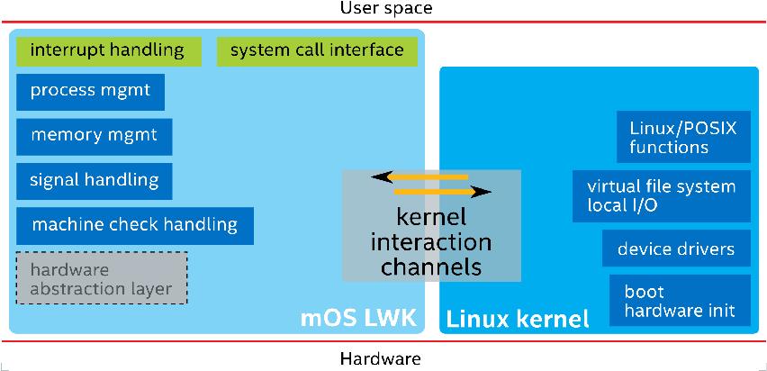
What is Multi-kernel System?
Running both FWK (Typically Linux ) and lightweight sub kernel side by side.
Data can be passed through shared memory or message passing.
FWK handles compatibility.
Sub kernel handles high performance tasks.

Slide 4
What is Lightweight kernels and Unikernels?

Slide 5
Lightweight kernels and Unikernels
Specialized for the very high end of HPC
Small footprint
Generally, faster performance
More power efficient

Slide 6
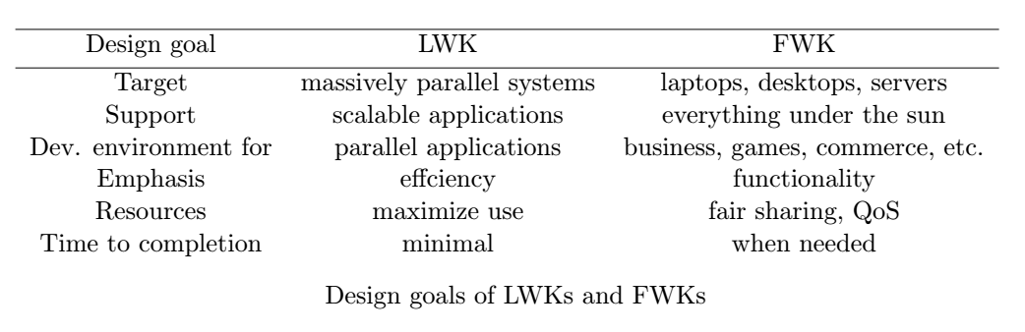
Full-weight vs Lightweight kernels

Slide 7
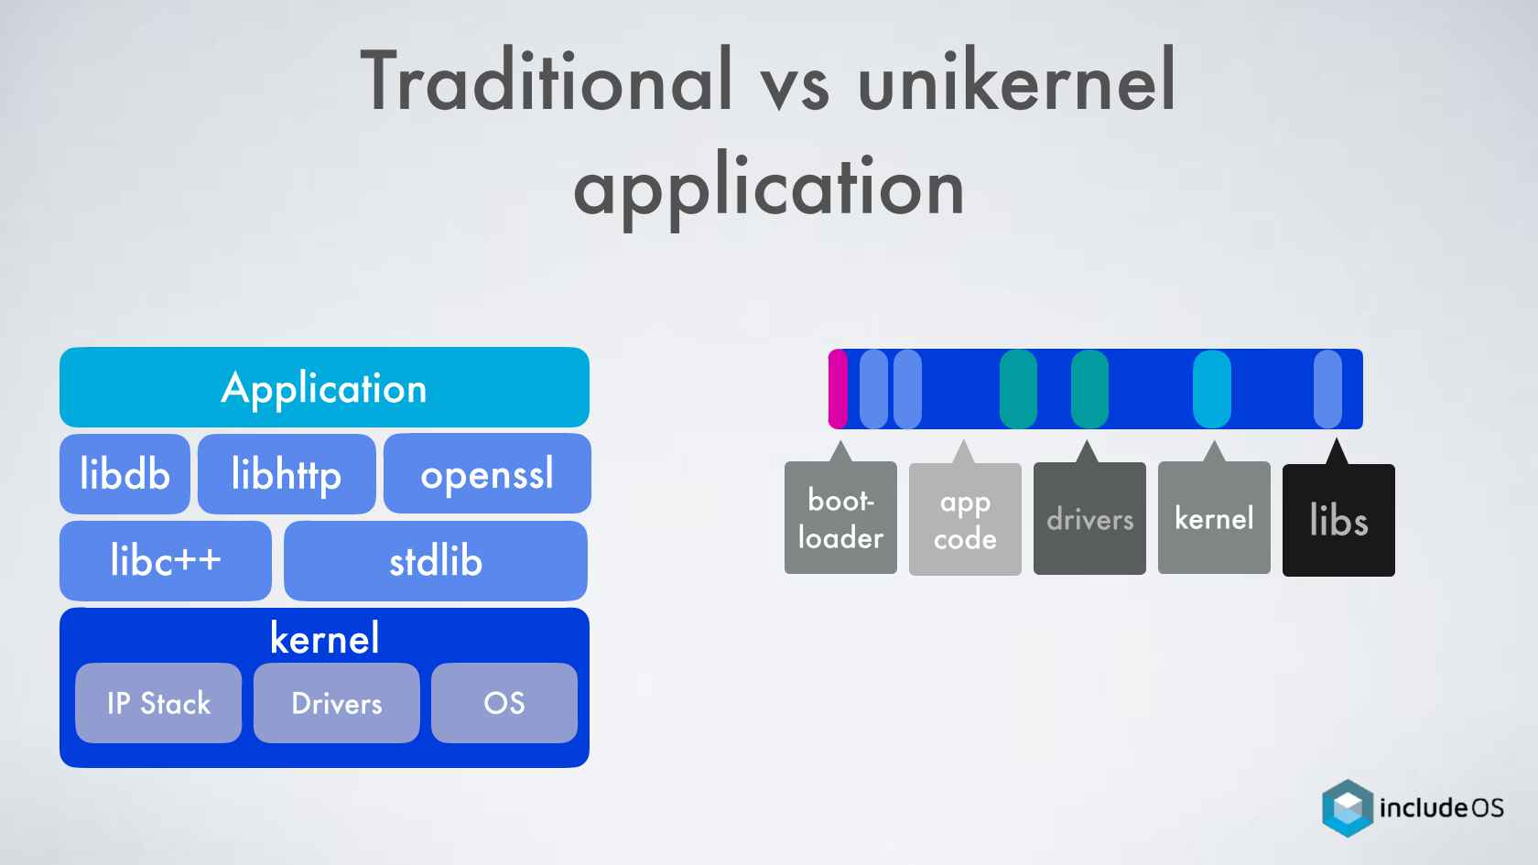
System Architecture of Unikernel
Lighter than LWK
Custom operating system compiled from source code with only necessary modules.
All in one.

Slide 8
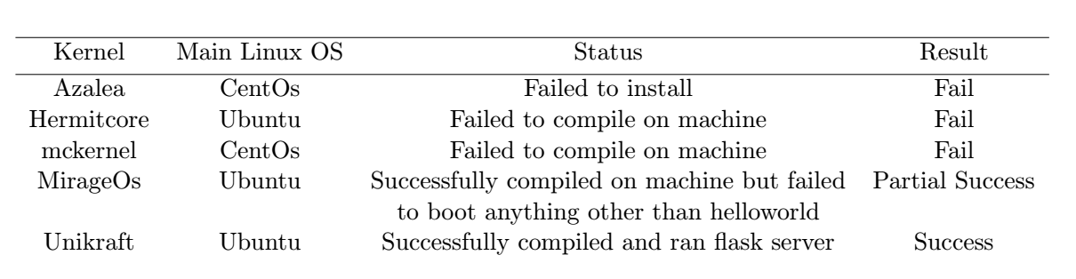
Experiments

Slide 9
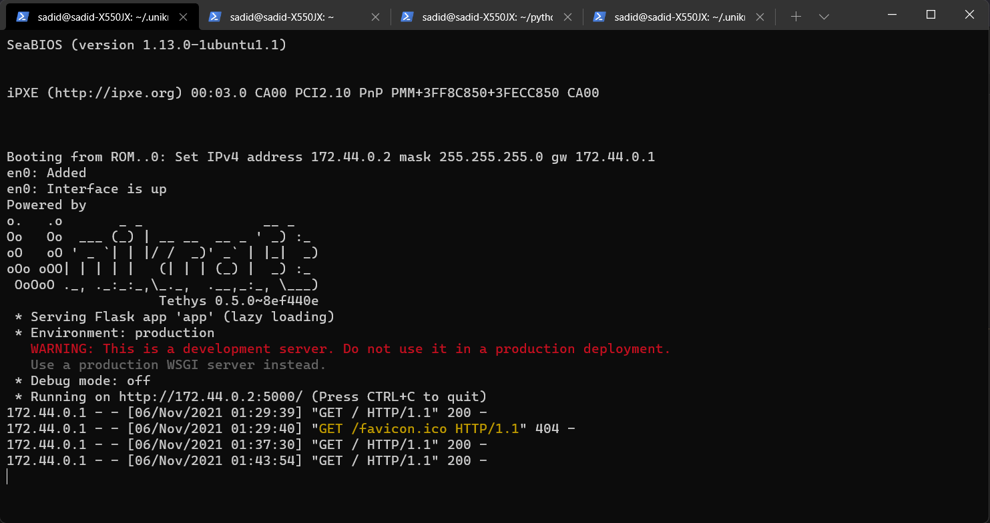
Experiments (continued)
Successfully booted Unikraft unikernel.
Able to run flask server on Unikraft.
Compared power consumptions and boot time.

Slide 10
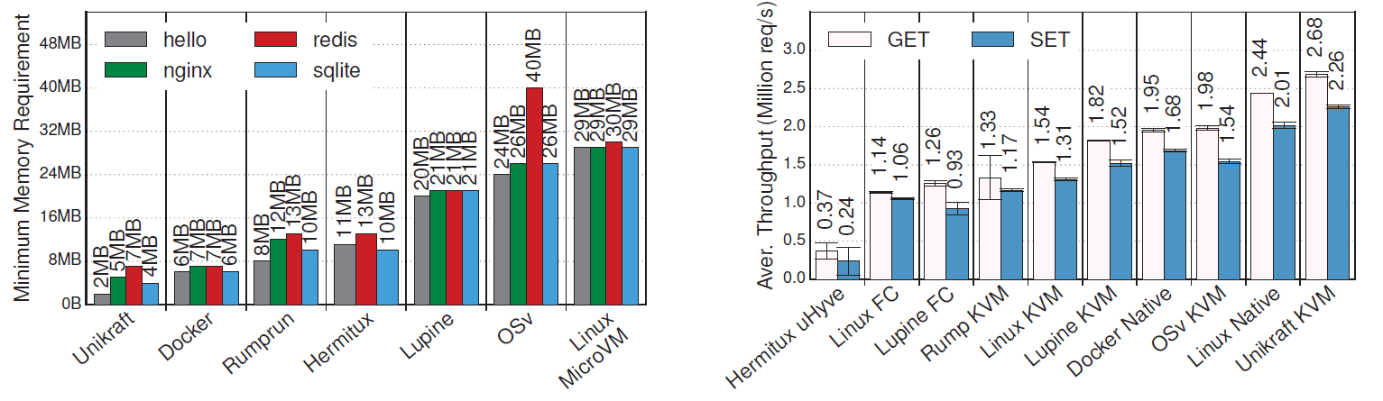
Performance and power consumption comparison of Unikraft
10%-15% faster than Native Linux while running in KVM
Requires less memory than competitors
Boots within 3 seconds

Slide 11
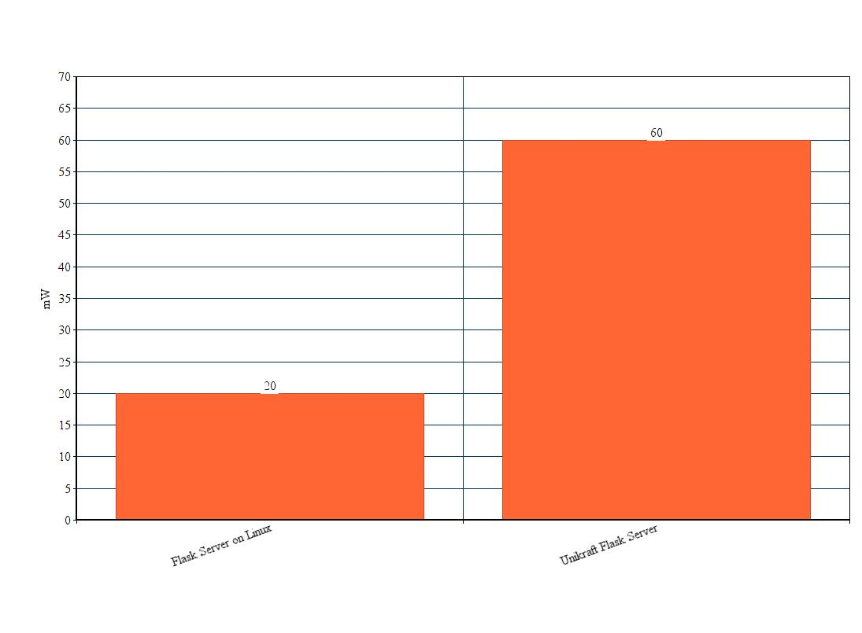
Average Power consumption

Slide 12
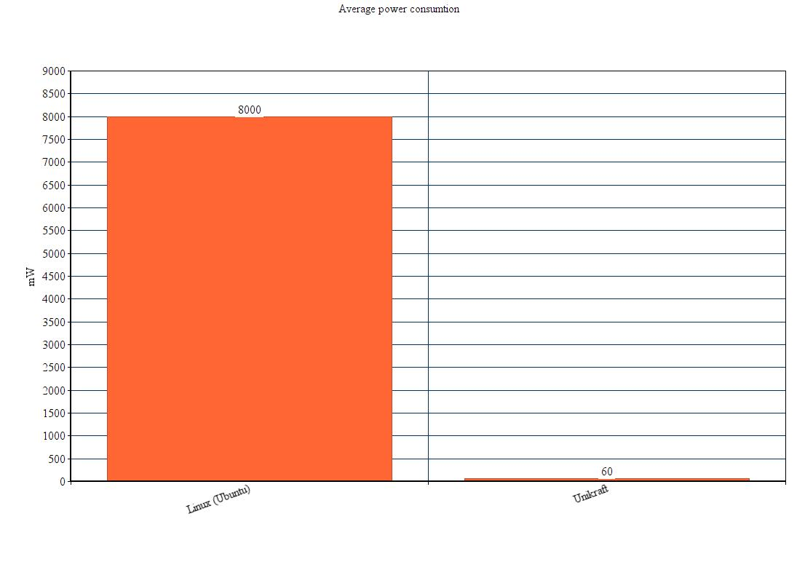
Power consumption (continued)

Slide 13
Reality

Slide 14
Availability
Most only available for some specific server cpus like Intel Xeon and Fujitsu A64FX
Some available for generic x86_64 cpus
Very limited support for arm64 cpus which is main target for this project

Slide 15
Disadvantages
Hard to implement.
Very specific hardware requirement and limited community support (as for now).

Slide 16
Conclusion and Future work
Promising start
Needs more support
Should be more available

Slide 17
Questions For Audience
For multi-kernel communication, between shared memory and message passing, which one is more scalable?
Is there any similar technique that is currently being used on consumer products?

Slide 18

Any Questions?

