Slide 1
AI SYNERGY HACKATHON 2026 • ROUND 1
HARVESTROUTE
A clearer way to compare where a harvest may actually pay.
Case 02 • Agriculture — The Harvest Decision Window
Team: Casual Tea Members: Srushti Rawal
Namya Kalani
Aditya Tomar
Aryaman Goyal

Slide 2
CASE UNDERSTANDING
This is a decision problem, not just a data problem
Official case: Agriculture 02, pp. 5 and 11.
Farmers must choose when and where to sell a highly perishable crop.
Reported prices vary, but the price a particular lot can obtain is uncertain.
Transport/loading may erase a distant market’s headline advantage.
Connectivity is intermittent and trusted local relationships matter.
The case’s numbers are simulated competition inputs, not verified local statistics.

Slide 3
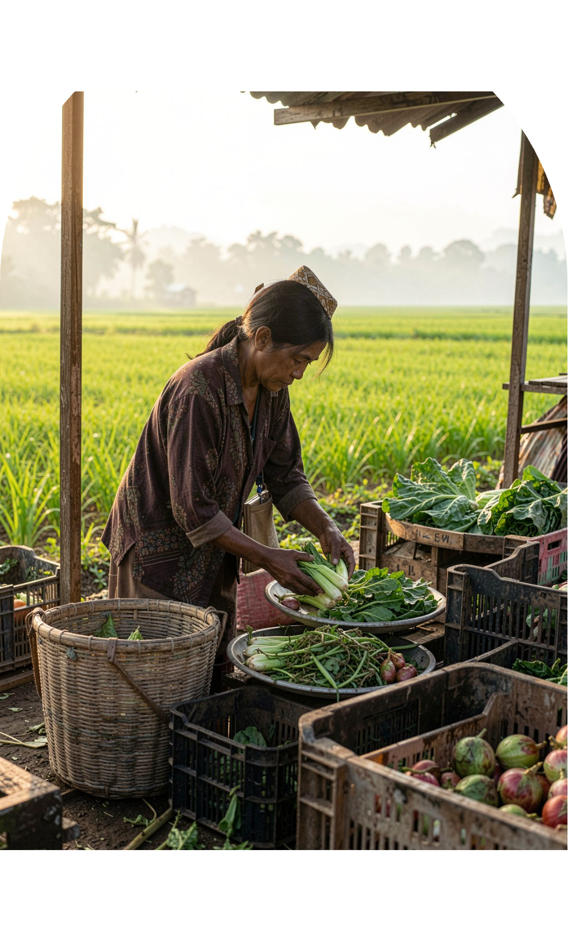
MAP
Who is affected—and what do we still not know?
Primary: small and marginal vegetable farmers; other stakeholders include FPOs, aggregators, transporters, traders/market committees and extension workers.
Unknown: obtainable lot price, grade deductions, route costs by load size, local data freshness and preferred low-connectivity channel.
Human risk: a wrong recommendation may cost the farmer time, transport money or crop quality.
Adoption risk: a technically good app may fail if it ignores trusted routines or unreliable data.

Slide 4
DIVERGE
Four plausible problem framings
We choose the framing that can be tested before asking farmers to trust a prediction.
Price discovery | useful, but reported prices already exist and may not be achievable for the farmer’s lot.
Price / harvest prediction | potentially useful, but data-hungry and risky if local validation is weak.
Collective selling / shared transport | could help, but needs coordination, volume and operational partners.
Net-realisation comparison | narrowest testable option that accounts for price, grade, costs and data quality.

Slide 5
INVESTIGATE
Existing tools change what a good solution looks like
Source links and what each source can/cannot establish are in the accompanying brief.
Reported market information
Advisory and marketplace tools
Therefore, “prices + weather + AI chatbot” alone is not a strong differentiator.
AGMARKNET / OGD: reported daily wholesale min/max/modal prices; modal price is not a guaranteed individual offer.
e-NAM: electronic bidding and related workflows in participating markets.
DeHaat Kisan: app listing describes mandi prices, weather/crop advisory and expert access.
AgriBazaar / Ninjacart: digital marketplace and supply-chain models already exist.

Slide 6
DECIDE
Our final problem statement
Smallholder vegetable farmers lack a reliable, low-connectivity way to compare feasible selling options
using the price they may actually obtain for their crop/grade and quantity, after route-specific selling costs, while understanding when information is stale, incomplete or uncertain.
Why this one: it addresses the actual selling decision, is more tractable than prediction and can be evaluated against actual sale records.

Slide 7
WORKFLOW
From farmer input to a cautious comparison
1. Enter lot details
2. retrieve/select matching price records
3. validate grade, unit and timestamp
4. Confirm costs
5. calculate deterministically
6. display comparison and uncertainty
7. Farmer/facilitator verifies quote and feasibility
8. farmer makes the decision
If data are missing, stale or conflicting, the system says so; it does not invent a “best market.”

Slide 8
CALCULATION
The number must be explainable
SALEABLE QUANTITY
ESTIMATED NET REALISATION
saleable quantity × matched price − transport − loading − commission − other selling costs.
with L an explicit loss/downgrade assumption.
Unknown costs are not silently set to zero; incomparable grades or units are not ranked.
AI can explain; deterministic code calculates; humans verify; farmer decides.

Slide 9
RESPONSIBLE AI
Human-AI collaboration with clear boundaries
AI
Code
optional Hindi/mixed-language input parsing and plain-language explanation grounded in displayed data.
unit conversion, arithmetic, freshness checks, input validation and ranking.
Humans
No fabricated prices, autonomous selling, guaranteed income/yield/price claims or unauthorised agronomic/financial advice.
verify quote, grade, costs and route practicality; farmer retains final authority.

