Slide 1

Team Research Pulse
HACKATHON SUBMISSION

Slide 2

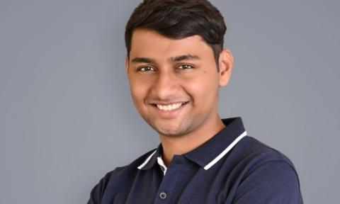
MEET THE TEAM
AI Engineer
AI Engineer
Sruthi Shivaramakrishnan
Astik Jadhav
Astik is an AI engineer who is passionate about machine learning, automation, and making AI do the boring stuff for us. When not building smart systems, he’s fine-tuning models—or wondering if they’re fine-tuning him.
Sruthi loves building AI projects that create real impact, from accessibility to education. A passionate classical singer, she integrates AI into her music to refine her pitch and compositions. Some AI-generated lyrics leave her laughing, but if a machine ever loves classical music, she’s probably behind it.

Slide 3
GLOBAL RESEARCH CHALLENGES
The growing reliance on global research collaboration is hindered by key challenges, including 7 typical problems identified through expert interviews, such as lack of commitment and ineffective communication, which threaten productivity and the success of scientific work worldwide.
Capacity and competence concerns
Fragmented ecosystem
Infrastructure limitations
High R&D Costs
R&D requires a lot of expenditure limiting research capabilities and hindering international collaborations.
Lack of coordination between academia, industry, and government creates silos, preventing effective collaboration on research projects.
Some international collaborators perceive a gap in research capacity and competence, leading to hesitation in collaborations.
Inadequate research infrastructure, including lack of specialized equipment and biobanks, can hinder collaborative projects, particularly in biomedical research.

Slide 4
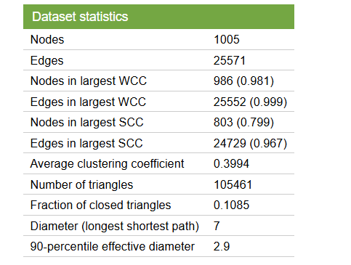
DATASET CHOSEN : EU EMAIL COMMUNICATION NETWORK
About Data
The network, based on anonymized email data from a European research institution, includes all internal communication between members. An edge (u, v) indicates that person u sent at least one email to person v. The dataset also provides "ground-truth" community memberships, assigning each individual to one of 42 departments. This network represents the core of the email-EuAll network, which also includes external connections with different node IDs.
Link to dataset: https://snap.stanford.edu/data/email-Eu-core.html

Slide 5

WHY WE CHOSE THIS DATA?
Relevance to Research Collaboration
Solving Research Collaboration Problems
Communication patterns reveal collaboration dynamics, helping identify potential issues.
Identifies challenges like communication barriers, improving collaboration strategies.
Potential for Enriched Data
Why This Dataset is Valuable
Future additions of nodes and data can deepen insights into research collaboration.
Focused on internal communication, providing clear insights into institutional research collaboration.

Slide 6
Notebook Walkthrough
TEAM RESEARCH PULSE

Slide 7
Demo
TEAM RESEARCH PULSE

Slide 8
Thank you!
TEAM RESEARCH PULSE

