Slide 1
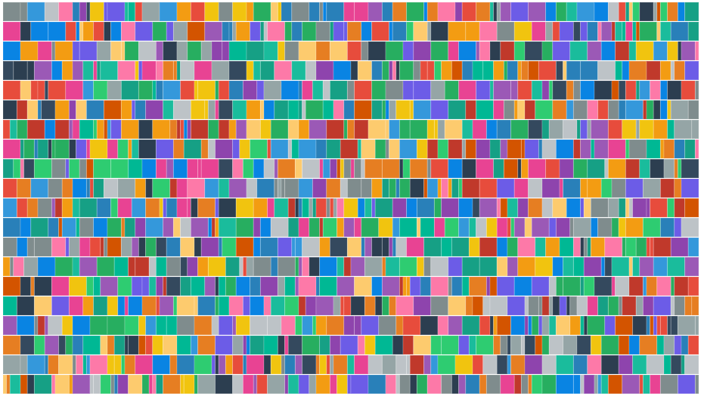
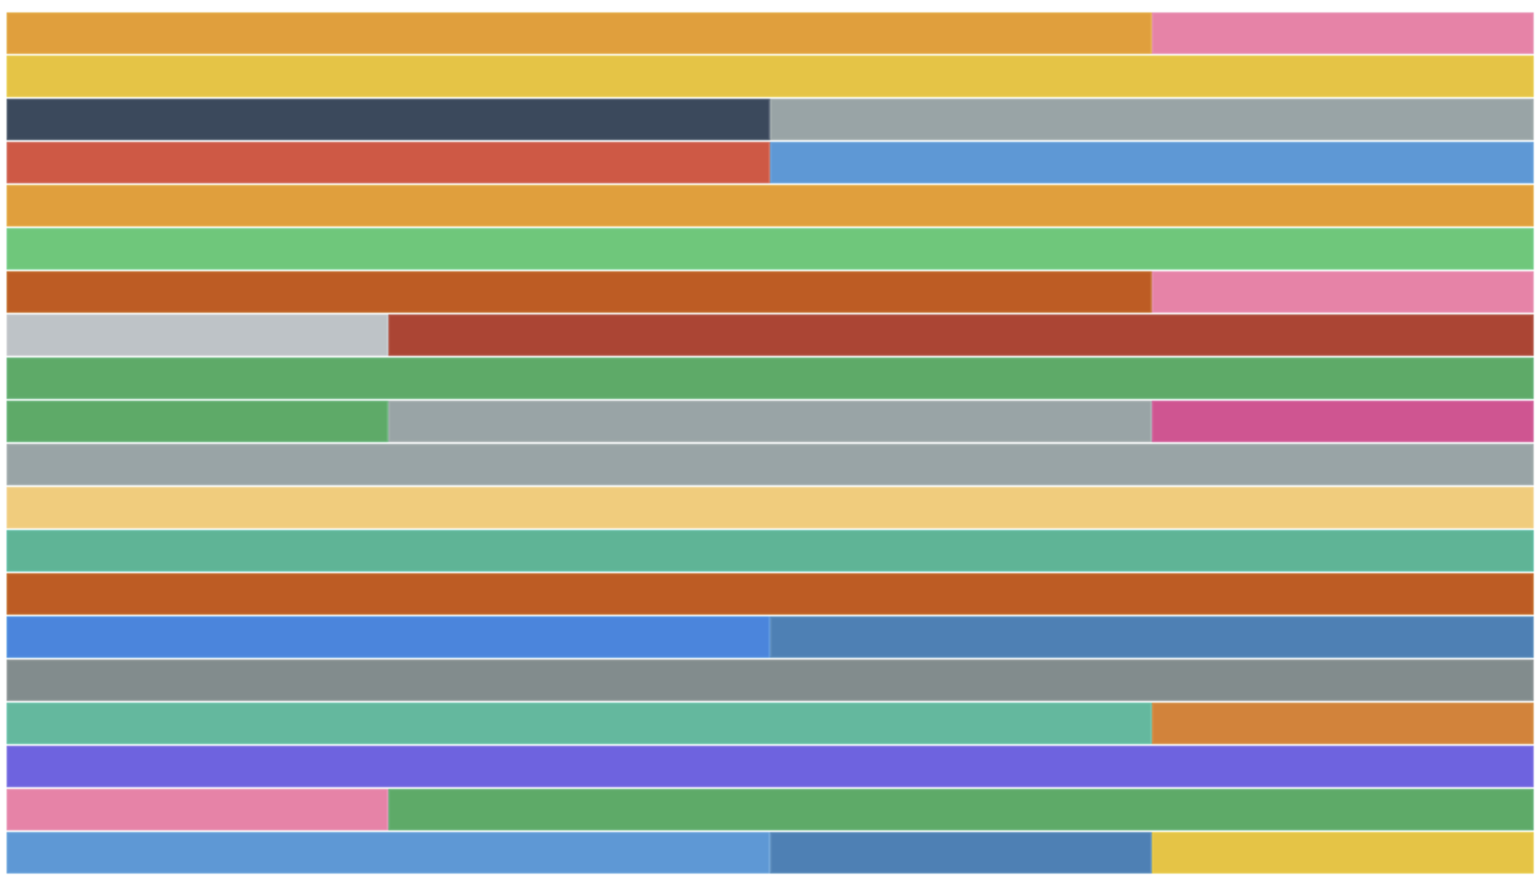
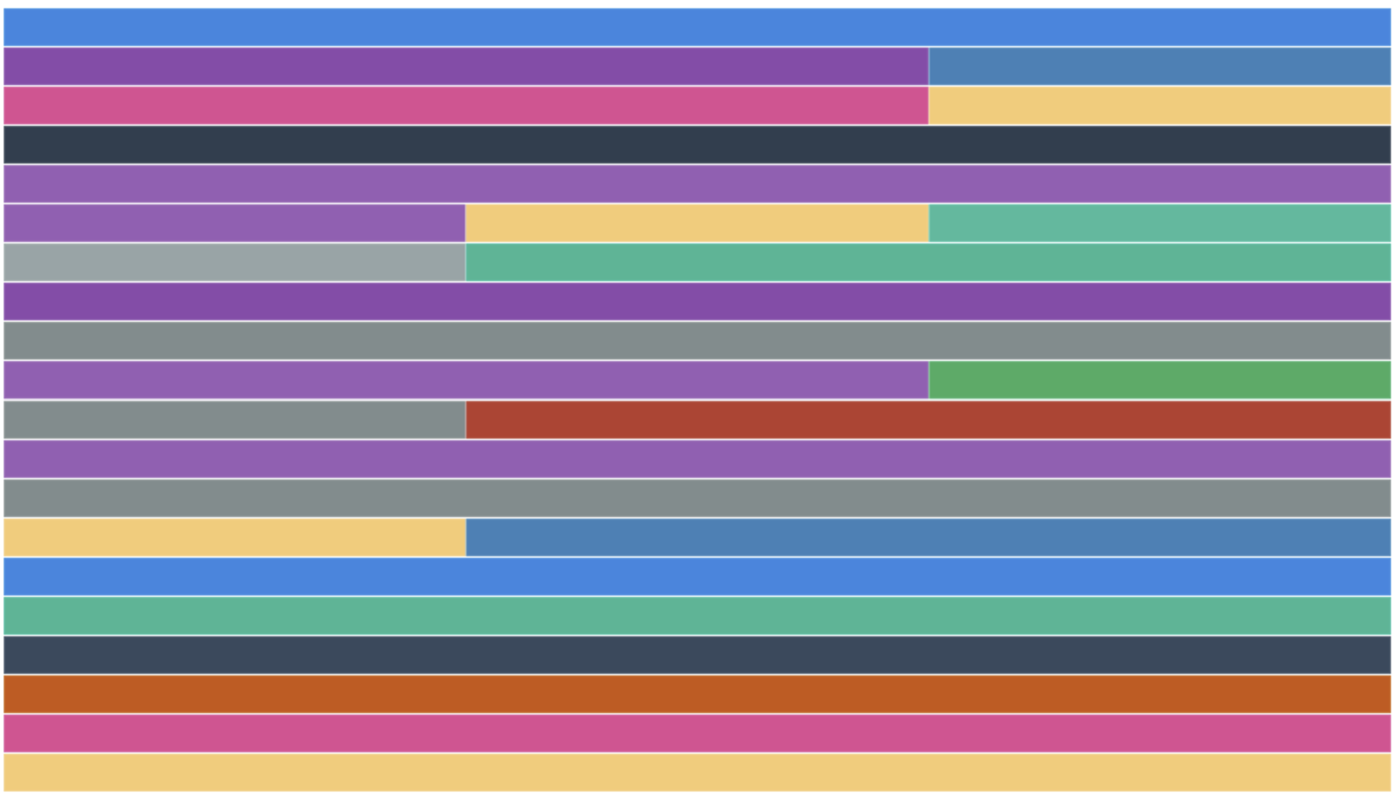
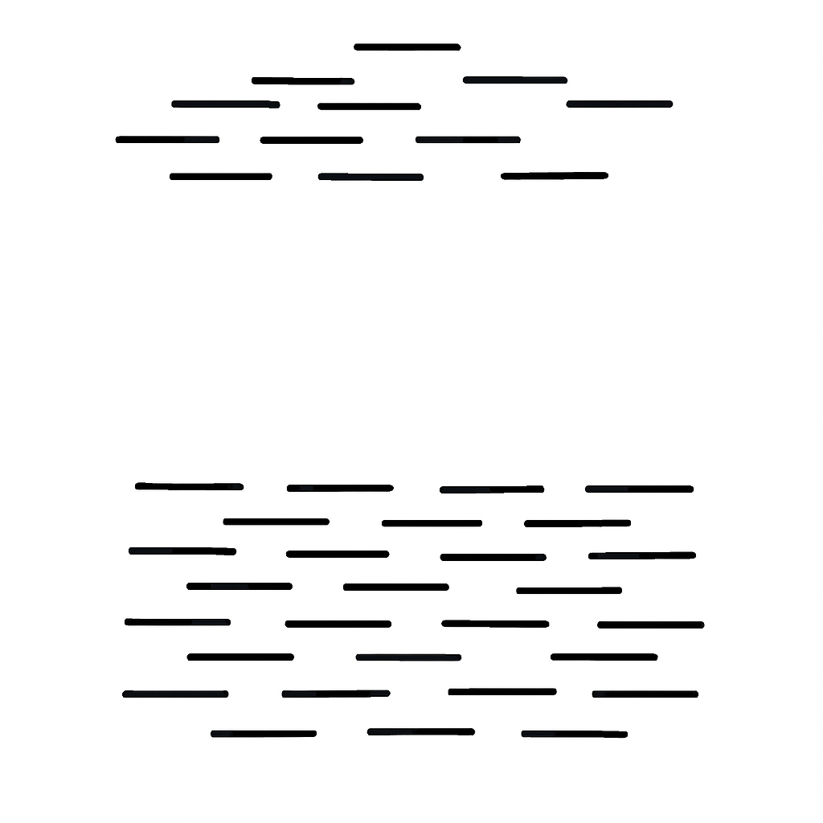
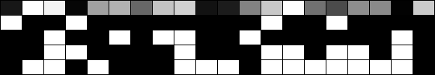
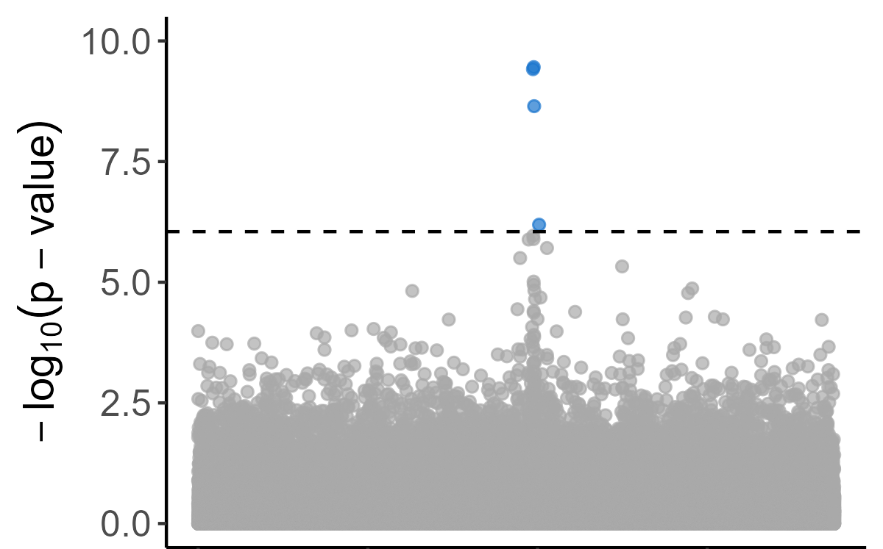
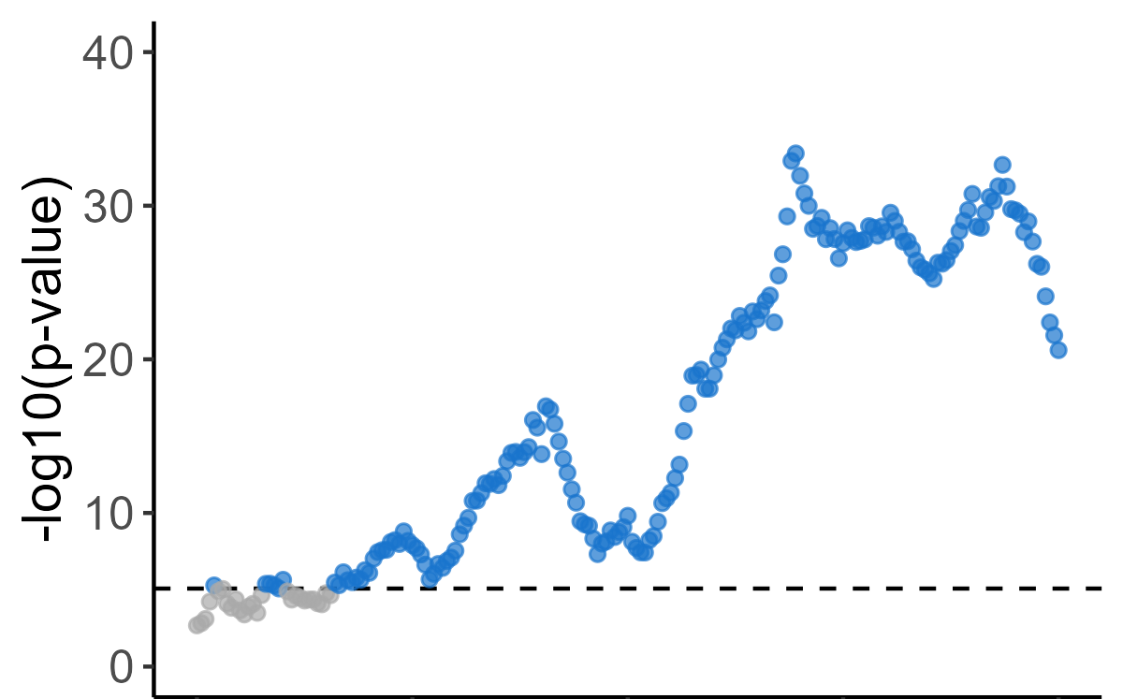

A
Outbred population
B
Multi-Parent Panel
Haplotypes
Haplotypes
Data:
Data:
Cases
Cases
Controls
Controls
SNPs
SNPs
 | REF | ALT
Cases | 52 | 48
Controls | 50 | 50
Controls
Y
Founders
X
 | REF | ALT
Cases | 46 | 54
Controls | 52 | 48
$${(Y−X\hat{f})}^{2}$$
 | f₁ | f₂ | … | f_{n}
Cases | 0.03 | 0.10 | … | 0.25
Controls | 0.05 | 0.12 | … | 0.20
Result: SNP-by-SNP Chi-square on counts; power is inversely proportional to binomial errors on coverage
Result: Window-based contrast of imputed haplotype frequencies; power is inversely proportional to errors imputed on frequencies

