Slide 1
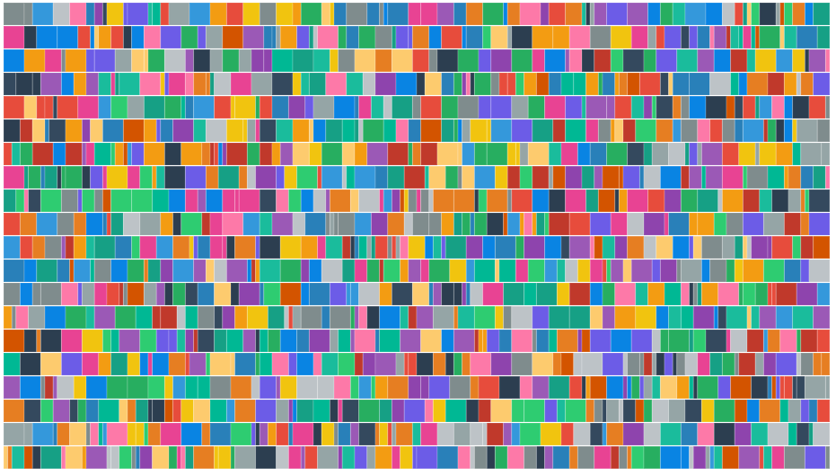
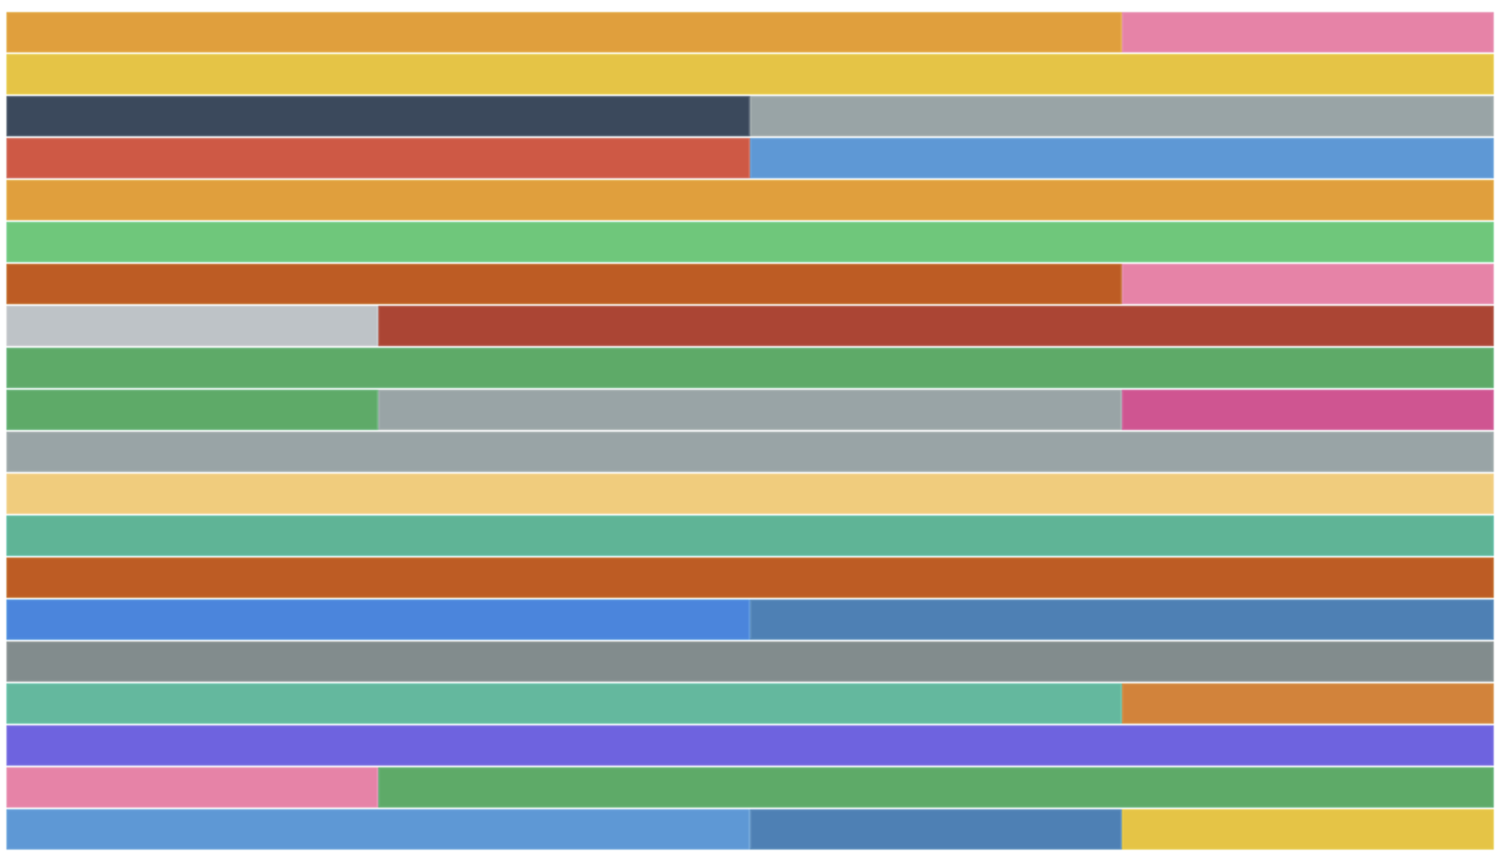
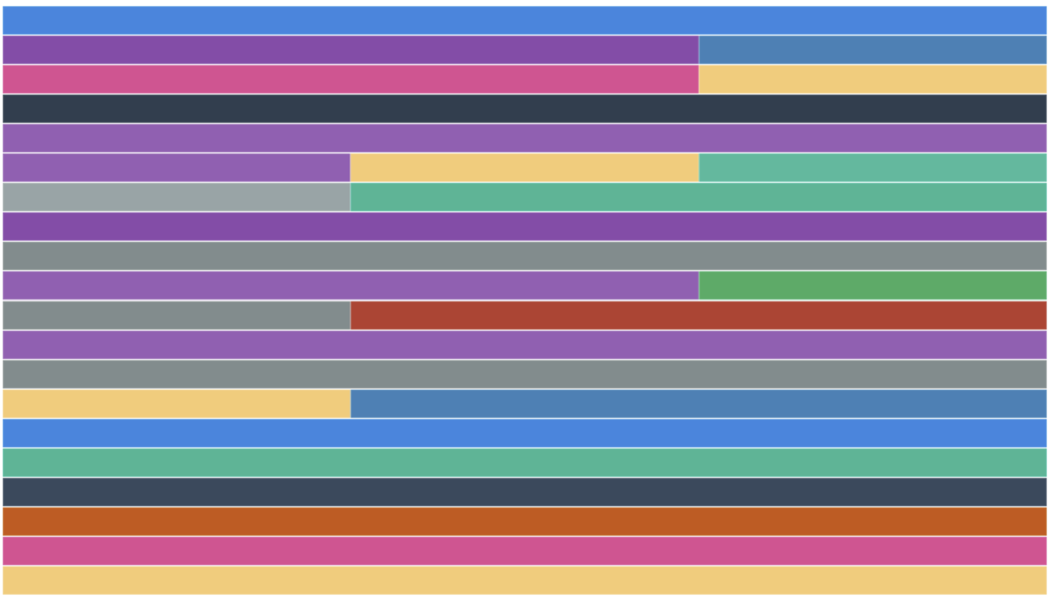
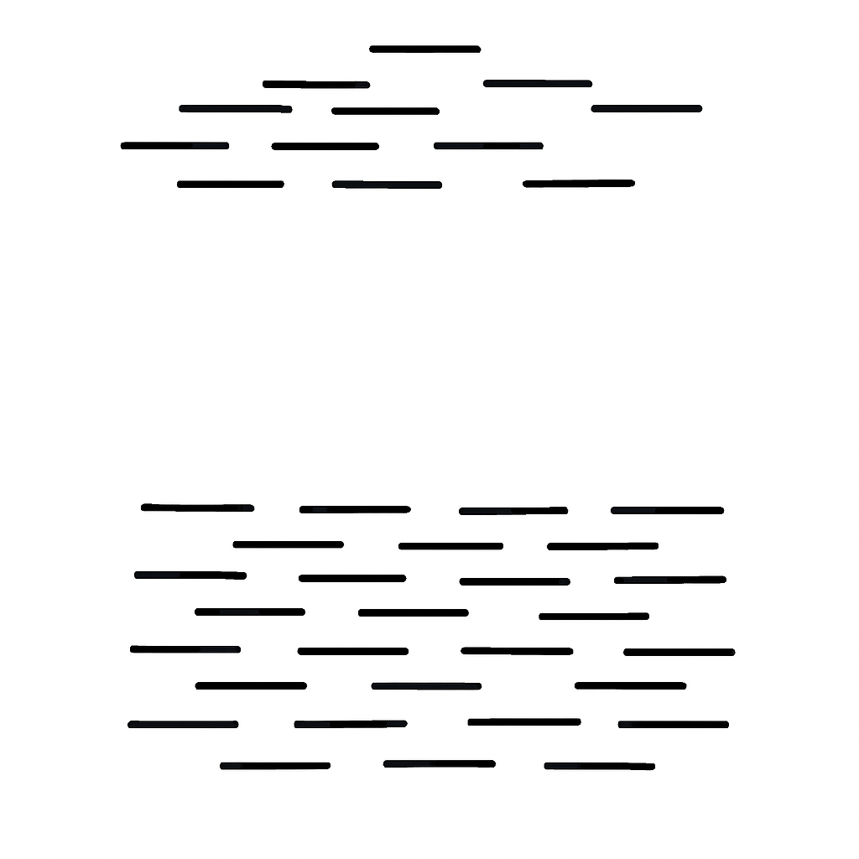
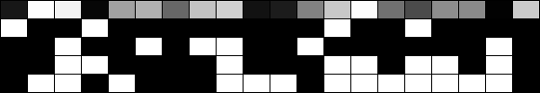

A
Outbred population
B
Multi-Parent Panel
Haplotypes
Haplotypes
Data:
Data:
Cases
Cases
Controls
Controls
SNPs
SNPs
 | REF | ALT
Cases | 52 | 48
Controls | 50 | 50
Controls
Y
Founders
X
 | REF | ALT
Cases | 46 | 54
Controls | 52 | 48
 | f_{Y1} | f_{Y2} | … | f_{Yn}
Cases | 0.03 | 0.10 | … | 0.25
Controls | 0.05 | 0.12 | … | 0.20
$${Minimize: (Y−X{\hat{f}}_{Y})}^{2}$$
Result: SNP-by-SNP Chi-square on counts; power is inversely proportional to binomial errors on coverage
Result: Haplotype-by-Haplotype Chi-square; Widow-based contrast of imputed frequencies; Power is inversely proportional to errors imputed on frequencies

