Slide 1
Digital Portfolio
STUDENT NAME: K.Srudhi
REGISTER NO AND NMID: B978FD5EE9EB4B1B9B3498157214C037
DEPARTMENT: B.C.A
COLLEGE: COLLEGE/ UNIVERSITY: S.I.V.E.T College

Slide 2
PROJECT TITLE
PORTFOLIO

Slide 3


AGENDA
Problem Statement
Project Overview
End Users
Tools and Technologies
Portfolio design and Layout
Features and Functionality
Results and Screenshots
Conclusion
Github Link
3/21/2024 Annual Review

Slide 4

PROBLEM STATEMENT
As a fresher, I need a portfolio website to showcase my skills, education, and achievements in a clear and professional way. This will help me stand out to recruiters and create a strong online present

Slide 5

PROJECT OVERVIEW
This portfolio website is created to showcase my skills, education, certifications, and projects. It is built with HTML, CSS, and JavaScript to make it simple, responsive, and user-friendly. The website acts as my online resume and helps me present myself professionally to recruiters and others.

Slide 6

WHO ARE THE END USERS?
1. Recruiters and Hiring Managers – to quickly evaluate the candidate’s skills, qualifications, and projects.
2. Academic Institutions/Faculty – to review the student’s achievements and projects for academic purposes.
3. Peers and Professionals – to collaborate, share knowledge, and connect professionally.
4. The Portfolio Owner (Self) – to build an online presence, showcase skills, and continuously update personal and professional growth.

Slide 7

TOOLS AND TECHNIQUES
1. HTML5 – For structuring the content and layout of the portfolio website.
2. CSS3 – For designing, styling, and creating a responsive, visually appealing interface.
3. JavaScript – For adding interactivity, smooth transitions, and dynamic behavior.
4. Visual Studio Code (VS Code) – As the code editor for development.

Slide 8
POTFOLIO DESIGN AND LAYOUT
My portfolio is designed with a simple and clean layout. It includes sections like Home, About Me, Skills, Projects, and Contact. The design is responsive so it looks good on both computers and mobile devices.
8

Slide 9
FEATURES AND FUNCTIONALITY
Responsive design (works on mobile and desktop)
Easy navigation with menu
Home, About, Skills, Projects, and Contact sections
Smooth scrolling and animations
Hosted online for easy access

Slide 10
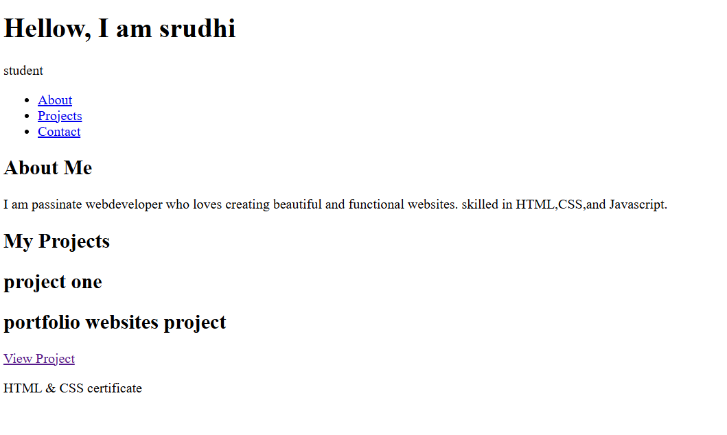

RESULTS AND SCREENSHOTS
3/21/2024 Annual Review
10

Slide 11
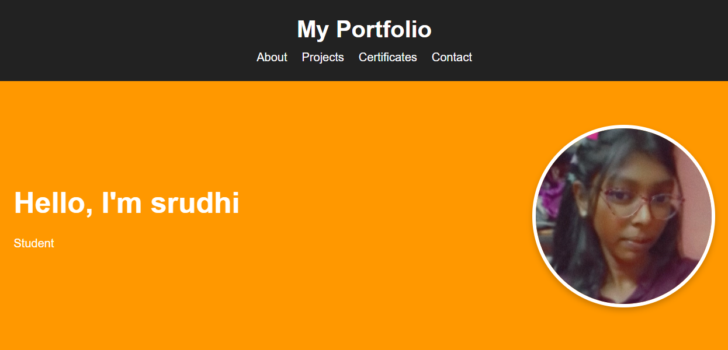

Slide 12
CONCLUSION
My portfolio is a simple and responsive website that highlights my skills, education, and projects. It acts as my online resume and can be updated as I grow in my career.
12

