Slide 1
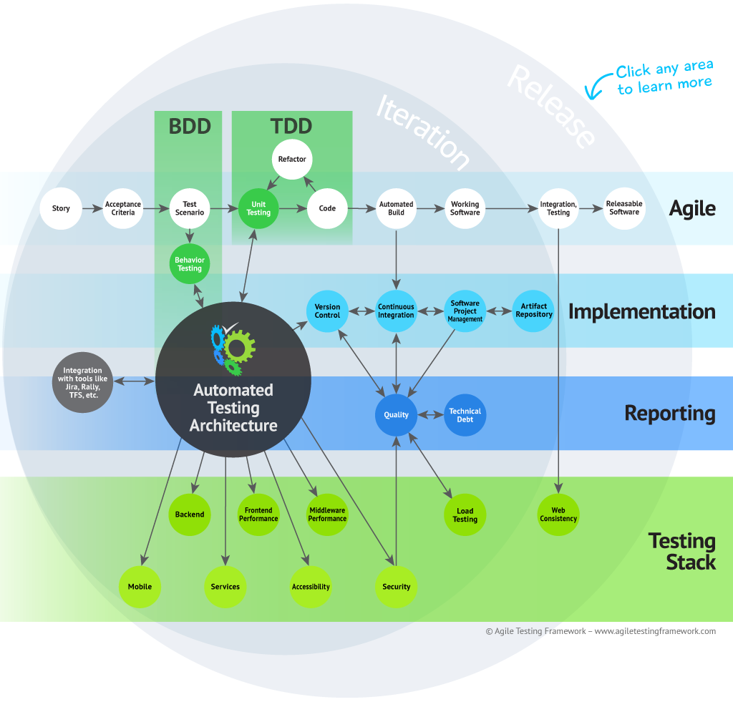
Agile Testing Framework
Introduction to DevOps

Slide 2
Introduction to DevOps
Pre-convergence
  Syntax Checking (RuboCop)
  Lint Checking (Foodcritic)
  Unit Test (ChefSpec)
Convergence
Post-Convergence
  Integration Tests (ServerSpec,MiniTest, BATS)
  Uses Test Kitchen
www.AgileTestingFramework.com

Slide 3
Introduction to DevOps
ChefDK
  RuboCop
  Foodcritic
  Rspec runs ChefSpec
  Test Kitchen (kitchen.ci)
    Uses Vagrant/VirtualBox to create a VM
    Test command runs integration tests
www.AgileTestingFramework.com

Slide 4
Introduction to DevOps
kitchen converge
  Starts VM, Converges
    Allows you to login to manually verify
kitchen verify
  Starts VM, Converges, Runs Integration Tests
kitchen test
  Starts VM, Converges, Runs Integration Tests, Destroys VM
www.AgileTestingFramework.com

Slide 5
Introduction to DevOps
Short
Demo
www.AgileTestingFramework.com

Slide 6
Introduction to DevOps
RuboCop
  http://batsov.com/rubocop/
Foodcritic
  https://acrmp.github.io/foodcritic/
ChefSpec
  http://sethvargo.github.io/chefspec/
ServerSpec
  http://serverspec.org/
www.AgileTestingFramework.com

Slide 7
Introduction to DevOps
Thank you
Questions
More info can be found at
http://www.agiletestingframework.com/contact-us/
www.AgileTestingFramework.com

