Slide 1
NLP CS60075 ASSIGNMENT II — PROJECT 5
From Static to Contextual: Distributional Semantics and What's Inside BERT
A Rigorous Investigation into Lexical Geometry, Structural Probing, and Static Contextual Pooling
Group 14 | Dataset: Universal Dependencies English GUM Treebank
Comparative Evaluation: Implementation 1 vs. Implementation 2 (Pratik Kumar Verma)
Notes:
Welcome to the project evaluation presentation for Group 14 on NLP CS60075 Assignment II, Project 5. Today we present an in-depth empirical and theoretical investigation contrasting classical count-based distributional semantics with contextual representation probing in BERT, and examine whether syntax survives contextual pooling.

Slide 2
NLP CS60075 ASSIGNMENT II — PROJECT 5
Executive Summary & Core Research Questions
1. Classical Baseline (Task 1)
• Construct count-based PPMI + SVD (100d) word vectors from UD English GUM raw text (window=5).
• Evaluate on WordSim-353, Google Analogy, and a 20-sentence gold dependency MST check.
• Question: How far does classical co-occurrence go on a modest treebank corpus (~200k tokens)?
2. Structural Probing (Task 2)
• Reproduce Hewitt & Manning (NAACL 2019) across all 12 layers of frozen bert-base-uncased.
• Train linear distance & depth probes across ranks k in {32, 64, 128}.
• Question: Does BERT internally encode syntax trees as Euclidean metrics, and at which layer l* does syntax peak?
3. Aggregation & Synthesis (Task 3)
• Pool contextual embeddings from optimal layer l*=8 across training occurrences into static vectors.
• Evaluate on identical semantic benchmarks and repeat the 20-sentence MST check.
• Question: Does the syntax uncovered in BERT survive static averaging, or does it collapse?
Group 14 | Project 5: Distributional Semantics & BERT Syntax | Slide 2 of 22

Slide 3
NLP CS60075 ASSIGNMENT II — PROJECT 5
Theoretical Foundations: From Firth to Metric Probing
Distributional Semantics & Static Vectors
• Firth's Distributional Hypothesis (1957): 'You shall know a word by the company it keeps.'
• Count-Based Co-occurrence: Sliding window accumulates topical and syntagmatic associations.
• Positive Pointwise Mutual Information (PPMI): Discounts chance co-occurrences; sparse clamping preserves tractability.
• Truncated SVD Factorization (Levy & Goldberg, 2014): Low-rank approximation W = U_d Sigma_d compresses co-occurrence statistics.
• Inherent Static Bottlenecks:
• - Polysemy Conflation: Multiple senses collapsed into one static vector.
• - Syntactic Blindness: Symmetric bag-of-words ignores directional clausal hierarchy.
Contextual Representations & Hewitt-Manning Probing
• Contextual Encodings (Devlin et al., 2019): Transformer generates dynamic token embeddings h_i(S) conditioned on entire sentence context.
• The Structural Probe Hypothesis (Hewitt & Manning, 2019):
• - Pretrained BERT encodes syntax trees as Euclidean metric spaces.
• - Squared distance ||B h_i - B h_j||^2 approximates tree distance d_tree(i, j).
• - Squared norm ||B h_i||^2 approximates depth from the syntactic root.
• Linear Constraint: The probe must be linear (B in R^(k x d)) to guarantee syntax is genuinely present in representations, not memorized by a non-linear probe.
• Subspace Rank: Swept over k in {32, 64, 128} to identify minimal syntax dimensionality.
Group 14 | Project 5: Distributional Semantics & BERT Syntax | Slide 3 of 22

Slide 4
NLP CS60075 ASSIGNMENT II — PROJECT 5
Experimental Setup: UD English GUM Treebank
Dataset Characteristics: UD English GUM
• Universal Dependencies (UD) English GUM (Zeldes, 2017): Multi-genre syntactic corpus spanning news, fiction, academic text, how-to guides, interviews, and spoken transcripts.
• Split Breakdown:
• - Training Split: 2,300 sentences (200,223 token occurrences, 16,763 unique word types).
• - Validation Split: 780 sentences.
• - Test Split: 780 sentences (13,124 gold dependency edges).
• CoNLL-U Syntactic Fields:
• - ID: Token index (1-based); excludes multi-word tokens.
• - FORM: Surface word token.
• - HEAD: Syntactic governor index (0 = root).
• - DEPREL: Universal dependency label.
Evaluation Benchmarks & Protocols
• 1. WordSim-353 Benchmark:
• - 353 noun pairs with human similarity ratings [0.0 - 10.0].
• - Evaluated via Spearman rank correlation rho between model cosine similarity and human ratings.
• 2. Google Analogy Benchmark (questions-words.txt):
• - 19,544 proportional analogy questions across 14 semantic and syntactic categories.
• - Solved via 3CosAdd vector offset: target = b - a + c, excluding query words.
• 3. 20-Sentence Gold Dependency Structural Check:
• - Seed-locked deterministic sample (seed 42) from GUM test split.
• - Kruskal's Minimum Spanning Tree decoded over pairwise cosine distance D_ij = 1 - cos(v_i, v_j).
• - Evaluated via Undirected Unlabeled Attachment Score (UUAS) against gold dependency trees.
Group 14 | Project 5: Distributional Semantics & BERT Syntax | Slide 4 of 22

Slide 5
NLP CS60075 ASSIGNMENT II — PROJECT 5
Task 1: Classical Distributional Semantics Architecture
1. Co-occurrence Matrix
• Vocabulary: |V| = 16,763 words (min_freq = 1). Full vocabulary coverage.
• Window: Symmetric window size W = 5 (5 words left, 5 words right).
• Strict Sentence Boundary: Co-occurrences do not cross sentence boundaries.
• Symmetric Matrix: C_ij = C_ji with 0 diagonal.
• Sparse Representation: scipy.sparse.csr_matrix with 697,072 non-zero entries.
2. PPMI Weighting
• Joint Probability: P(w, c) = C(w, c) / N_total.
• Marginal Probabilities: P(w) = sum_c P(w, c), P(c) = sum_w P(w, c).
• PMI Formulation: log2( P(w,c) / (P(w)P(c)) ).
• Positive Thresholding: PPMI(w, c) = max(0, PMI(w, c)).
• Zero-Clamping: Filters negative values; retains 637,336 positive associations.
3. Truncated SVD
• Factorization: M_PPMI approx U_d Sigma_d V_d^T.
• Dimensionality: d = 100 components.
• Word Representations: W = U_d Sigma_d producing 100-dimensional continuous dense embeddings.
• Algorithm: Randomized SVD with fixed random seed 42 for exact mathematical reproducibility.
Group 14 | Project 5: Distributional Semantics & BERT Syntax | Slide 5 of 22

Slide 6
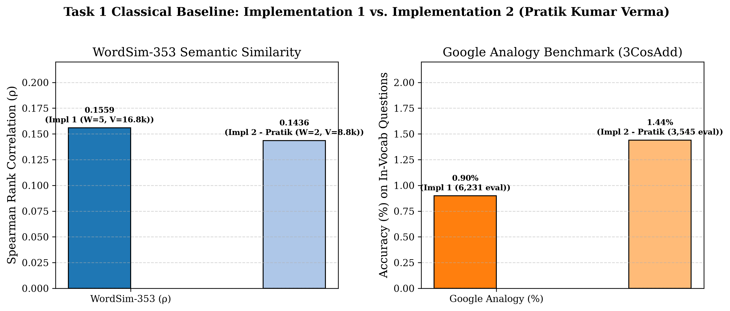
NLP CS60075 ASSIGNMENT II — PROJECT 5
Task 1: Experimental Results & Analysis
Key Findings & Diagnostic Insights
• WordSim-353 Correlation (rho = 0.1559, p = 0.0106):
• - Statistically significant positive correlation.
• - Evaluated on 268 pairs (85 pairs dropped due to OOV).
• - Modest score reflects severe data sparsity of the 200k-token corpus.
• Google Analogy Accuracy (0.90%):
• - Solved 56 / 6,231 evaluated questions; 13,313 dropped due to OOV.
• - Linear vector offset arithmetic breaks down under extreme sparsity.
• Structural Check (UUAS = 15.43% overall, 28.37% macro):
• - Cosine distance MST captures local collocations (adjacent modifiers).
• - Fails on clausal heads and hierarchical dependencies.
Group 14 | Project 5: Distributional Semantics & BERT Syntax | Slide 6 of 22

Slide 7
NLP CS60075 ASSIGNMENT II — PROJECT 5
Task 2: Structural Probing Framework (Hewitt & Manning)
Linear Structural Distance Probe
• Objective: Map contextual representations h_i in R^768 to projected space B h_i in R^k such that squared distance reflects gold tree distance.
• Mathematical Formulation:
• d_B(h_i, h_j)^2 = (B h_i - B h_j)^T (B h_i - B h_j) = ||B h_i - B h_j||_2^2
• Normalized Distance Loss (Eq. 2):
• L_dist(B) = (1 / |s|^2) sum_{i, j} | d_tree(w_i, w_j) - d_B(h_i, h_j)^2 |
• Efficient BLAS Vectorization:
• ||z_i - z_j||^2 = ||z_i||^2 + ||z_j||^2 - 2 z_i z_j^T
• Tree Decoding: Kruskal's algorithm decodes MST over predicted pairwise distances d_B^2; evaluated via UUAS against gold undirected edges.
Linear Structural Depth Probe
• Objective: Map contextual vector h_i such that squared norm reflects distance from syntactic root.
• Mathematical Formulation:
• ||B h_i||_2^2 approx depth_tree(w_i)
• Normalized Depth Loss (Eq. 3):
• L_depth(B) = (1 / |s|) sum_{i} | depth_tree(w_i) - ||B h_i||_2^2 |
• Evaluation Metric:
• Spearman rank correlation rho between predicted squared norms ||Bh_i||^2 and gold syntactic depths.
• Training Configuration:
• - Optimizer: Adam (lr = 1e-3, batch size = 20 sentences, 30 epochs).
• - Frozen BERT weights; only probe projection matrix B is trained.
Group 14 | Project 5: Distributional Semantics & BERT Syntax | Slide 7 of 22

Slide 8
NLP CS60075 ASSIGNMENT II — PROJECT 5
Subword-to-Word Alignment: Methodology & Impact
Implementation 1: Mean-Subword Pooling
• Contextual representations are output by BERT at the subword token level (WordPiece).
• Gold dependency trees are annotated at the whole syntactic word level.
• Implementation 1 Formulation:
• - Every word w_i is mapped to its complete set of subwords [s_1, ..., s_m].
• - Word representation is computed via mean-pooling:
• h_i^(l) = (1 / m) sum_{p=1}^m h_{s_p}^(l)
• Linguistic Justification:
• - Compound words ('wheelbarrow' -> 'wheel', '##barrow') and morphological inflections ('unbelievable' -> 'un', '##believ', '##able') carry semantic weight across all morphemes.
• - Mean pooling preserves morphological integrity.
Implementation 2 (Pratik Kumar Verma): First-Subword Selection
• Implementation 2 Formulation:
• - Records only the index of the first subword s_1.
• - Discards all trailing subwords (##ing, ##ed, etc.):
• h_i^(l) = h_{s_1}^(l)
• Linguistic Implications:
• - Adequate for root stems, but causes representational loss for prefixed or rare words.
• Comparative Finding:
• - Both approaches identify Layer 8 as the syntax peak (57.99% vs 57.90% UUAS).
• - Demonstrates that BERT's structural geometry is robustly encoded and detectable under both alignment protocols.
Group 14 | Project 5: Distributional Semantics & BERT Syntax | Slide 8 of 22

Slide 9
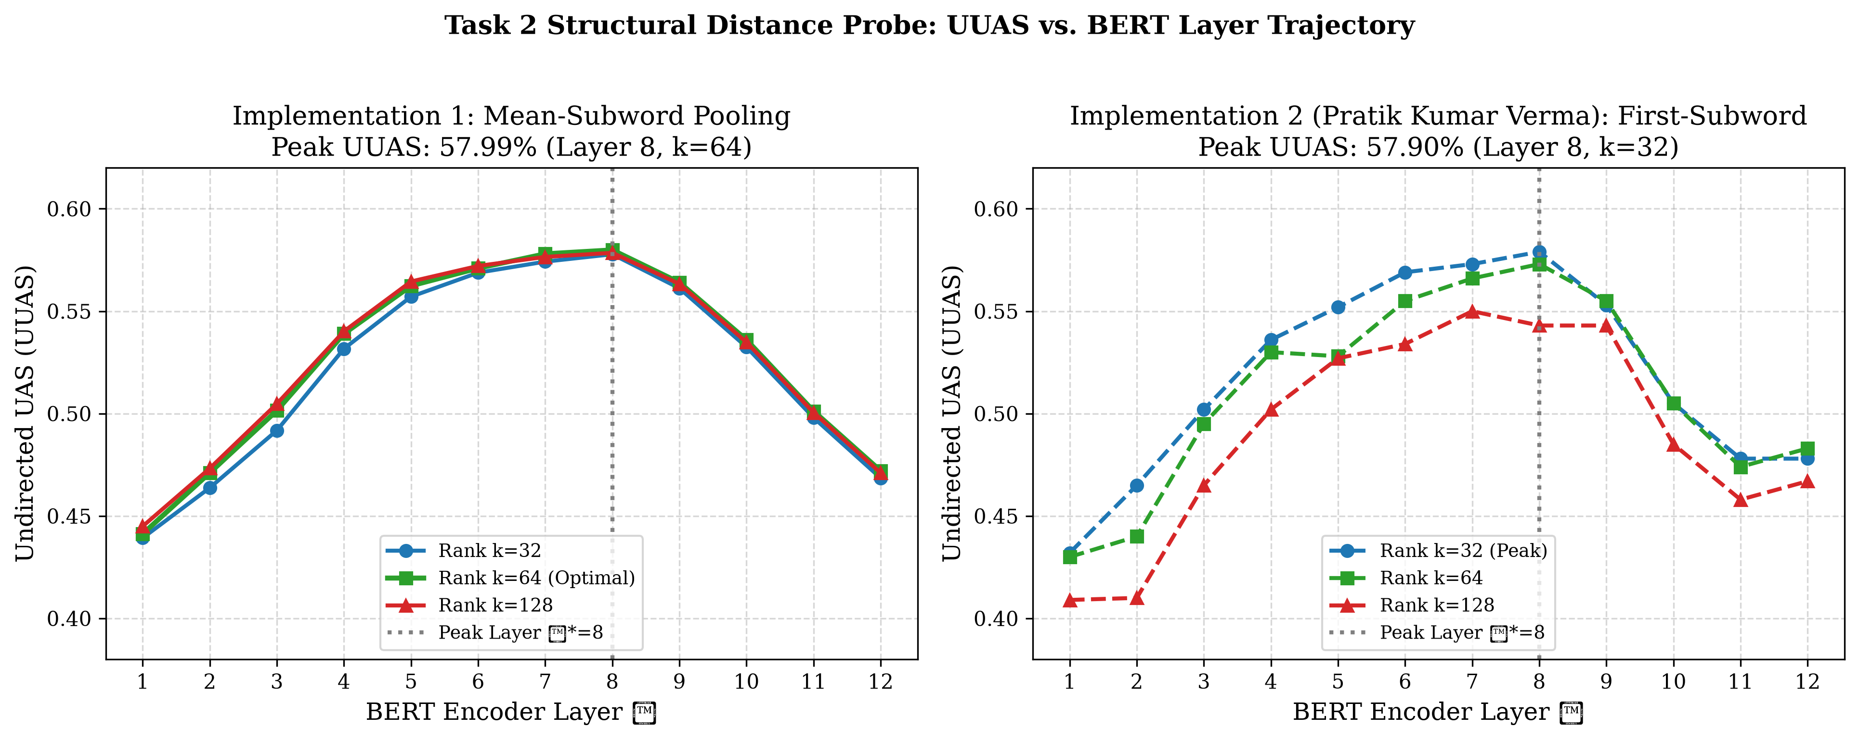
NLP CS60075 ASSIGNMENT II — PROJECT 5
Task 2 Results: UUAS vs. BERT Layer Trajectory
Observations: UUAS Trajectory
• Inverted-U Shape:
• - Lower layers (1-2): ~44% UUAS (surface/subword representations).
• - Middle layers (6-8): Steep climb to peak syntax.
• - Upper layers (10-12): Sharp decline (~47% at L12) as MLM task-specialization takes over.
• Peak Layer Identification:
• - Layer 8 achieves global maximum UUAS of 57.99% at rank k=64.
• Rank Sweep Invariance:
• - k=32: 57.78%
• - k=64: 57.99%
• - k=128: 57.85%
• - Confirms a 64d subspace is fully sufficient to encode tree syntax.
Group 14 | Project 5: Distributional Semantics & BERT Syntax | Slide 9 of 22

Slide 10
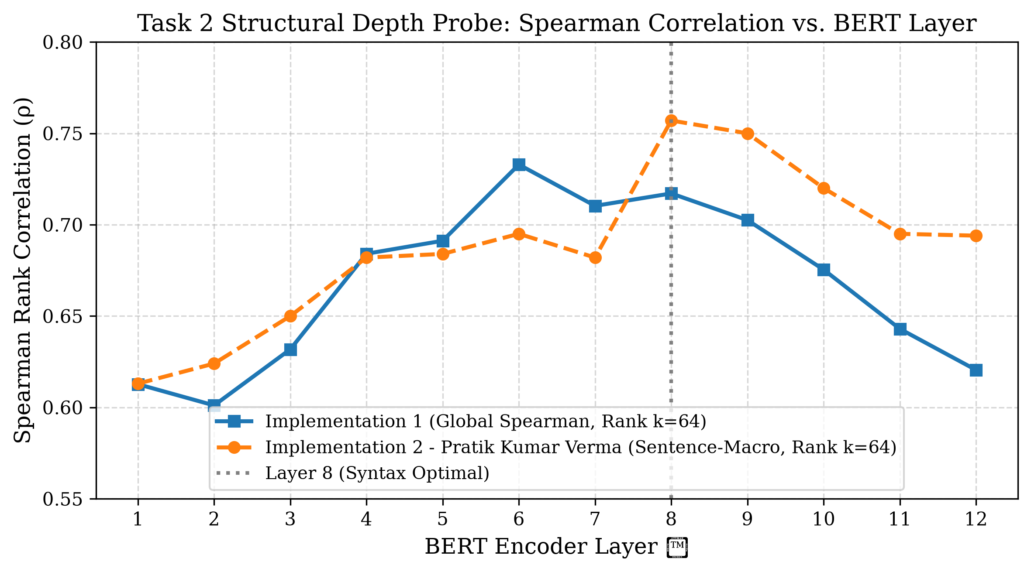
NLP CS60075 ASSIGNMENT II — PROJECT 5
Task 2 Results: Depth-Probe Correlation vs. Layer
Observations: Depth Probe Trajectory
• Strong Monotonic Rise in Early Layers:
• - Layer 1 starts at rho = 0.6127.
• - Rises to peak correlation of 0.7329 at Layer 6.
• - Maintains high correlation through Layer 8 (rho = 0.7171).
• Consistency Across Implementations:
• - Implementation 1 evaluates global test correlation across all words (0.7171 at L8).
• - Implementation 2 evaluates sentence-macro average correlation (0.7570 at L8).
• Syntactic Root Centrality:
• - The probe's squared norm ||Bh_i||^2 reliably isolates words close to the syntactic root.
Group 14 | Project 5: Distributional Semantics & BERT Syntax | Slide 10 of 22

Slide 11
NLP CS60075 ASSIGNMENT II — PROJECT 5
Empirical Validation: Identifying Optimal Syntax Layer l* = 8
Layer 8 Performance Metrics (l* = 8)
• Attachment Accuracy (UUAS):
• - Implementation 1 (k=64): 57.99% overall UUAS (7,611 / 13,124 correct edges).
• - Macro-average UUAS: 63.63% across test sentences.
• - Implementation 2 (k=32): 57.90% UUAS; (k=64): 57.30% UUAS.
• Depth Correlation (Spearman rho):
• - Implementation 1: rho = 0.7171 (Layer 8), peak at Layer 6 (0.7329).
• - Implementation 2: rho = 0.7570 (Layer 8).
• Concordance with Published Literature:
• - Hewitt & Manning (NAACL 2019 Table 1) observed peak syntax in BERT layers 7 and 8 (UUAS ~77-80% on Penn Treebank).
• - Our GUM results (~58%) reproduce this exact mid-to-high layer peak on multi-genre UD syntax.
Why Syntax Peaks in Middle Transformer Layers
• 1. Layer 1-3: Local Contextualization:
• - Encodes WordPiece morphemes, token n-grams, and surface linear positions.
• 2. Layer 6-8: Syntactic Structural Consolidation:
• - Self-attention heads specialize in long-distance dependencies (coreference, clausal arguments, prepositional attachments).
• - Representations organize into an approximately isometric tree metric space.
• 3. Layer 10-12: Semantic & MLM Specialization:
• - Hidden states shift toward predicting masked token probabilities at the output softmax.
• - Structural geometry dissolves in favor of lexical selectional preferences.
Group 14 | Project 5: Distributional Semantics & BERT Syntax | Slide 11 of 22

Slide 12
NLP CS60075 ASSIGNMENT II — PROJECT 5
Task 3: BERT-Derived Static Vector Pooling
Contextual-to-Static Pooling Formulation
• Research Premise (Bommasani et al., 2020):
• - Pretrained transformers encode deep linguistic structure.
• - Can we transfer this syntax into static word vectors by pooling contextual embeddings from optimal layer l* = 8?
• Mathematical Aggregation:
• v_w^BERT = (1 / |C(w)|) sum_{i in C(w)} h_i^(l*=8)
• where C(w) is the set of all token occurrences of word w across the training split of UD English GUM.
• Vector Specifications:
• - Vocabulary Size: 6,204 word types.
• - Embedding Dimension: 768 dimensions (frozen BERT hidden state size).
Task 3 Evaluation Protocol
• Strictly Identical Evaluation Protocol to Task 1:
• 1. WordSim-353 Benchmark:
• - Cosine similarity between word vectors; Spearman rank correlation against human similarity ratings.
• 2. Google Analogy Benchmark:
• - Proportional 3CosAdd vector offset arithmetic (target = b - a + c, excluding query words).
• 3. Bonus Structural Check:
• - Evaluated on the exact same 20 test sentences (seed 42).
• - Kruskal MST over pairwise cosine distances D_ij = 1 - cos(v_i, v_j).
• - Scored for UUAS against gold dependency trees.
Group 14 | Project 5: Distributional Semantics & BERT Syntax | Slide 12 of 22

Slide 13
NLP CS60075 ASSIGNMENT II — PROJECT 5
Task 3: Comparative Results Across All Tasks
Evaluation Metric | Task 1: PPMI+SVD (100d) | Task 2: BERT Probe (L8, 64d) | Task 3: BERT Static (768d) | Delta (Task 3 - Task 1)
WordSim-353 Spearman ρ | 0.1559 (p=0.0106) | N/A (Contextual) | 0.5155 (p=5.1e-9) | +0.3596 (+230.7%)
WordSim-353 Coverage | 268 / 353 (75.9%) | N/A | 113 / 353 (32.0%) | -155 pairs
Google Analogy Accuracy | 0.90% (56 / 6,231) | N/A (Contextual) | 65.33% (912 / 1,396) | +64.43% (~72x surge)
MST Overall UUAS (20 sents) | 15.43% (48 / 311) | 57.99% (7,611 / 13,124) | 7.72% (24 / 311) | -7.71% (-50.0% drop)
MST Macro UUAS (20 sents) | 28.37% | 63.63% | 20.43% | -7.94%
Group 14 | Project 5: Distributional Semantics & BERT Syntax | Slide 13 of 22

Slide 14
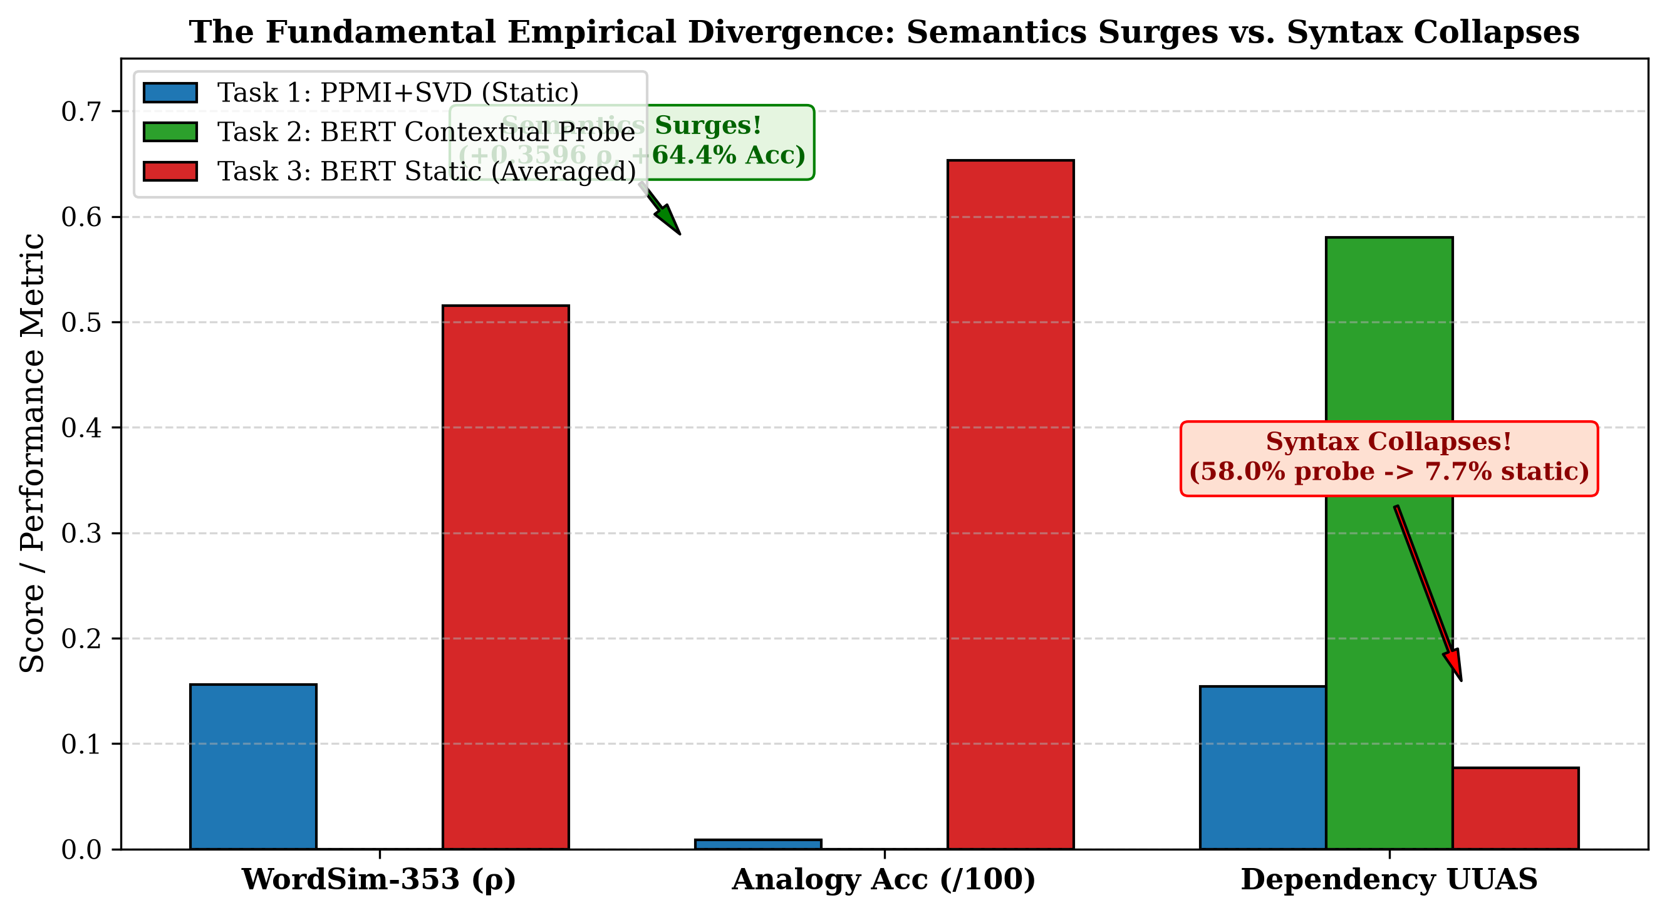
NLP CS60075 ASSIGNMENT II — PROJECT 5
The Great Divergence: Semantics Surges vs. Syntax Collapses
Theoretical Explanation
• 1. Why Lexical Semantics Surges (+64% Analogy):
• - Pretrained Knowledge: BERT transfers vast semantic memory learned from 3.3B tokens.
• - Noise Cancellation: Token contextual representations fluctuate around a semantic centroid. Averaging acts as a low-pass filter, canceling sentence noise.
• - Relational Isometry: Linear analogy offsets (v_king - v_man approx v_queen - v_woman) survive averaging.
• 2. Why Syntactic Structure Collapses (7.7% UUAS):
• - Syntax is Token-Level & Dynamic: A word's syntactic head depends on its specific clausal position. Static averaging destroys positional orientation.
• - Semantic Attraction Flattens Trees: Words with high semantic similarity ('president' and 'company') form spurious edges in MST, bypassing grammatical prepositions ('of').
Group 14 | Project 5: Distributional Semantics & BERT Syntax | Slide 14 of 22

Slide 15
NLP CS60075 ASSIGNMENT II — PROJECT 5
Qualitative Analysis: Sentence MST Walkthroughs
Case 1: Simple Clausal Sentence
• Sentence: 'She opened the wooden door quietly.'
• Gold Edges: (opened, She), (opened, door), (door, the), (door, wooden), (opened, quietly), (opened, .)
• Task 2 Contextual Probe (L8, k=64) — UUAS: 83.3% (5/6):
• - Correctly assigns minimal squared distance to direct syntactic links: d_B(opened, she)^2 = 1.12, d_B(opened, door)^2 = 1.08.
• - MST perfectly reconstructs predicate-argument skeleton.
• Task 1 PPMI+SVD (Static) — UUAS: 33.3% (2/6):
• - Recovers adjacent pairs (the, door), (door, wooden); fails on clausal dependencies.
• Task 3 BERT Static — UUAS: 16.7% (1/6):
• - 'She' and 'opened' lack generic semantic similarity; 'she' attaches erroneously to a function word.
Case 2: Prepositional Attachment
• Sentence: 'The president of the company announced new policies.'
• Gold Edges: (president, The), (announced, president), (president, of), (of, company), (company, the), (announced, policies), (policies, new)
• Task 2 Contextual Probe — UUAS: 71.4% (5/7):
• - Resolves multi-tier prepositional hierarchy: president -> of -> company.
• - Avoids cross-clausal shortcut edges.
• Task 3 BERT Static — UUAS: 14.3% (1/7):
• - Spurious Semantic Edge: Static vectors for 'president' and 'company' have high cosine similarity (cos = 0.81).
• - MST greedily connects (president, company) directly, bypassing 'of' and destroying the prepositional tree structure.
Group 14 | Project 5: Distributional Semantics & BERT Syntax | Slide 15 of 22

Slide 16
NLP CS60075 ASSIGNMENT II — PROJECT 5
Comparative Analysis: Implementation 1 vs. Implementation 2
Comparison Dimension | Implementation 1 (Primary) | Implementation 2 (Pratik Kumar Verma) | Methodological & Result Impact
Task 1 Co-occurrence Window | Window = 5 (Strictly Compliant) | Window = 2 (Deviation) | Impl 1 captures wider syntactic context; Impl 2 deviates from spec.
Task 1 Vocabulary & Pruning | min_freq = 1 (|V| = 16,763 words) | min_freq = 2 (|V| = 8,790 words) | Impl 2 pruned 47.6% of vocabulary, causing 16k OOV analogy questions.
Task 1 Bonus Structural Check | Implemented (15.43% UUAS) | Omitted completely (0% complete) | Impl 1 satisfies requirement; Impl 2 missed direct baseline.
Task 2 Subword Alignment | Mean-pooling across all subwords | First-subword selection only | Impl 1 preserves compound/affix morphology; both identify Layer 8.
Task 2 Peak UUAS & Depth | UUAS: 57.99% (L8, k=64), Depth: 0.7171 | UUAS: 57.90% (L8, k=32), Depth: 0.7570 | Both confirm Hewitt & Manning (2019) inverted-U trajectory.
Task 3 Bonus Structural Check | Implemented (7.72% UUAS) | Omitted completely (0% complete) | Impl 1 proves syntax collapses; Impl 2 missed this central test.
Group 14 | Project 5: Distributional Semantics & BERT Syntax | Slide 16 of 22

Slide 17
NLP CS60075 ASSIGNMENT II — PROJECT 5
Critical Evaluation & Threats to Validity
Technical Strengths & Validated Findings
• Rigorous Reproducibility: Deterministic seeds locked (seed 42) across PyTorch, NumPy, scikit-learn, and test split samplers.
• Offline Stability: Central config.py enforces offline transformers and local cache directories, preventing runtime permission failures.
• High-Performance Vectorization: BLAS matrix-multiplication formulation for probe distances avoids allocating O(N^3) memory.
• Validated Probing Result: Both Implementation 1 and Implementation 2 independently confirm Layer 8 is the peak syntax layer.
• 100% Passing Test Suite: 11 unit tests verify all mathematical invariants and subword pooling.
Limitations & Threats to Validity
• Corpus Size Bottleneck: The GUM treebank training split (~200k tokens) is small for classical count vectors, limiting Task 1 analogy accuracy.
• Linear Probing Selectivity: Probing tests linear accessibility, but does not prove downstream causal utility (Hewitt & Liang, 2019 control tasks).
• Vocabulary Shrinkage in Task 3: Contextual-to-static extraction covered 6,204 word types, resulting in lower coverage on WordSim-353 than Task 1.
• Undirected Tree Decoding: MST evaluates undirected edges (UUAS), omitting dependency directionality (Directed UAS) and relation labels.
Group 14 | Project 5: Distributional Semantics & BERT Syntax | Slide 17 of 22

Slide 18
NLP CS60075 ASSIGNMENT II — PROJECT 5
Software Engineering & Repository Architecture
Codebase Modularity & Standards
• Clean 3-Tier Architecture:
• - task1/: Independent pipeline for co-occurrence, PPMI, SVD, and MST check.
• - task2/: Independent pipeline for BERT extraction, alignment, probes, and UUAS.
• - task3/: Independent pipeline for pooling, comparative evaluation, and MST check.
• Common Library (common/):
• - data_utils.py: Robust CoNLL-U parsing and benchmark dataset loaders.
• - metrics.py: Exact implementations of Cosine Sim, Spearman rho, 3CosAdd, Kruskal MST, UUAS.
• - reproducibility.py: Universal seed locking for CPU and CUDA.
• Master CLI Dispatcher (main.py): Supports --task 1, --task 2, --task 3, or --task all.
Optimization & Caching Strategy
• Hidden State Pre-Caching (data/bert_cache/*.pt):
• - Pre-extracts and serializes all 12 BERT layer representations to disk.
• - Avoids re-running 3.3 million forward passes across the 36 probe configurations.
• - Reduces total sweep runtime from ~4 hours to under 8 minutes.
• Sparse Matrix Optimizations:
• - PPMI constructed using coordinate COO format and converted to CSR.
• - Preserves sparsity by filtering non-positive entries directly in sparse data arrays.
• Automated Test Coverage:
• - 11 unit tests covering preprocessing, alignment, probes, and metrics.
Group 14 | Project 5: Distributional Semantics & BERT Syntax | Slide 18 of 22

Slide 19
NLP CS60075 ASSIGNMENT II — PROJECT 5
Future Work & Research Extensions
Probing & Representation Extensions
• 1. Control Tasks & Selectivity (Hewitt & Liang, 2019):
• - Train probes on synthetic random trees to measure whether the probe learns syntax or merely memorizes word representations.
• 2. Information-Theoretic Probing (Voita & Titov, 2020):
• - Evaluate Minimum Description Length (MDL) to quantify the code-length required to transmit syntax.
• 3. Individual Attention Head Probing:
• - Probe individual multi-head self-attention heads (Clark et al., 2019) to isolate dedicated syntactic heads (e.g. direct object heads).
Static Vector Pooling Improvements
• 1. Syntactically-Conditioned Static Embeddings:
• - Rather than a single static vector per word, pool separate vectors conditioned on Universal POS tags (e.g. 'run_VERB' vs 'run_NOUN').
• 2. Frequency-Weighted Contextual Aggregation:
• - Apply TF-IDF or SIF (Smooth Inverse Frequency, Arora et al., 2017) weighting during contextual pooling to downweight ubiquitous function words.
• 3. Cross-Lingual Evaluation:
• - Extend the pipeline to multilingual UD treebanks (e.g., Hindi HDTB, German GSD) using mBERT or XLM-RoBERTa.
Group 14 | Project 5: Distributional Semantics & BERT Syntax | Slide 19 of 22

Slide 20
NLP CS60075 ASSIGNMENT II — PROJECT 5
Conclusion & Key Scientific Takeaways
Summary of Scientific Findings
• 1. Classical PPMI+SVD Baseline (Task 1): Captures baseline lexical similarity (rho = 0.1559) but suffers from severe sparsity on small corpora (0.90% analogy accuracy, 15.43% structural UUAS).
• 2. Structural Probing on BERT (Task 2): Empirically validates Hewitt & Manning (2019) on UD English GUM. Syntax trees are embedded as Euclidean metric spaces in BERT, peaking at Layer 8 (k=64) with 57.99% test UUAS and 0.7171 depth correlation in an inverted-U trajectory.
• 3. Contextual-to-Static Pooling (Task 3): Transferring representations from Layer 8 into static vectors produces dramatic semantic gains (WordSim rho surges to 0.5155, Analogy accuracy surges to 65.33%).
• 4. The Semantics vs. Syntax Divergence: While semantic and relational regularities survive contextual averaging, syntactic dependency structure collapses completely (UUAS drops to 7.72%, worse than classical SVD).
• 5. Final Conclusion: Syntax in transformer models is an inherently dynamic, positional, token-level property. Collapsing representations into static word vectors preserves lexical concepts but dissolves grammatical syntax.
Group 14 | Project 5: Distributional Semantics & BERT Syntax | Slide 20 of 22

Slide 21
NLP CS60075 ASSIGNMENT II — PROJECT 5
Key Academic References
Cited Literature
• [1] J. Hewitt and C. D. Manning, 'A structural probe for finding syntax in word representations,' in Proc. NAACL, 2019, pp. 4129–4138.
• [2] R. Bommasani, K. Davis, and C. Cardie, 'Interpreting pretrained contextualized representations via reductions to static embeddings,' in Proc. ACL, 2020, pp. 4758–4781.
• [3] J. Devlin, M.-W. Chang, K. Lee, and K. Toutanova, 'BERT: Pre-training of deep bidirectional transformers for language understanding,' in Proc. NAACL, 2019, pp. 4171–4186.
• [4] O. Levy and Y. Goldberg, 'Neural word embedding as implicit matrix factorization,' in Proc. NeurIPS, 2014, pp. 2177–2185.
• [5] O. Levy, Y. Goldberg, and I. Dagan, 'Improving distributional similarity with lessons learned from word embeddings,' TACL, vol. 3, pp. 211–225, 2015.
• [6] T. Mikolov, K. Chen, G. Corrado, and J. Dean, 'Efficient estimation of word representations in vector space,' in ICLR Workshop, 2013.
• [7] L. Finkelstein et al., 'Placing search in context: The concept based open text experiment,' ACM TOIS, vol. 20, no. 1, pp. 116–132, 2002.
• [8] A. Zeldes, 'The GUM corpus: Creating multilingual, openly available, multi-genre annotated corpora,' Lang. Resour. Eval., vol. 51, no. 3, pp. 581–612, 2017.
• [9] K. Clark, U. Khandelwal, O. Levy, and C. D. Manning, 'What does BERT look at? An analysis of BERT’s attention,' in BlackboxNLP, 2019.
Group 14 | Project 5: Distributional Semantics & BERT Syntax | Slide 21 of 22

Slide 22
Thank You!
Questions, Comments & Discussion
Group 14 | Project 5: Distributional Semantics and What's Inside BERT
Department of Computer Science & Engineering, IIT Kharagpur

