Slide 1
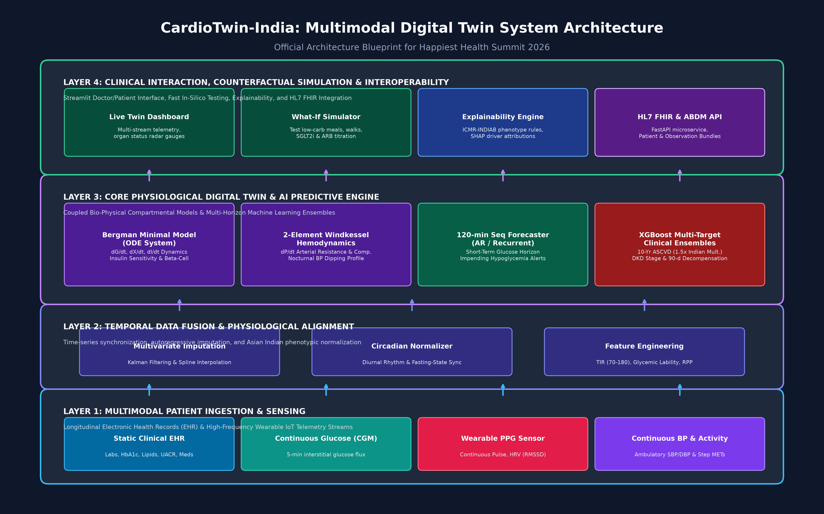
CardioTwin-India: Architecture Blueprint
Multimodal Physiomarker Digital Twin for Type-2 Diabetes & Cardio-Metabolic Progression in India

