Slide 1

VISUALSIM ARCHITECT STUDY
DESIGN-SPACE EXPLORATION OF A QUAD-CORE ARM CORTEX-A53 MEMORY SUBSYSTEM
VisualSim Architect study of cache capacity, system-bus width, and DDR4 speed.
Team Name: 404 Signal Not found
Team Members : Srujan Pratap Powar ,Arshiya Agarwal ,Minal Pramod Borkar and Aadya Priyadarshi

Slide 2


SYSTEM VIEW
Memory performance is a system property
Multi-core behavior
Multi-core performance depends on cache hit/miss behavior, latency, bandwidth, contention, and memory-controller behavior.
Workload first
The memory subsystem must be designed around the workload, not processor frequency alone.
02

Slide 3
EXPLORATION QUESTION
More memory resources do not guarantee proportional gains
QUESTION
How do L2 capacity, system-bus width, and DDR4 speed affect measured performance?
OBJECTIVES
  Model the subsystem.
  Vary the three parameters.
  Measure cache/interconnect/DRAM behavior.
  Identify bottlenecks.
03

Slide 4
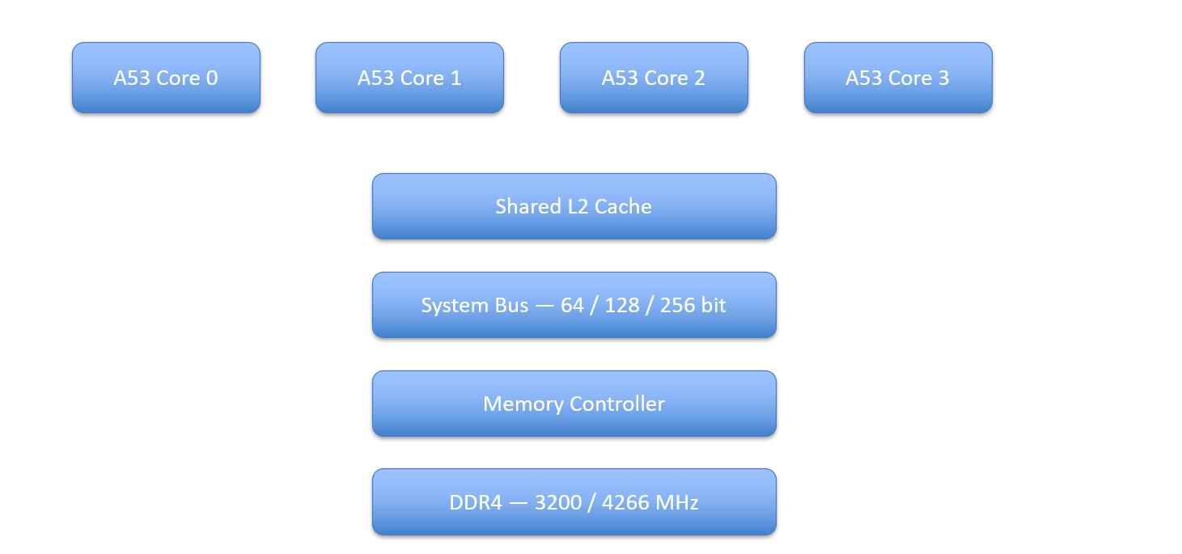
ARCHITECTURE
Four Cortex-A53 cores share one memory path
Core 0, Core 1, Core 2, and Core 3 feed a shared L2 cache, system bus, memory controller, and DDR4 memory.
Supplied System Architecture view
04

Slide 5
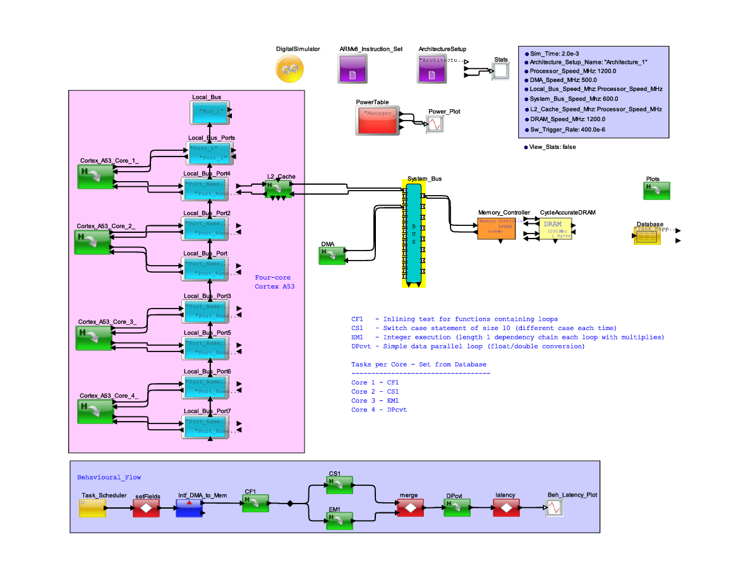
METHOD
VisualSim turns architecture choices into measurable evidence
Configure the architecture.
Run the simulation.
Generate Architecture Statistics.
Extract metrics and compare configurations.
Simulation duration: 2 ms.
Actual VisualSim model used for the study
05

Slide 6
EXPLORATION SPACE
Three design axes define the exploration space
PARAMETER | CONFIGURATIONS
L2 cache | 256 KB, 1 MB, 2 MB
System bus | 64-bit, 128-bit, 256-bit
DDR4 | 3200 MHz, 4266 MHz
Simulation time | 2 ms
06

Slide 7
ARCHITECTURE STATISTICS
Metrics connect local behavior to system impact
L2
Cache behavior
Hit/miss ratio, latency,
throughput, utilization.
SYSTEM BUS
Interconnect pressure
Mean, maximum, and
minimum utilization.
DRAM
Memory response
Throughput, read/write split, delay, queue usage, and overflow.
Values come from VisualSim Architecture Statistics output.
07

Slide 8
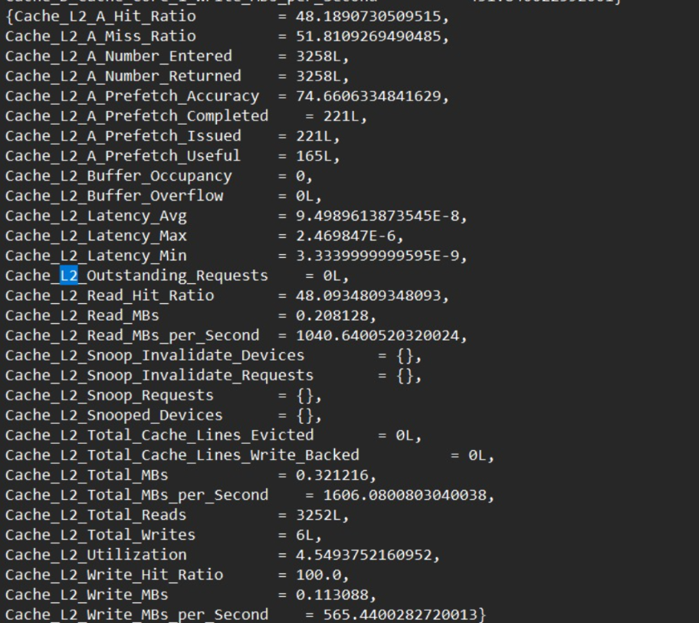
REFERENCE POINT
The 1 MB, 64-bit, 3200 MHz system is the reference point
RECORDED L2 RESULTS
48.1891
%
L2 hit ratio
94.9896 ns
Average latency
4.5494%
Utilization
PARAMETER | BASELINE
Processor | 4 × ARM Cortex-A53
L2 cache | 1 MB
System bus | 64-bit
DDR4 | 3200 MHz
Simulation | 2 ms
results of baseline architecture (Initial Analysis)(No modifications in parameters of architecture)
08

Slide 9
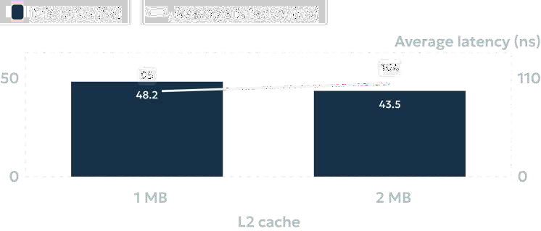
Doubling L2 capacity did not improve this workload's cache results
RECORDED 2 MB RUN
43.51%
Hit ratio
103.67 ns
Average latency
8.45%
Utilization
Capacity alone cannot overcome access pattern, locality, organization, or replacement behavior.
09

Slide 10
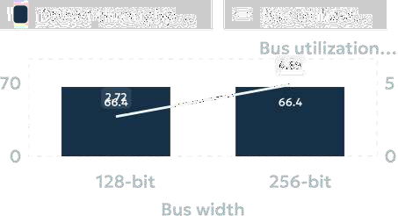

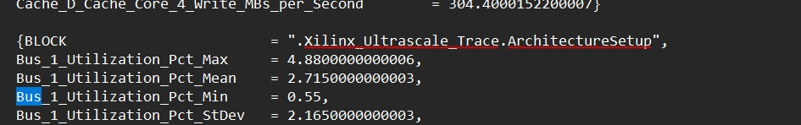
SYSTEM-BUS COMPARISON
Wider buses did not raise measured DRAM throughput
COMPARABLE RUNS
66.3691
DRAM throughput (MB/s)
14.19 ns
Average DRAM delay in both
recorded runs
0
Request overflow in both
recorded runs
10

Slide 11
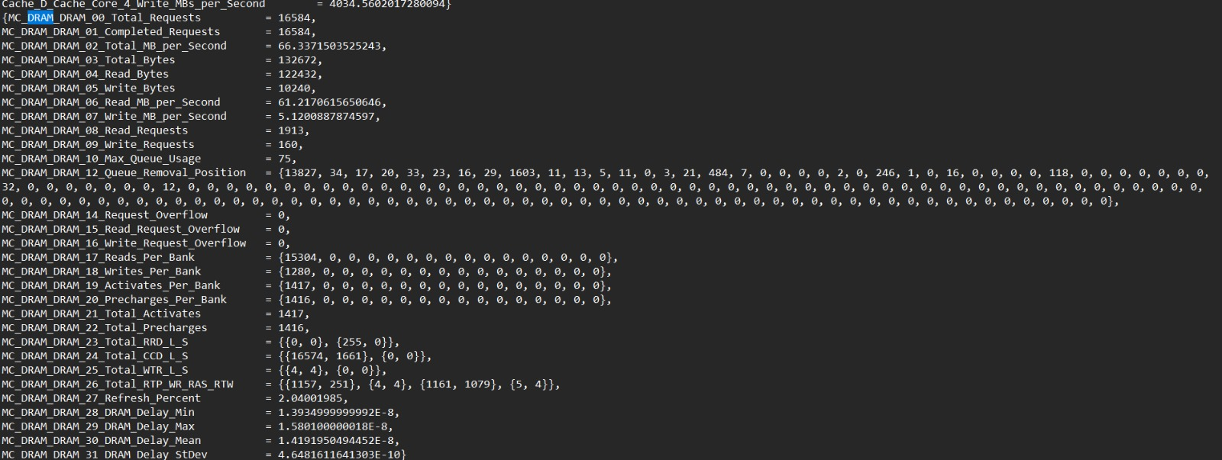
L2 cache capacity did not improve the measured hit rate
L2 CAPACITY · RECORDED COMPARISON
Configuration | Hit ratio | Miss ratio | Average latency | Utilization
1 MB baseline | 48.1891% | 51.8109% | 94.9896 ns | 4.5494%
2 MB recorded run | 43.51% | 56.49% | 103.67 ns | 8.45%
For this workload, more capacity did not automatically improve cache performance.

Slide 12
Recorded bus-width runs showed no DRAM throughtput increase
BUS WIDTH · RECORDED COMPARISON
Bus width | L2 hit ratio | L2 latency | Mean bus utilization
128-bit | 48.4821% | 92.7396 ns | 2.7175%
256-bit | 44.0054% | 101.00 ns | 4.8933%
MEASURED DRAM THROUGHPUT
66.3691 MB/s
Both recorded configurations produced approximately 66.37 MB/s DRAM throughput, indicating that wider bus width did not translate into higher measured throughput in these runs.

Slide 13
Higher DDR4 frequency had only marginal workload impact
DDR4 FREQUENCY · WORKLOAD RESPONSE
DDR4 frequency | DRAM throughput | Average delay | Maximum queue
3200 MHz | 66.3372 MB/s | 14.1920 ns | 75
4266 MHz | approximately 66.37–66.40 MB/s | approximately 14.19 ns | approximately 76–77
Nominal DDR frequency increased by about 33.3%, while measured workload throughput stayed near 66.3–66.4 MB/s.

Slide 14
Additional memory resources did not produce proportional gains
RESOURCE SWEEP · FLAT PERFORMANCE RESPONSE
L2
1 MB → 2 MB
Hit ratio and latency did not improve in the recorded comparison.
BUS
128 → 256 bit
Recorded 128-bit and 256-bit runsDRAM throughput remained approximately 66.37 MB/s.
DDR4
3200 → 4266 MHz
Throughput remained
approximately 66.3–66.4 MB/s.
OBSERVED RESPONSE
FLAT
Across the recorded comparisons, more memory resources did not produce proportional gains.

Slide 15
The recorded results do not indicate raw bus width or DDR bandwidth as the dominant limitation
INTERPRETATION · EVIDENCE BOUNDARY
256-bit bus utilization — Approximately 4.89%, indicating substantial unused capacity in the recorded run.
DDR4 speed change — DRAM throughput stayed near 66.3–66.4 MB/s despite the DDR4 speed change.
L2 behavior — Results varied with capacity, highlighting the role of access pattern, locality, cache organization, and
replacement behavior.
Interpretation — The likely constraints may include request rate, cache behavior, memory access pattern, controller
behavior, or latency rather than peak bandwidth.

Slide 16
Match resources to the workload
CONCLUSION
Across the evaluated workload, larger L2, a wider bus, and faster DDR4 did not produce proportional gains.
That result is workload-specific—not a claim that more capacity or bandwidth never helps. Characterize the
bottleneck and validate any change through simulation before trading for area, power, cost, or complexity.
The best architecture is not the one with the most resources — it is the one whose resources match the workload.
GOOGLE DRIVE LINK FOR RESULTS
https://drive.google.com/drive/folders/183LKC2KJys0E755W3UO0OFMtQTdpns4i?usp=sharing

