Slide 1
Genome Sequencing AI/ML Model
Srujana Vanka , Jewel Benny

Slide 2
Aim
To develop and deploy an AI/ML model/web app that is capable of accurately predicting from which location a particular sequence originated or spread from.
Black Box
Sequence
Location

Slide 3
Concept
Common Transmission Chains - In a given location, if multiple individuals are infected with the same viral strain and they pass it on to others in a similar way, a common transmission chain is established. This means that the virus is being transmitted locally within a specific geographic area.
Limited Introduction of New Variants – There may be limited introduction of new viral variants from outside the location. This is because most cases are linked by local transmission, and new variants have a lesser chance of being introduced from other locations.

Slide 4
Example
AACCAACCAACTTTCGATCTCTTGTAGATCTGTTCTCTAAACGAACTTTAAAATCTGTGTGGCTGTCACTCGGCTGCATGCTTAGTGCACTCACGCAGTATAATTAATAACTAATTACTGTCGTTGACAGGACACGAGTAACTCGTCTATCTTCTGCAGGCTGCTTACGGTTTCG…
ACCAACCAACTTTCGATCTCTTGTAGATCTGTTCTCTAAACGAACTTTAAAATCTGTGTGGCTGTCACTCGGCTGCATGCTTAGTGCACTCACGCAGTATAATTAATAACTAATTACTGTCGTTGACAGGACACGAGTAACTCGTCTATCTTCTGCAGGCTGCTTACGGTTTCGT…
Sample 1 - Karnataka
Sample 2 - Karnataka
CTTTCGATCTCTTGTAGATCTGTTCTCTAAACGAACTTTAAAATCTGTGTGGCTGTCACTCGGCTGCATGCTTAGTGCACTCACGCAGTATAATTAATAACTAATTACTGTCGTTGACAGGACACGAGTAACTCGTCTATCTTCTGCAGGCTGCTTACGGTTTCGTCCGTTTTGC…
ACTTTCGATCTCTTGTAGATCTGTTCTCTAAACGAACTTTAAAATCTGTGTGGCTGTCACTCGGCTGCATGCTTAGTGCACTCACGCAGTATAATTAATAACTAATTACTGTCGTTGACAGGACACGAGTAACTCGTCTATCTTCTGCAGGCTGCTTACGGTTTCGTCCGTTTTG…
Sample 3 - Delhi
Sample 4 - Delhi

Slide 5
The Dataset – RCoV19
RCoV19 is a comprehensive collection of data related to the COVID-19 pandemic caused by the SARS-CoV-2 virus - https://ngdc.cncb.ac.cn/ncov/?lang=en
Created to facilitate research and analysis of the virus, its transmission, and its impact on public health.
Includes a wide range of information, such as epidemiological data, clinical data, genomic data, and more.

Slide 6
RCoV19 – Some Quick Facts
16,901,308
SARS-COV-2 sequences
9428
Locations
297,203
SARS-COV-2 sequences sampled from India
4,723
SARS-COV-2 sequences sampled from India that are downloadable
Rest
Downloadable from a different website (GISAID)
1
2
3
4
5

Slide 7
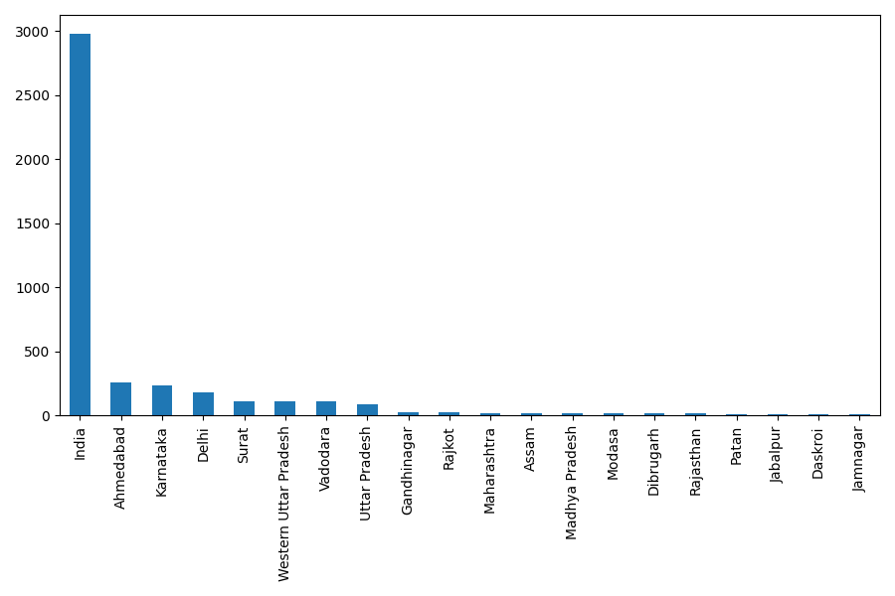
Location Distribution
Around 3000 samples were only labelled “India”.

Slide 8
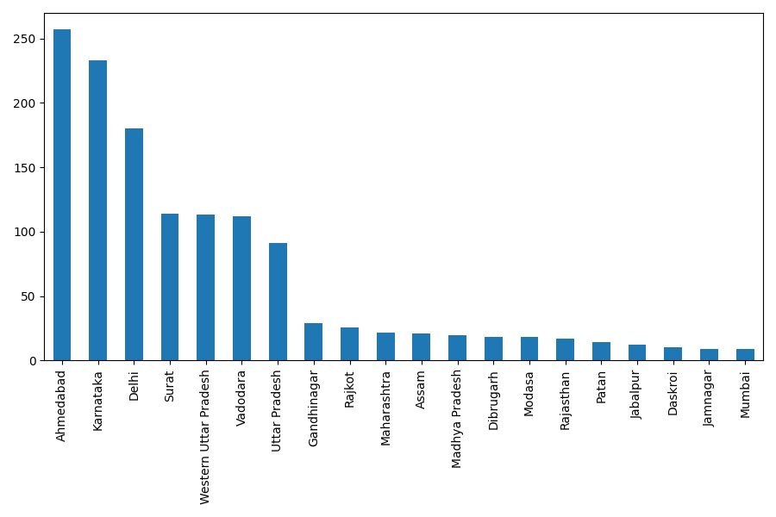
Location Distribution
The location distributions are largely unbalanced.

Slide 9
Software System

Slide 10
System Flow Diagram

Slide 11
System Tech Stack
Front End
ReactJS, AngularJS, Bootstrap etc.
Backend
Flask, NodeJS, Python etc.
Database (TBD)

Slide 12
Front End

Slide 13
Front-End Stack
Our project's front-end leverages Create React App (CRA), a convenient toolkit.
Key components include React (for interactivity), HTML/CSS (for layout), and JavaScript (for functionality).
We manage dependencies with npm/Yarn and use Babel and Webpack to streamline development.
Additionally, we will utilize frameworks like Bootstrap for responsive design and AngularJS for enhancing our app's capabilities.

Slide 14
Front-End Functionalities
File Upload:
Users can upload files enabling them to interact with our platform by submitting data with ease.
Robust validation checks to ensure only valid file formats, such as FASTA, .txt and .csv, are accepted.
To be done - Dashboard:
The dashboard is the central hub of our application, displaying crucial metrics, results, and user-specific information in real-time.
We plan to develop an elegant UI that features intuitive navigation, clear instructions, and an aesthetically pleasing layout.

Slide 15
Docker and Containerization
In our project, Docker is used for containerizing the entire application, including the front-end components.
Isolation: Docker containers isolate applications and their dependencies, enhancing security and reducing conflicts.
Resource Efficiency: Docker optimizes resource usage, allowing us to run multiple containers on the same machine without compromising performance.
Quick Deployment: With Docker, we can deploy updates and new features rapidly, ensuring minimal downtime.

Slide 16
Back End

Slide 17
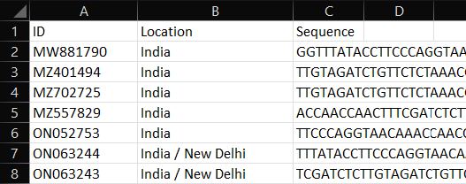
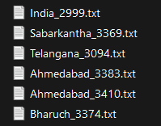
Data Preprocessing
BioPython is a library for biological computation in Python.
What is done till now –
Splitting the FASTA dataset into each individual sequences
FASTA to .txt conversion
FASTA to .csv conversion
Merging of metadata with sequence data with key as ID
.csv dataset
.txt dataset

Slide 18
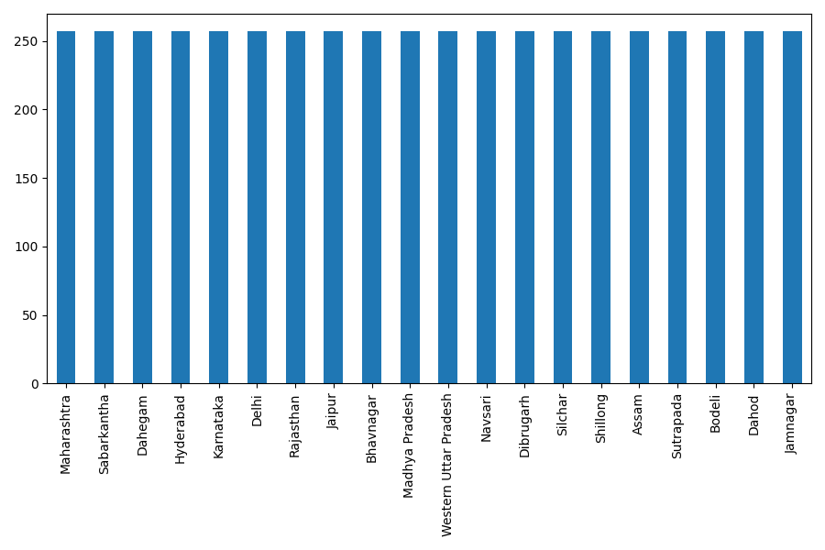
Dataset Balancing
The downloaded dataset was highly imbalanced – some locations contains hundreds of sampled while others contained barely one or two.
To counter this, locations with less than a certain number of samples were removed from the dataset.
Samples with location as just “India” (around 3000 samples) were removed.
The rest of the samples were randomly oversampled to obtain a balanced dataset.
Before random oversampling
After random oversampling

Slide 19
ML Model
K-Merize
The sequence is split into K-mers. For example, if K=3 and the sequence is AATGC, the K-Mers are AAT, ATG and TGC.
1
Convert to N-Grams
The K-Mers are split into N-grams. For example, if the K-Mers are AAT, ATG and TGC; and N=2, the N-grams are AAT ATC and ATG TGC. This preserves some ordering present in the original sequence.
2
Vectorize Using Count Vectorizer
The tokens are the N-grams. The tokens are vectorized using a bag of words model (count vectorizer).
3
Classify Using Suitable Classifier
The vectors are used to train a location classifier. The classifier predicts the location of test samples.
4

Slide 20
Classifier Models
Multiple models were tested, namely –
Bayes Classifier
Logistic Regression
Random Forest
Support Vector Classifier
K Nearest Neighbours
Decision Tree
Multi-Layer Perceptron
Gradient Boosting Classifier
Ada Boost Classifier

Slide 21
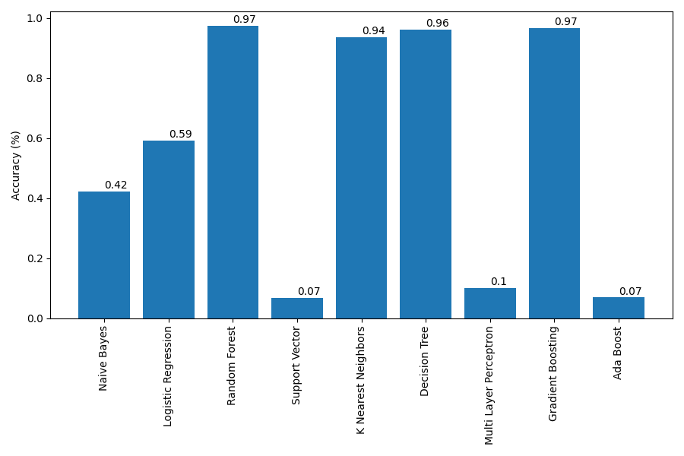
Classifier Accuracy Comparison
Random forest classifier provided the best accuracy of 97%.

Slide 22
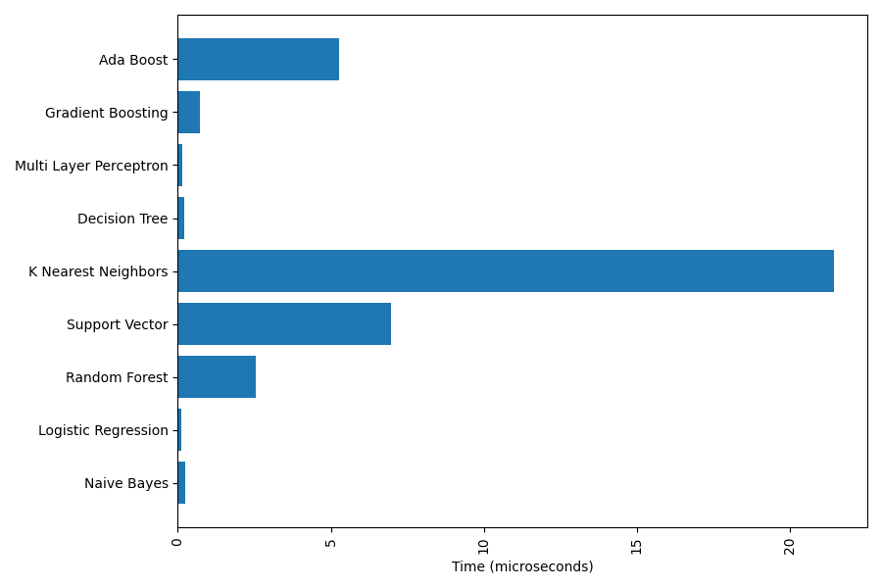
Classifier Prediction Time Comparison

Slide 23
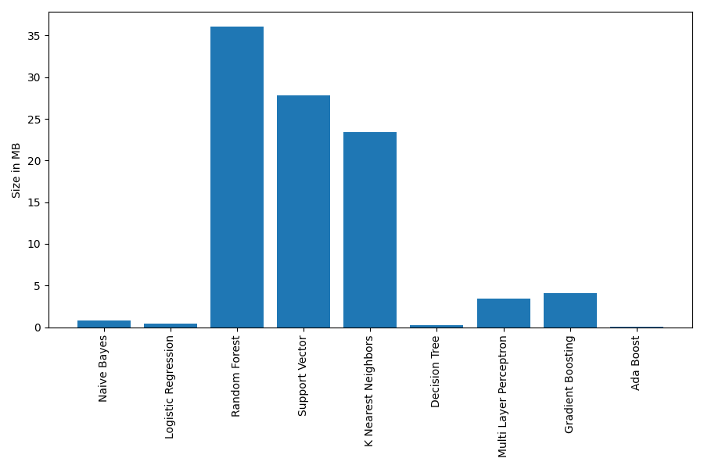
Classifier File Size Comparison

Slide 24
To Do

Slide 25
Functional and Non-functional Requirements
Front-End
Dashboard and User authentication
Train on bigger dataset if possible
ML Model
Backend and Integration
Write API functions, integrate frontend and backend
Database
If needed
Documentation
Document the code properly
1
2
3
4
5

Slide 26
Thank you

