Slide 1


Project Review 4 On
InfraMiner AI: A Multi-Agent AI Framework for Sustainable Resource Sourcing and Resilience Planning in Large-Scale Infrastructure Projects
Major Project Presentation (Phase I)
23R21A6602 | - A. Srujana
23R21A6654 | - U. Apoorva
23R21A6637 | - M. Kranthi Kumar
23R21A6632 | - K. Vinay Kumar
Under the Guidance of
Mrs. B. Ammanni
Assistant Professor
Department of Computer Science & Engineering-Artificial Intelligence and Machine Learning

Slide 2

Contents
Work Division
Introduction
Abstract
Literature Survey
Objectives
Existing System
Disadvantages of Existing System
Proposed Methodology
Proposed Architecture
Advantages of Proposed System
Data Sources
Hardware & Software Requirements
Implementation and Results
References
Batch No. A2
Slide 2

Slide 3
Team Work Division
Member | Area | Main Responsibilities
A Srujana (23R21A6602) | Full Stack & Integration | Backend, database, dashboard, agent integration, visualization and system testing
U Apoorva (23R21A6654) | AI Agents & Decision Support | Multi-agent development, source ranking, cost/risk evaluation, disruption simulation and alternative recommendation
M Kranthi Kumar (23R21A6637) | Source & Geospatial Analysis | Material-source data, supplier/source identification, distance, routes, GIS and logistics analysis
K Vinay Kumar (23R21A6632) | Data & Document Intelligence | Project document collection, data extraction, preprocessing, material requirement identification
Batch No. A2
Slide 3

Slide 4
Introduction
Infrastructure development is essential for economic growth, connectivity, and industrial development. However, planning and executing large-scale projects involves complex decisions related to construction resources, logistics, cost, environmental conditions, and unexpected risks. Projects such as the Vadhavan Port, which involves large-scale reclamation, offshore breakwater construction, and extensive supporting infrastructure, demonstrate the complexity of modern infrastructure development. As infrastructure projects become larger and more complex, traditional approaches that depend heavily on manual analysis and separate information sources can make timely and informed decision-making difficult. Project teams may need to analyze technical documents, resource data, geographic information, cost details, and environmental factors before selecting suitable strategies. This creates a need for intelligent systems that can support integrated and resilient infrastructure planning. InfraMiner AI is proposed to address this need by applying multi-agent Artificial Intelligence to infrastructure resource planning and decision support.

Slide 5
Abstract
Large-scale infrastructure projects require the coordinated planning of construction materials, resource availability, transportation, cost, environmental constraints, and potential supply disruptions. However, the information required for these decisions is often distributed across project reports, technical documents, geographic data, and resource records, making integrated decision-making difficult. This project proposes InfraMiner AI, a multi-agent Artificial Intelligence framework for sustainable resource sourcing and resilience planning in large-scale infrastructure projects. The system uses specialized AI agents to analyze project documents, identify material requirements, discover and evaluate candidate sources, estimate quantities and costs, perform geospatial logistics analysis, assess environmental factors, and generate explainable recommendations. A resilience module simulates disruptions such as source unavailability, material shortages, price fluctuations, and transportation interruptions to identify alternative sourcing strategies. The Vadhavan Port project is used as a real-world case study to demonstrate the proposed framework's applicability to complex infrastructure resource planning.
Keywords: Multi-Agent Artificial Intelligence, Construction Material Planning, Generative AI, Retrieval-Augmented Generation, Sustainable Infrastructure

Slide 6
Literature Survey
No | Title | Author | Journal Name & Year | Methodology Adapted | Key Findings | Gaps
1 | Artificial Intelligence in Construction Supply Chains: A Scientometric Review and Future Research Agenda | Qiang Xu, Haitao Chen, Li Xu, Yongshun Xu | Buildings, 2026 | Applied scientometric analysis to study AI applications and research trends in construction supply chains. | • AI is increasingly applied to construction supply chains. • Supports resource optimization and logistics. • Highlights sustainability and resilience as emerging areas. | Existing studies are fragmented across different AI applications and do not provide an integrated decision-support framework.
2 | Retrieval Augmented Generation-Driven Information Retrieval and Question Answering in Construction Management | Akshitha Katkeri, Tejaswini S, Spoorthy Anni, Tanisha N | Advanced Engineering Informatics, 2025 | Proposed a RAG-based framework using hierarchical document processing, retrieval and LLM-based question answering for construction management. | • Improves construction information retrieval. • Provides grounded answers from project information. | Focuses mainly on information retrieval and question answering.
Batch No. A2
Literature_Survey_20_papers
Slide 6

Slide 7
Literature Survey
NO | Title | Author | Journal Name & Year | Methodology Adapted | Key Findings | Gaps
3 | Material Selection in the Construction Industry: A Systematic Literature Review on Multi-Criteria Decision Making | Asad Ur Rehman Bajwa, Chandana Siriwardana, Wajiha Shahzad, Muhammad Ahmad Naeem | Environment Systems and Decisions, 2025 | Conducted a systematic literature review of MCDM approaches for construction-material selection using technical, economic and sustainability criteria. | • Material selection involves multiple criteria. • MCDM supports complex material-selection decisions. | Existing MCDM approaches generally use predefined criteria and do not automatically connect project requirements with actual material sources.
4 | Wood-for-Construction Supply Chain Digital Twin to Drive Circular Economy and Actor-Based LCA Information | Luca Morganti, Andreas Rudenå, Birgit Brunklaus, Peter Bomark, Alberto Armijo Prieto, Johan Skog, Theo Zaffagnini, Alessandro Pracucci, Julen Astudillo Larraz | Production, 2025 | Developed a digital-twin approach connecting construction-material supply-chain actors, traceability and life-cycle assessment information. | • Improves material traceability. • Supports sustainable resource management. • Connects supply-chain information with environmental assessment. | Focuses on a specific construction-material supply chain and LCA rather than generalized intelligent source selection.
Batch No. A2
Literature_Survey_20_papers
Slide 7

Slide 8
Objectives
To develop a RAG-enabled Multi-Agent AI framework for automated extraction of construction material requirements and project constraints from project documents.
To integrate GIS-based geospatial analysis and AHP-TOPSIS MCDM for evaluating and ranking material sources using cost, availability, logistics, environmental, technical, and risk criteria.
To implement resilience-based What-If analysis for dynamic source re-evaluation and explainable primary and alternative source recommendations under supply disruptions.

Slide 9
Existing System
Procore: A construction management platform that supports material procurement, tracking, delivery, and supply-chain management, but does not focus on AI-based material source selection and disruption analysis
Autodesk Construction Cloud: A platform that centralizes construction project information and supports procurement and project coordination, but does not provide integrated AI-based source ranking.
BIM–WMS Decision Support System: A BIM/GIS-based system for construction material source selection considering location, cost, and sustainability, but lacks multi-agent AI and disruption-aware alternative planning
Batch No. A2
Slide 9

Slide 10
Disadvantages of Existing System
Fragmented decision-making: Material availability, cost, logistics, environmental factors, and technical suitability are often evaluated through separate tools.
Limited disruption planning: Existing systems provide limited support for simulating source failures, material shortages, or transportation disruptions.
Manual alternative selection: Identifying and evaluating alternative material sources during supply disruptions still requires significant expert effort.
Batch No. A2
Slide 10

Slide 11
Proposed Methodology
The proposed InfraMiner AI system is a four-agent multi-agent framework designed to automate material sourcing and decision-making for infrastructure projects. The system takes a project document, such as a DPR as its primary input. First, it passes it to Agent 1 – Project & Material Intelligence, which retrieves relevant sections and extracts project information, location, constraints, required materials, quantities and specifications. The extracted material requirements are then passed through the shared project state to Agent 2 – Source & Logistics, which identifies suitable material sources from available source information and determines transportation modes and source-to-project distances. Agent 3 – Cost, Environment & Resilience evaluates each candidate using material cost, transportation cost, environmental impact, and supply-disruption/resilience factors. Finally, Agent 4 – Decision forms a multi-criteria decision matrix and applies AHP to determine the relative importance of cost, logistics, environmental impact, and resilience, then uses TOPSIS to compare alternatives based on alternatives according to their distance from the ideal solution. Feasibility checks are then applied and the system generates an explainable sourcing plan containing the selected source, alternative/fallback sources, cost, environmental considerations and resilience information. The agents are coordinated using LangGraph, which supports stateful multi-step workflows and allows deterministic processing and LLM-based processing to be combined in the same workflow.
Batch No. A2
Slide 11

Slide 12
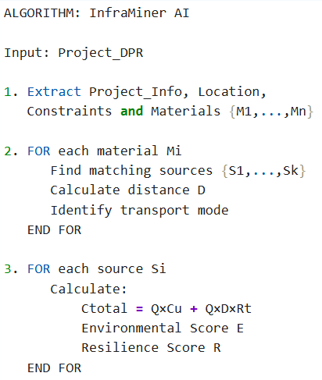
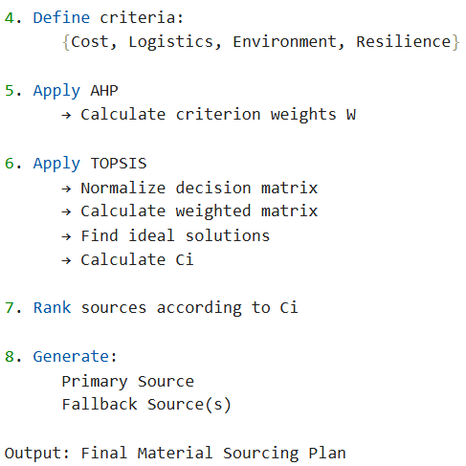
Proposed Methodology
Pseudocode:
Batch No. A2
Slide 12

Slide 13
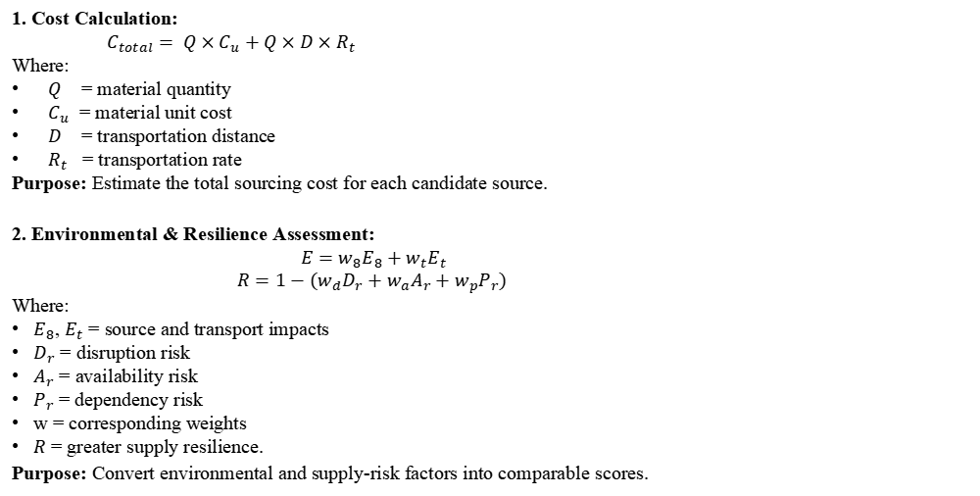
Proposed Methodology
1. Cost Calculation:
${ C}_{total}= Q×C_{u}+Q×D×R_{t}$
Where:
$Q$ = material quantity
$C_{u}$ = material unit cost
$D$ = transportation distance
$R_{t}$ = transportation rate
Purpose: Estimate the total sourcing cost for each candidate source.
2. Environmental & Resilience Assessment:
$E=w_{8}E_{8}+w_{t}E_{t}$
$R=1−(w_{d}D_{r}+w_{a}A_{r}+w_{p}P_{r})$
Where:
$E_{8}$, $E_{t}$ = source and transport impacts
$D_{r}$ = disruption risk
$A_{r}$ = availability risk
$P_{r}$ = dependency risk
w = corresponding weights
$R$ = greater supply resilience.
Purpose: Convert environmental and supply-risk factors into comparable scores.
Batch No. A2
Slide 13

Slide 14
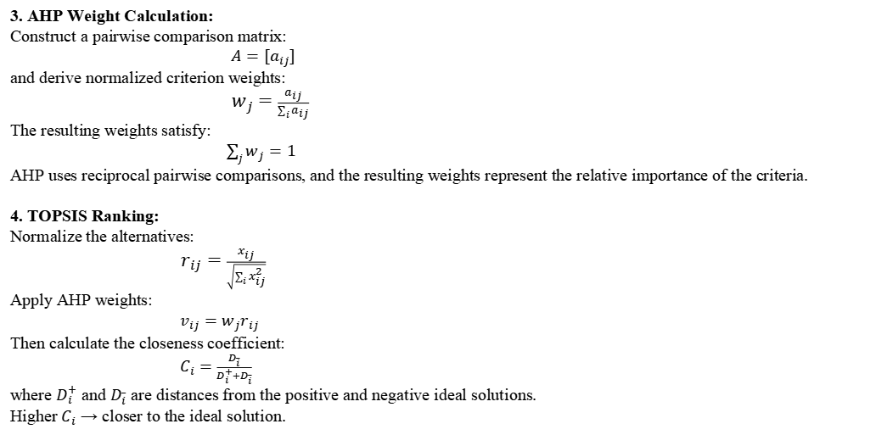
Proposed Methodology
3. AHP Weight Calculation:
Construct a pairwise comparison matrix:
$A=[a_{ij}]$
and derive normalized criterion weights:
$w_{j}=\frac{a_{ij}}{\sum_{i}{a_{ij}}}$
The resulting weights satisfy:
$\sum_{j}{w_{j}}=1$
AHP uses reciprocal pairwise comparisons, and the resulting weights represent the relative importance of the criteria.
4. TOPSIS Ranking:
Normalize the alternatives:
$r_{ij}=\frac{x_{ij}}{\sqrt{\sum_{i}{x_{ij}^{2}}}}$
Apply AHP weights:
$v_{ij}=w_{j}r_{ij}$
Then calculate the closeness coefficient:
$C_{i}=\frac{D_{i}^{_}}{D_{i}^{+}+D_{i}^{_}}$
where $D_{i}^{+}$ and $D_{i}^{_}$ are distances from the positive and negative ideal solutions.
Higher $C_{i}$ → closer to the ideal solution.
Batch No. A2
Slide 14

Slide 15
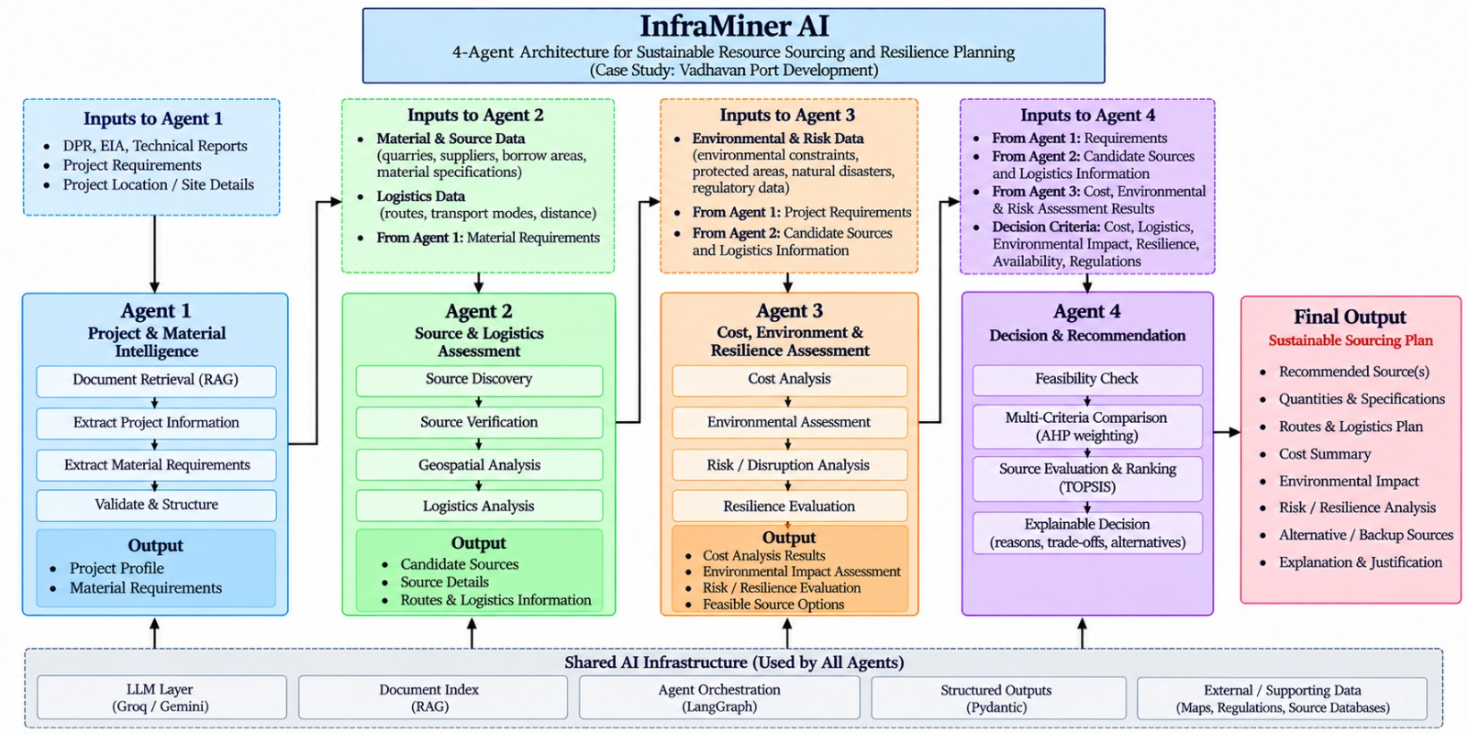
Proposed Architecture​
Fig 1: Proposed Multi-Agent Architecture for InfraMiner AI
Batch No. A2​
Slide 15​

Slide 16
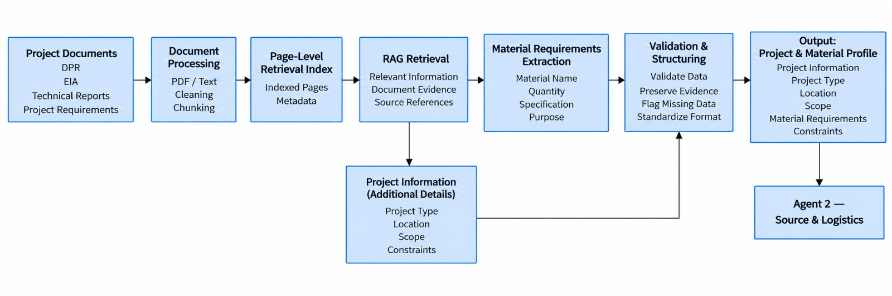
Proposed Architecture​
Fig 2: Architecture of Agent 1 – Project & Material Intelligence
Batch No. A2​
Slide 16​

Slide 17
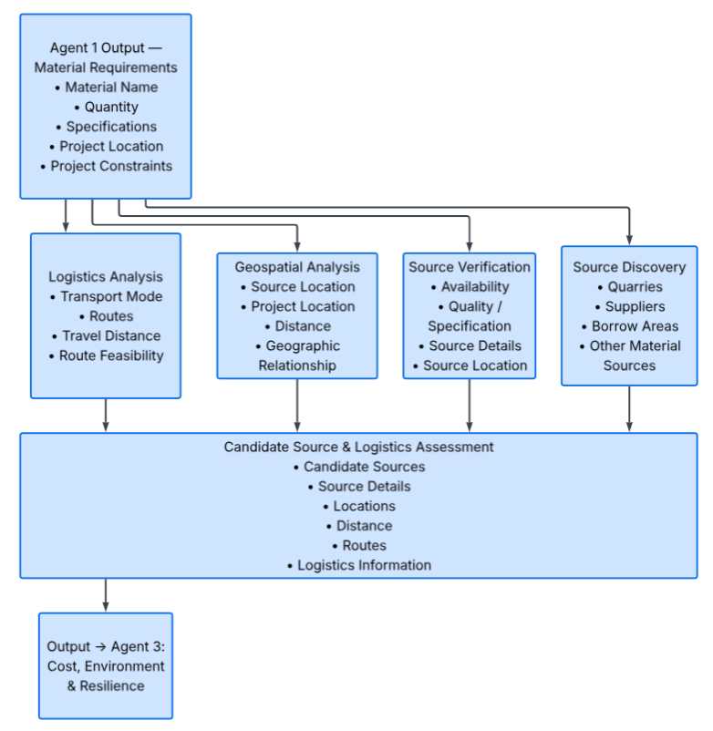
Proposed Architecture​
Fig 3: Architecture of Agent 2 – Source & Logistics
Batch No. A2​
Slide 17​

Slide 18
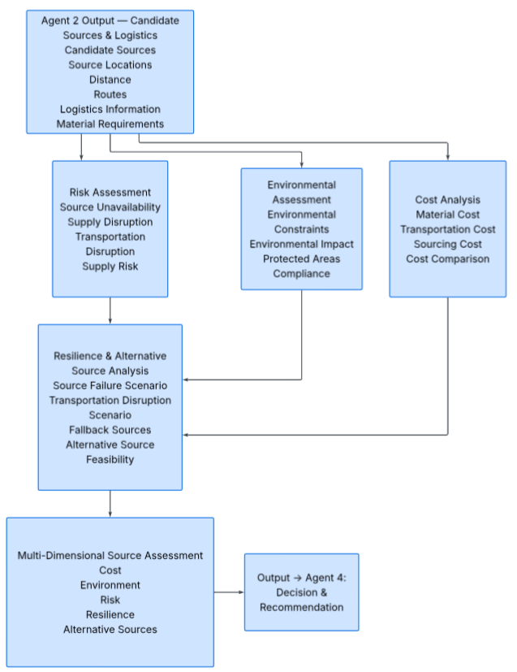
Proposed Architecture​
Fig 4: Architecture of Agent 3 – Cost, Environmental and Resilience Assessment
Batch No. A2​
Slide 18​

Slide 19
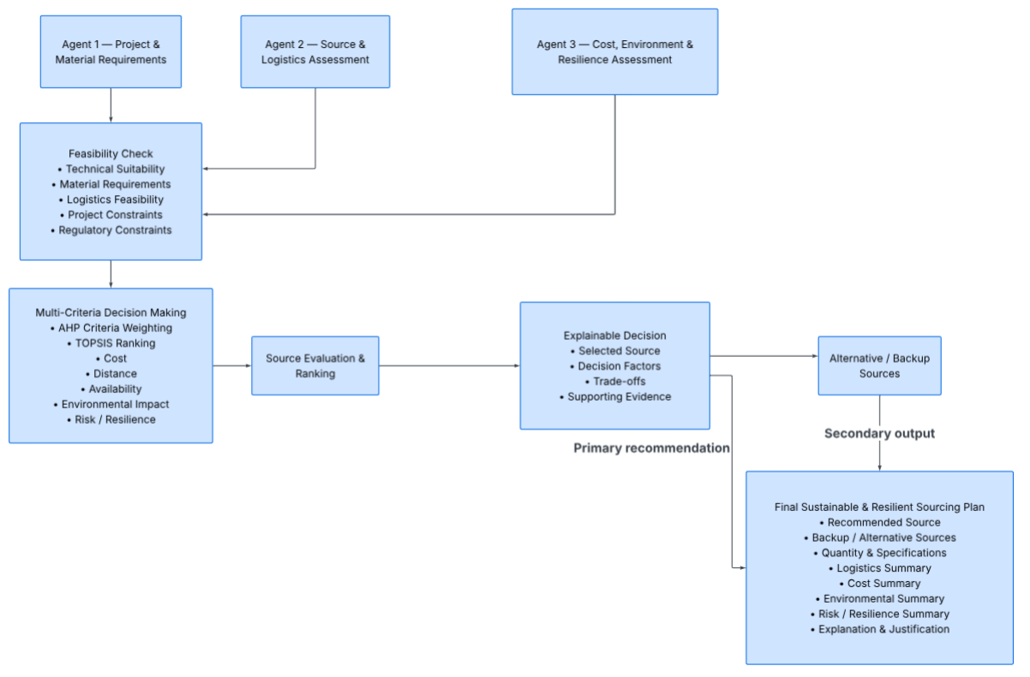
Proposed Architecture​
Fig 5: Architecture of Agent 4 – AHP–TOPSIS Decision Engine
Batch No. A2​
Slide 19​

Slide 20
Advantages of Proposed Methodology
Automated material identification: Extracts material requirements, quantities, and specifications from project documents, reducing manual effort.
Multi-factor source selection: Evaluates cost, availability, suitability, logistics, environmental factors, and risk together.
Intelligent decision support: Ranks potential sources and provides explainable recommendations instead of relying only on the nearest or cheapest source.
Improved resilience: Simulates supply disruptions and recommends alternative sources to support continuous project planning.
Batch No. A2
Slide 20

Slide 21
Data Sources
JNPA / Vadhvan Port Project: DPRs, project requirements, construction activities, material specifications and quantities.
Indian Bureau of Mines (IBM): Mining/mineral information and potential material-source details.
OpenStreetMap (OSM): Source locations, road networks, routes and distance information.
MoEFCC / PARIVESH: Environmental clearances, environmental constraints and related project information.
Batch No. A2
Slide 21

Slide 22

Hardware & Software Requirements
Hardware:
Processor: Intel Core i5 or above
RAM: 8 GB minimum (16 GB recommended)
Storage: 256 GB SSD or higher
Graphics: NVIDIA GTX 1650 / RTX 3050 or equivalent
Software:
Programming: Python
Multi-Agent Framework: LangGraph
RAG & LLM Framework: LangChain
Document Processing: PyMuPDF
Database & Vector Search: PostgreSQL, pgvector
Geospatial: PostGIS, OpenStreetMap
Data Processing: Pandas, NumPy
Backend: FastAPI
Dashboard & Visualization: Streamlit, Plotly
ML: Scikit-learn
Batch No. A2
Slide 22

Slide 23
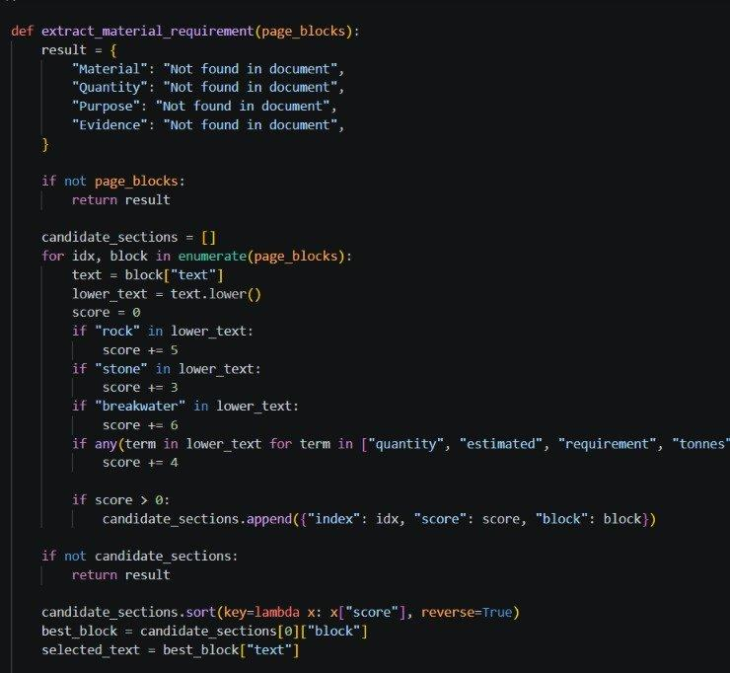
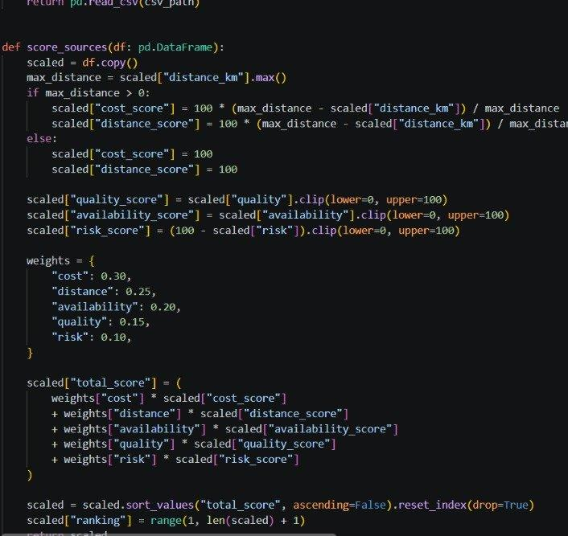
Implementation & Code Development
Batch No. A2​
Slide 23

Slide 24
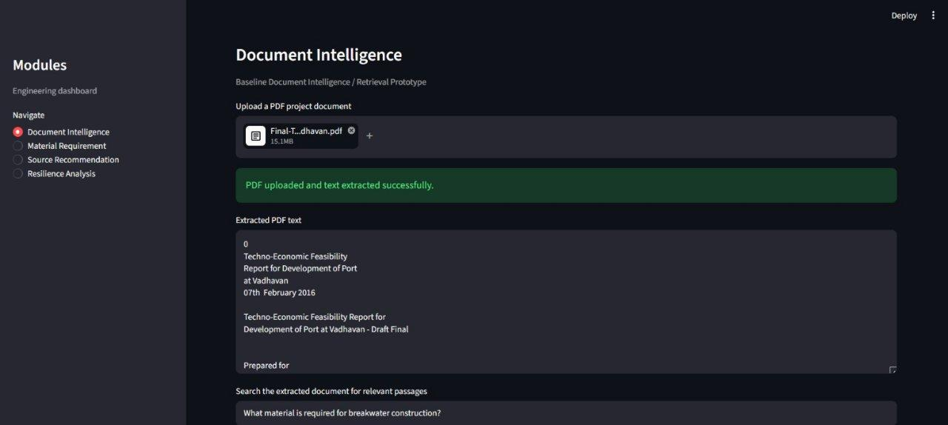
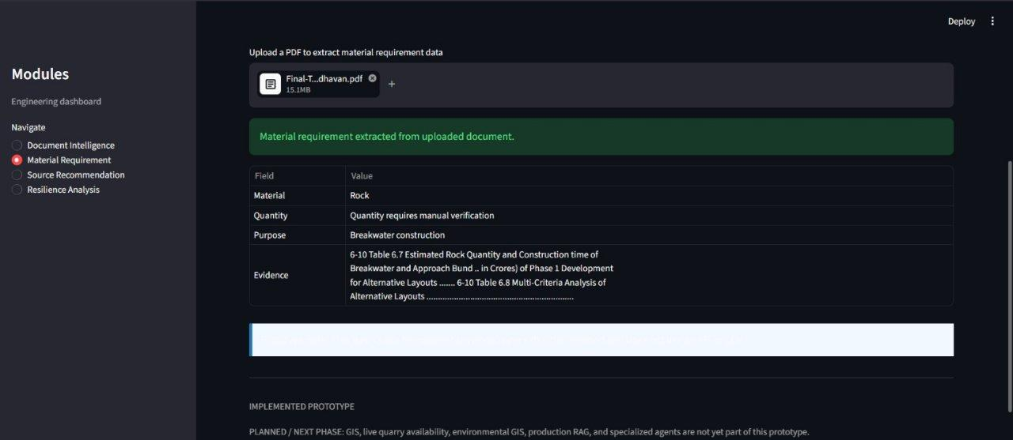
Results
Fig. 1: Document intelligence that extract information and answer questions.​​​
Fig. 2: Material Requirement Agent: gives the material that is required & the quantity required.​
Batch No. A2​​
Slide 24

Slide 25
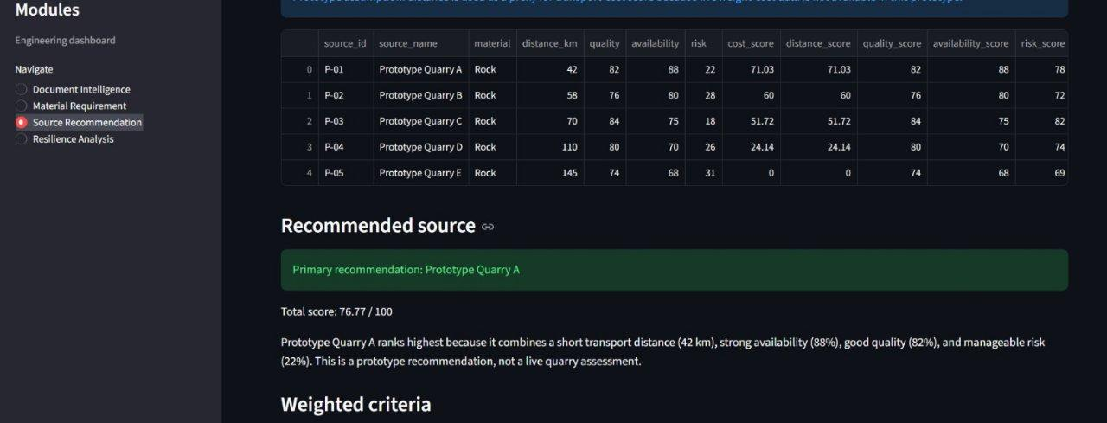
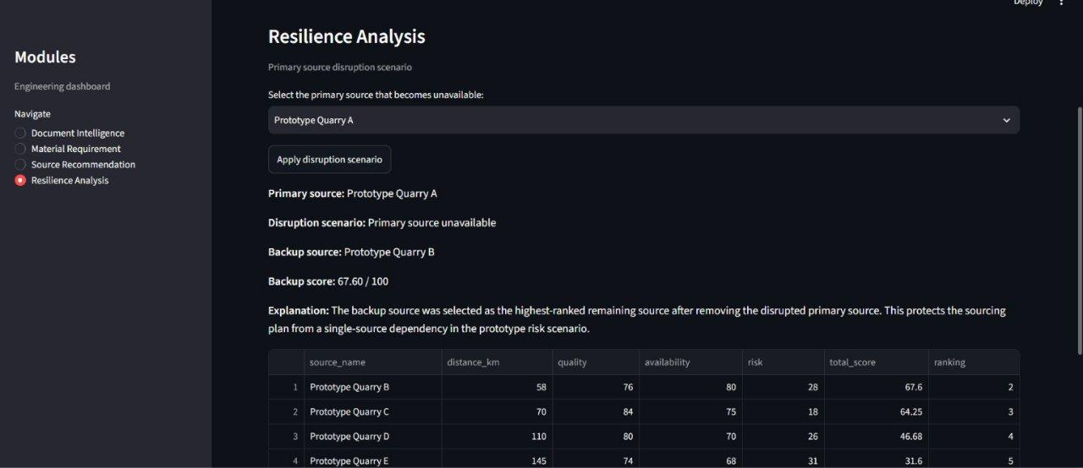
Results
Fig. 4: Resilience Agent: gives the alternate recommendations. ​
Fig. 3: Recommendation Agent
Batch No. A2​​
Slide 25

Slide 26
References
1. ELBARE, S., ZAIBI, O., & ZGHIDI, N. (2026). Impact of Smart Ports on Regional Economic Growth: A Difference-in-Differences Analysis of European Ports. IEEE Intelligence in Business & Industry (IBI).
2. Li, H., Liu, Y., Yan, J., Gao, J., Yang, X., & Naili, M. (2025). Position Paper: Emergent Machina Sapiens Urge Rethinking Multi-Agent Paradigms in Critical Infrastructures. International Joint Conference on Neural Networks (IJCNN), IEEE.
3. Hu, Z., Gu, X., Liu, J., Ge, X., Wang, S., & Yin, S. (2024). Mechanical Properties and Hydration Mechanism of Iron Tailings–Cement-Based Supplementary Cementitious Materials. Buildings, MDPI.
4. Abdulova, E., & Kalashnikov, A. (2022). Categorization and Criticality Assessment of Facilities of Critical Infrastructure. 2022 International Conference on Management of Large-Scale System Development(MLSD), IEEE.
Batch No. A2
Slide 26

Slide 27
Any Queries?

