Slide 1
DES 157 Final
Priori: for your task management needs

Slide 2

Visual Research

Slide 3
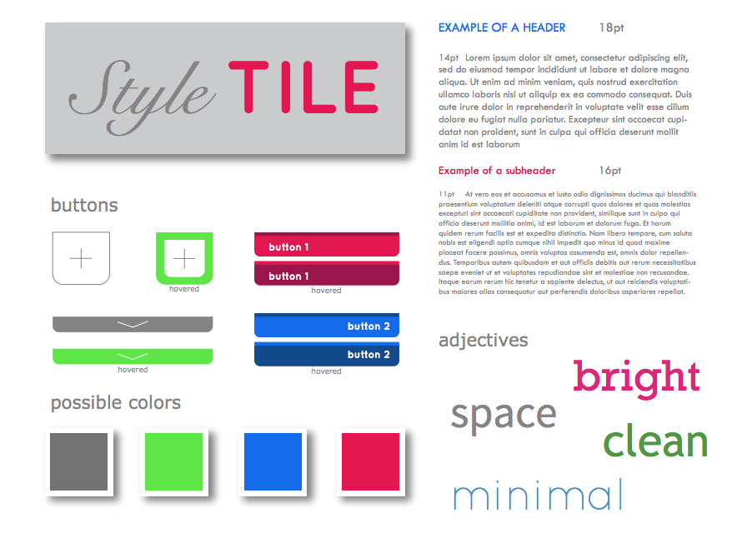
Visual Research

Slide 4
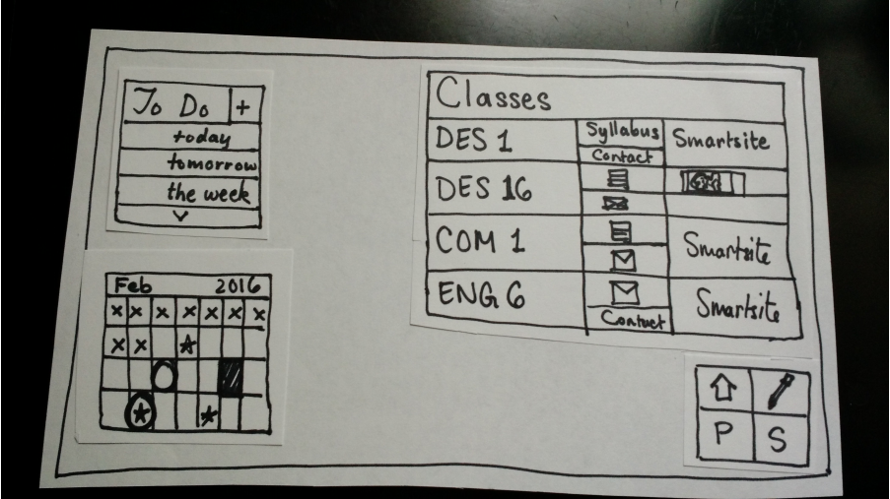
Storyboard

Slide 5
Needs
~ to do lists don’t always work
~ prioritization is key
~ changing your process

Slide 6
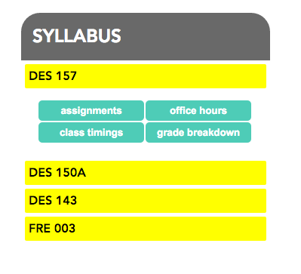
Syllabus

Slide 7
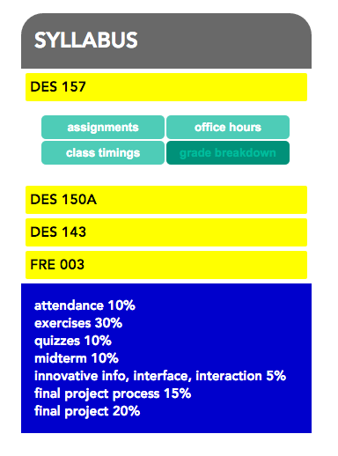
Syllabus

