Slide 1
MailMind AI
Your Inbox, Intelligently Organized
NLP · Machine Learning · Agentic AI
Final-Year Project | Team: [Your Names] | Guide: [Faculty Guide]
Notes:
Open with the one-line promise: an inbox that organises, prioritises and acts for you. Keep it to ~20 seconds before diving in.

Slide 2
THE PROBLEM
Email Overload Is a Productivity Tax
Knowledge workers face dozens of emails every single day
High cognitive load triaging each message manually
Important and urgent mail gets buried under the noise
Promotions, social and spam crowd out real priorities
Traditional inboxes are flat lists with no sense of importance
40+
emails received per day
~28%
of the workday spent in the inbox
Attention is the scarce resource.
Notes:
Frame the pain everyone feels: the inbox is a flat list with no sense of what matters. Set up the need for intelligence.

Slide 3
EXISTING SYSTEM
Static Rules That Tag, But Don't Understand
Manual sorting
Keyword / rule filters
No prioritisation
Slow, repetitive and error-prone; the user does all the work.
Brittle to new wording; easily fooled and quickly outdated.
Cannot rank importance within legitimate mail.
No learning
No assistance
Ignores how you actually open, reply, ignore or delete.
Produces no summaries and suggests no next action.
Notes:
Stress that traditional filters are static rules — they tag, but they do not understand, rank or act.

Slide 4
PROPOSED SYSTEM
MailMind AI — An Agentic Email Assistant
Understands, prioritises and acts on your inbox — five pillars in one pipeline.
1
2
3
4
5
Classification
NLP Signals
Context Priority
Behaviour
Agentic Output
6-category ML model
keywords · sentiment urgency · intent
sender · recency · VIP
learns from your actions
summarise · suggest · flag
Notes:
Position MailMind as five pillars working in one pipeline — not just a smarter filter, but an assistant that takes the next step.

Slide 5
OBJECTIVES
What the System Sets Out to Achieve
1
Reduce cognitive load
Cut the effort of triaging a crowded inbox.
2
Prioritise what matters
Rank mail by true importance and urgency.
3
Personalise over time
Adapt ranking from each user's behaviour.
4
Be proactive
Summaries, urgent flags and suggested actions.
5
Improve productivity
Surface the few emails that need action first.
Notes:
Five objectives map directly to the five pillars; each is measurable through automation rate and classification accuracy.

Slide 6
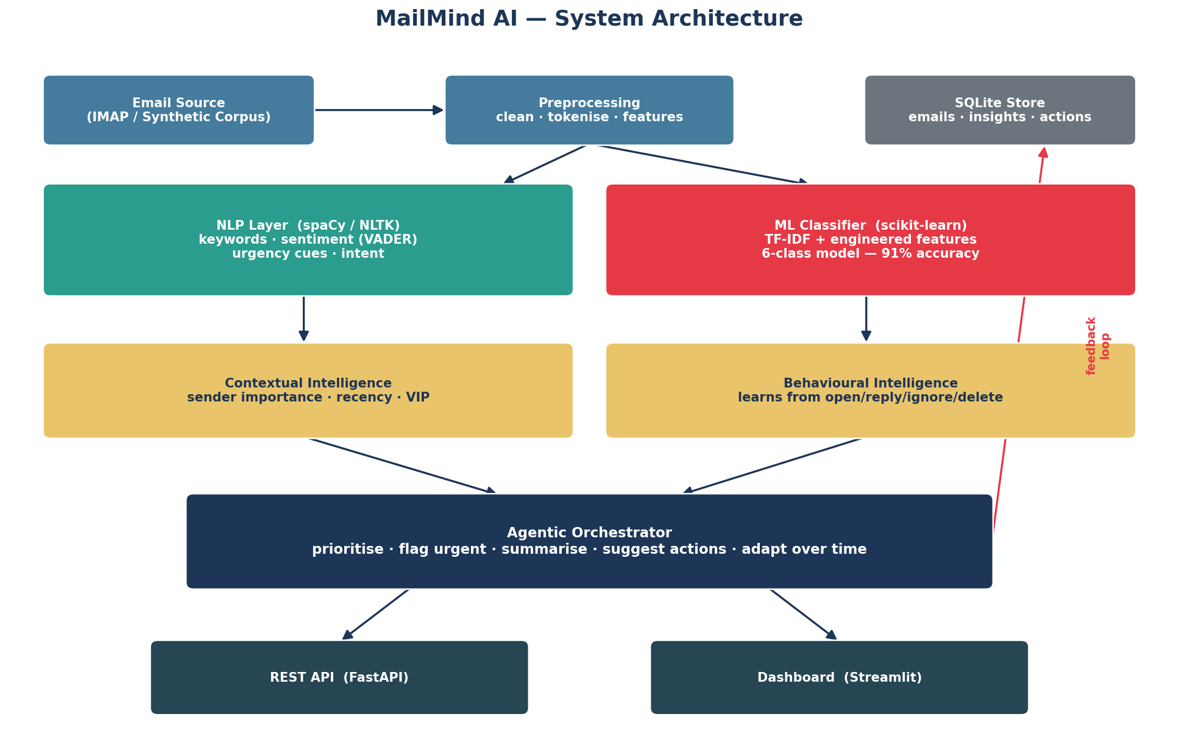
ARCHITECTURE
A Layered, Modular Python System
Notes:
Walk left to right: data in, intelligence in the middle (NLP + ML, then context + behaviour), agentic insights out to the API and dashboard. A feedback loop writes user actions back to the store.

Slide 7
WORKFLOW
How One Email Flows Through MailMind
1
Classify
ML model assigns one of six categories
2
Analyse
NLP extracts keywords, sentiment, urgency, intent
3
Prioritise
Context scorer computes a 0–100 priority
4
Adapt
Behavioural layer adjusts from past actions
5
Act
Summarise, suggest actions, flag urgent / VIP / spam
process_inbox() returns insights sorted by priority · record_feedback() closes the loop
Notes:
Emphasise this is a per-email pipeline; record_feedback() closes the loop so the system adapts over time.

Slide 8
AI COMPONENTS
Five Complementary Intelligence Layers
Classification
NLP Processing
Behavioural Intelligence
TF-IDF + engineered features → six categories at 91% accuracy.
Keyword extraction, VADER sentiment, urgency and intent detection.
Learns engagement from opens, replies, ignores and deletes.
Contextual Intelligence
Agentic AI
Sender importance, recency and VIP signals → priority.
Summarises, suggests the next action and adapts over time.
Notes:
One card per pillar. Make clear these are complementary stages, not competing models.

Slide 9
TECHNOLOGIES
A Production-Shaped Python Stack
Core ML / Data
NLP
Backend / API
scikit-learn · numpy · pandas · scipy · joblib
NLTK (VADER, punkt, WordNet) · optional spaCy
FastAPI · uvicorn · pydantic
Frontend / Viz
Storage
Testing
Streamlit · altair · matplotlib · seaborn
SQLite (standard library)
pytest — 44 tests, all passing
Notes:
Group by layer so the audience sees a coherent, production-shaped stack rather than a random tool list.

Slide 10
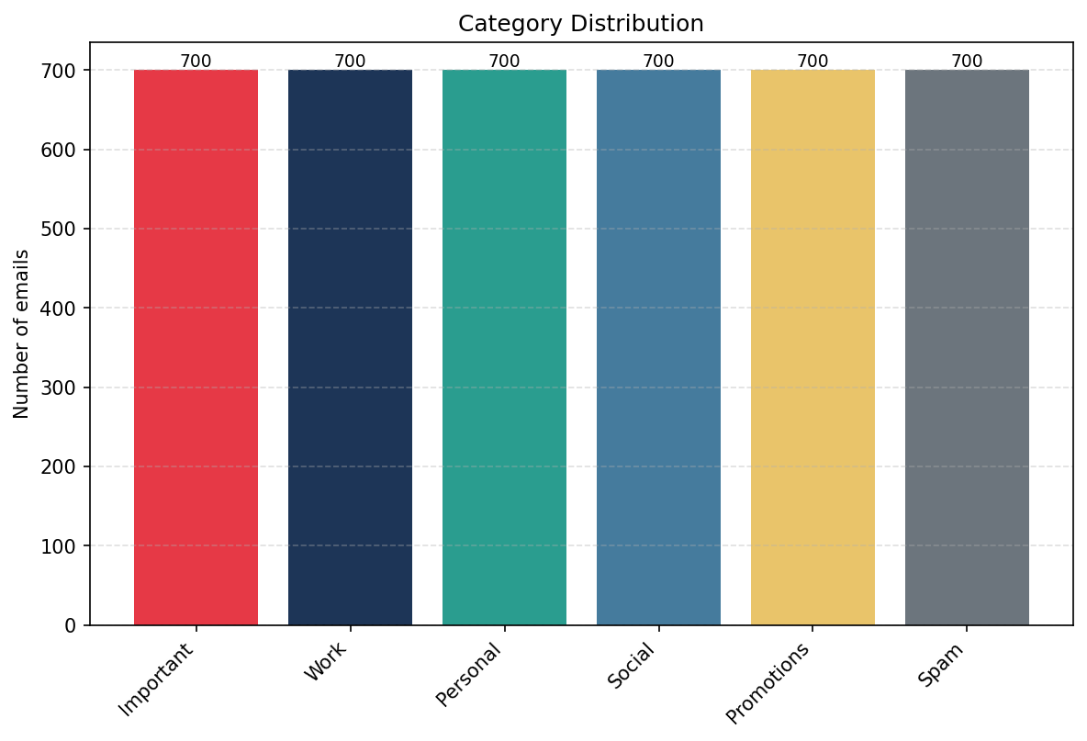
DATASET
A Realistic, Reproducible Synthetic Corpus
4,200 synthetic emails — 700 per category, perfectly balanced
Six categories with 14 × 14 templates and slot-filling
12% ambiguity borrows confusable neighbour bodies
Category-specific senders, links and attachment rates
Deterministic (seed = 42); stratified 80 / 20 split
3,360 train · 840 test
Notes:
Highlight that the 12% ambiguity makes classes realistically overlapping — not artificially separable.

Slide 11
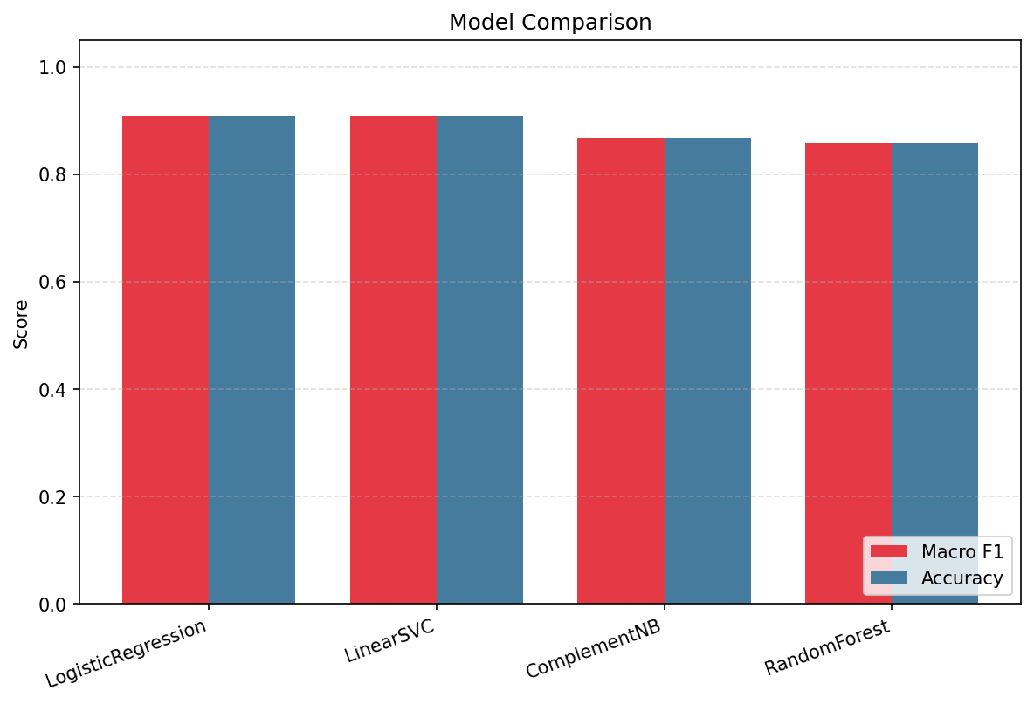
MODEL TRAINING
Comparing Four Classifiers, Keeping the Best
TF-IDF (1–2)-grams + 8 engineered numeric features
Combined via ColumnTransformer with MaxAbsScaler
Four models compared on the 840-email test set
Best: Logistic Regression — F1 0.9095 / acc 0.9095
Beat Linear SVM, Complement NB and Random Forest
Notes:
Logistic Regression edged out a calibrated Linear SVM and clearly beat the tree and Naive-Bayes baselines on sparse, high-dimensional text.

Slide 12
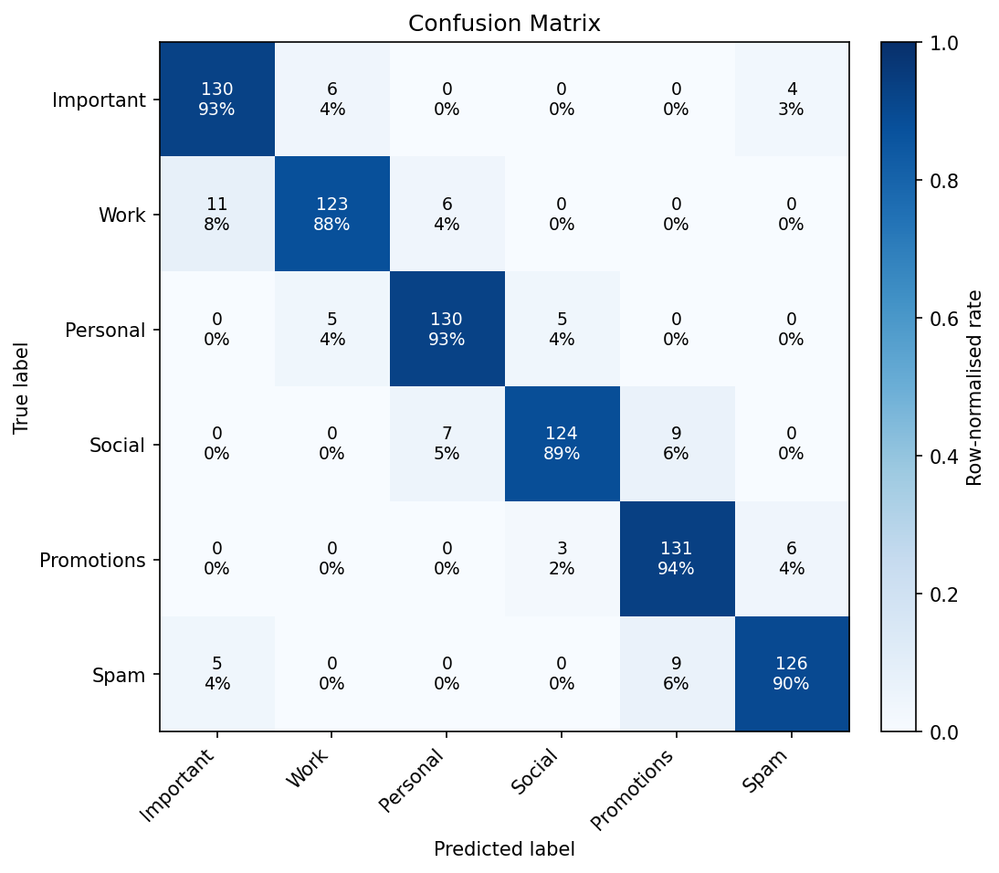
RESULTS & FINDINGS
Strong, Honest, Interpretable Performance
90.9%
0.91
+18.8
test accuracy
macro F1
pts vs rules
Per-class F1 from 0.898 (Work) to 0.919 (Personal)
Errors cluster on overlapping pairs: Work↔Important, Promotions↔Spam
Rule-based baseline 72.1% → 67.5% relative error reduction
Rules cannot prioritise, learn, summarise or suggest actions
Notes:
The confusion matrix shows errors cluster on genuinely ambiguous pairs, which is expected and acceptable. The +18.8 points over a keyword baseline is measured on the same test set.

Slide 13
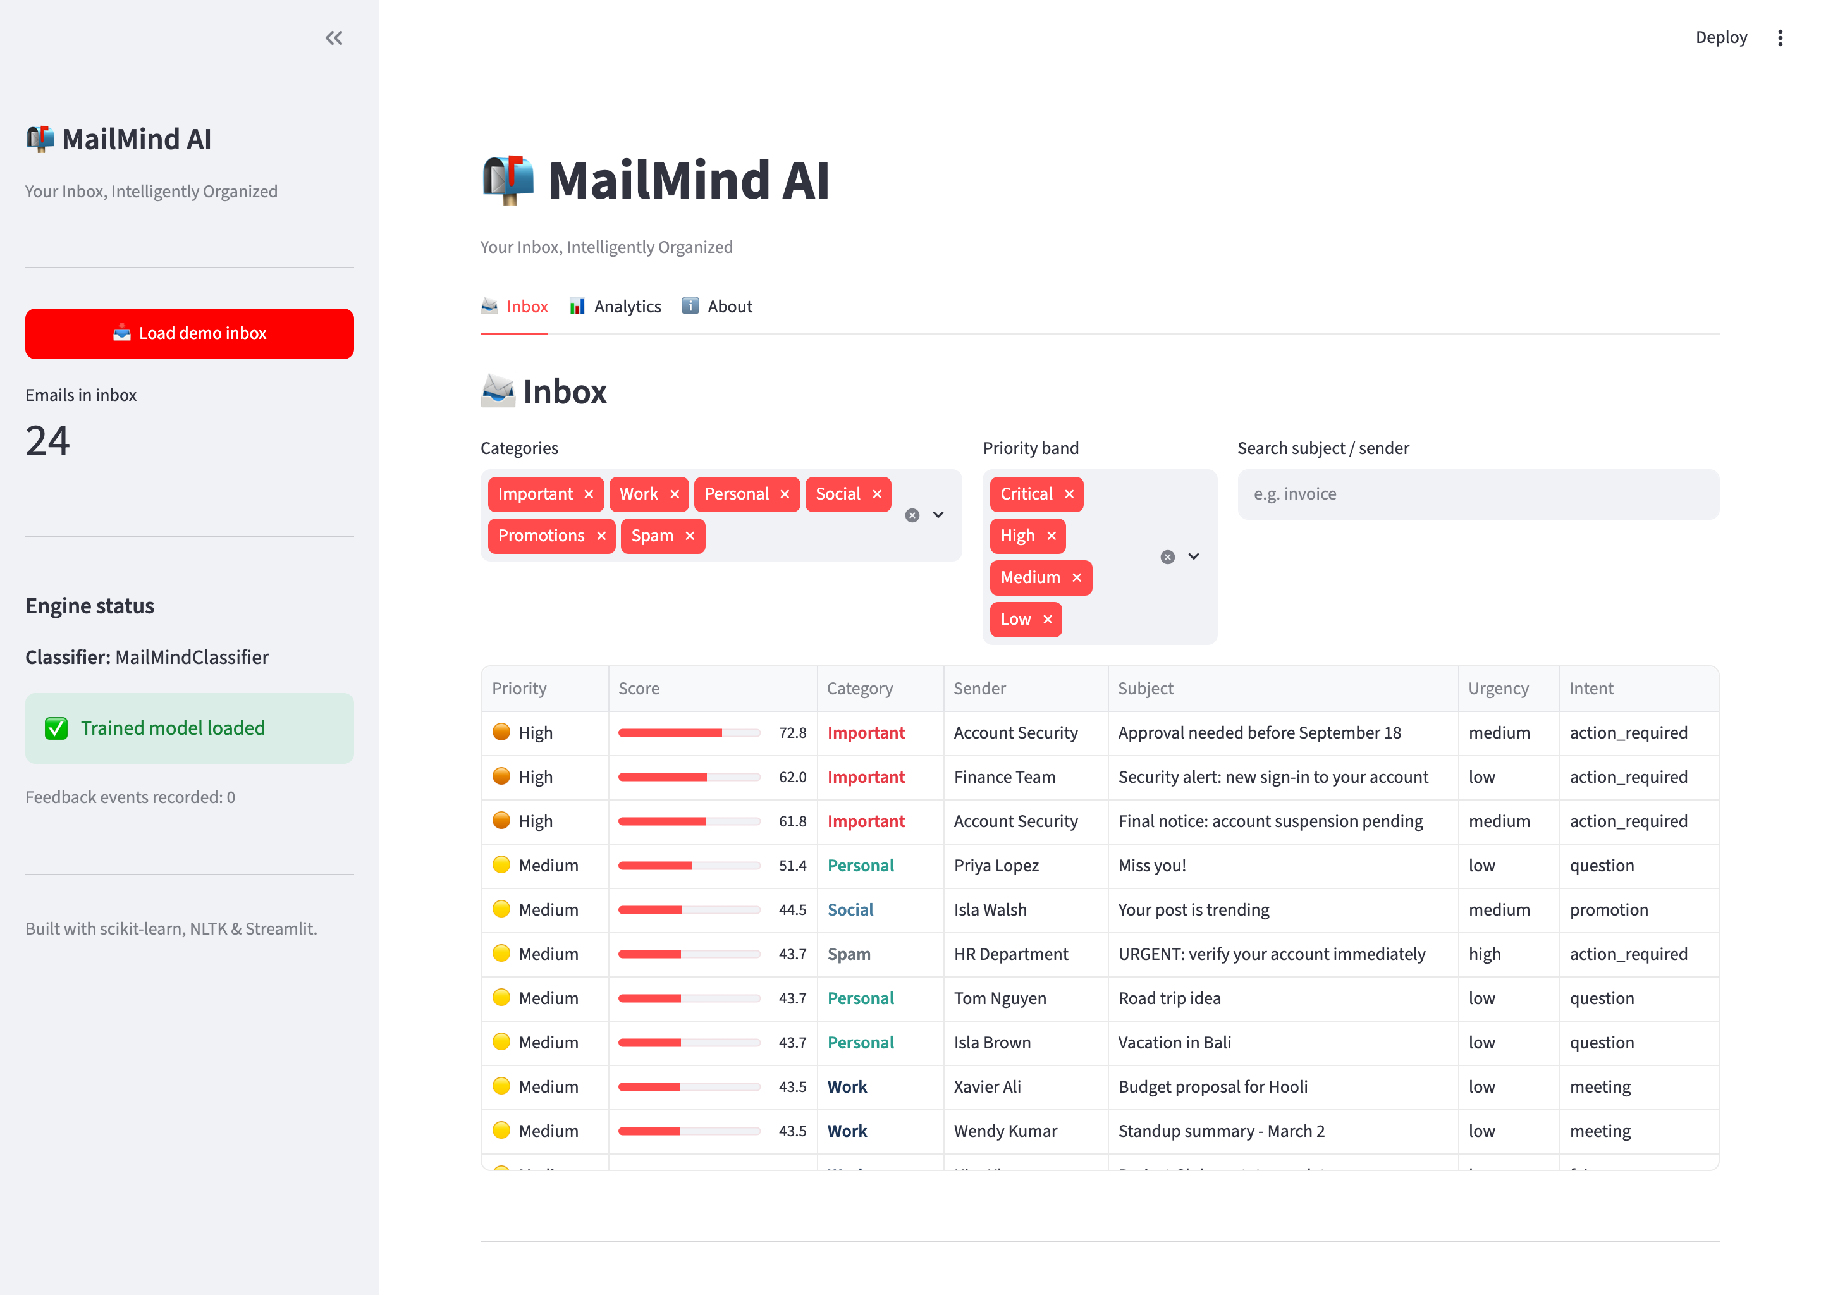
DEMO
The Working Streamlit Dashboard
Live inbox
Sorted by priority score
Critical / High / Medium / Low bands
Category, urgency & intent per email
One-click suggested actions
Outage → Important, High (79.1)
Notes:
Demo the live inbox — point out the priority ordering and the one-click suggested actions per email. Analytics and detail views also exist.

Slide 14
FUTURE SCOPE & CONCLUSION
From a Flat Inbox to an Intelligent Assistant
Live mailbox integration via IMAP / Gmail & Microsoft Graph
Transformer embeddings (BERT) behind the existing feature interface
Generative AI for context-aware reply drafting
Per-user online learning and multilingual support
MailMind AI turns a noisy, flat inbox into a prioritised, self-organising assistant — classifying, summarising and acting on email with 91% accuracy.
Thank you.
Notes:
Be honest — time-saving is an illustrative estimate from the measured automation rate, not a human user study. Close on the vision.

