Slide 1
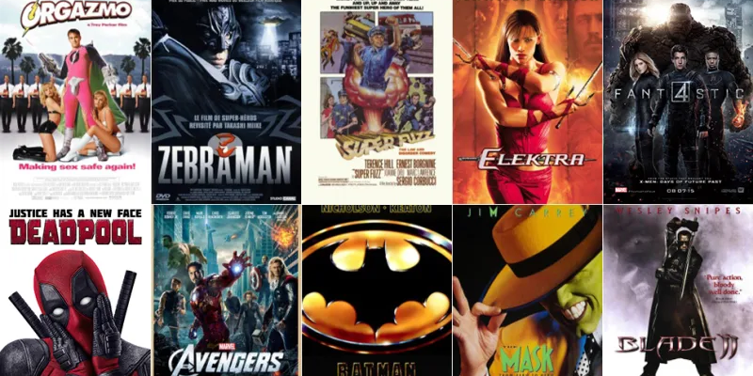
1000 MOVIES- EDA
Srujana Vadapalli & Srinivas Nanduri

Slide 2
Background on DataSET
The dataset is taken from the IMDB database.
It contains data of 1000 most popular movies(by IMDB rating) for the period of 10 years 2006-2016.
Users registered on this site are invited to rate any film on a scale of 1 to 10
This dataset has 12 different columns and 1000 rows of movies

Slide 3
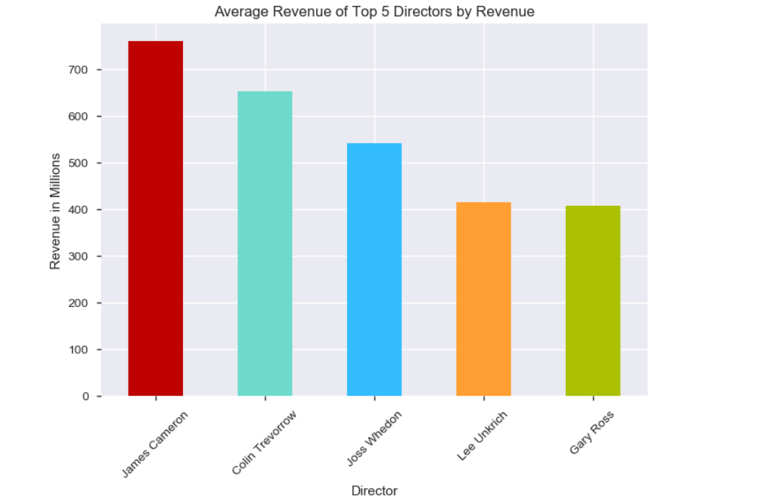
Which director's movies had received higher Revenue ?
The director who has earned the highest average revenue is James Cameron

Slide 4
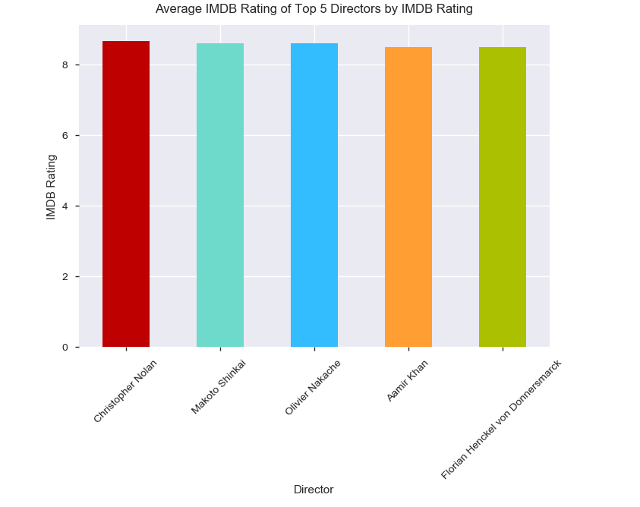
Which director's movies had received higher IMDB Rating ?
Christopher Nolan directed movies had received higher IMDB ratings

Slide 5
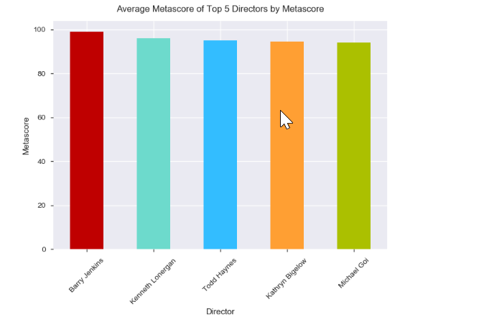
Which director's movies had received higher Metacritic score ?
Barry Jenkins directed movies had received higher meta score ratings

Slide 6
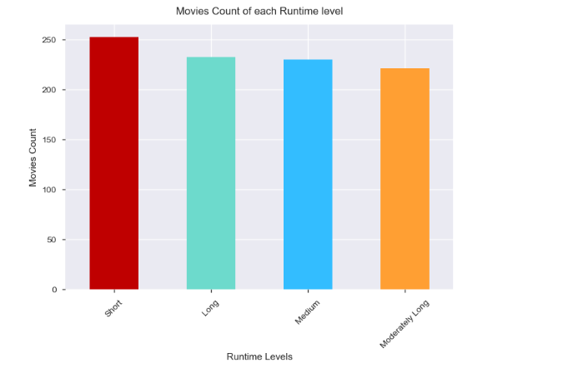
Movies count of each run time level
There are around 250 short duration movies that were released over the past 10 years (2006-2016)
Notes:
| Runtime(in minutes) | Level |
|----------------------- |----------|
| 66-100 ------ Short
| 100-111 ------ Medium
| 111-123 ------ Moderately Long
| 123-187 ------ Long

Slide 7
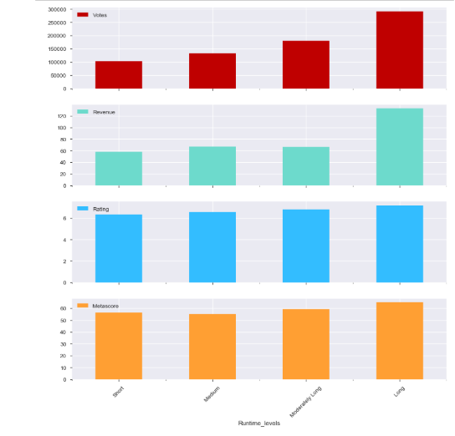
Which interval of Runtime receives higher votes, revenue ,ratings and metascore?
Viewers tend to rate movies more that have long Runtimes(greater than 123 minutes). Movies with Runtime (greater than 123 minutes) beats other movies in terms of Revenue by a significant margin.

Slide 8
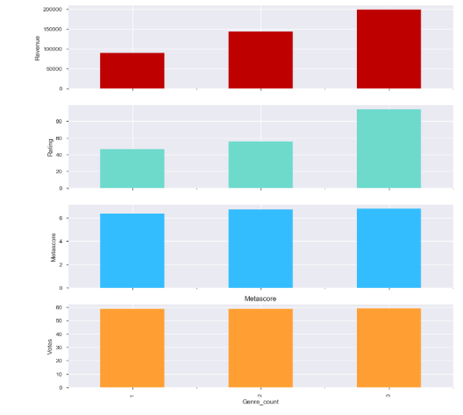
Does the total number of Genres in the movie affect the votes, revenue, popularity, critical acclaim of the movie ?
The number of Genres in the movie increase the Revenue and IMDB Rating of the movie significantly. On average, a movie with more than 2 Genres tends to earn double the revenue than a movie with only 1 Genre.

Slide 9
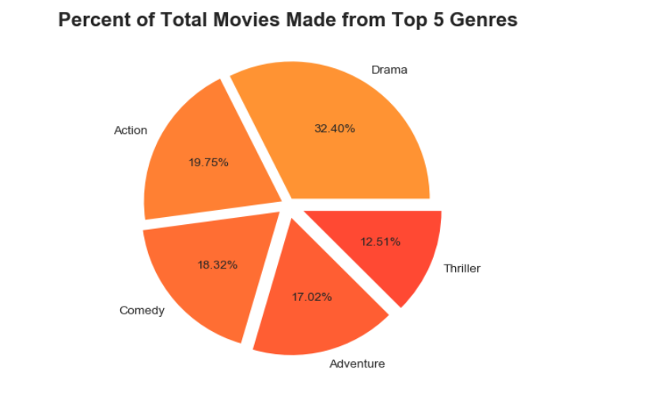
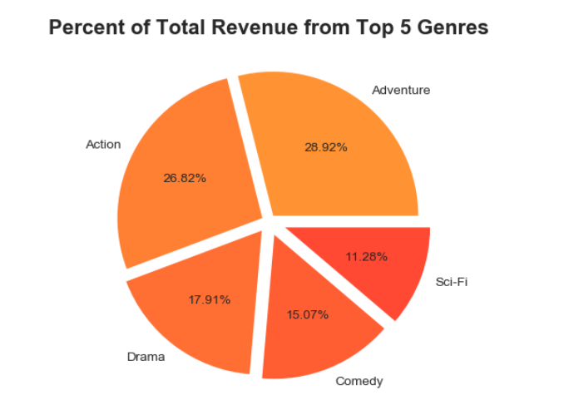
Which genres are more profitable?
The Adventure and Action movies have whopping percentages in terms of their revenues over all the years combined with Drama or Comedy

Slide 10
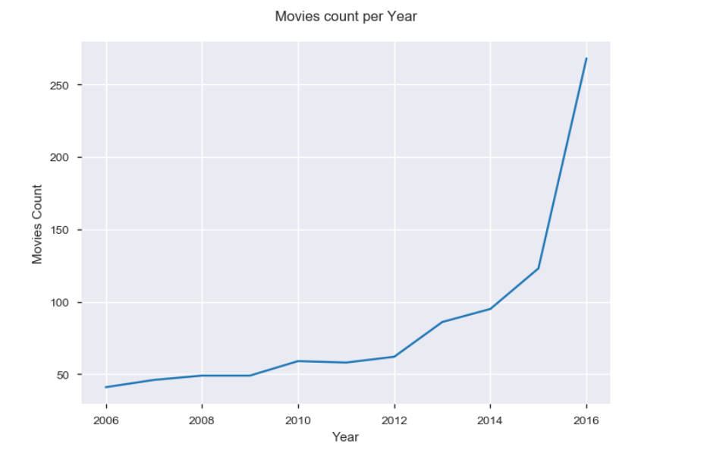
Is the growth of the movie industry on the rise ?
The number of movies released over the last 10 years period is showing an upward trend. There is dramatic increase(more than double) in the number of movies released in 2016, when compared to the number of movies released in 2015.

Slide 11
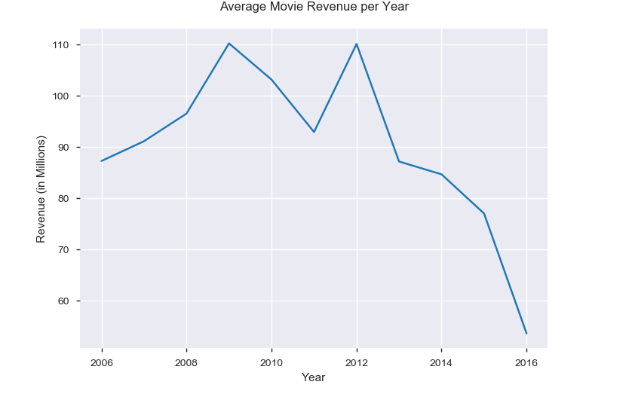
Is the average revenue of the movies increasing over the years ?
The average revenue of movies per year decreasing, while the total revenue of movies is increasing over the years.

Slide 12
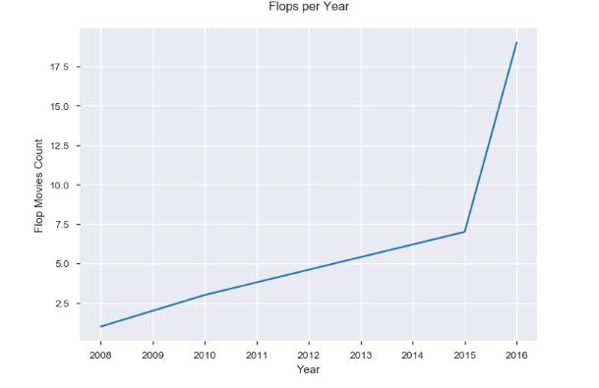
How is the trend of flop(Decreased rating Vs Number of Movies released) movies ?
The number of movies that didn't earn impressive revenue drastically increased in the year 2016 in comparison with all previous years.

Slide 13
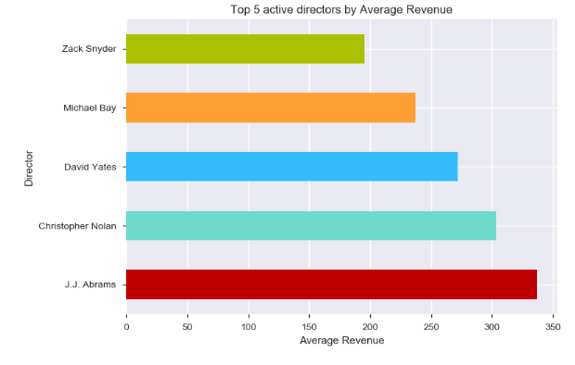
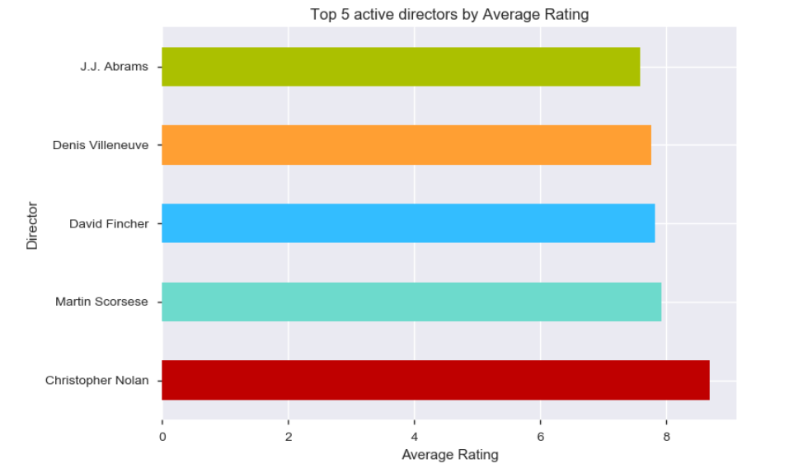
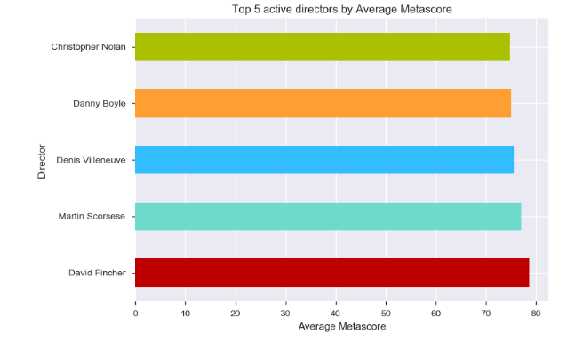
Top 5 Directors who earn more revenue , rating and meta critic score

Slide 14
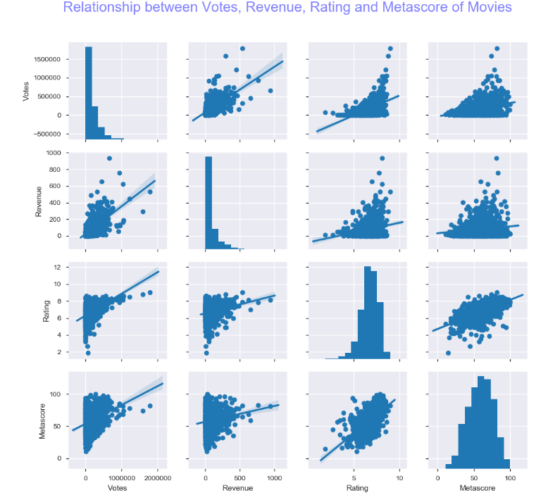
What is the relationship between Votes, Revenue, Rating and Metascore of movies ?
Rating and Metascore have strong correlation. So it means the Registered users on IMDB and Critics on Metacritic tend to rate the same way for most movies.

Slide 15
Conclusion
More directors directed movies in the genre of Drama and Action combined with Comedy, Adventure or Thriller that were proven to be more popular as well.
Industry is growing with respect to number of movies released and the total revenue gained year on year.
Rating and Metascore have strong correlation. So it means the Registered users on IMDB and Critics on Metacritic tend to agree with each other for most movies.
Movies with Long runtimes (> 123 minutes) earn more in terms of Votes, Revenue, Rating and Metascore with Revenue beating all others drastically.

Slide 16

Actionable Insights
Invest in movies directed by active directors - those people who direct multiple moderately high budget movies. For instance, Christopher Nolan movies is certain to bring in more Revenue, Rating and Metascore.
Invest in movies that have Long runtimes - Runtime greater than 2 hrs.
Produce movies with 3 Genre combination - Include a mix of Drama, Animation, Adventure, Action, Thriller.
Invest in movies that will satisfy both People and Critics - These movies will earn higher Revenue more often than not.

Slide 17
THANKS

