Slide 1
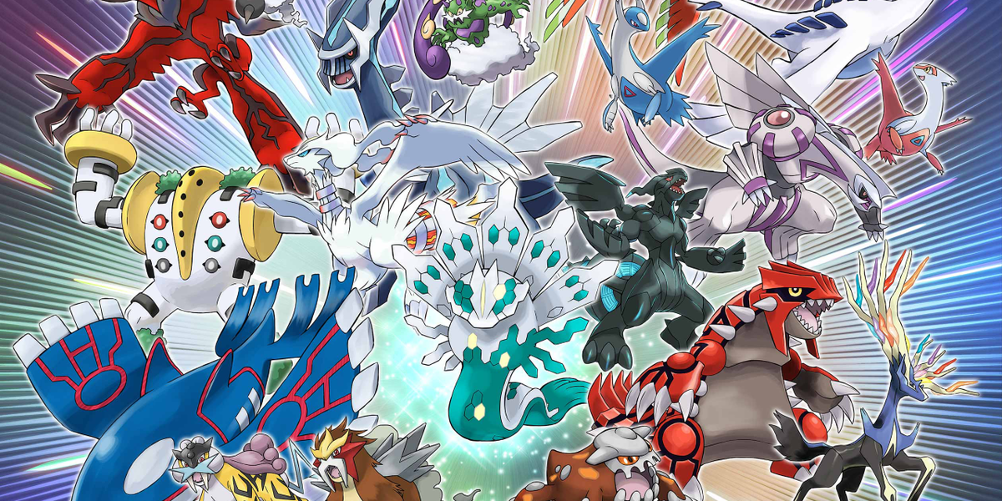
Pokémon DATA ANALYSIS
Srujana Vadapalli & Srinivas Nanduri

Slide 2
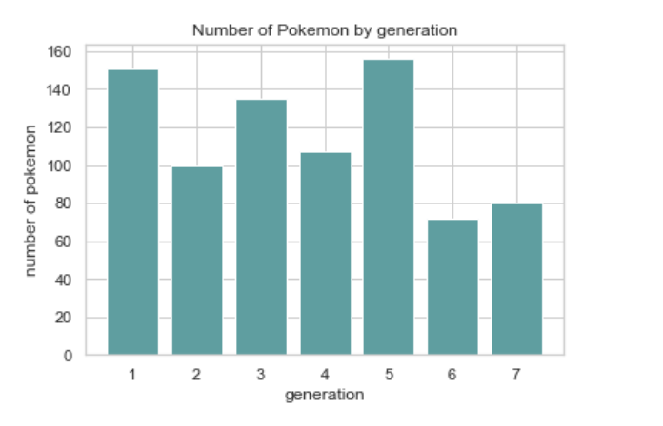
Which GENERATION Pokémon’s ARE MORE IN NUMBER
Generation 5 Pokémon's are more in number followed by Generation 1 and generation 3.

Slide 3
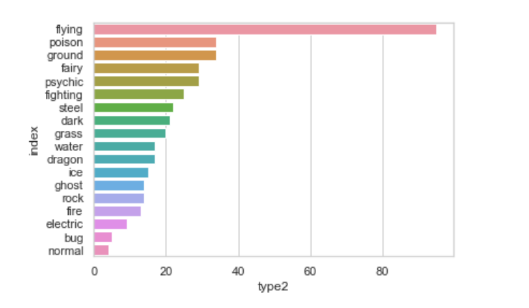
Type Vs Number
Flying type Pokémon's are more in number

Slide 4
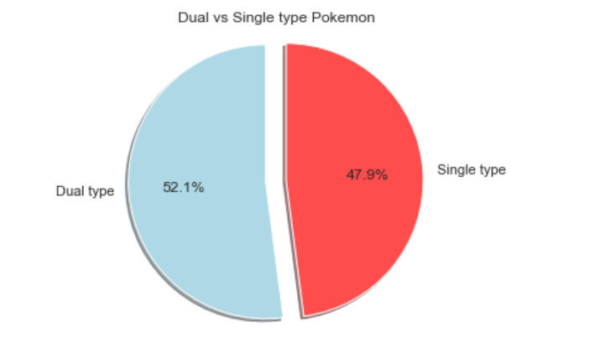
Dual vs Single type Pokémon's
Almost 48% of Pokémon are single type meaning that they don’t possess secondary abilities whereas 52% have both primary and secondary abilities (e.g. primary: bug, secondary: flying)

Slide 5
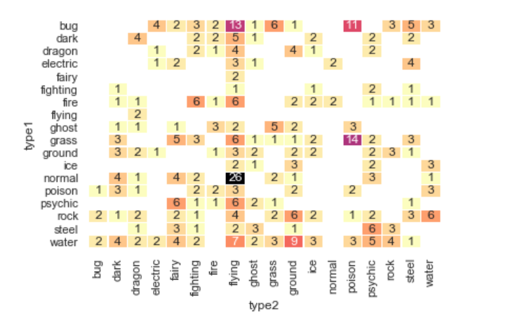
Heat Map for type-1 vs type-2

Slide 6
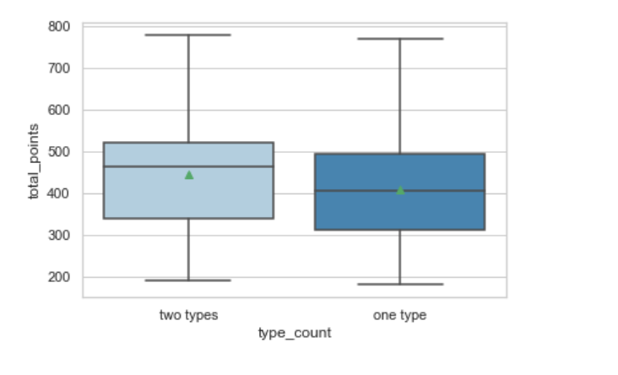
Pokémon Types

Slide 7
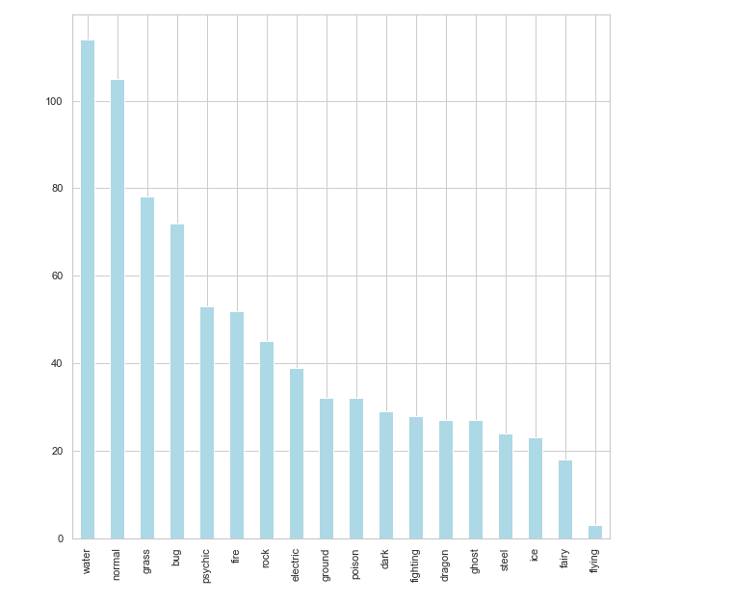
Different sets of Pokémon's
The different types of Pokémon that are present in our dataset are visible clearly.
Water Pokémon seems to be a favorite choice because the dataset has a lot of water type Pokémon.
There are very few flying type Pokémon.

Slide 8
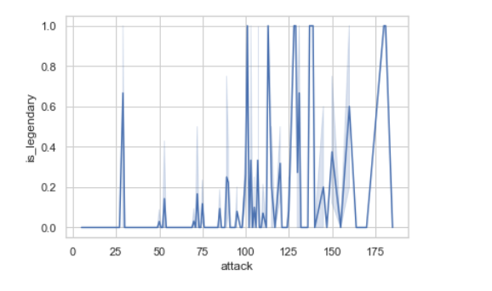
WHICH TYPE OF POKEMON HAS HIGHER ATTACK VALUES
This shows us that legendary Pokémon have higher values of attack when compared to normal Pokémon. Most of the legendary Pokémon have values of attack more than 100 units. So this graph helps us understand the influence of attack values on the target. This can be of help for picking out the right features in our dataset.

Slide 9
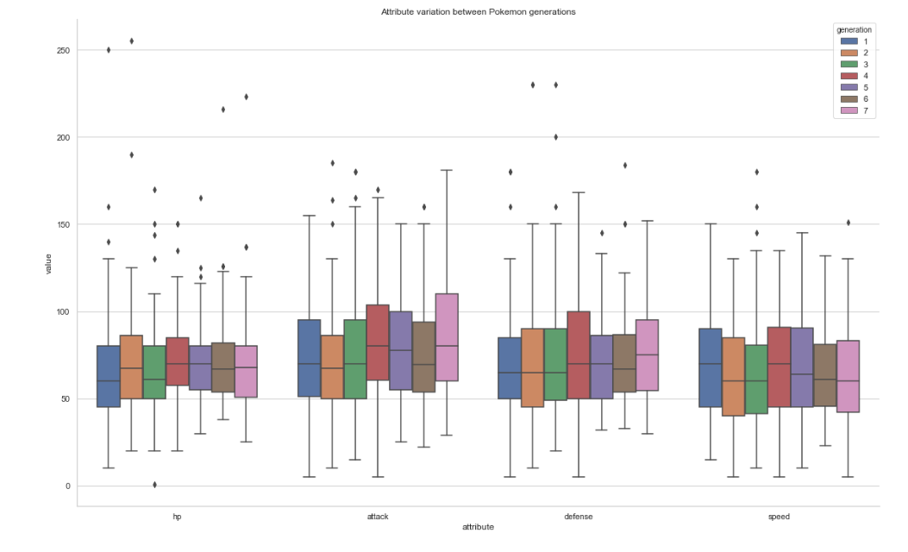
Attribute variation between Pokémon generations

Slide 10
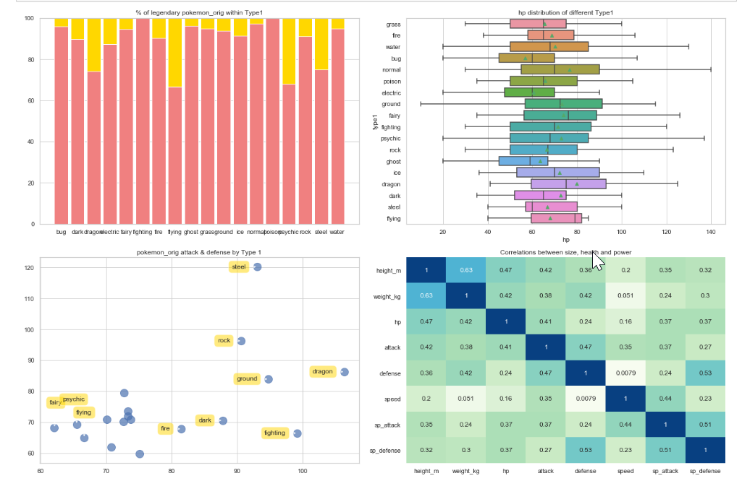
Pokémon's strength analysis
1. dragon, flying, psychic and steel have relatively larger percentage of legendary pokemon
2. ghost, electric and bug pokemon tend to have lower hp whereas fairy and flying pokemon types tend to have higher hp
3. On average, dragon type has the highest attack and steel type has significantly higher defense

Slide 11
Model selection/predictions

Slide 12
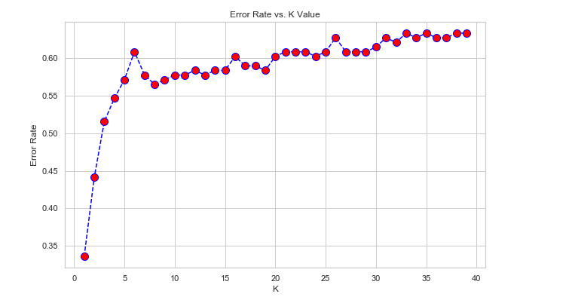
KNN with PCA for type Prediction

Slide 13
KNN with PCA for legendary Pokémon prediction

Slide 14
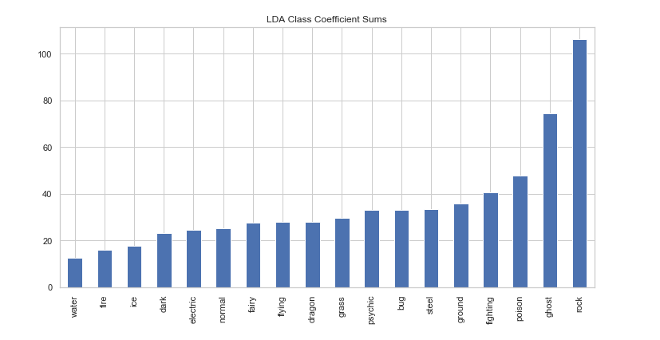
LDA class coefficient sums

Slide 15
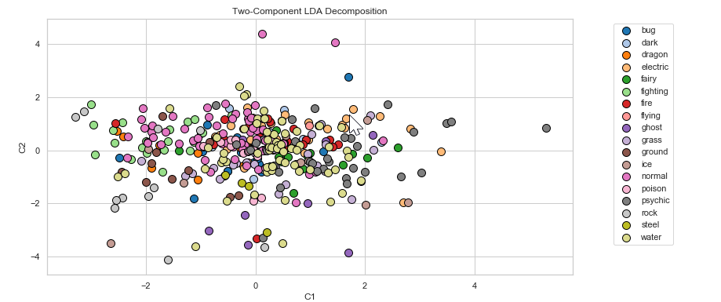
Two component LDA composition

Slide 16
Conclusions
General Observations
1. Generation 1, 3 and 5 have relatively higher number of Pokémon introduced
2. The most common Pokémon types are water, normal, grass and bug.
3. Water Pokémon seems to be a favorite choice because the dataset has a lot of water type Pokémon.
4. There are very few flying type Pokémon.
5. Most Pokémon only have a primary type but only 52% of Pokémon have both primary and secondary abilities (e.g. primary: bug, secondary: flying)
6. normal + flying, grass + poison, bug + flying and bug + poison are the most common type 1&2 combination
7. The legendary Pokémon have higher values of attack when compared to normal Pokémon. Most of the legendary Pokémon have values of attack more than 100 units.

Slide 17
1. PCA doesn't seem to have much impact due to the lesser number of components and less variance.
2. The optimal number of neighbors for using in KNN algorithm is 3.
3. The accuracy of KNN model is 93%.
4. SVC Model (SVM) seems to be having higher accuracy for training set but for test data it is only 90%.
KNN Model seems to be better for predicting as far as this data set is considered.

