Slide 1
AI-POWERED STUDY BUDDY
CAPSTONE PROJECT
Presented By:
1.Remudala Srujana-Malla Reddy College Of Engineering For Women-Computer Science And Engineering

Slide 2
OUTLINE
Problem Statement
System Development Approach
Algorithm & Deployment (Step by Step Procedure)
Result
Conclusion
Future Scope(Optional)
References

Slide 3
Problem Statement
Students often face difficulties in understanding complex concepts while studying independently. Searching online can lead to lengthy, scattered, or irrelevant information, and access to teachers or tutors is not always immediate. This creates a gap in effective learning and quick revision.
There is a need for an intelligent study assistant that can:
Explain difficult concepts in simple and easy-to-understand terms
Summarize study notes for quick learning
Generate quizzes or flashcards on demand for self-assessment
AI-powered tools can address this gap by providing personalized, on-demand learning support, making study sessions more efficient and engaging.

Slide 4
System Approach
Programming Language
Python 3.10+ – core language for backend and AI integration
AI & APIs
Google Gemini 2.5 Flash – for AI-powered explanations, summarization, and quiz generation
OpenAI / Generative AI APIs (if applicable)
Web Framework
Streamlit – for building the interactive frontend and deployment
Environment & Deployment
.env files – secure storage of API keys
Docker – containerization for consistent environment
Google Cloud Run / Streamlit Cloud – deployment of the app online
Supporting Libraries
pandas, numpy – for data handling
python-dotenv – for managing environment variables

Slide 5
Algorithm & Deployment
Algorithm
User Interaction
Students input topics, notes, or questions . Simple, intuitive interface for entering queries.
AI Processing
Google Gemini 2.5 Flash generates explanations, summaries, and quizzes . Efficient handling of long or complex inputs.
Performance
Responses delivered under 3 seconds for typical queries . Optimized for lightweight and fast processing in Streamlit.
Availability & Accessibility
App accessible online 24/7 via Streamlit Cloud or Google Cloud Run . Mobile-responsive interface for laptops, tablets, and phones.
Scalability & Future Integration
Modular architecture for adding new features (e.g., flashcards, topic recommendations, multilingual support).Cloud deployment ensures handling multiple users simultaneously without performance degradation.
Deployment
Local Testing: streamlit run app.py
Cloud Deployment: Streamlit Cloud → Connect GitHub repo → Deploy
Google Cloud Run → Containerize with Docker → gcloud builds submit → gcloud run deploy
Secure environment variable management for API keys using .env or Streamlit Secrets.

Slide 6
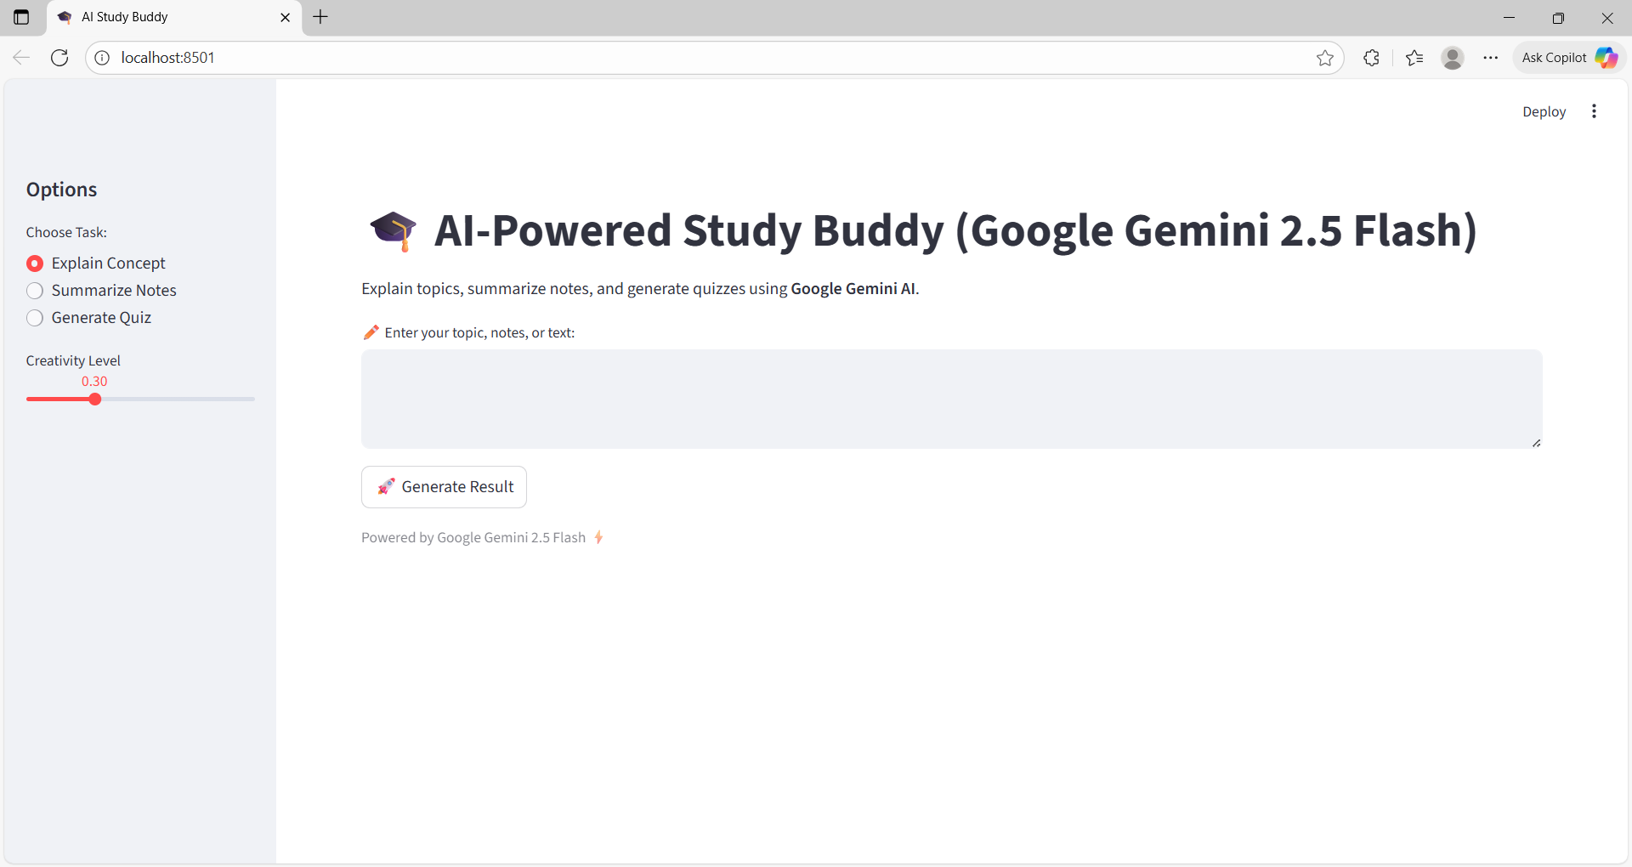
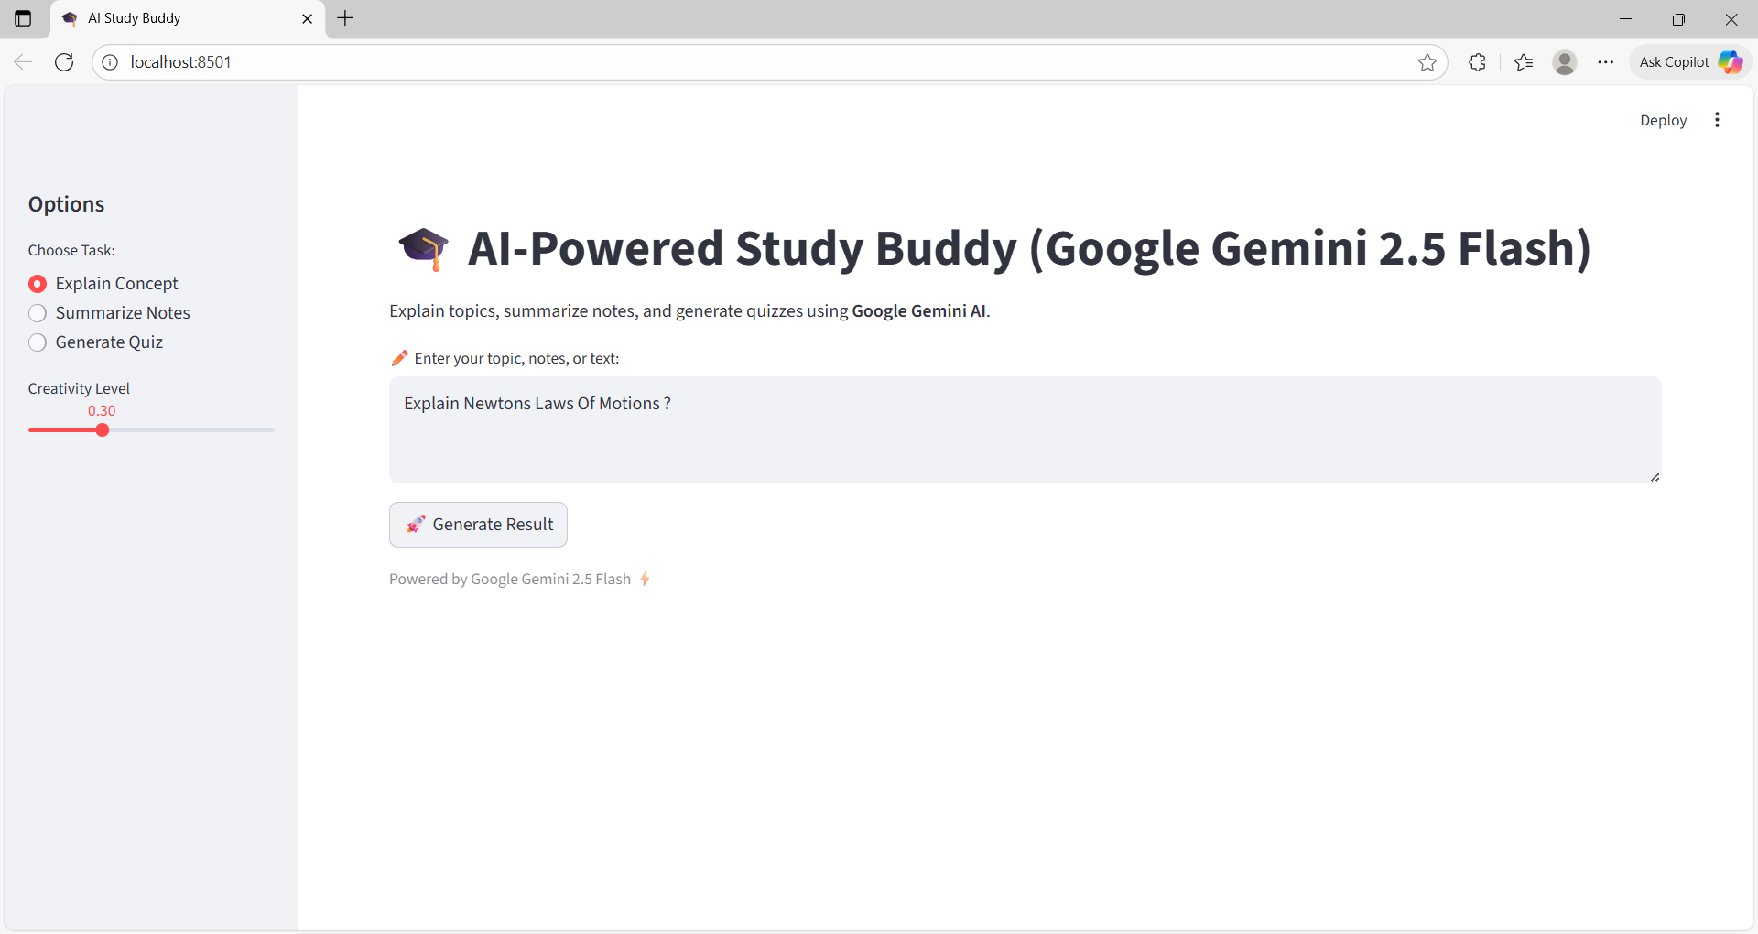
Result
a)Interface Page/Landing page
b) Explaining concept Page

Slide 7
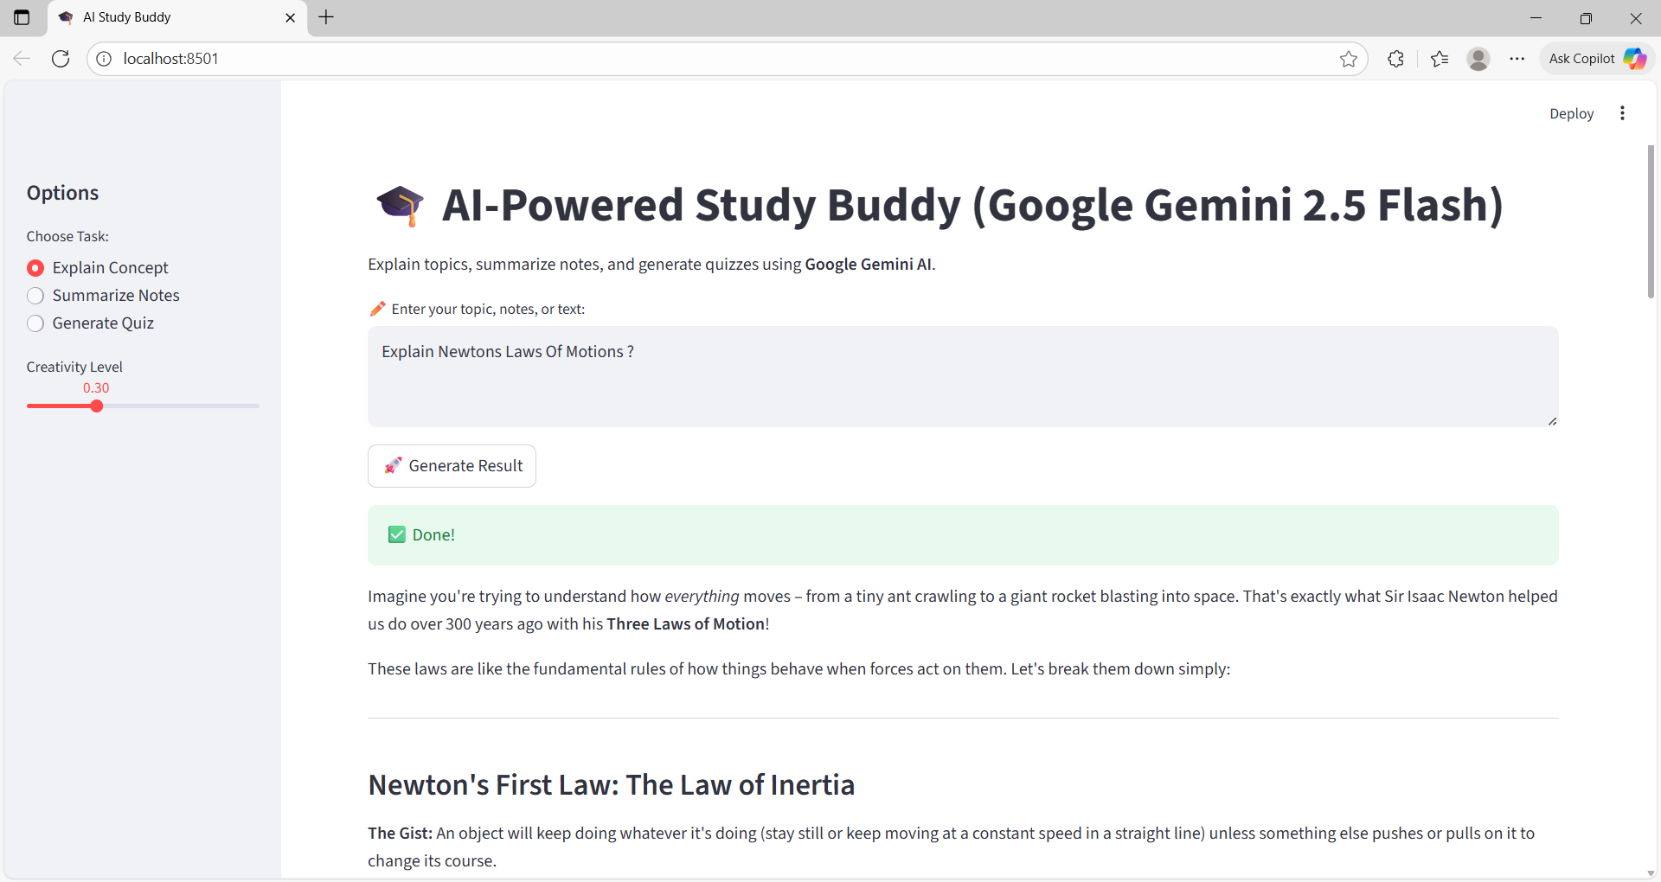
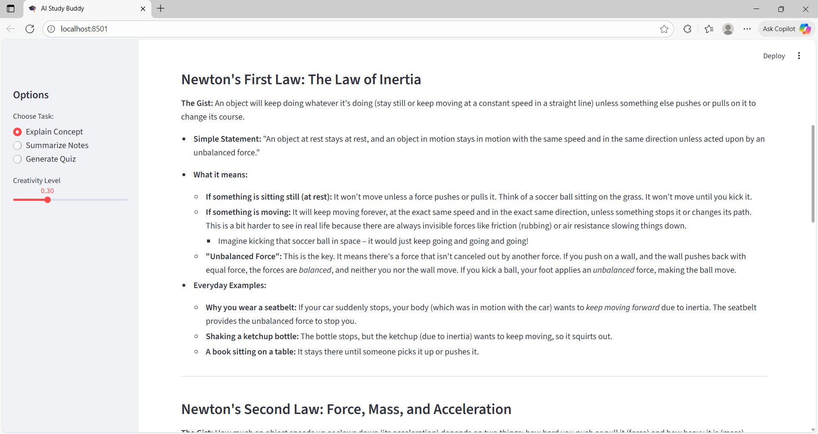
Result

Slide 8
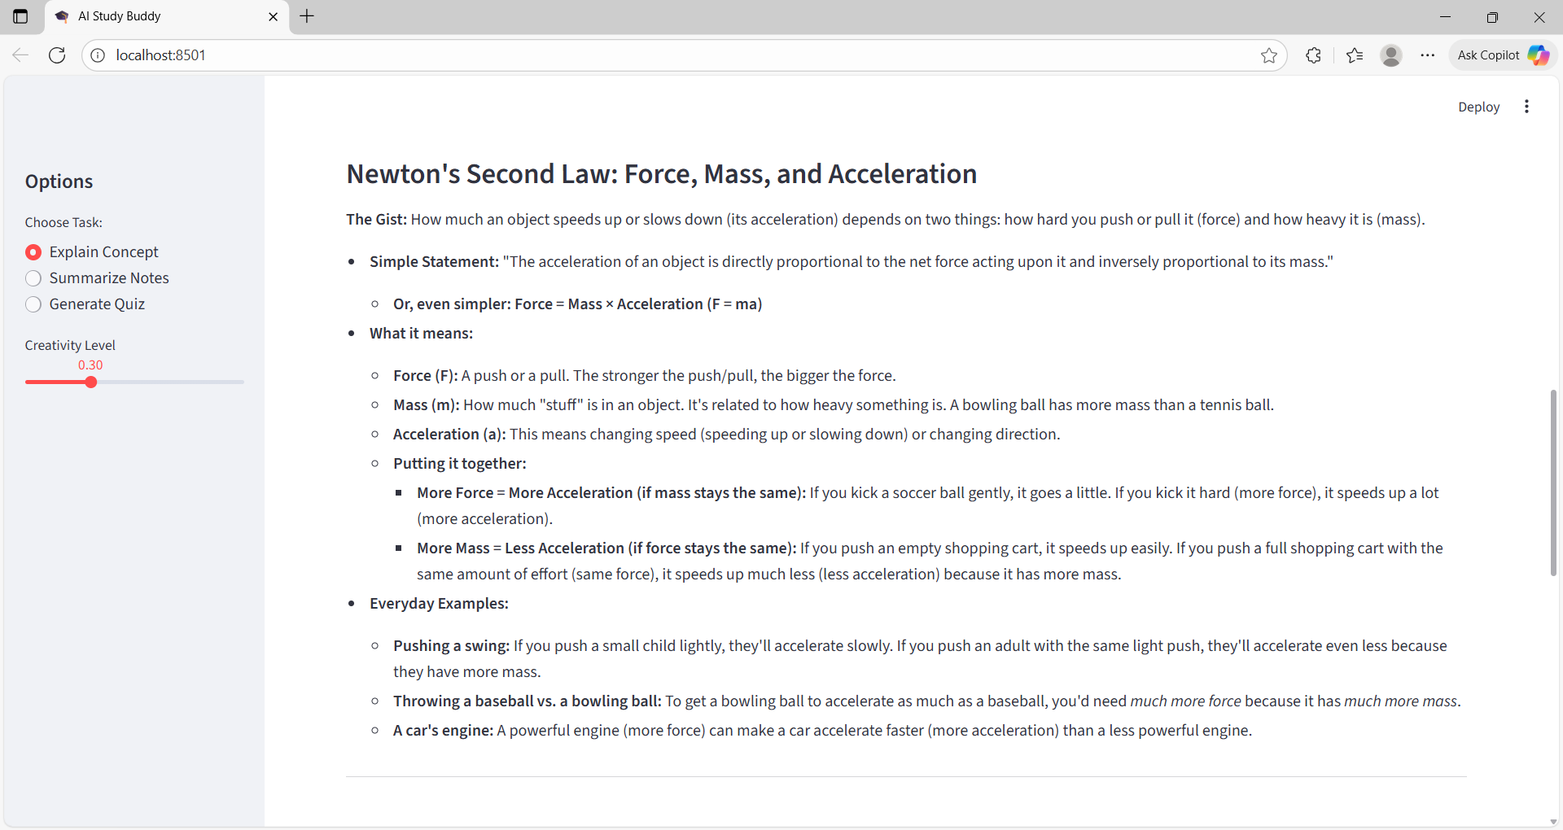
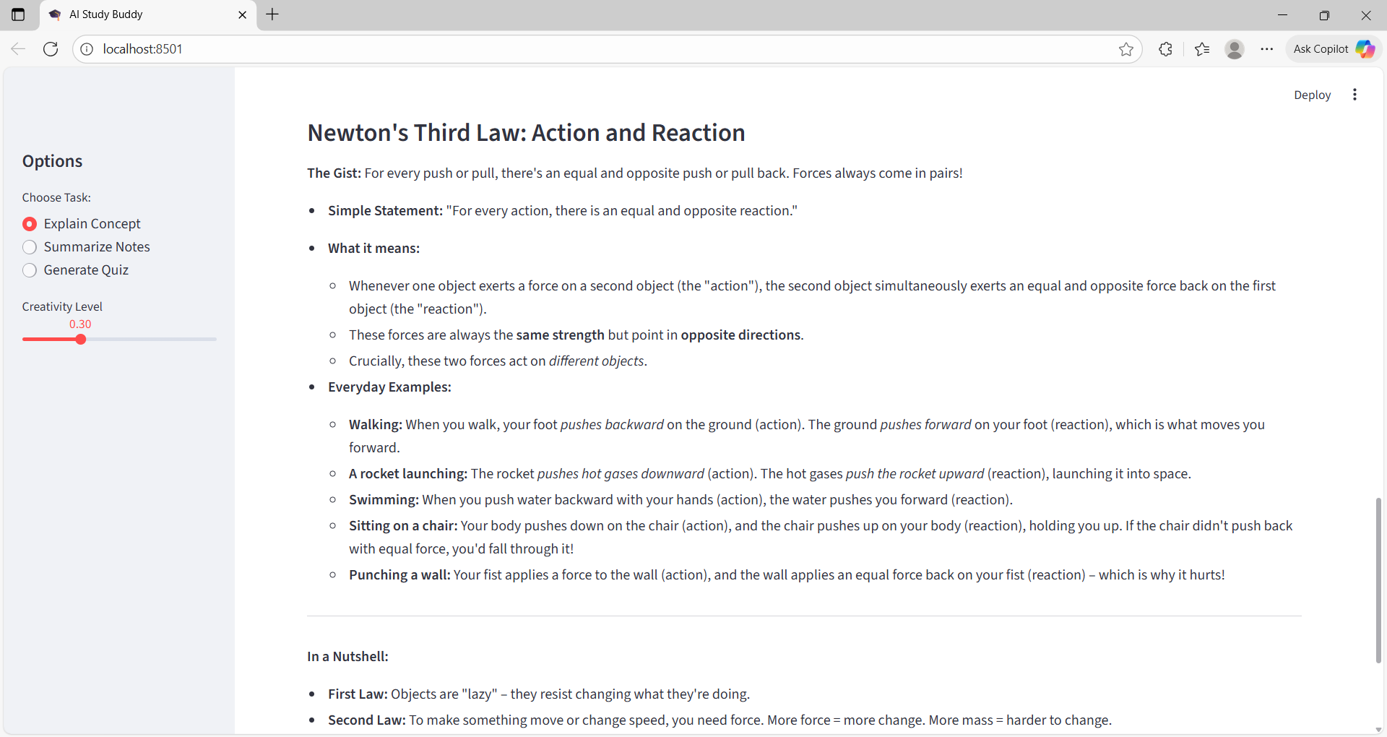
Result

Slide 9
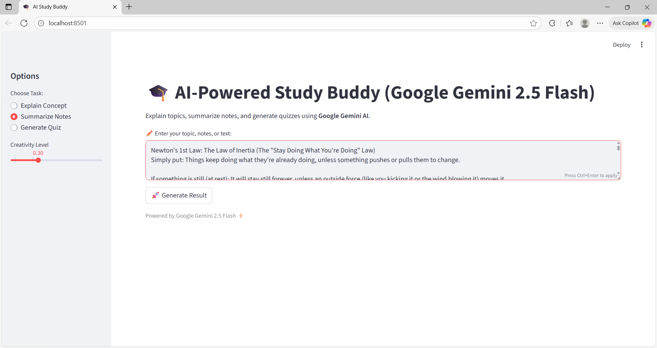
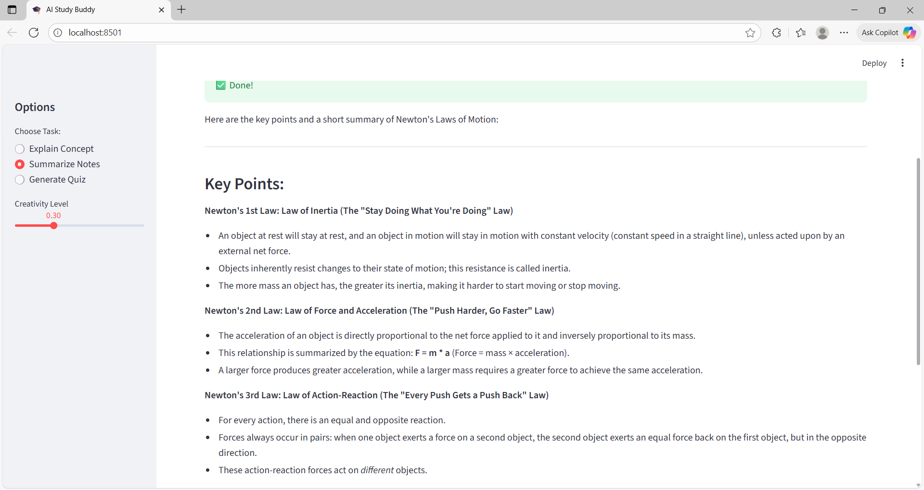
Result
c) Summarize Page

Slide 10
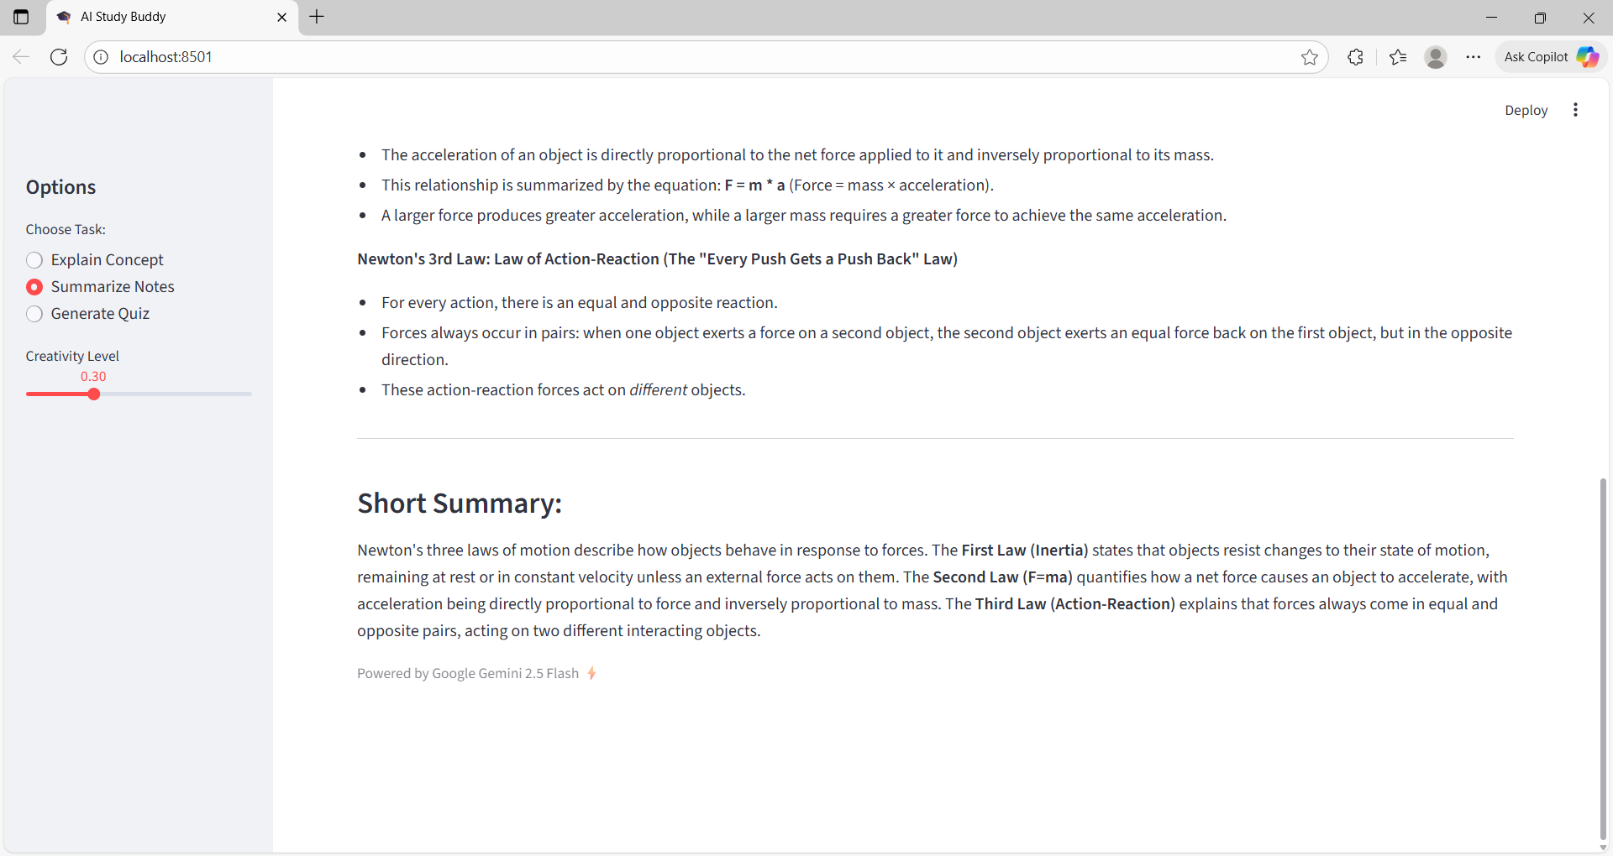
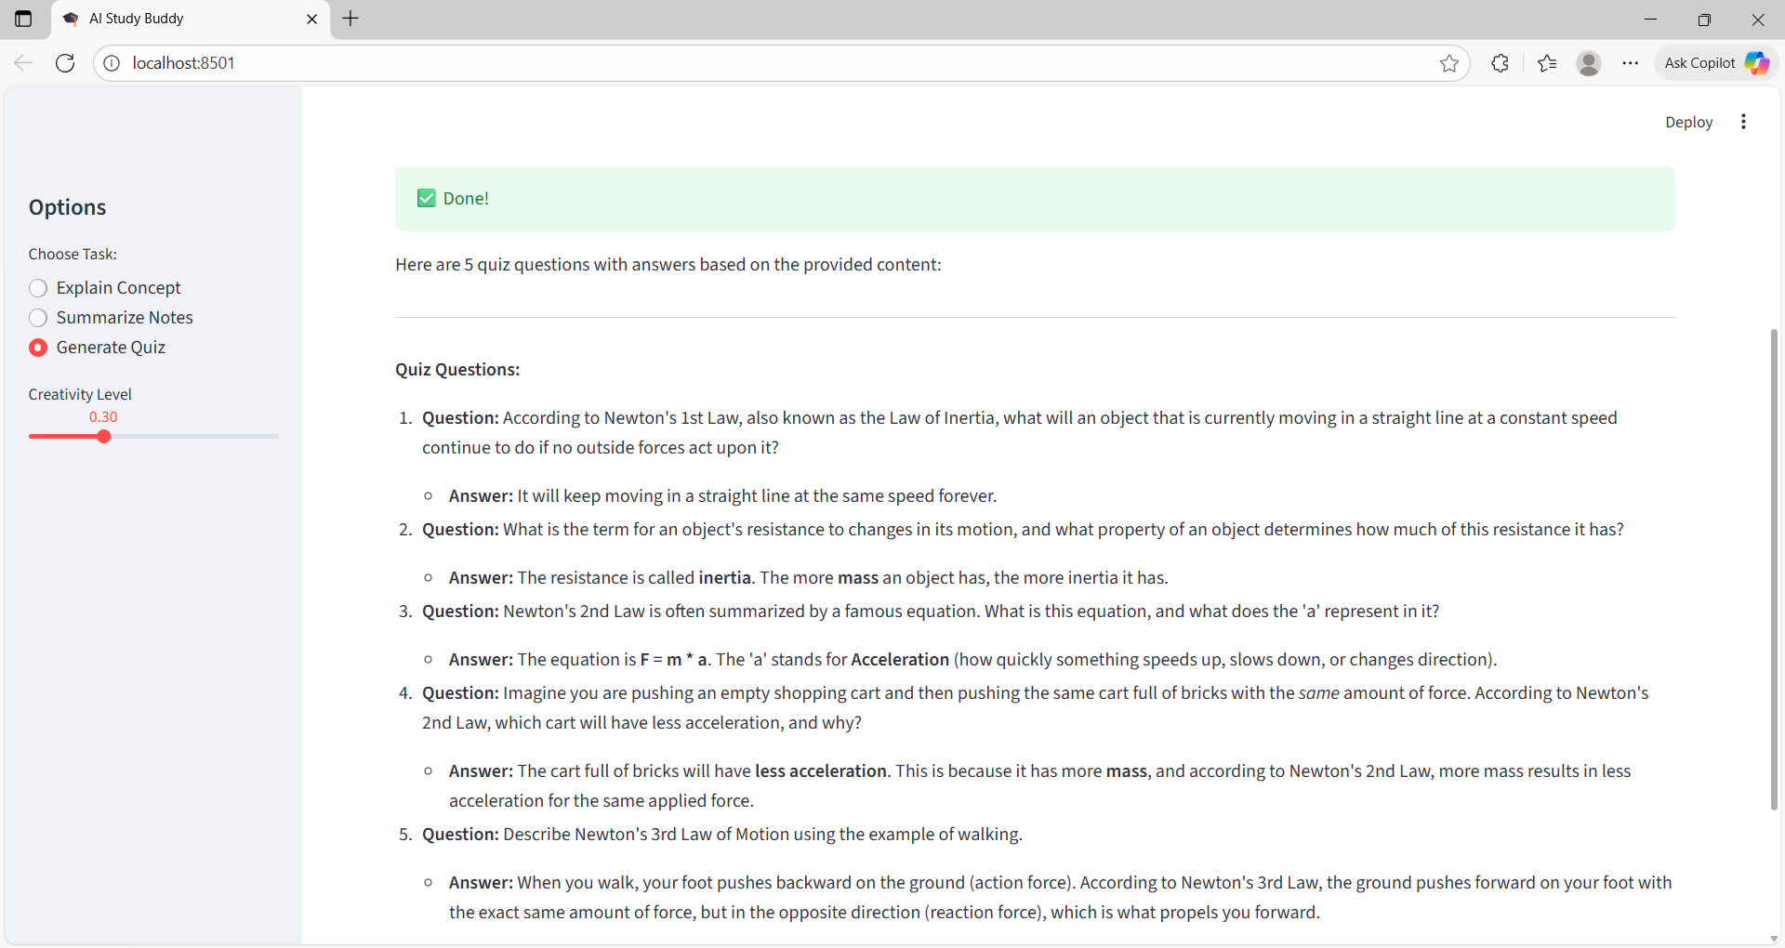
Result
d) Quiz page

Slide 11
GITHUB AND DEPLOYMNET LINK
Attach your GitHub Link : https://github.com/srujanayadav379/AI-POWERED-STUDYBUDDY.git
Deployment link :
https://ai-powered-studybuddy-wtufejrxa6zydwf2ceh4xn.streamlit.app/

Slide 12
Conclusion
AI Study Buddy simplifies learning by providing easy explanations, summaries, and quizzes.
Makes self-study efficient, accessible, and interactive.
Scalable and user-friendly, with potential for future enhancements.
Reduces reliance on lengthy online searches and teacher availability.
Supports personalized and on-demand learning for students.
Demonstrates how AI can enhance education, making study smarter and more engaging.

Slide 13
Future scope(Optional)
Multilingual Support
Enable explanations, summaries, and quizzes in multiple languages for global users.
Personalized Learning Paths
Tailor study plans based on student performance and preferences.
Voice Interaction
Add voice input/output for hands-free learning and better accessibility.
Gamification & Progress Tracking
Include points, badges, and progress dashboards to increase engagement.
Integration with Learning Platforms
Connect with Google Classroom, LMS, or other educational apps for seamless study.
Advanced AI Features
Adaptive quizzes, AI-generated flashcards, and topic recommendations for smarter learning

Slide 14
References
Martínez, F., et al. (2023) – Study-Buddy: A Knowledge Graph-Powered Learning Companion for School Students ResearchGate
Labadze, L. (2023) – Role of AI Chatbots in Education: Systematic Literature Review SpringerOpen
Rao, P. K., et al. (2025) – AI Personal Study Buddy: A Web-Based Adaptive Learning System IJSDR
Wang, J., et al. (2025) – AI-Powered Study Buddy: Students' Learning Performance and Perception Nature
Pappas, C. (2025) – AI as a Study Buddy: Helping Students Learn Smarter eLearning Industry

Slide 15
THANK YOU

