Slide 1
Snake and Ladder
By: Srujan Vasudevrao Deshpande and Vaibhav Gupta

Slide 2

Introduction
Problem Statement: Implementation of Snake and Ladder Game using Graphs and Multilist.
We are going to implement a 5x6 snake and ladder game. (30 Squares)
Rules: You start at 1, end at 30, snake or ladder require 0 moves.

Slide 3
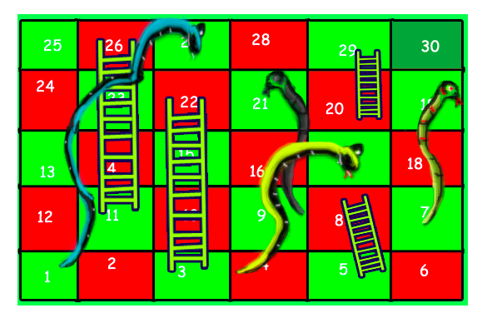
The Game Board

Slide 4
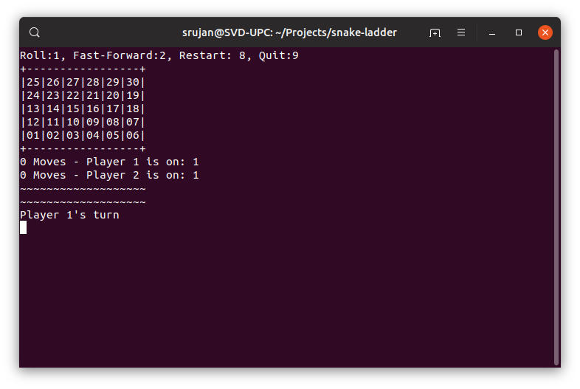
Demonstration

Slide 5
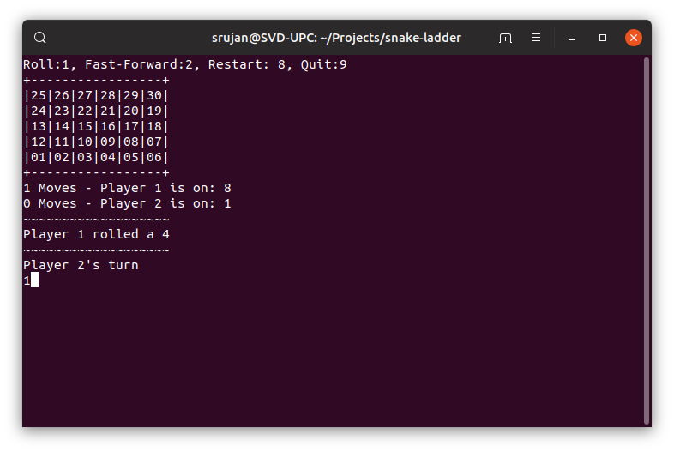
Demonstration

Slide 6

Demonstration

Slide 7
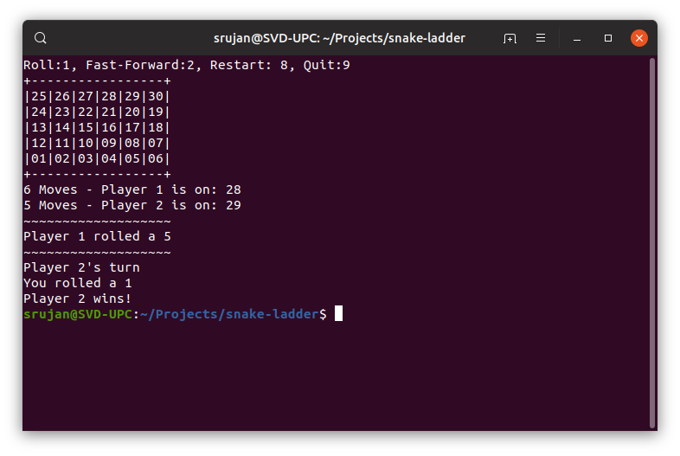
Demonstration

Slide 8
Approach
The multilist stores the current node, next node, the link of the current node and the link of the next node.
Each box is a node
Each edge is a list
The multilist is stored in a csv file. The program reads it and then generates the actual multilist.
In order to play using fast-forward mode, we skip asking the user to input and directly roll the dice.

Slide 9
Graphs
A graph is another word for a network, i.e., a set of objects (called vertices or nodes) that are connected together. The connections between the vertices are called edges or links.

Slide 10
Algorithms – Dice Roll
C does not have true random number generation and can only generate pseudo random numbers. This means every time the program re-runs, the random numbers repeat.
We set the current time as the seed for the random number at the start of every game.
Thus, every game will have different random numbers and different dice rolls.

Slide 11
Algorithms - Moves
The number rolled by the dice is passed to the move function which first checks if there are that many spaces left to move.
Then it moves n-1 spaces.
For the last move, it checks if there is a snake or ladder which can be taken. If yes, it takes that, else it moves normally forward.
At the end we check if the last square had been reached.

Slide 12
Any Questions?

