Slide 1
Predicting Recessions using Yield Curves
By: Srujan Vasudevrao Deshpande PES2201800105
Vaibhav Gupta PES2201800093

Slide 2


Data Source
Initial Data Sourced from US Dept. of Treasury website
All bonds, but only from 1990 onwards
Later data sourced from FRED (Federal Reserve Economic Data)
Data at least 1968 onwards

Slide 3
Yield Curves and Recession
What are they?

Slide 4
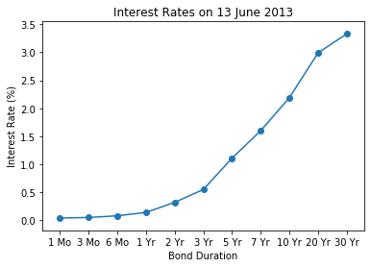
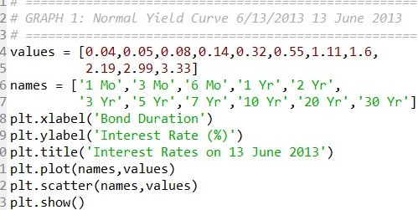
Yield Curve
A Yield Curve is a graph depicting the different interest rates for similar financial instruments of different maturities.

Slide 5
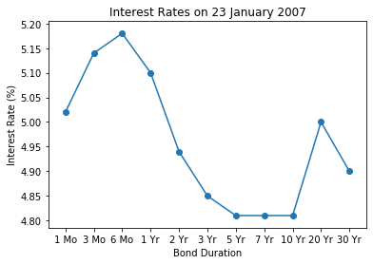
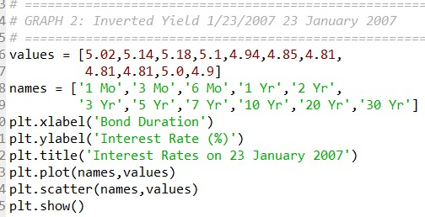
Inverted Yield Curve
A Yield Curve is a graph depicting the different interest rates for similar financial instruments of different maturities.

Slide 6
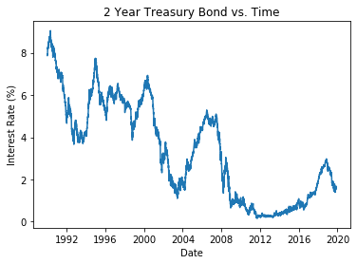
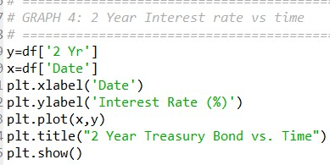
Long Term Yield Curve
A Yield Curve is a graph depicting the different interest rates for similar financial instruments of different maturities.

Slide 7
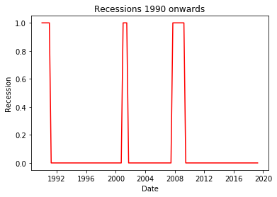
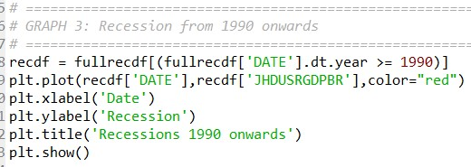
Recession
A recession is defined as 2 consecutive quarters of negative GDP growth

Slide 8
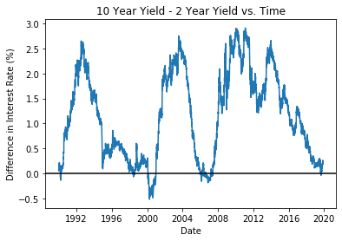
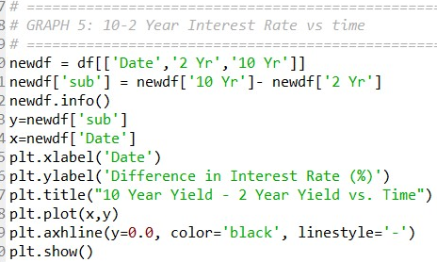
Long Term Yield Curve
Curve of 10 year – 2 year Treasury Bonds interest Rates

Slide 9
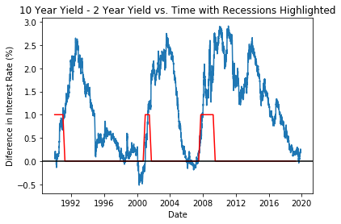
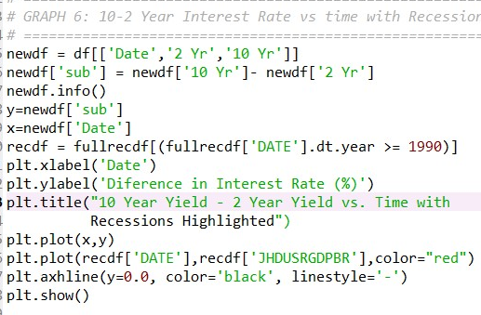
Long Term Yield Curve
A Yield Curve is a graph depicting the different interest rates for similar financial instruments of different maturities.

Slide 10





Classification using LightGBM
Capable of Handling Large Scale Data
Faster Training
Higher Efficiency
Better Accuracy
Lower Memory Usage
LightGBM is a gradient boosting framework that uses tree based learning algorithms.
It’s made by Microsoft

Slide 11
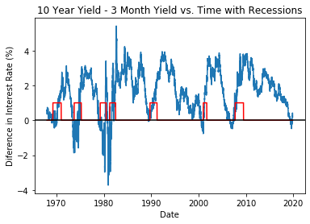

Classification
Confusion Matrix and Accuracy for only 3 Months and 10 year values
We initially used 3 month and 10 year values

Slide 12
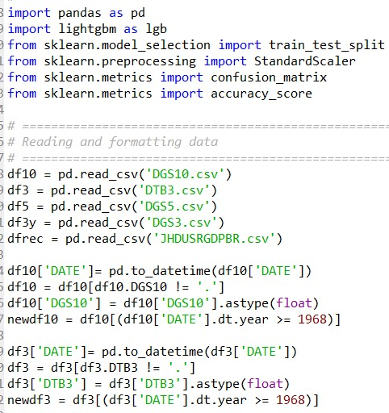
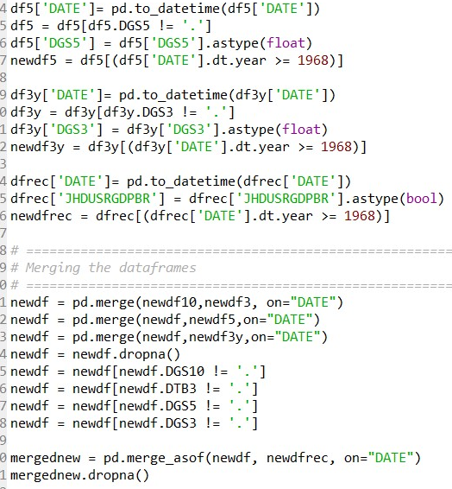
Data Cleaning and Preprocessing

Slide 13
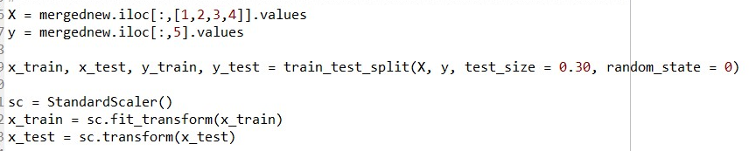
Splitting the dataset and scaling
train_test_split splits the data into 70:30 by randomly assigning the data.
Only 7 recessions have actually occurred from 1968 onwards and this helps the model get more accurate

Slide 14
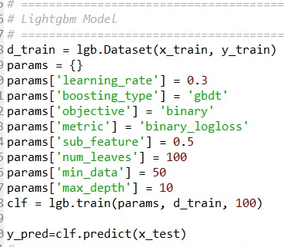
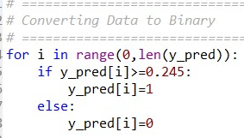
Setting Paramaters and Running the Model
LightGBM
Converting the data

Slide 15
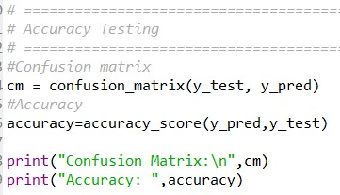

Confusion Matrix and Accuracy

Slide 16

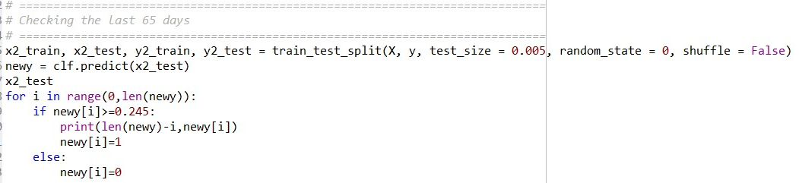
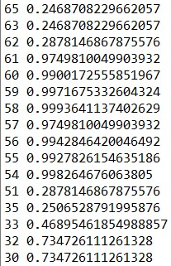
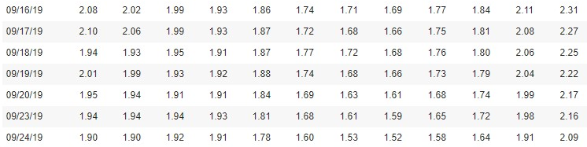
Are we currently heading for a recession?

Slide 17
Any Questions?

Slide 18
Thank You!

