Slide 1
PROJECT PRESENTATION
CloudPulse
Cloud Infrastructure Operations
A unified view of resources, estimated spend, and incidents
Srujan Gowda KS • 24BCS10339
BSc Computer Science | Scaler School of Technology
GitHub: https://github.com/srujangowda07/devops-project

Slide 2
CLOUDPULSE / OVERVIEW
The problem and the idea
Cloud resources and operational issues can be hard to follow in one place.
THE CHALLENGE
THE CLOUDPULSE APPROACH
Scattered information
Unified inventory
Resource status, provider, region, and estimated cost need a clear overview.
One dashboard lists registered resources and their status.
Incidents are easy to miss
Incident visibility
Operational issues need a visible place to be recorded and reviewed.
Open incidents and estimated monthly spend appear alongside inventory.
Important: costs shown in the app are estimates entered for tracked resources, not live cloud billing data.
Srujan Gowda KS • 24BCS10339 • Scaler School of Technology
02 / 10

Slide 3
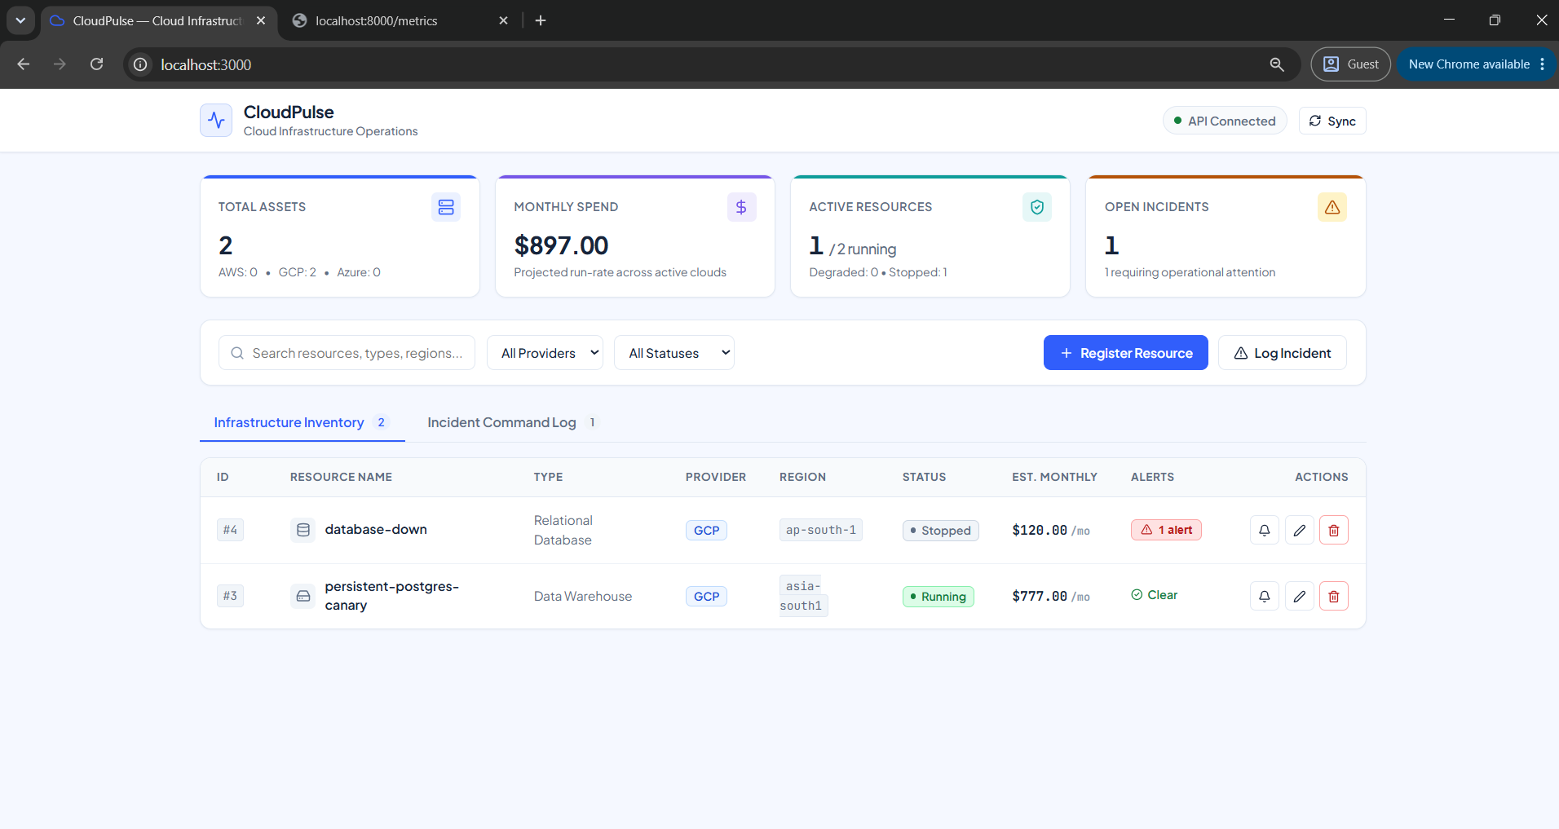
CLOUDPULSE / PRODUCT
The CloudPulse dashboard
The interface brings inventory, estimated spend, resource status, and incidents together.
Srujan Gowda KS • 24BCS10339 • Scaler School of Technology
03 / 10

Slide 4
CLOUDPULSE / DESIGN
A simple, layered architecture
Each part has a clear job, so the app can be developed and run as separate services.
FRONTEND
API
DATABASE
OPERATIONS
React + Vite
FastAPI / Python
PostgreSQL
Docker / CI/CD
REQUEST FLOW
The browser calls the API; the API reads or updates records in PostgreSQL. Docker Compose runs the services together for local development.
Deployment and monitoring tools support delivery and operations; they do not make the inventory a live cloud-provider feed.
Srujan Gowda KS • 24BCS10339 • Scaler School of Technology
04 / 10

Slide 5
CLOUDPULSE / TECHNOLOGY
Tools chosen for the job
A practical stack that covers the application and its delivery workflow.
React + Vite
FastAPI + Python
PostgreSQL + SQLAlchemy
Builds a responsive browser interface.
Provides API endpoints and interactive API docs.
Stores application records in a relational database.
Docker Compose
GitHub Actions + Trivy + GHCR
Terraform + Kubernetes + Helm
Starts the frontend, backend, database, and migration service together.
Automates checks, scans images, and publishes container images.
Defines infrastructure and packages app deployment configuration.
Prometheus + Grafana
Why this stack? It keeps the web app, data layer, testing, packaging, security checks, and deployment configuration clearly separated.
Provides metrics collection and dashboard visualization configuration.
Alternatives exist (for example, Django or Flask for the API), but this project uses FastAPI for a lightweight API and built-in interactive documentation.
Srujan Gowda KS • 24BCS10339 • Scaler School of Technology
05 / 10

Slide 6
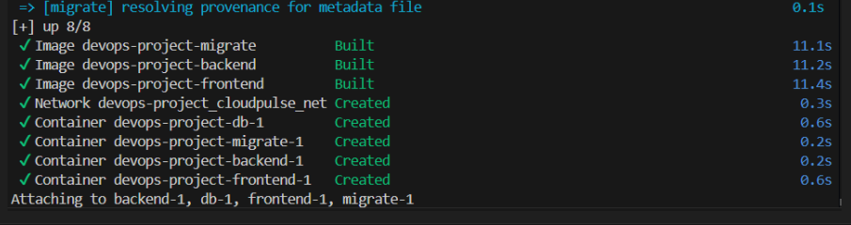
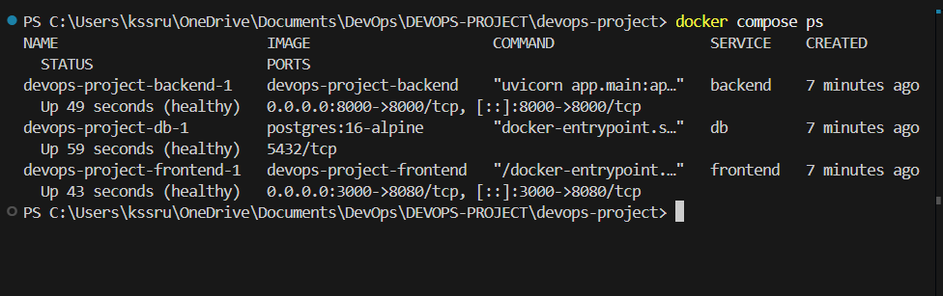
CLOUDPULSE / LOCAL RUN
Running the app with Docker Compose
The screenshot shows images built and the application services created for the local environment.
Srujan Gowda KS • 24BCS10339 • Scaler School of Technology
06 / 10

Slide 7
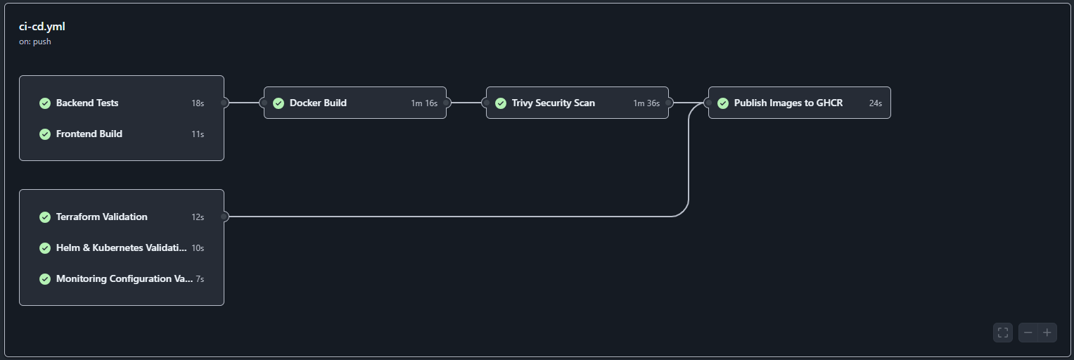
CLOUDPULSE / DELIVERY
Automated CI/CD checks
The GitHub Actions workflow shows tests, builds, security scanning, validation, and image publishing.
Evidence shown: all visible workflow jobs completed successfully, including Trivy scanning and publishing images to GHCR.
Srujan Gowda KS • 24BCS10339 • Scaler School of Technology
07 / 10

Slide 8
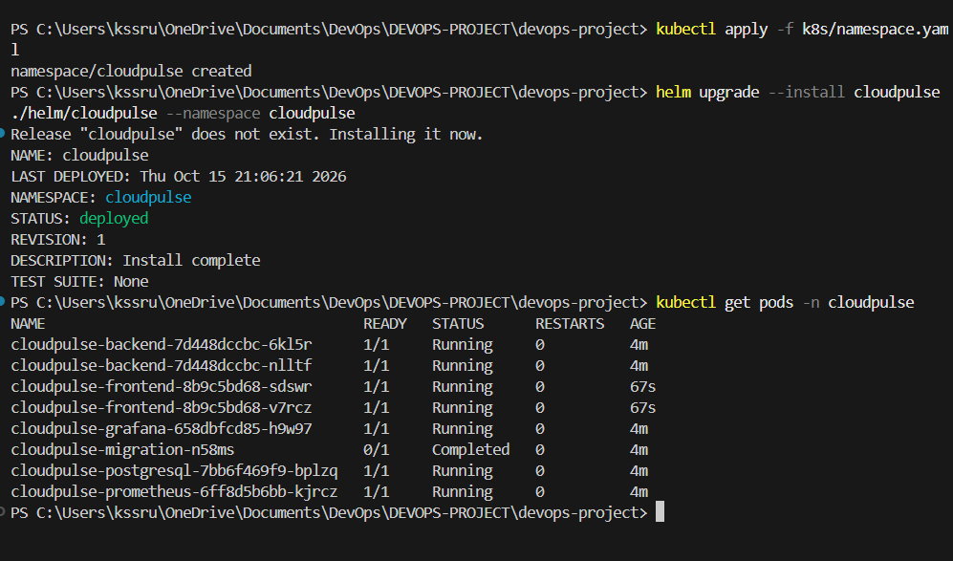
CLOUDPULSE / DEPLOYMENT
Kubernetes deployment
Helm reports a deployed release, and the screenshot shows the status of application and monitoring pods.
Evidence shown: CloudPulse release deployed in the cloudpulse namespace. The migration pod is shown as 0/1 at capture time; not every pod is ready.
Srujan Gowda KS • 24BCS10339 • Scaler School of Technology
08 / 10

Slide 9
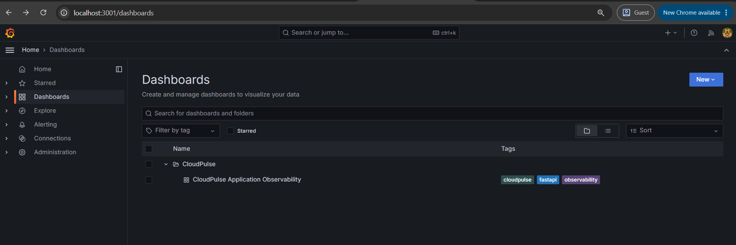
CLOUDPULSE / OBSERVABILITY
Monitoring dashboard configured
Grafana contains a CloudPulse observability dashboard entry for application metrics.
Srujan Gowda KS • 24BCS10339 • Scaler School of Technology
09 / 10

Slide 10
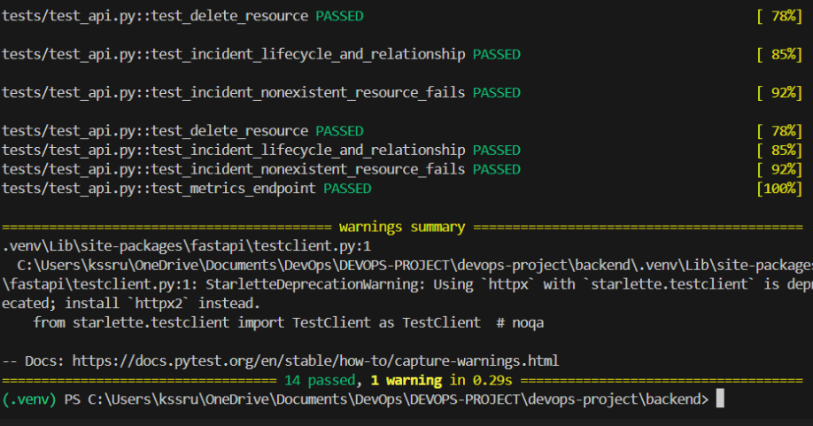
CLOUDPULSE / VERIFICATION
Automated tests
The provided test output shows API lifecycle and metrics endpoint checks passing.
Srujan Gowda KS • 24BCS10339 • Scaler School of Technology
10 / 10

