Slide 1


Battle – Card
Flipkart vs Amazon

Slide 2

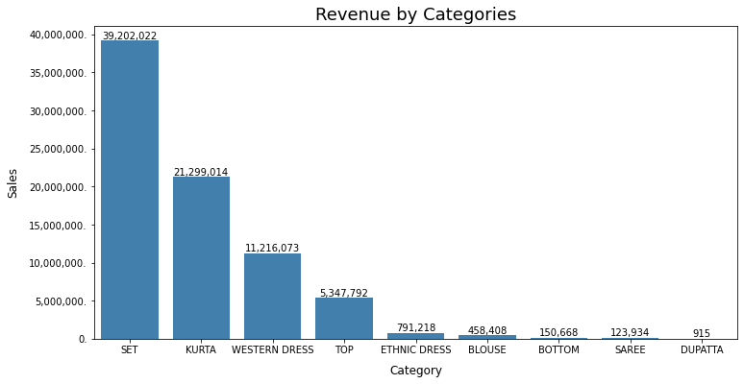
Sales – Product Amazon
This is the product sales distribution of Amazon –
Which primarily consists of
Clothes and other kind’

Slide 3

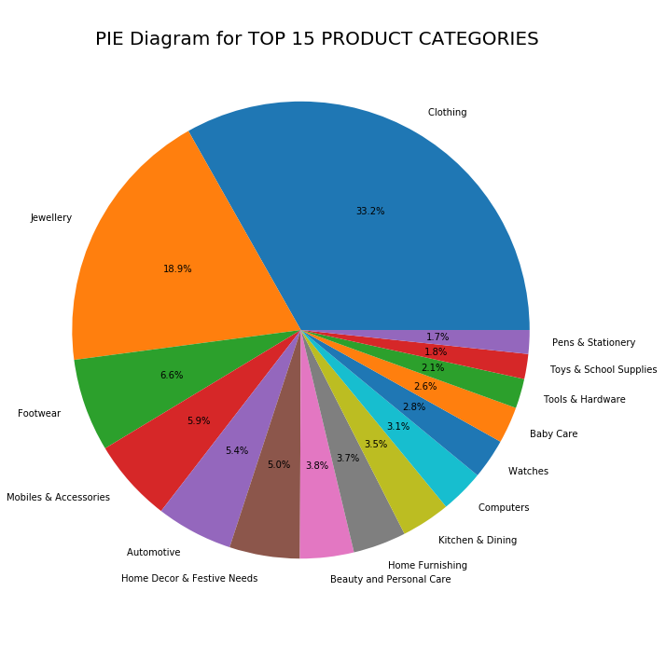
Sales – Product Flipkart
While this product sales tells a different story by Flipkart –
They majorly sell Jewellery and other accessories like footwear and multiple other things

Slide 4

Bullet Card
Flipkart’s(+):
1 – Here we can say Flipkart sells more precious metals(Jewellery)
2 – Flipkart also sells more accessories compared to its competitor(Amazon)
Reason
1 – This can be accounted by the discount offered by the online-app
Which allows the user to purchase a lot ornaments compared to other items
And to Amazon

Slide 5

Bullet Card
Flipkart's(-):
1 – As far as the metals and accessories are concerned they are sold well in Flipkart, But not the clothing apparels’
2 – Flipkart to up the game they can absorb the strategy by amazon
For the clothing(especially women)

Slide 6

Conclusion
Flipkart
As per the data analysed the company fares well with multiple items,
So that is a good thing but they can come up with a strategy to up their sales on clothing and other items to increase their sales vertically and push their customer-base

