Slide 1

CAPSTONE PROJECT Loan Approval Prediction Using Machine Learning
Presented By
Student Name: Srujan kumar
College Name: guru nanak institute of technology
Department: Ai & ds
Email ID: srujan7182@gmail.com
AICTE Student ID: AINSI_120618

Slide 2
OUTLINE
Problem Statement
Proposed System/Solution
System Development Approach
Algorithm & Deployment
Result (Output Image)
Conclusion
Future Scope
References

Slide 3
Problem Statement
In traditional banking systems, the loan approval process is often manual, time-consuming, and subject to human bias or inconsistency. Loan officers must evaluate multiple factors such as income, credit score, employment history, and past defaults — a task that can be prone to errors and delays, especially when handling large volumes of applications.
As financial institutions increasingly adopt digital systems, there is a strong demand for intelligent, data-driven tools that can assist in making accurate and consistent loan decisions.
This project aims to develop a machine learning-based model that predicts whether a loan should be approved or rejected based on historical applicant data. By automating this process, banks can improve efficiency, reduce processing time, and enhance the fairness and reliability of loan approvals.

Slide 4
Proposed Solution
The proposed system aims to address the challenge of accurately predicting whether a loan application should be approved or rejected based on applicant data. This involves leveraging supervised machine learning techniques to analyze historical loan data and automate decision-making in financial institutions.The solution will consist of the following components:
Data Collection:
Gather historical loan data containing information such as age, income, employment experience, loan amount, loan intent, credit score, and loan approval status.
Ensure that the dataset includes both categorical and numerical attributes relevant to loan decisions.
Data Preprocessing:
Detect and remove outliers using the Interquartile Range (IQR) method to improve model robustness.
Encode categorical variables using Label Encoding to convert them into numeric form.
Scale numerical features using MinMaxScaler to normalize the data and enhance model convergence.
Machine Learning Algorithm:
Implement and compare machine learning classifiers such as Logistic Regression and Random Forest.
Select Random Forest as the final model due to its higher accuracy and better generalization
Deployment:
The solution is executed in Jupyter Notebook using Python.
Evaluation:
Evaluate model performance using classification metrics such as: Accuracy, Precision, Recall, F1 Score.
Random Forest achieved an accuracy of 92.08% and an F1 Score of 0.87, outperforming Logistic Regression.
Result: The Random Forest classifier successfully predicted loan approval status with high accuracy. The model demonstrated its potential to automate loan approval decisions, reduce manual workload, and ensure fair and fast processing.

Slide 5
System Approach
Technologies and Tools Used:
Python (programming language)
Jupyter Notebook (for development)
Pandas, NumPy (data handling)
Matplotlib, Seaborn (visualization)
Scikit-learn (machine learning)
Workflow:
Data loading and exploration
Data cleaning and preprocessing
Label encoding for categorical data
Outlier detection and removal using IQR
Feature scaling using MinMaxScaler and StandardScaler
Model building using Logistic Regression and Random Forest
Evaluation and comparison

Slide 6
Algorithm & Deployment
Algorithm Selection:
Logistic Regression: A baseline classifier to learn the linear decision boundary.
Random Forest Classifier: An ensemble learning method for better accuracy and reduced overfitting.
Data Input : 'person_age', 'person_income', 'person_emp_exp', 'loan_amnt', 'loan_int_rate', 'loan_percent_income', 'cb_person_cred_hist_length', 'credit_score', 'loan_status'], ['person_gender', 'person_education', 'person_home_ownership','loan_intent', 'previous_loan_defaults_on_file’.
Training Process:
The dataset was preprocessed by handling missing values, encoding categorical data, removing outliers using IQR, and scaling numeric features.
Both Logistic Regression and Random Forest were trained using Scikit-Learn and
Prediction Process:
The model takes a new applicant’s details as input and predicts a binary outcome: 1-(Loan Approved), 0- Loan Rejected.
The model evaluates patterns based on historical data and identifies whether the new application fits the approval profile.

Slide 7
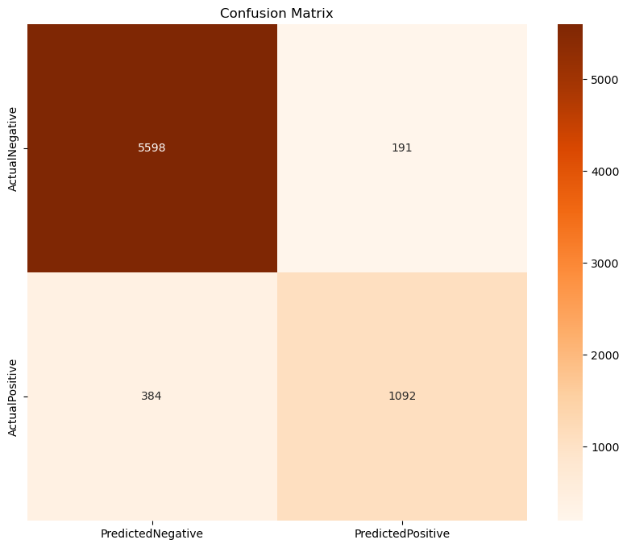
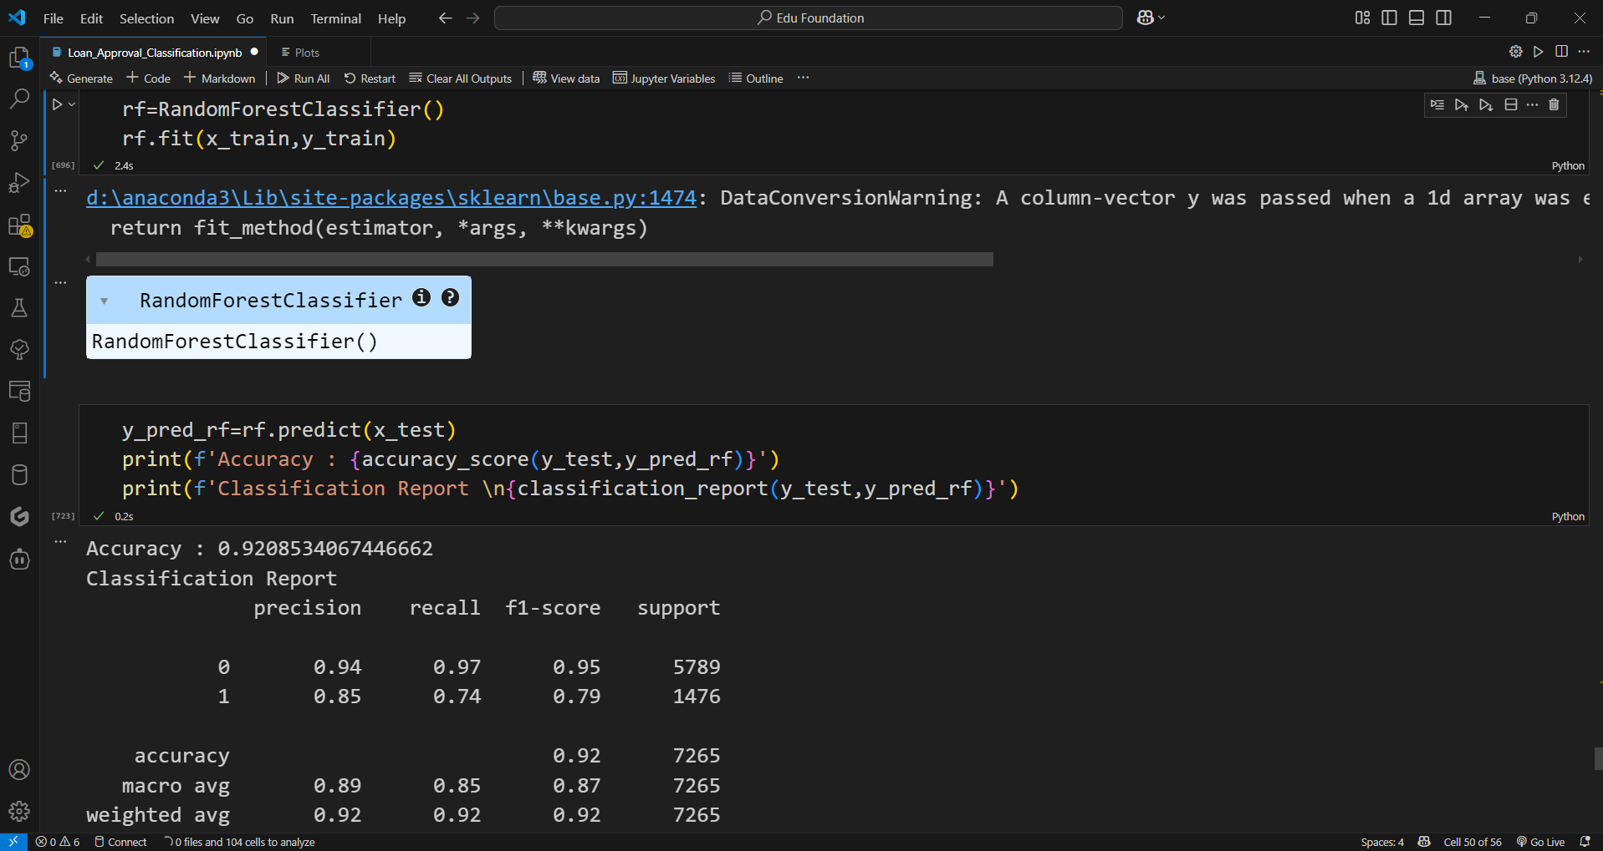
Result
Visual Results Included:Confusion Matrix of Random Forest, Classification Report.

Slide 8
Conclusion
The proposed machine learning model accurately predicts loan approval status using key applicant data.
With proper preprocessing and the use of Random Forest, the system achieved high performance — 92.08% accuracy and a strong F1 score of 0.87.
Key challenges included handling class imbalance and outliers in numeric data. These were addressed using encoding, scaling, and IQR-based filtering.
Overall, the solution demonstrates the effectiveness of AI in automating financial decisions. It improves processing speed, reduces manual errors, and can be further enhanced with additional features and real-time deployment. areas.

Slide 9
Future scope
This model has a strong foundation, and it can be improved further by:
Including more advanced features like:Co-applicant detailsLoan repayment historyNumber of previous loans
Deploying the model as a web application using Flask or Streamlit
Connecting the system to real-time data sources via APIs
Performing hyperparameter tuning to improve F1 score and recalltechniques.

Slide 10
References
Scikit-learn Documentation: https://scikit-learn.org
Pandas Documentation: https://pandas.pydata.org
Kaggle Dataset: Loan Modeling Dataset
AICTE Internship Guidelines
GitHub Link: Link

Slide 11
Thank you

