Slide 1



Crop and Fertilizer Recommendation System using Machine Learning

Slide 2

Learning Objectives
Understand Data Preprocessing: Learn how to clean, preprocess, and analyze agricultural datasets and handle missing values, duplicate entries, and feature selection.
Identify Key Features and Relationships: Use statistical and visualization techniques to analyze soil and climate factors and also understands how different features influence crop and fertilizer recommendations.
Gain Insights from Exploratory Data Analysis (EDA): Interpret histograms, scatter plots, and distribution graphs for better insights and Identify patterns in crop yield and soil nutrient levels.
Build a Predictive Model: Develop and train a machine learning model (in this case, a Decision Tree Classifier) used to predict crop and ferfilizer recommendations.
Evaluate Model Performance: Assess the model's accuracy using metrics like Mean Absolute Error (MAE) to ensure its reliability in making predictions.
Work with Real-World Agricultural Data: Gain hands-on experience with datasets relevant to agronomy and understand how environmentals factors impact farming decisions.
GOAL
Source :
www.freepik.com/

Slide 3
Tools and Technology used
Programming Languages & Libraries:
Python – Core programming language for data analysis and machine learning.
Pandas – For data manipulation and preprocessing.
NumPy – For numerical operations and array handling.
Matplotlib & Seaborn – For data visualization and exploratory analysis.
Data Processing & Analysis
Jupyter Notebook – Interactive environment for running Python code.
Scikit-learn – Machine learning library for implementing classification models.
Data Cleaning Techniques – Handling missing values, duplicates, and data transformations.
Machine Learning (If applicable)
Supervised Learning Algorithms – Classification models for crop recommendations.
Decision Trees & Random Forests – For predictive analysis in agriculture.

Slide 4
Tools and Technology used
Version Control & Deployment
Git & GitHub – For version control and project collaboration.
Google Colab (if used) – Cloud-based execution of notebooks.
Additional Tools
CSV Data Handling – Processing structured datasets.
Agronomic Data Analysis – Understanding soil, climate, and crop requirements.

Slide 5
Methodology
Data Collection:
Description: Gather the crop and fertilizer recommendation system dataset which contains historical data.
Tools: Pandas (pd.read_csv())
Exploratory Data Analysis (EDA):
Description: Explore the dataset to understand its structure, summary statistics, distributions, and relationships between variables.
Tools:
Pandas (head(), tail(), shape(), describe(), info())
Seaborn (histplot(), heatmap())
Matplotlib (plt.hist(), plt.scatter(), plt.subplot())
Data Cleaning:
Description: Identify and handle missing values and duplicate records.
Tools:
Pandas (isnull().sum(), duplicated().sum())
Data Visualization:
Description: Create visualizations to better understand the data distribution and correlations among variables.
Tools:
Seaborn (histplot(), heatmap())
Matplotlib (plt.hist(), plt.scatter(), plt.subplot(), plt.boxplot())

Slide 6
Methodology
Data Preprocessing:
Description: Split the dataset into training and testing sets, and standardize the feature values.
Tools:
scikit-learn (train_test_split(), StandardScaler())
Model Building:
Description: Train a machine learning model (Decision Tree Classifier in this case) on the training data.
Tools:
scikit-learn (DecisionTreeClassifier(), fit())
Model Evaluation:
Description: Evaluate the model’s performance on the test data using appropriate metrics.
Tools:
scikit-learn (predict(), mean_absolute_error())

Slide 7
Problem Statement:
Background: Agriculture is a critical sector that feeds the global population. However, farmers often face challenges in selecting the right crop for their land and determining the optimal fertilizer to enhance yield. Incorrect decisions lead to reduced productivity, soil degradation, and economic losses. A data-driven approach can help optimize agricultural practices, ensuring better crop selection and soil management.
Problem: Farmers need accurate and reliable recommendations for crop selection and fertilizer application based on soil conditions, weather parameters, and nutrient levels. Traditional decision-making methods rely on experience and trial-and-error, which can be inefficient and unsustainable. There is a need for a smart system that utilizes data science and machine learning to provide precise agricultural recommendations.
The objective of this project is to develop a Crop & Fertilizer Recommendation System that leverages data analytics to:
Recommend the most suitable crop based on soil and climatic factors.
Suggest the optimal fertilizer to maintain soil health and maximize yield.
Improve farming efficiency through data-driven insights.
By implementing this system, farmers can make informed decisions, increase productivity, and contribute to sustainable agriculture.

Slide 8
Solution:
This system utilizes machine learning and data analytics to provide accurate recommendations based on soil composition, climate conditions, and nutrient levels.
Data Loading:
Load the dataset containing values of crop and fertilizers.
Exploratory Data Analysis (EDA):
Conduct EDA to understand the dataset's structure, summary statistics, and distributions.
Use Pandas functions like head(), describe(), info().
Data Cleaning:
Check for and handle missing values and duplicates.
Data Visualization:
Create visualizations to understand data distributions using Histplot, Scatterplot, Heatmap and Boxplot[Outliers].
Feature Selection:
Identify and select relevant features that contribute to the prediction of crops and fertilizers.
Separate features and target variable.

Slide 9
Solution:
Data Preprocessing:
Split the dataset into training and testing sets.
Standardize the feature values.
Encoding:
Finding the unique and nunique and making as a dictionary.
Model Building:
Train a Decision Tree Classifier model using the training data.
Model Prediction:
Predict the crop for the given environment which includes {N,P,K,temperature,humidity,ph,rainfall}.

Slide 10
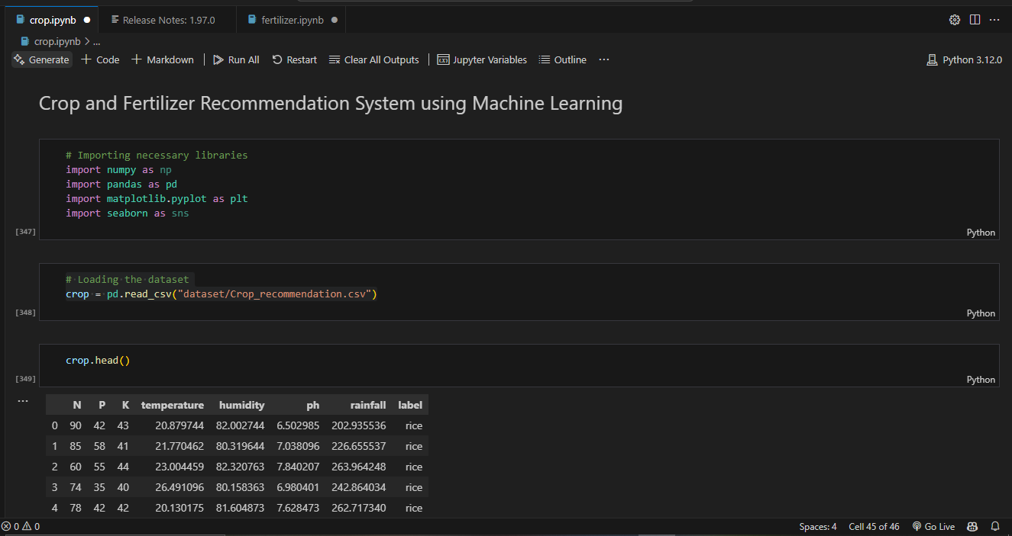
Screenshot of Output:

Slide 11
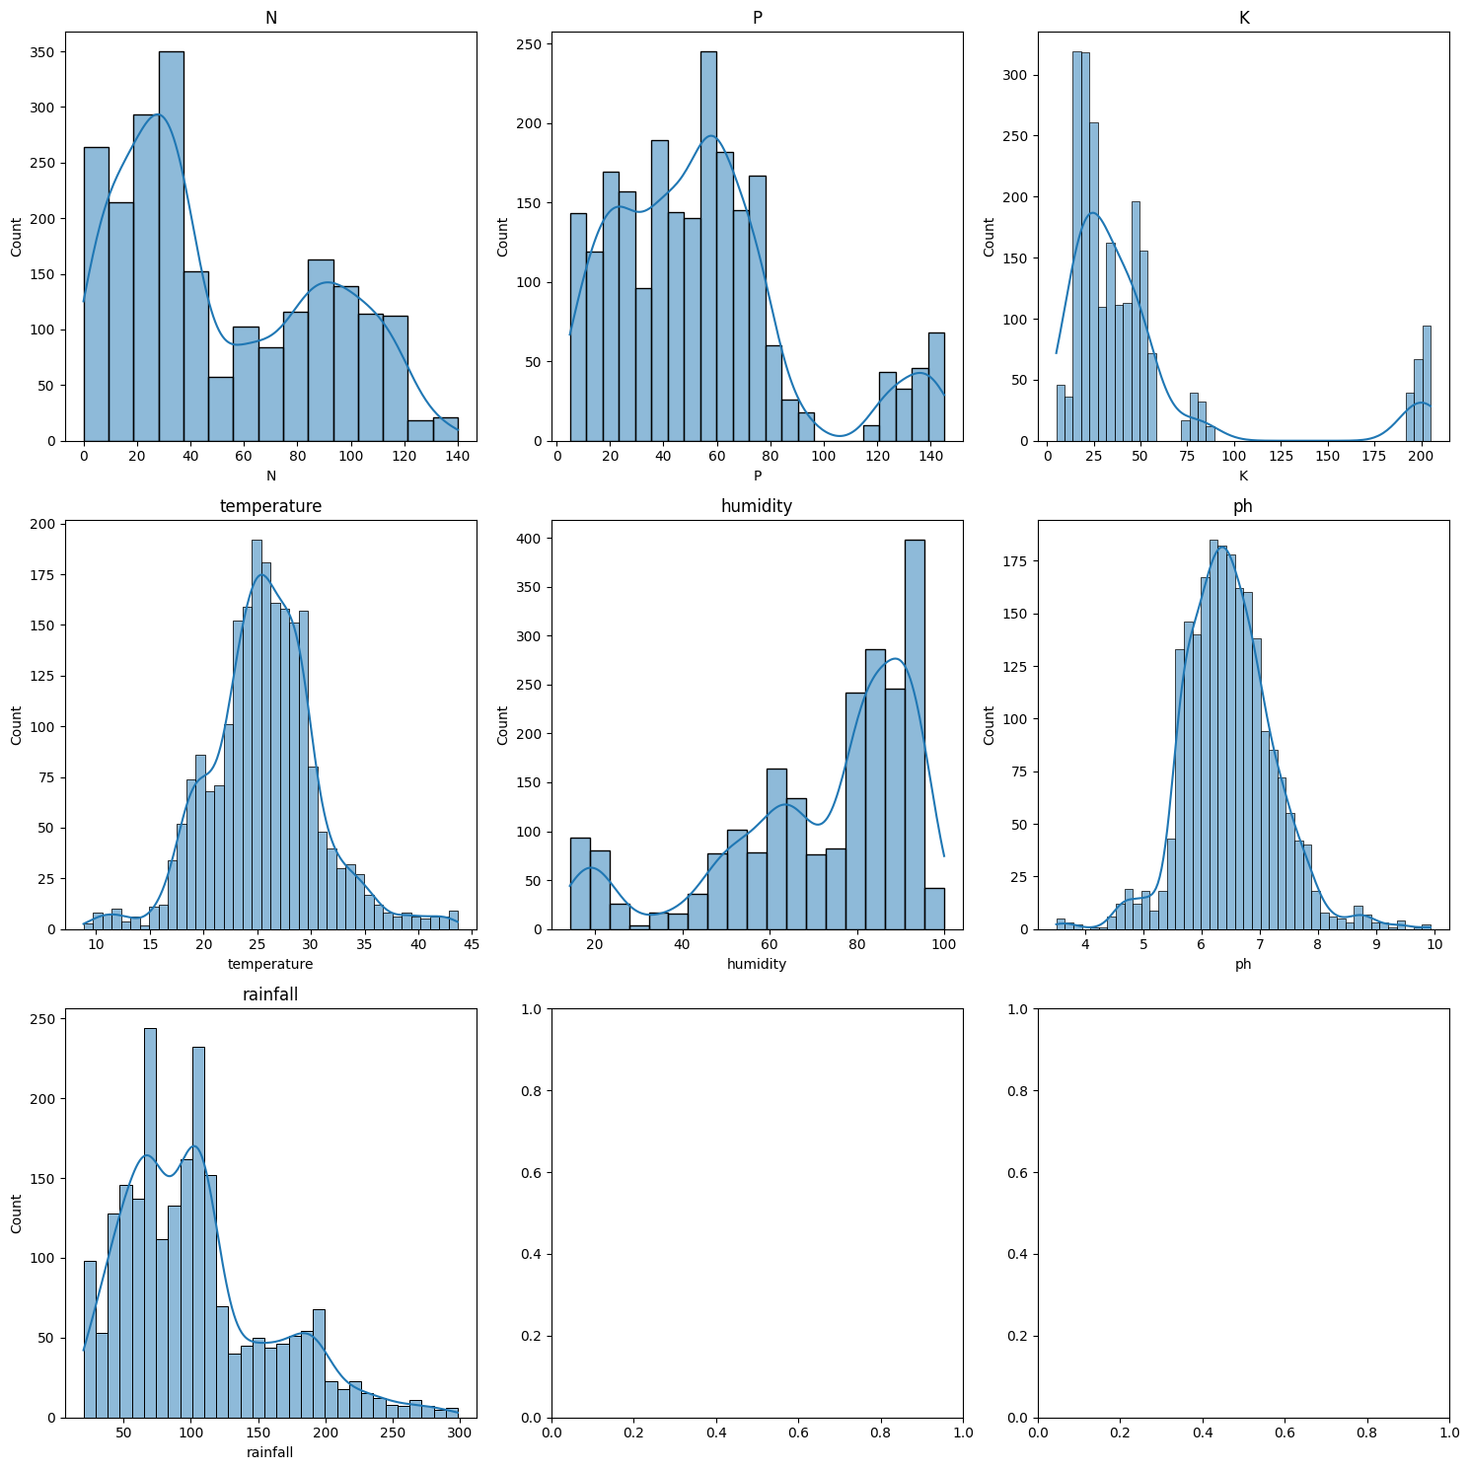
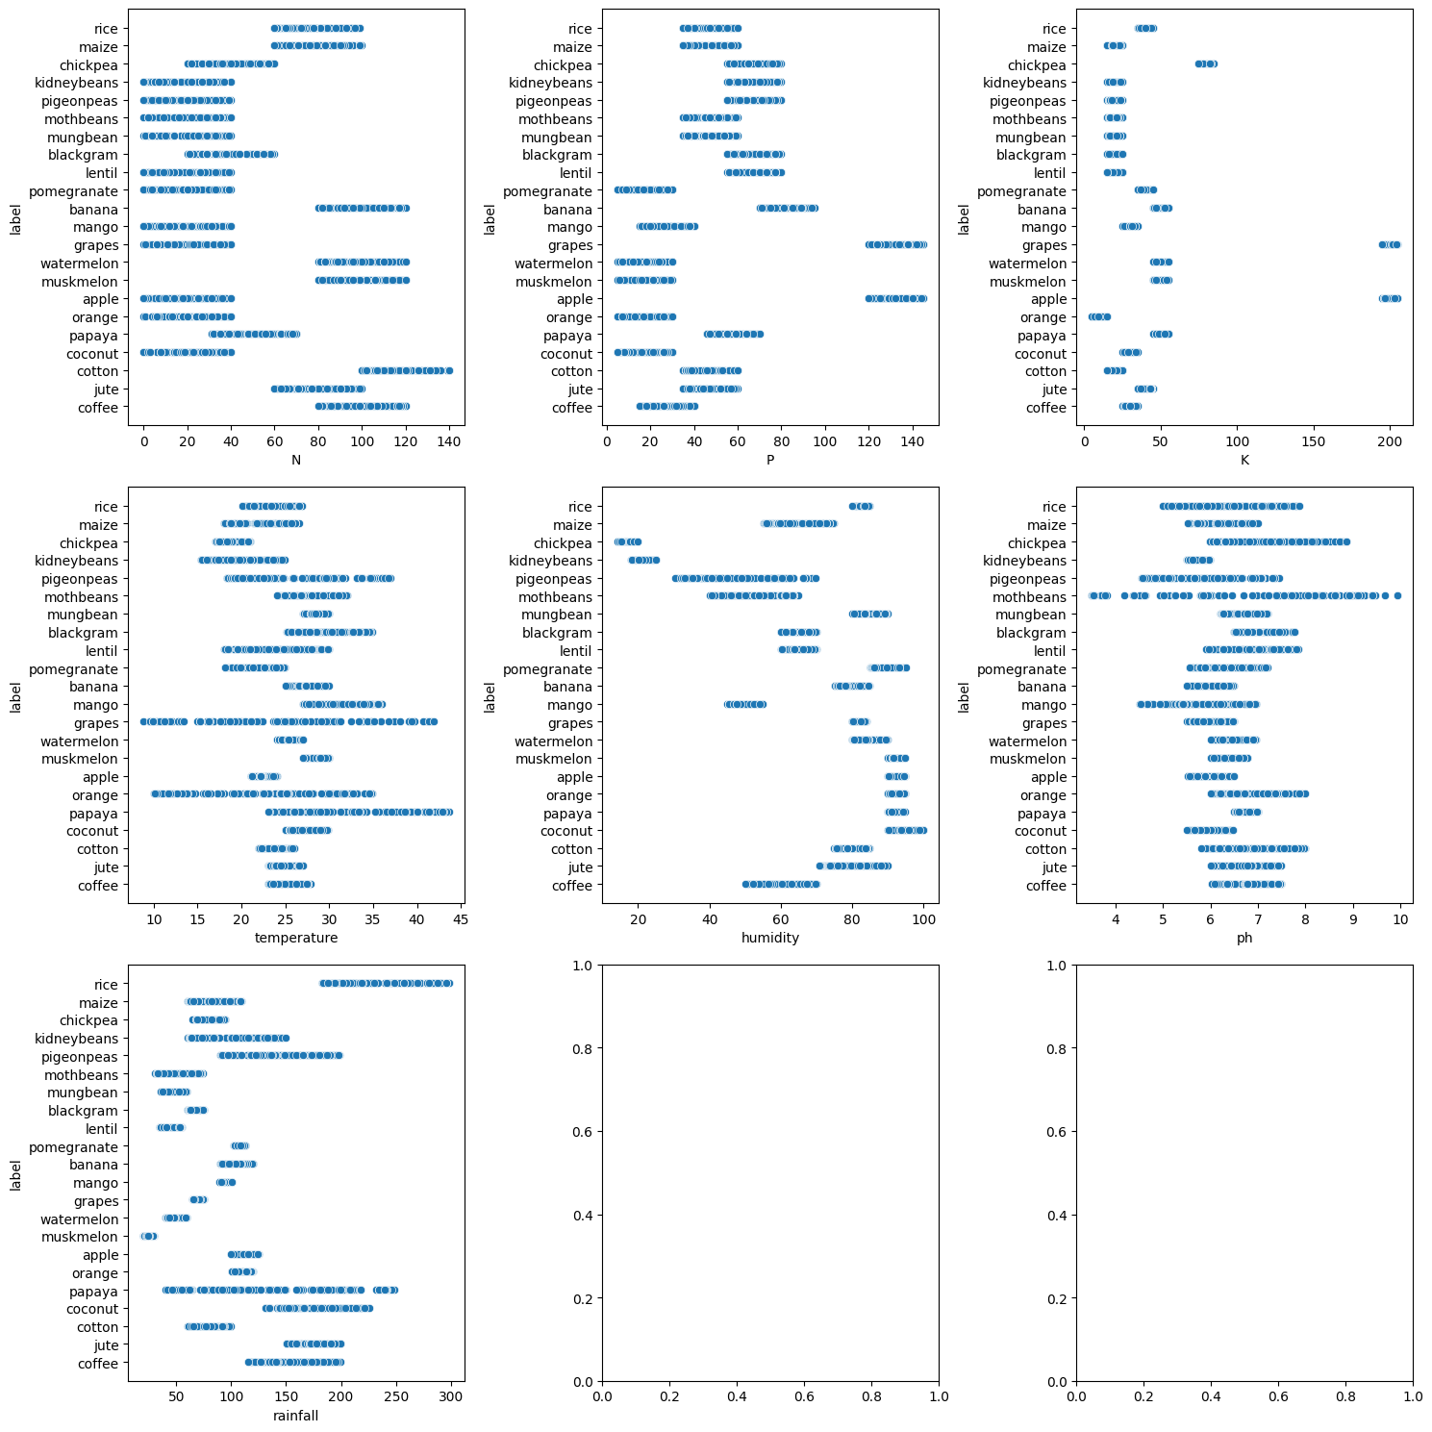
Screenshot of Output:
Histplot:-
Scatterplot:-

Slide 12
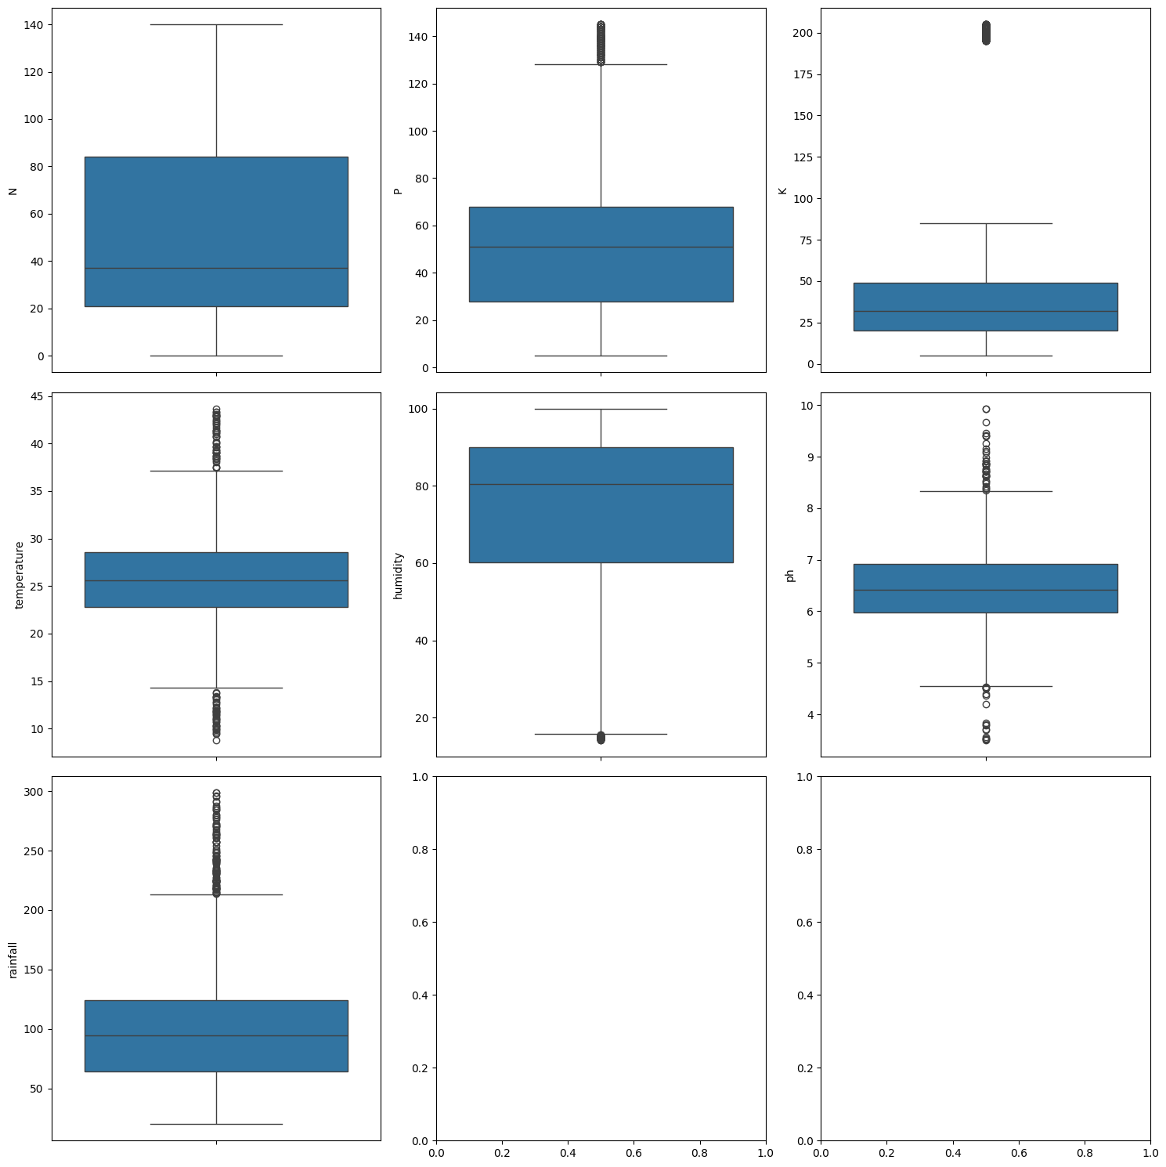
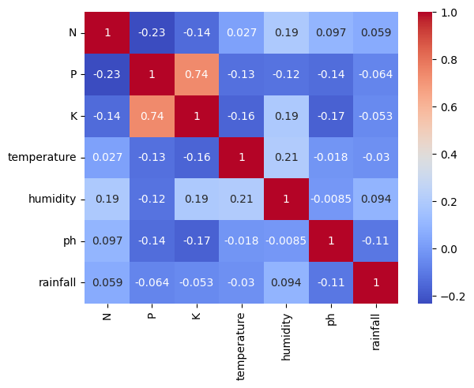
Screenshot of Output:
Boxplot:-
Heatmap:-

Slide 13
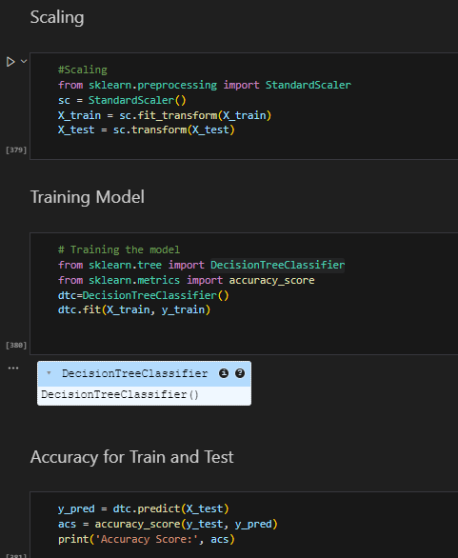
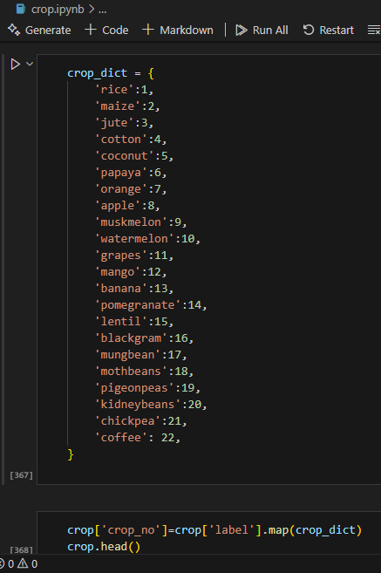
Screenshot of Output:
Scaling & Training Model :-
Crop Dictionary:-

Slide 14
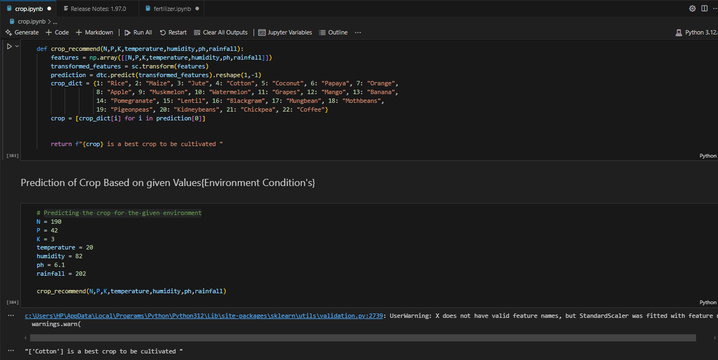
Screenshot of Output:
Predictive Model :-

Slide 15
Conclusion:
The Crop & Fertilizer Recommendation System offers a data-driven approach to modernizing agriculture. By leveraging machine learning and data analytics, this system provides farmers with precise recommendations for crop selection and fertilizer application. This not only enhances productivity but also promotes sustainable farming practices.
Through effective data preprocessing, exploratory analysis, and predictive modeling, the system helps minimize resource wastage, optimize soil health, and improve overall crop yield. By reducing dependency on traditional trial-and-error methods, it empowers farmers to make informed decisions based on scientific insights.
In conclusion, implementing this solution is a step forward in revolutionizing agriculture, making it more efficient, productive, and environmentally friendly

