Slide 1
Post-Mortem Analysis of the MapReduce Framework Case Study: E-commerce Sales Data Processing
BATCH-2
Done By:
M. Srujan Nayak
1601-23-737-189
IT-3 VI SEM
Imtisal Rangrez
1601-23-737-180
IT-3 VI SEM

Slide 2
INTRODUCTION
Rapid growth of e-commerce platforms generates massive data
Data includes:
Orders
Cities
Prices
Categories
Traditional systems fail to process such large datasets efficiently

Slide 3
PROBLEM STATEMENT
Processing large-scale e-commerce data is:
Time-consuming
Resource-intensive
Key issues:
High disk I/O
Slow execution
Lack of scalability

Slide 4
OBJECTIVE
Process large e-commerce dataset
Calculate:
City-wise revenue
Implement using:
Hadoop MapReduce
Analyze performance

Slide 5
HADOOP ARCHITECTURE
HDFS:
Stores data across nodes
MapReduce:
Processes data in parallel
Workflow: Dataset → HDFS → Map → Shuffle → Reduce → Output

Slide 6
MAPREDUCE WORKFLOW
Mapper:
Emits (city, amount)
Shuffle:
Groups same city
Reducer:
Computes SUM(amount)

Slide 7
DATASET
E-commerce dataset (CSV format)
Attributes:
Order ID
City
Category
Amount
Dataset size: Simulated up to 10–15GB

Slide 8
METHODOLOGY
Dataset uploaded to HDFS
MapReduce job executed
Mapper extracts fields
Reducer aggregates revenue

Slide 9
RESULTS
Successfully computed city-wise revenue
Large dataset processed efficiently
Distributed processing improved scalability

Slide 10
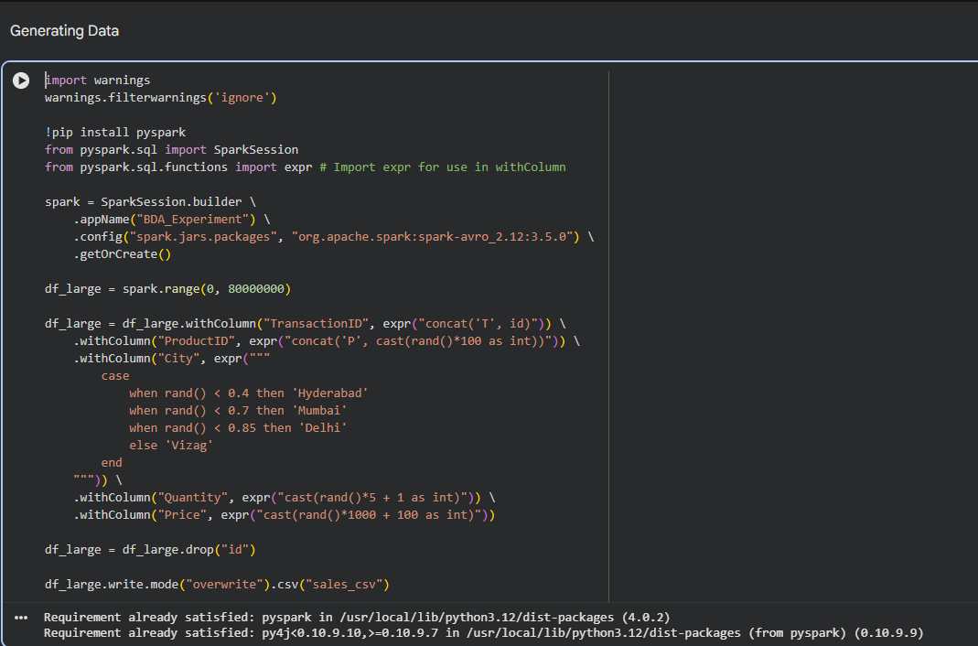

Slide 11
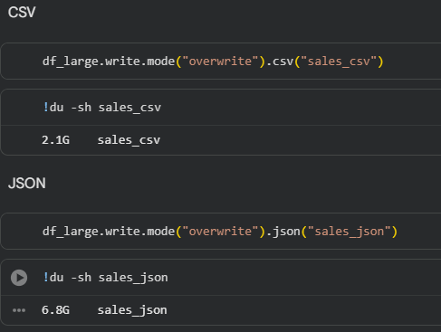
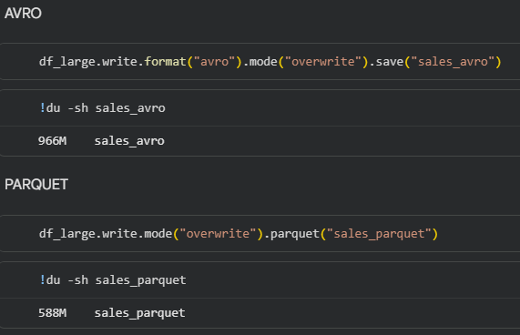
Converting to file formats

Slide 12
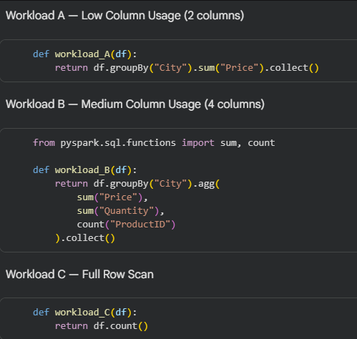
Adaptive Format Selection Framework

Slide 13
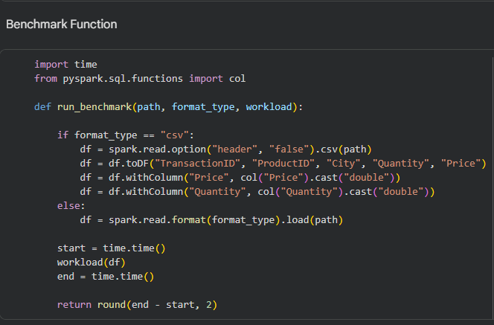
BENCHMARK FUNCTION

Slide 14
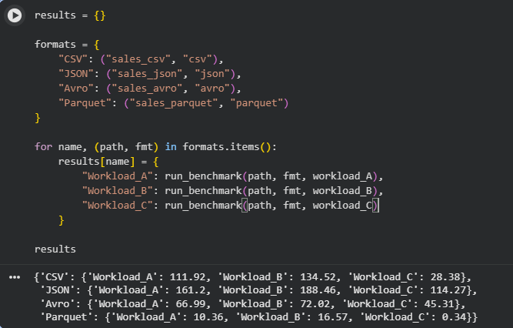
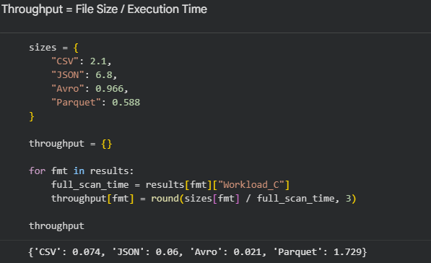

Slide 15
THANK YOU

