Slide 1
INTEGRATED BANKING SYSTEM
Use Case-7
Team members-
1.Ayush Raj
2.Rugved Choudhary
3.Saima Rashid
4.Shivani Dasgupta
5.Srujan Sudam

Slide 2


Slide 3


REMITTANCE MANAGEMENT COMES TO THE RESCUE!

Slide 4


CLIENT EXPECTATIONS
ADD or MODIFY BENEFICIARY ACCOUNTS
ADD or DELETE CREDIT CARDS
AVAIL AUTOPAYMENT SERVICES
CUSTOMER
APPROVE or DISAPPROVE CARD AND BENEFICIARY REQUESTS
BANK ADMIN

Slide 5
INSCOPE
OUTSCOPE
ASSUMPTIONS
User can login and access remittance facilities.
Auto payment facility – List of Service Providers. List of accounts.
Option for bank admin to view and take a decision. Provision to enter remarks.
Format validation.
Addition to Service Providers List.
Auto-payment through multiple accounts.
Validating the login details.
Logic behind bank admin’s decision.
User is already logged in.
No provision for bank admin to change user’s details.
Bank admin’s decision not required for auto payment.

Slide 6
WELCOME PAGE
CUSTOMER
BANK ADMIN
CREDIT CARD
VIEW REQUEST
BENEFICIARY
QUIT
AUTOPAYMENT
QUIT

Slide 7

CUSTOMER ACTION
ENTER CARD NUMBER
ADD CREDIT CARD
ENTER NAME ON CARD
ENTER EXPIRY DATE
CREDIT CARD
DELETE CREDIT CARD
ENTER CARD NUMBER
EXIT FOR CUSTOMER MENU

Slide 8
CUSTOMER ACTION
CHOOSE TYPE OF ACCOUNT
ADD BENEFICIARY
ENTER ACCOUNT NUMBER
ENTER ACCOUNT NAME
ENTER IFSC CODE
ENTER BANK NAME
ENTER ACCOUNT NUMBER
ENTER ACCOUNT NAME
BENEFICIARY
MODIFY BENEFICIARY
ENTER IFSC CODE
ENTER BANK NAME
SAVE CHANGES
QUIT
DELETE BENEFICIARY
ENTER ACCOUNT NUMBER
EXIT FOR CUSTOMER MENU

Slide 9
CUSTOMER ACTION
ENTER ACCOUNT NUMBER
ADD AUTOPAYMENT
ENTER SERVICE PROVIDER ID
ENTER AMOUNT
ENTER DATE OF START
AUTOPAYMENT
REMOVE AUTOPAYMENT
ENTER SERVICE PROVIDER ID
EXIT FOR CUSTOMER MENU

Slide 10
BANK ADMIN ACTION
CREDIT CARD REQUEST
APPROVE
DISAPPROVE
VIEW REQUEST
ENTER CUSTOMER ID
BENEFICIARY REQUEST
EXIT FOR BANK ADMIN MENU

Slide 11
SCHEMA- DIAGRAM

Slide 12
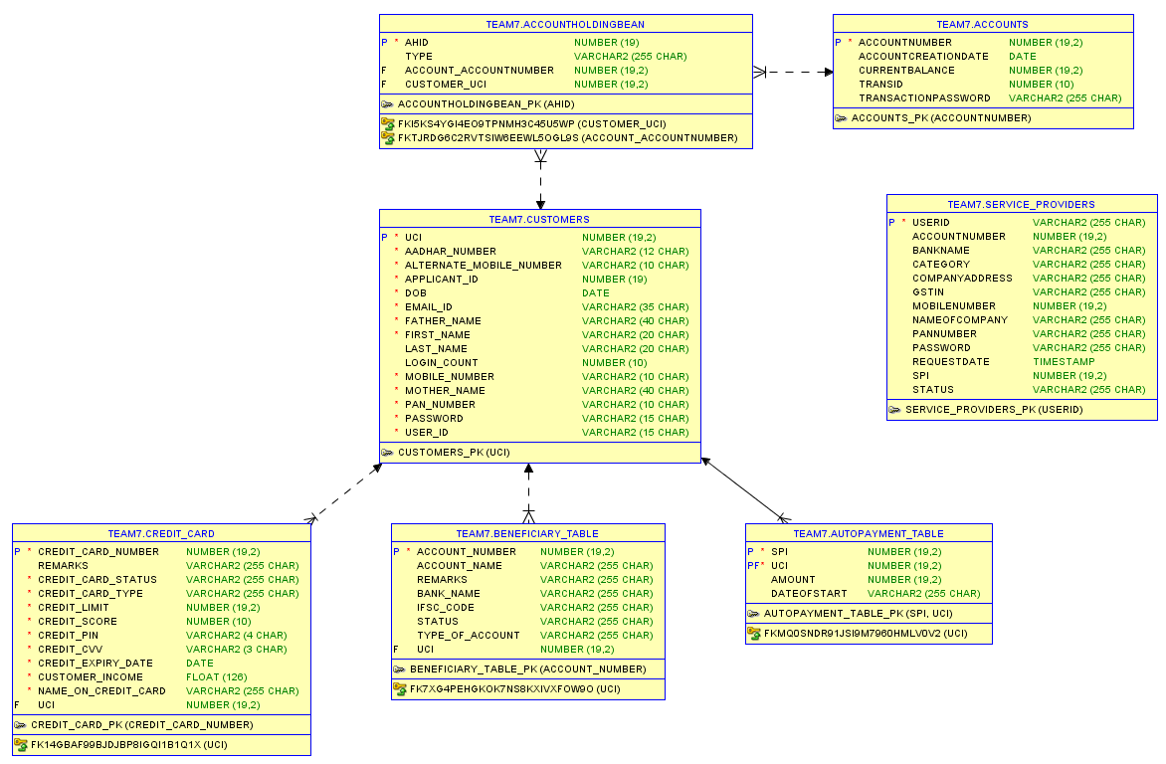

Slide 13
DEMO SCREENS

Slide 14
ENTER IDENTITY
Choose your identity from MENU:
------------------------
1 CUSTOMER
2 BANK_ADMIN
3 QUIT
Your choice :
1
Customer id:
23654235624564
Password
q45674667
Welcome abc
You are logged in successfully!!
Choose your identity from MENU:
------------------------
1 CUSTOMER
2 BANK_ADMIN
3 QUIT
Your choice :
2
------------------------
Choose a valid option
------------------------
1 VIEWREQUESTS
2 EXIT
Choices:
Choose your identity from MENU:
------------------------
1 CUSTOMER
2 BANK_ADMIN
3 QUIT
Your choice :
50
Please enter a valid option.
------------------------
Choose your identity from MENU:
------------------------
1 CUSTOMER
2 BANK_ADMIN
3 QUIT
Your choice :

Slide 15
ADD CREDIT CARD
Enter 1 to add a credit card.
Enter 2 to delete a credit card
Enter 3 to go back.
1
Please Enter a valid CreditCard number (16 digits)
4564564
Please Enter a valid CreditCard number (16 digits)
7897897897897897
Please enter a valid Name on your CreditCard (Please ensure no spaces)
abc
Please enter a valid expiry date on your card number in (MM/YYYY) format.
12/2019
Details entered by you :
Card name : abc
Card Number : 7897897897897897
Expiry date :2019-12-30
Card gone for approval.. Good luck!!
Welcome back to the credit card facilities.
You are logged in successfully!!
------------------------
Choose the desired action
------------------------
1 CREDITCARD
2 BENEFICIARY
3 AUTOPAYMENT
EXIT
1
The credit cards already existing for the customer:
1) Name on the card : kip
Card number : 9999999999999999
Expiry date : 2040-02-29
Card Status : APPROVED

Slide 16
DELETE CREDIT CARD
------------------------
Choose the desired action
------------------------
1 CREDITCARD
2 BENEFICIARY
3 AUTOPAYMENT
4 EXIT
1
The credit cards already existing for the customer:
1) Name on the card : jug
Card number : 6666666666666666
Expiry date : 2080-03-30
Card Status : APPROVED
Bank Admin remarks:pop
------------------------
Enter 1 to add a credit card.
Enter 2 to delete a credit card
Enter 3 to go back.
2
Please Enter a valid CreditCard number (16 digits)
555555555555555HGD
Please Enter a valid CreditCard number (16 digits)
66666666666666666
Card deleted!!
------------------------
Welcome back to the credit card facilities.

Slide 17
ADD BENEFICIARY
Choose the desired type of account
------------------------
1 SELFINSAME
2 SELFINOTHERS
3 OTHERSINSAME
4 OTHERSINOTHERS
Choices:
1
Please enter a valid Account number(11 digits)
7894561
Please enter a valid Account number(11 digits)
78945612313
Please enter a valid Account Holder Name (Case Sensitive)
abcabc
Please enter a valid IFSC code(11 characters)
HDFC5454545
Enter the bank name (case sensitive)
HDFC
The details entered by you are :
Name of the beneficiary : abcabc
Beneficiary account number : 78945612313
Bank name : HDFC
IFSC code : HDFC5454545
Beneficiary gone for approval... Good luck!!
Welcome Neel Banerjee
You are logged in successfully!!
------------------------
Choose the desired action
------------------------
1 CREDITCARD
2 BENEFICIARY
3 AUTOPAYMENT
4 EXIT
2
Sorry Neel Banerjee
No beneficiaries present.. please go on and add a beneficiary to enjoy our services
Enter 1 to add a beneficiary.
Enter 2 to modify a beneficiary.
Enter 3 to delete a beneficiary.
Enter 4 to go back.
1

Slide 18
MODIFY BENEFICIARY
Welcome abc
You are logged in successfully!!
------------------------
Choose the desired action
------------------------
1 CREDITCARD
2 BENEFICIARY
3 AUTOPAYMENT
4 EXIT
2
The beneficairies already existing for the customer:
1) Name of the beneficiary : abcabc
Beneficiary account number : 78945612313
Bank name : HDFC
IFSC code : HDFC5454545
Status: APPROVED
Bank Admin Remarks:good
Enter 1 to add a beneficiary.
Enter 2 to modify a beneficiary.
Enter 3 to delete a beneficiary.
Enter 4 to go back.
2
Please enter a valid Account number(11 digits)
67676767676
Please enter a valid account number(11 digits)
78945612313
Enter 1 to change the Account Holder Name.
Enter 2 to change the IFSC code.
Enter 3 to change the bank name.
Enter 4 to save changes. (Once saved changes, you can't change again till bank verification is done)
Enter 5 to exit.
2
Enter a valid IFSC code(11 characters)
HDFC4444444
Enter 1 to change the Account Holder Name.
Enter 2 to change the IFSC code.
Enter 3 to change the bank name.
Enter 4 to save changes. (Once saved changes, you can't change again till bank verification is done)
Enter 5 to exit.
4
Modified beneficiary details are gone for approval.

Slide 19
DELETE BENEFICIARY
Welcome Neel Banerjee
You are logged in successfully!!
------------------------
Choose the desired action
------------------------
1 CREDITCARD
2 BENEFICIARY
3 AUTOPAYMENT
4 EXIT
2
The beneficairies already existing for the customer:
1) Name of the beneficiary : abcabc
Beneficiary account number : 78945612313
Bank name : HDFC
IFSC code : HDFC4444444
Status:APPROVED
Bank Admin Remarks:GOODJOB
Enter 1 to add a beneficiary.
Enter 2 to modify a beneficiary.
Enter 3 to delete a beneficiary.
Enter 4 to go back.
3
Enter a valid account number to be deleted.
GUGGUG
Enter a valid account number to be deleted.
78945612313
Account deleted Successfully

Slide 20
AUTOPAYMENT
------------------------
Choose the desired action
------------------------
1 CREDITCARD
2 BENEFICIARY
3 AUTOPAYMENT
4 EXIT
3
The added autopayment services for the customer.
1) Customer ID : 5555111151511029
Service Provider ID : 1000001
Amount set to be deducted : 1112
Date of start : 31/10/2019
------------------------
Choose a valid option
------------------------
1 ADDAUTOPAYMENTS
2 REMOVEAUTOPAYMENTS
3 EXIT
Choices:
2
The added autopayment services for the customer.
1) Customer ID : 5555111151511029
Service Provider ID : ServiceProviderId [Spi=1000001, uci=5555111151511029]
Amount set to be deducted : 1112
Date of start : 31/10/2019
Enter a valid service provider id to be registered.
1000001
Autopayment service removed successfully

Slide 21
AUTOPAYMENT
------------------------
Choose a valid option
------------------------
1 ADDAUTOPAYMENTS
2 REMOVEAUTOPAYMENTS
3 EXIT
Choices:
1
Your IBS accounts are :
Account :12345678901
The IBS service providers are :
Name : Airtel
Service Provider ID : 1000001
Enter a valid service provider id to be registered.
1000001
Enter a valid account number from which amount should be deducted
12345678901
Enter a valid amount to be deducted
100
Enter a valid start date in format dd/MM/yyyy
90/20/1900
Enter a valid start date in format dd/MM/yyyy
20/12/2019
AutoPayment of service provider: 1000001 added and Rs. 100 will be deducted per month from the date of start
The added autopayment services for the customer.
1) Customer ID : 5555111151511029
Service Provider ID : 1000001
Amount set to be deducted : 100
Date of start : 20/12/2019

Slide 22
BANK ACTION
(BENEFICIARY)
------------------------
Choose your identity from MENU:
------------------------
1 CUSTOMER
2 BANK_ADMIN
3 QUIT
Your choice :
2
------------------------
Choose a valid option
------------------------
1 VIEWREQUESTS
2 EXIT
Choices:
5
Please enter a valid option.
------------------------
Choose a valid option
------------------------
1 VIEWREQUESTS
2 EXIT
Choices:
1
The following customers have new approval requests :
1 : 5555111151513301
Please enter a valid customer id to view individual requests
Enter 1 to exit
E4WG524987
Please enter a valid customer id to view individual requests
Enter 1 to exit
5555111151513301
Id entered by you is : 5555111151513301
Enter 1 to view Creditcard requests.
Enter 2 to view Beneficiary Requests.
Enter 3 to exit.
2
Beneficiary name : abcabc
Beneficiary Account number : 78945612313
Bank name : qqqqq
IFSC code : qqqqqqqqqqq
Press 1 or 2 according to the decision and proceed to the next beneficiary.
Enter 1 to approve.
Enter 2 to disapprove.
Enter 3 to exit this section.
1
Would you like to enter remarks?
Enter 1 for yes and 2 for no.
1
Please enter the response.
good
Beneficiary approved by the bank representative.

Slide 23
BANK ACTION
(CREDIT CARD)
Enter 1 to view Creditcard requests.
Enter 2 to view Beneficiary Requests.
Enter 3 to exit.
1
Credit card number : 7897897897897897
Credit card expiry : 2019-12-30
Name on the credit card : abc
Press 1 or 2 according to the decision and proceed to the next
card.
Enter 1 to approve.
Enter 2 to disapprove.
Enter 3 to exit this section.
42
Enter a valid choice of decision of credit card
Press 1 or 2 according to the decision and proceed to the next
card.
Enter 1 to approve.
Enter 2 to disapprove.
Enter 3 to exit this section.
1
Would you like to enter remarks?
Enter 1 for yes and 2 for no.
1
Please enter the response.
GOOD WORK
------------------------
Card approved by the bank representative.
Bank admin response:
GOOD WORK
------------------------
Choose your identity from MENU:
------------------------
1 CUSTOMER
2 BANK_ADMIN
3 QUIT
Your choice :
2
------------------------
Choose a valid option
------------------------
1 VIEWREQUESTS
2 EXIT
Choices:
5
Please enter a valid option.
------------------------
Choose a valid option
------------------------
1 VIEWREQUESTS
2 EXIT
Choices:
1
The following customers have new approval requests :
1 : 5555111151513301
Please enter a valid customer id to view individual requests
Enter 1 to exit
5555111151513301
Id entered by you is : 5555111151513301

Slide 24
THANK YOU.

