Slide 1
AAA Northeast Member Analysis
A market segmentation of AAA members
By:
Srujan Surapaneni

Slide 2
Agenda
Background
Objectives
Methodology
Exploratory Data Analysis
Model Analysis
Analysis Results
Recommendations
Appendix

Slide 3
Background
AAA Northeast is one of the regional clubs comprising the American Automobile Association
Details:
Areas Covered: Rhode Island, Connecticut, Massachusetts and portions of New York and New Jersey
58 Million members
Services offered: roadside assistance, maps and various discounts

Slide 4
Objectives
Provide a market segmentation of AAA members (or member households) that allows AAA Northeast to better serve their members.
Outcomes:
Analyze numbers & members location wise.
Identify non-desirable members
Predict cost
Identify factors influencing cost
Identify factors influencing product sale

Slide 5
Approach & Methodology
Stage 1: Summarize data to the household level
Stage 2: Data exploration
Stage 3: Create Dummy variables and one hot encoding
Stage 4: Over sampling using SMOTE
Stage 5: Splitting data into training and testing sets
Stage 6: Model fitting
Stage 7: Confusion matrix to cross validate
Stage 8: Join training and validation sets
Stage 9: Develop models to predict the likelihood of using roadside service as well as the total cost of roadside usage
Stage 10: Use model results to cluster/segment the members. (Used a small number of clusters (4-6))
Stage 11: Use model results to predict the desired customers based on the cost incurrence

Slide 6
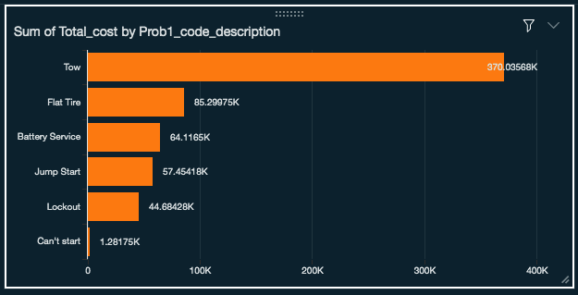
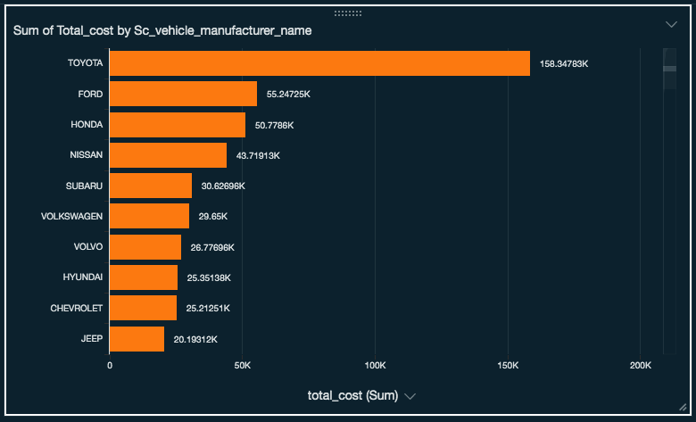
Exploratory Data Analysis
The bar chart above represents total cost by problem categories that’s been reported on each service call
From the analysis above, the highest costing service is when the vehicle gets towed and the lowest is when the problems are simple such as needing a boost to start
Tow services are 4 times more expensive than the next most expensive service
The bar chart above represents top 10 cars by total cost by customer’s car manufacturers that’s been serviced
From the analysis above, the cars that costed the highest amount for the service are from Toyota and Jeep being the last among the top 10

Slide 7
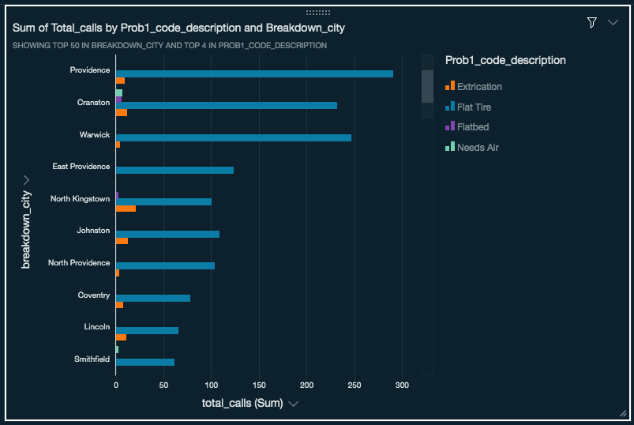
Exploratory Data Analysis (Contd.)
The bar chart above represents total calls made by problem categories from top 10 locations that’s been reported on each service call
From the analysis above, the place from which the highest number of calls were received is Providence
From the analysis above, its clear that the most numbers of calls on each of the locations reported flat tire issues
The next problem that’s been reported was Extrication

Slide 8
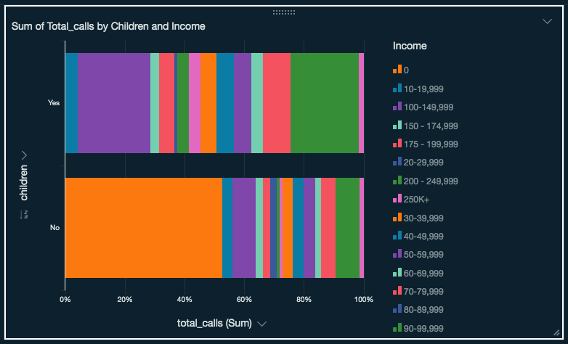
Exploratory Data Analysis (Contd.)
The stacked bar chart above represents total calls made from households with children vs without children stacked stacked together based on the household income
From the analysis above, households with No children and that belonged to 30-39k category made the highest number of calls which is ~50% of the total calls in the category
It is also clear that the households with children that made the highest number of calls belonged to the 100-149k income category and 200-249k category

Slide 9
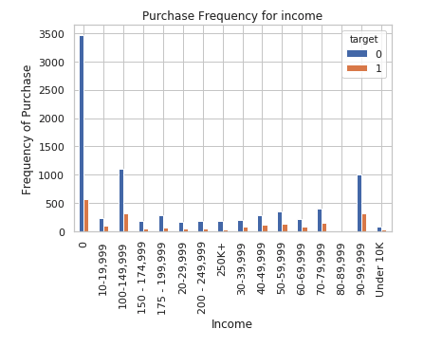
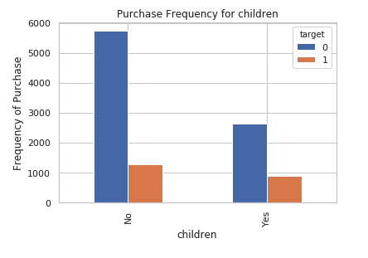
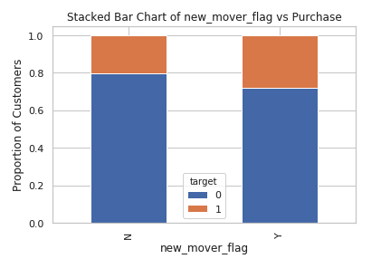
LOGISTIC REGRESSION – MEMBERSHIP DETERMINATION
Model Analysis
Target 1 is the customers who bought the service and 0 is who has not
From the analysis above, during the model build, we have observed that income variable has quite some significance on whether a customer is a potential member
Target 1 is the customers who bought the service and 0 is who has not
From the analysis above, during the model build, we have observed that customers with no children bought the service more than the ones that did not
The bar chart above represents proportion of customers that bought the service vs that did not against the new mover flag
It’s observed that the column may not be a good indicator hence cannot be used in the model training

Slide 10

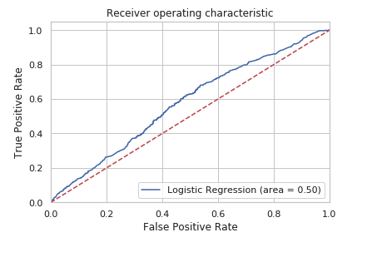
LOGISTIC REGRESSION – MEMBERSHIP DETERMINATION (CONTD.)
Regression model us built using 70/30 split on existing customers
Data transformations, standardization procedures were applied to in continuous measures and hot encode categorical variables
The model predicted the potential membership with a 79% accuracy
More data is required to improve the curve and move it farther away from the central line that determines the true positivity of the model prediction
The curve represents that the classifier can perform better in labelling some positive than placing them close to negatives

Slide 11
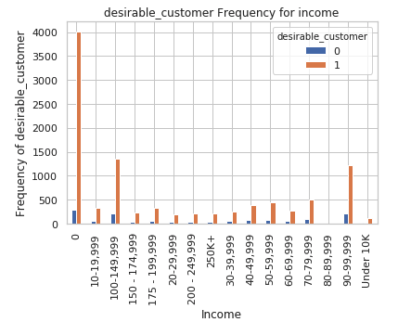
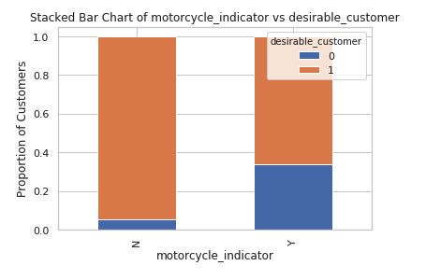
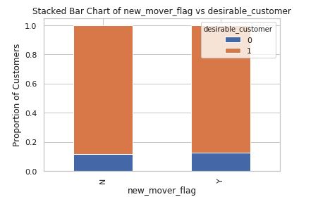
LOGISTIC REGRESSION – DESIRABILITY DETERMINATION
Model Analysis
Target 1 is the customers who are more desirable due to their total cost incurred and 0 is who is not due to the highest cost they incurred to the company
we have observed that income variable has quite some significance on whether a customer is desirable or not
Target 1 is the customers who are more desirable due to their total cost incurred and 0 is who is not due to the highest From the analysis above, during the model build, we have observed that customers with motorcycle are less desirable than the one’s without
The bar chart above represents proportion of desirability based on the cost vs that did not against the new mover flag
It’s observed that the column may not be a good indicator hence cannot be used in the model training

Slide 12
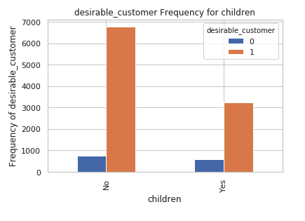
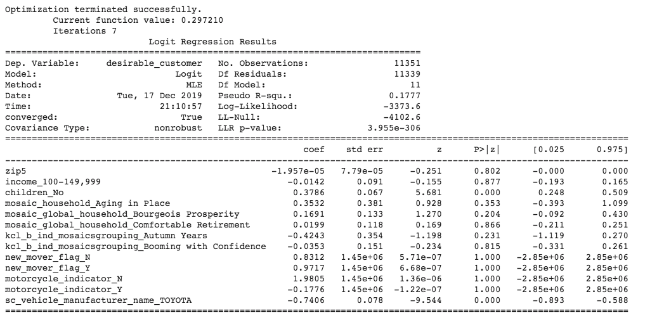
LOGISTIC REGRESSION – DESIRABILITY DETERMINATION (CONTD.)
Target 1 is the customers who bought the service and 0 is who has not
From the analysis above, during the model build, we have observed that children variable has quite some significance on whether a customer is a desirable member or not
During the initial build, the variables with the highest P value has been removed and variables with the lowest p-values have ben used for the training
Length of residence, children, and car manufacturer were used for the model build
Precision, recall and F-measure were all determined in the subsequent steps of the model build to improve on the classifier’s performance

Slide 13
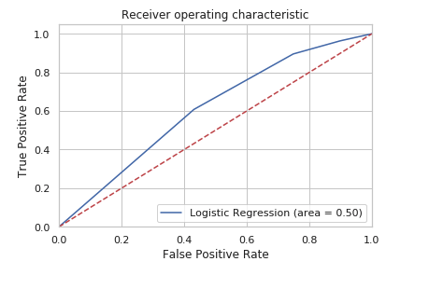
LOGISTIC REGRESSION – DESIRABILITY DETERMINATION (CONTD.)
Regression model us built using 70/30 split on existing customers
Data transformations, standardization procedures were applied to in continuous measures and hot encode categorical variables
The model predicted the potential membership with a 79% accuracy
More data is required to improve the curve and move it farther away from the central line that determines the true positivity of the model prediction
The curve represents that the classifier can perform better in labelling some positive than placing them close to negatives

Slide 14
Summary & Observations
The highest costing service is when the vehicle gets towed and the lowest is when the problems are simple such as needing a boost to start
Tow services are 4 times more expensive than the next most expensive service
The cars that costed the highest amount for the service are from Toyota and Jeep being the last among the top 10
The place from which the highest number of calls were received is Providence, so customers living close-by are less desirable due to the fact that there’s been increase in the number of flat tire issues which may be due to the road conditions
Households with No children and that belonged to 30-39k category made the highest number of calls which is ~50% of the total calls in the category. So these households are less desirable
It is also clear that the households with children that made the highest number of calls belonged to the 100-149k income category and 200-249k category, so households that fall into these income categories are less desirable
During the model build, we have observed that customers with no children bought the service more than the ones that did not, so this bucket might be a potential target for advertisement
We have observed that customers with motorcycle are less desirable than the one’s without

Slide 15
Recommendations
To reduce tow costs, it might be advisable to have more service shops near the cities/places with highest call rates
Customers with Toyota cars made most number of calls and costed 4 times as much. So extra attention is required when offering services to these customers
It’s advisable that the customers with children are the target groups for the campaigns as the number of calls made by them were significantly less than the households with no children
Income groups 100-149 and 200-249k seems to be making more calls than the other groups, so these groups are less desirable and hence the other income groups can be considered target groups for campaign

Slide 16
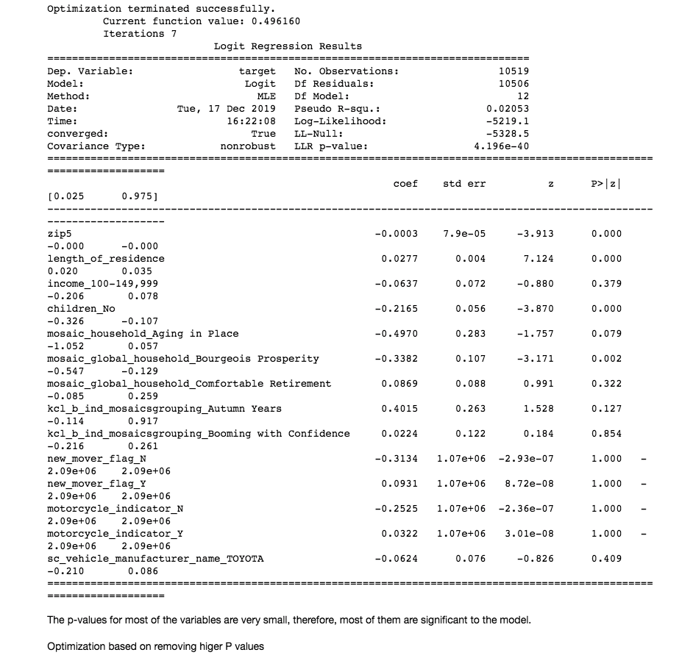
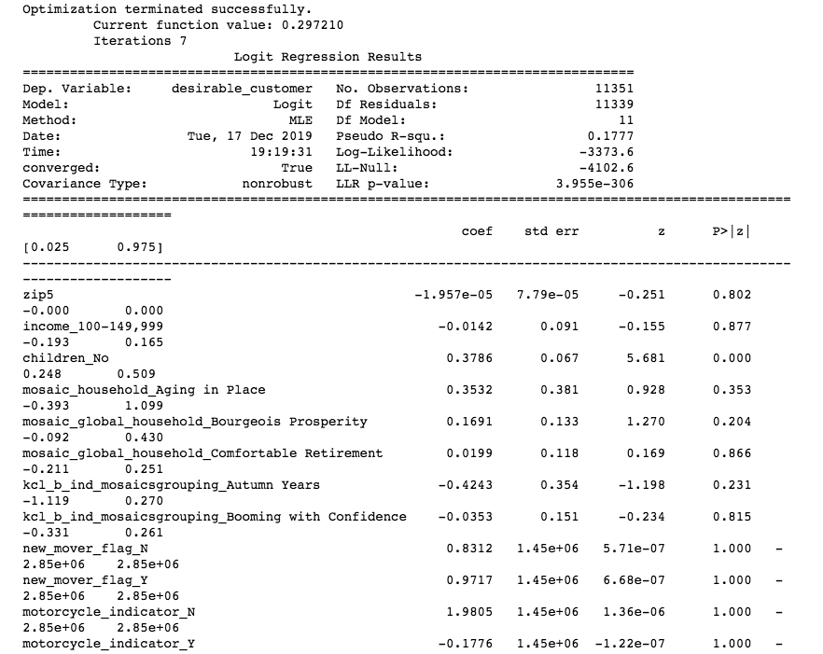
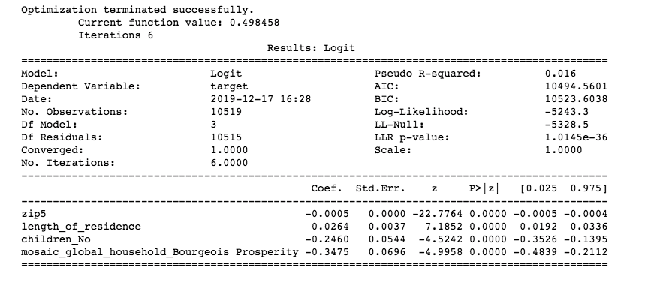
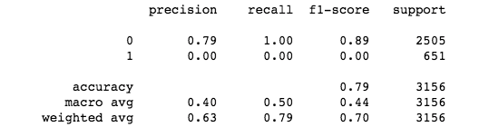
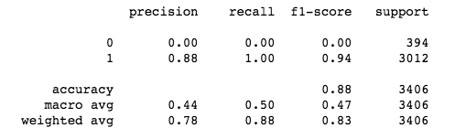
Appendix

