Slide 1

CSC 177- Data Analytics and Mining
Project 1: Data Preprocessing Project
## Team Challengers (23):
1. Srujay Reddy Vangoor
2. Vaibhav Jain
3. Bashar Allwza
4. Varun Bailapudi
5. Uddayankith Chodagam

Slide 2
Comprehensive Set of Techniques for Preprocessing
There are a total 6 types of techniques for preprocessing and they are listed below.
● Data Cleaning
● Dimensionality Reduction
● Feature Engineering
● Sampling Data
● Data Transformation
● Imbalanced Data

Slide 3
Steps for Data Preprocessing
The data which we used in our project has numerical values so before training and testing we done some preprocessing on it.
● Check for null values
● Check for data type
● Analysing Data with Line and pair plots
● Creating heat map to check the correlation
● Dropping Lights and Data because of low correlation
● Checking for duplicates

Slide 4
Steps for Data Preprocessing (Contd.)
● Box plot to check for outliers
● Calculate Z-Score
● Removed rows where z-score is >3 and <-3
● Sorting the data frame
● Splitting into input and output feature
● Performing min-max scaling

Slide 5
Check for outliers
An Outlier is a data-item/object that deviates significantly from the rest of the (so-called normal)objects.
They can be caused by measurement or execution errors. The analysis for outlier detection is referred toas outlier mining. There are many ways to detect the outliers, and the removal process is the data frame same as removing a data item from the panda’s data frame.
Outliers can be detected using visualization, implementing mathematical formulas on the dataset, or using the statistical approach.

Slide 6
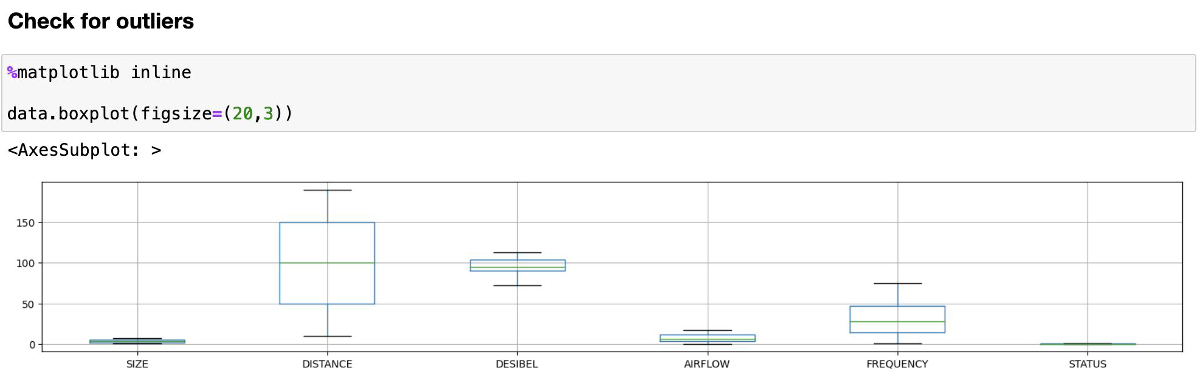
Check for outliers (Contd.)

Slide 7
HeatMap
Heatmaps visualize the data in 2-D colored maps making use of color variations like hue, saturation, or luminance. Heatmaps describe relationships between variables in form of colors instead of numbers.
We can create a basic heatmap using the sns.heatmap() function:
sns.heatmap(df)

Slide 8
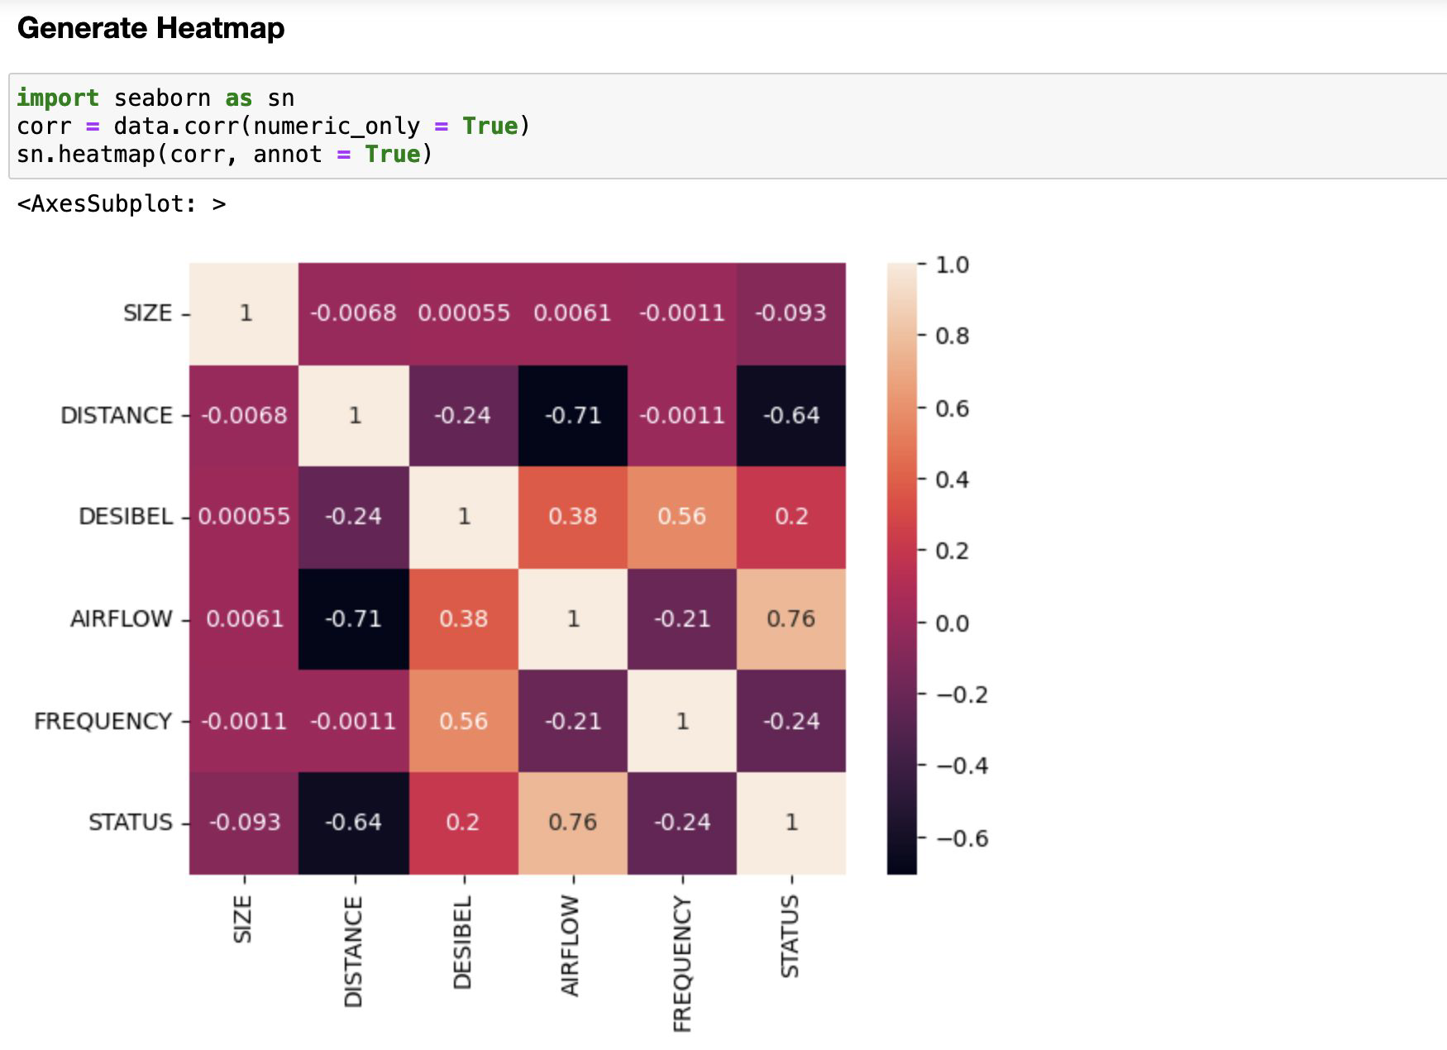
HeatMap (Contd.)

Slide 9
Perform Standardizing
To standardize the data , Z-Score is a very popular method in pandas that is used to standardize the data. Z-Score will tell us how many standard deviations away a value is from the mean. When we standardize the data the data will be changed into a specific form where the graph of its frequency will form a bell curve.

Slide 10
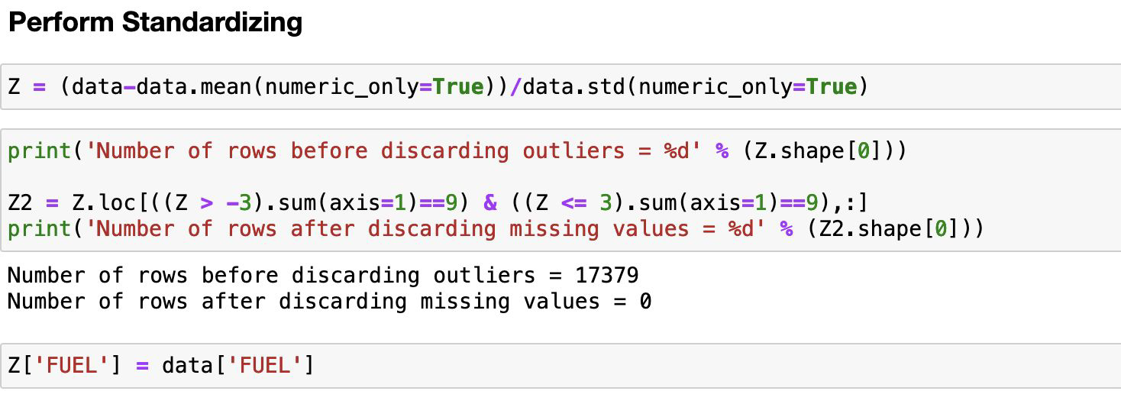
Perform Standardizing (Contd.)

Slide 11
Shuffle the dataset and sort dataframe
Because our data is often sorted in a particular way (say, for example, by date or by geographical area), we want to make sure that our data is representative. Because of this, we will want to shuffle our Pandas dataframe prior to taking on any modelling. Shuffling data has the effect of reducing variance and making sure that models remain general and overfit less.
We will be using the sample() method of the pandas module to randomly shuffle DataFrame rows in Pandas. In order to sort the dataframe in pandas, function sort_values() is used. Pandas sort_values() can sort the data frame in ascending or descending order.

Slide 12
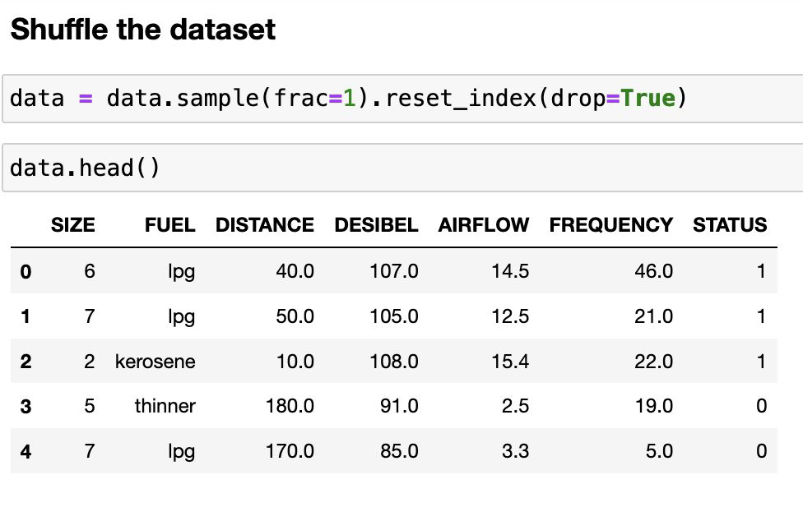
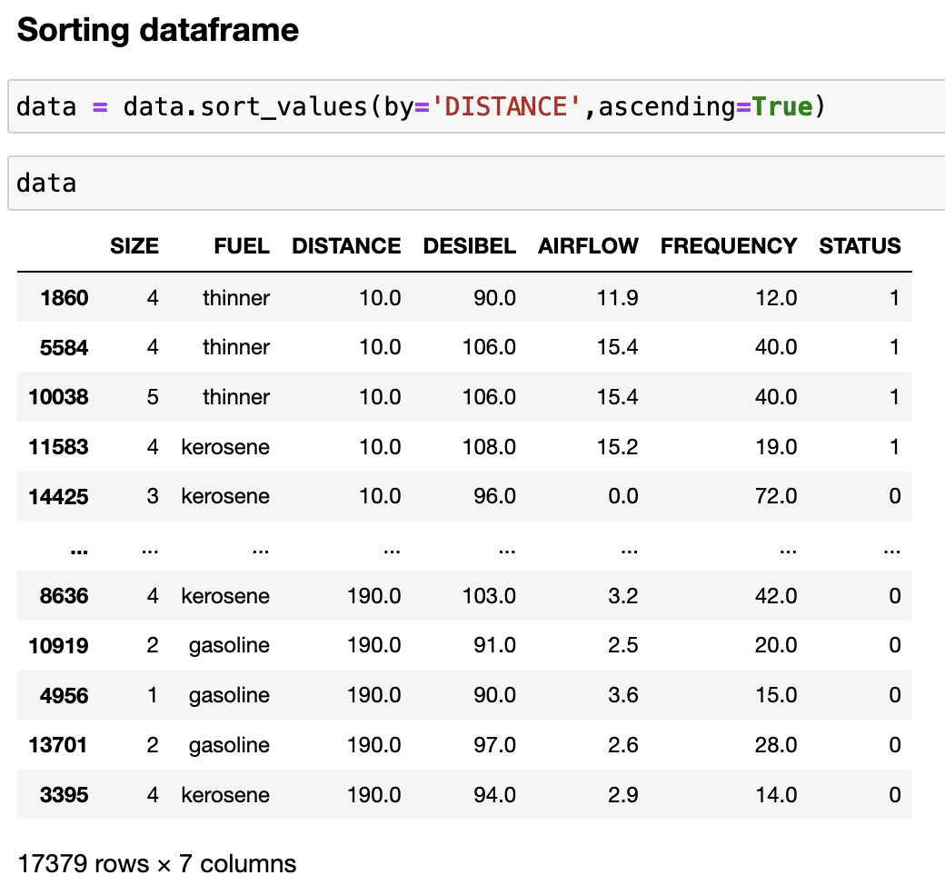
Shuffle the dataset and sort dataframe (Contd.)

Slide 13
Label encoding for categorical data
1. Create an instance of LabelEncoder() and store it in labelencoder variable/object.
2. Apply fit and transform which does the trick to assign numerical value to categorical value and the same is stored in new column called “encoded_FUEL”.
3. Note that we have added a new column called “encoded_FUEL” which contains numerical value associated to categorical value and still the column called State is present in the dataframe. This column needs to be removed before we feed the final preprocess data.

Slide 14
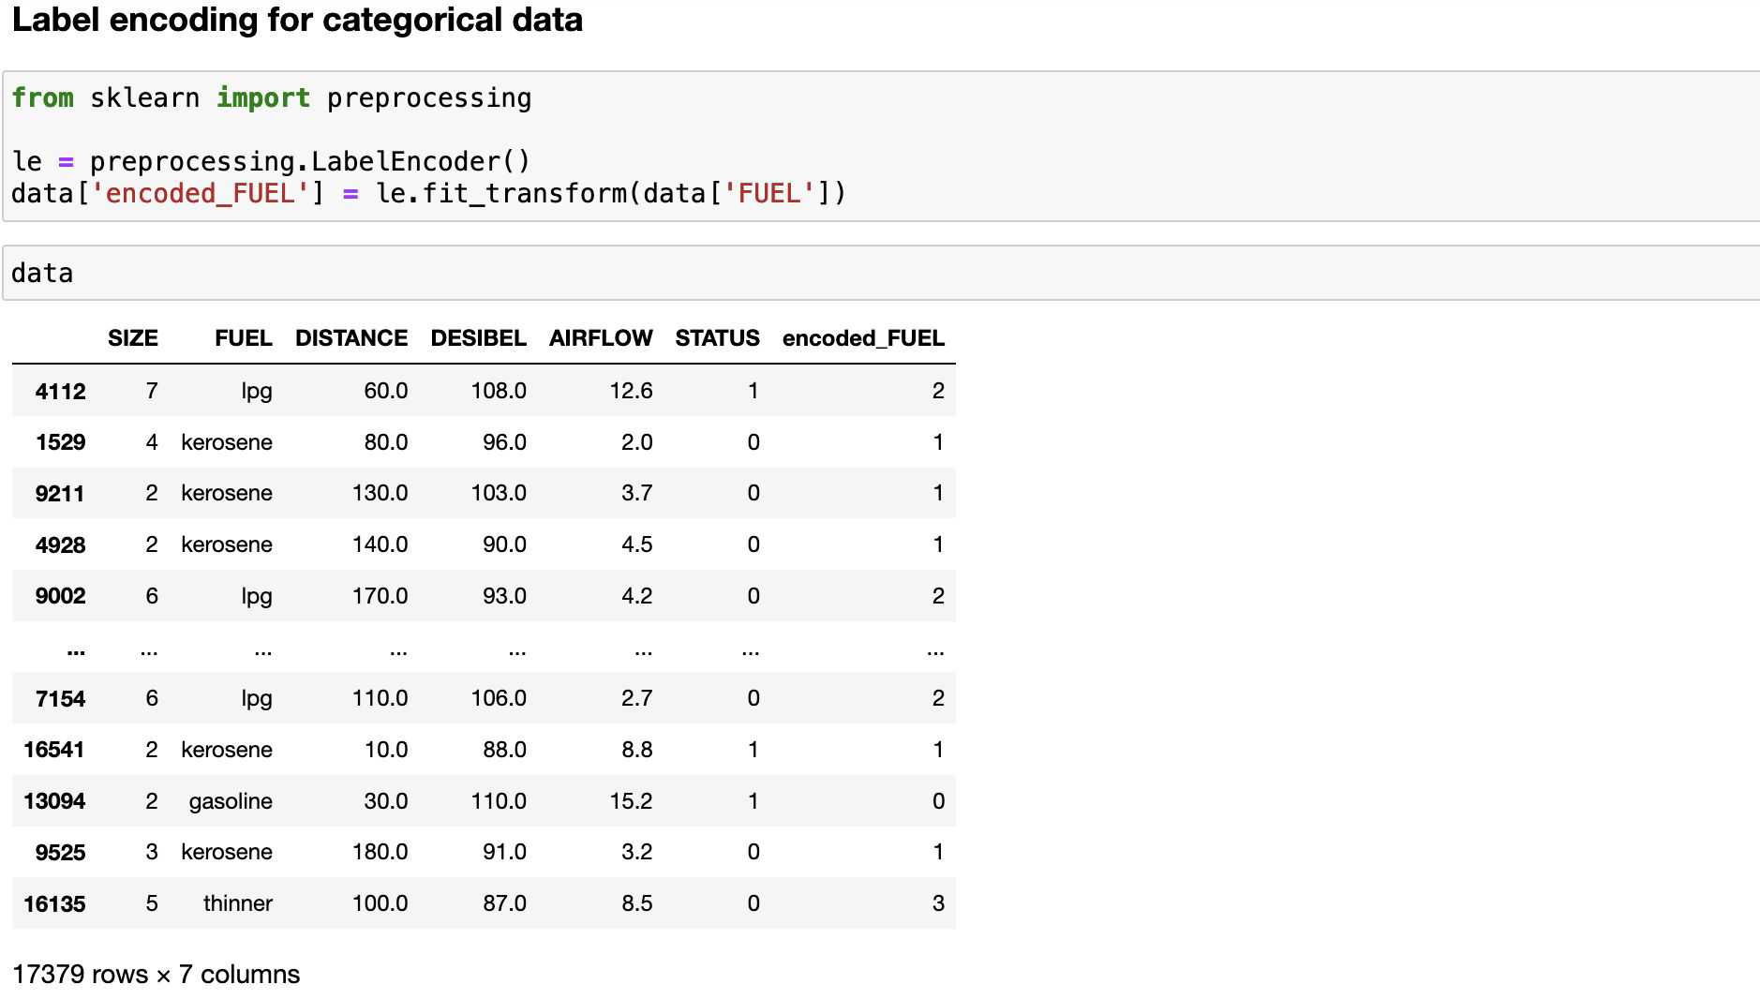
Label encoding for categorical data (Contd.)

Slide 15
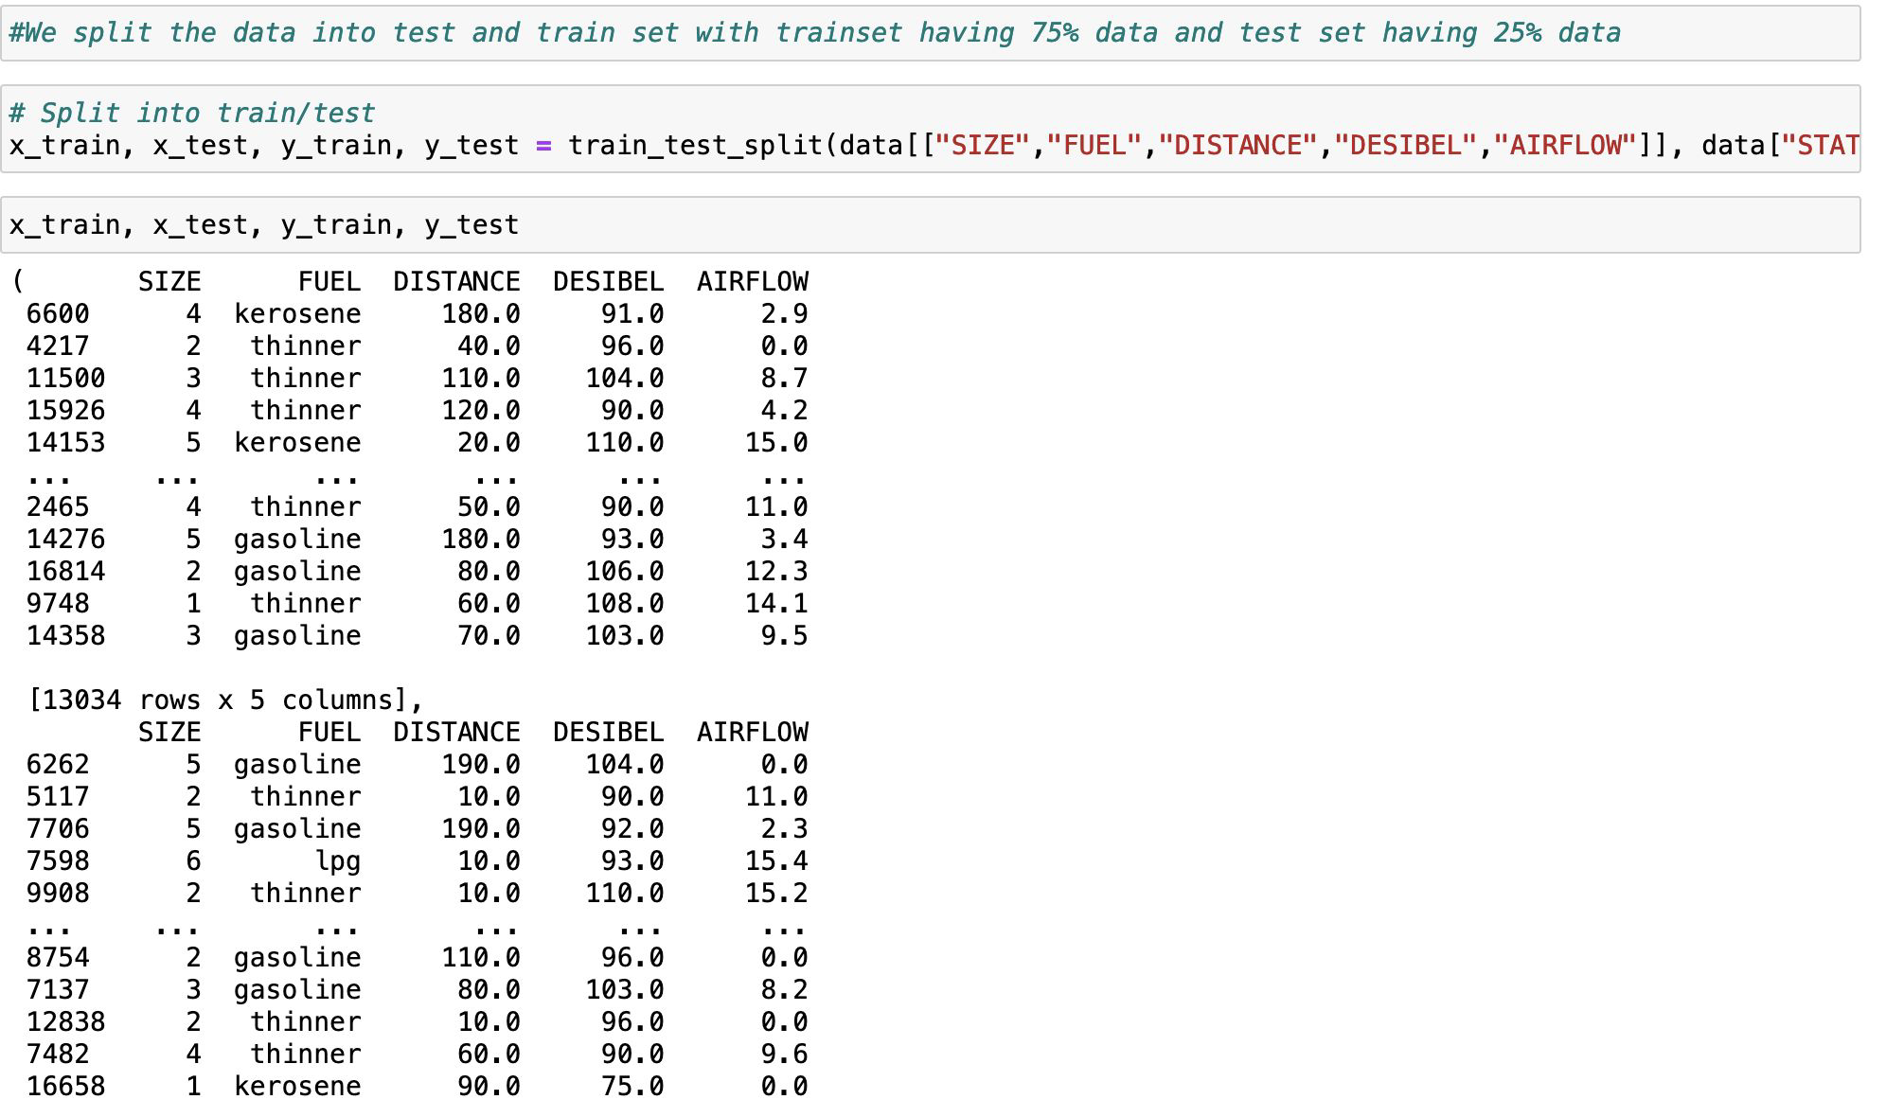
Splitting dataframe

Slide 16
Means and Standard Deviations on data
The mean is the sum of all the entries divided by the number of entries. Standard Deviation is a measure of spread in Statistics. It is used to quantify the measure of spread, variation of a set of data values. A low measure of Standard Deviation indicates that the data are less spread out, whereas a high value of Standard Deviation shows that the data in a set are spread apart from their mean average values.

Slide 17
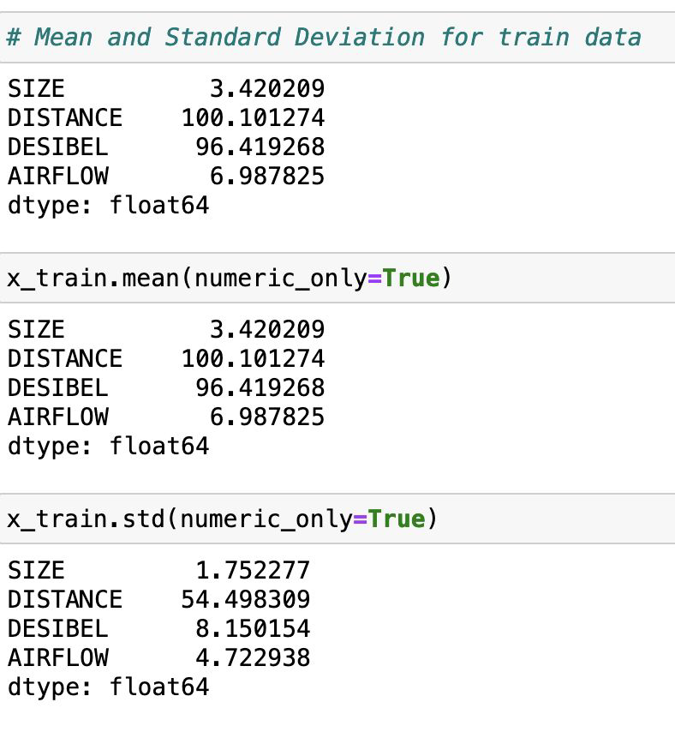
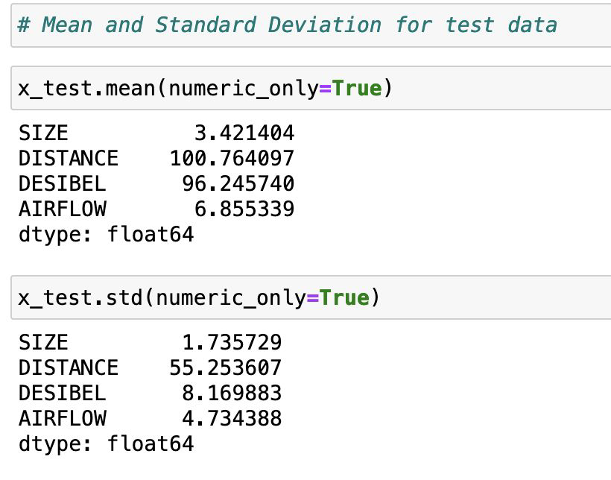
Means and Standard Deviations on data (Contd.)

Slide 18
Discretization
Discretization is the process of converting continuous data into discrete buckets by grouping it. Discretization is also known for easy maintainability of the data. Training a model with discrete data becomes faster and more effective than when attempting the same with continuous data. Here the value counts gives how many unique data elements are present and count of each of these unique elements.

Slide 19
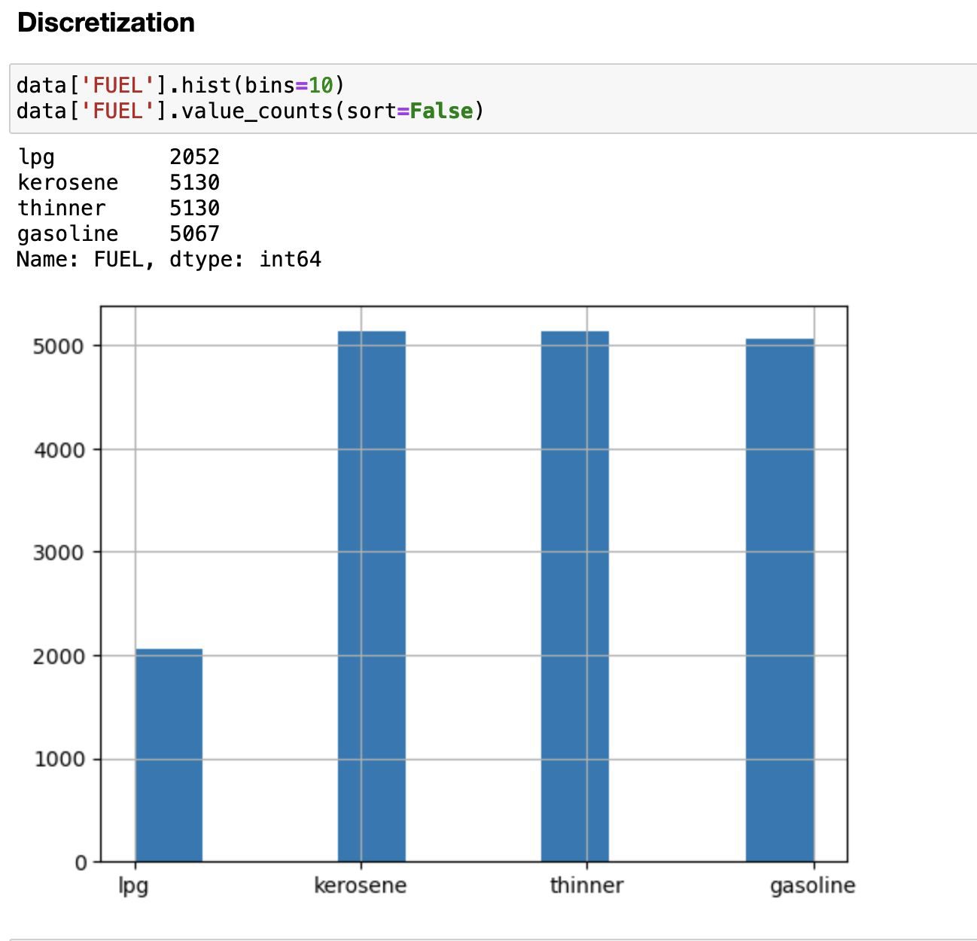
Discretization (Contd.)

Slide 20
Principal Component Analysis
Principal Component Analysis is basically a statistical procedure to convert a set of observations of possibly correlated variables into a set of values of linearly uncorrelated variables.
Each of the principal components is chosen in such a way that it would describe most of them still available variance and all these principal components are orthogonal to each other. In all principal components, first principal component has a maximum variance.

Slide 21
Human insights on preprocessed data
●The data can be used for Energy Prediction of Household Appliances.
●The data was pre-processed keeping in mind that the result data can be directly given to the model for prediction.
●As such the correlation was determined with heat-maps and made sure that the data will not negatively affect the predictions that are going to be done my the Neural Network model.
●Min Max scaling was also done so as to decrease the prediction deviation.

Slide 22
Thank you!!

