Slide 1
DAB 401: Final Group Project
Predicting cross sell capabilities of insurance sales

Slide 2
Presented By
Manikanta Akash Kasina (0753796)
Vanishree Ramakrishnan(0750362)
Srujeeth Tatipatri Srinivas(0755624)
Sai Sowmya Tummuri(0755803)
Jagadish Babu Mandava(0749201)

Slide 3
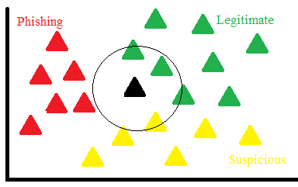
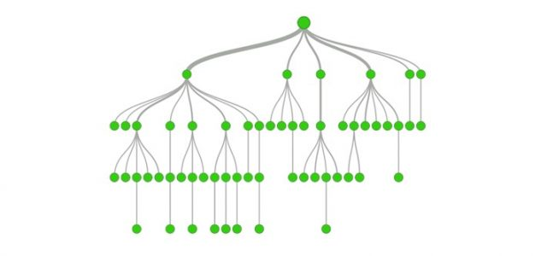
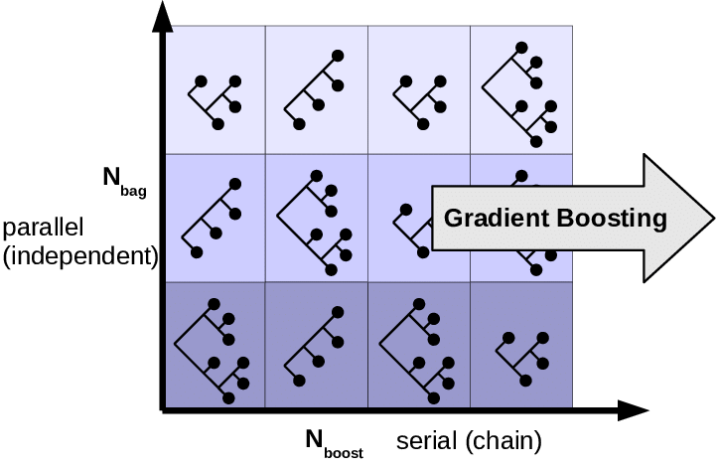
Models Used
Gradient Boosting
KNN
Decision Tree
Meet our consultants
01
02
03
04
Here you could describe the topic of the section

Slide 4
Problem Statement
insurance
COMPANY
Insurance companies provide a tax-free sum or aid for compensating some specific loss, damage, illness, or death in exchange for a small premium. The most obvious advantage is its functional purpose. While usually a lot of options are available to choose from, it is beneficial both for the insurance company as well as the insurer.
By making use of machine learning and deep learning models, we are aiming to develop and train a model for predicting the cross-sell capabilities of multiple insurance policies. Using the insurance data collected, we will be predicting whether a customer who opted for health insurance enrolls in vehicle insurance provided by the same

Slide 5
Problem Statement
insurance
COMPANY
This helps to identify the prospective consumers for the insurance agency, identifying the worth and estimating the investment and revenue pertained to the vehicle insurance section.

Slide 6
Importance Of Financial Analytics
01
Financial analytics will help business make smart decisions to curtail waste and to improve revenue(profit).
Helps us to better understand the current market trend and forecast any discrepancies in the market.
Timely information for business to make better informed decisions.
Has the potential to help organization adapt to the trends that will influence its operations.
Shapes up the future goals of business.

Slide 7
Dataset Description
The data collected consists of around 12 columns comprising of data related to Gender, Age, Driving License data, Annual Premium, etc.
The target variable is identified as response which indicated whether a customer is interested in vehicle insurance provided by the same company.
Data Source:
/datahack.analyticsvidhya.com/contest/
https://datahack.analyticsvidhya.com/contest/janatahack-cross-sell-prediction/True/

Slide 8
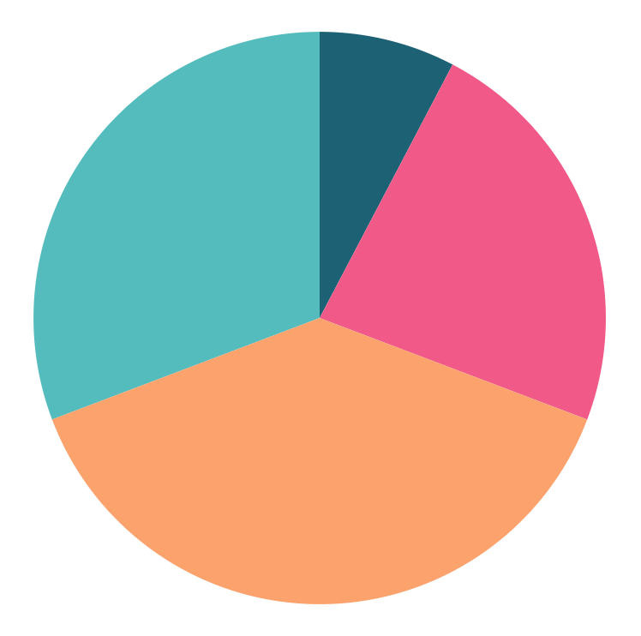
Exploratory Data Analysis (Tableau)
Outreach
Top Rated Values
Health
Travel
Home
Money
To modify this graph, click on it, follow the link, change the data and replace it here

Slide 9
Exploratory Data Analysis (Tableau)
Outreach
Top Rated Values
Health
Travel
Home
Money
To modify this graph, click on it, follow the link, change the data and replace it here

Slide 10
UNDERSTANDING THE PROBLEM
mars
jupiter
saturn
Despite being red, Mars is actually a cold place full of iron oxide dust
It’s the biggest planet in the Solar System and the fourth-brightest object in the sky
Yes, this is the ringed one. It’s a gas giant, composed mostly of hydrogen and helium

Slide 11
OUR COMPETITORS
Mercury | Mars | Jupiter | Saturn
Yes | Yes | No | No
No | Yes | Yes | No

Slide 12
KNN
It’s a simple classification problem where in we will predict the new sample point by using a database where in each of the data points are divided into several classes.
Also known as lazy learning algorithm/non-parametric since they won’t require training data points for model generation.

Slide 13
Decision Tree
It’s a CART(Classification & Regression)algorithm that will partition the explanatory variable into several mutually exclusive regions which closely resembles a tree structure in which each separation or branch is called a node.
Many organization may deploy this algorithm for decision support system. This structured model enables the user to see how and why one choice may lead to the next and the varied solutions that are possible

Slide 14
Gradient Boosting
Gradient Boosting when used for classification will try to build an additive model, which will enable us to amplify the arbitrary differentiable loss functions.
Combines varied weak learning models together to build a strong predictive model.

Slide 15
TARGET
$50,000
60%
40%
Family unit
Gender
Age
Female
Male
20-39
40+
Salary per year
Public SECTOR
Private Company

Slide 16

Conclusion
Mercury is the SMALLEST planet
Here you can write about the solutions you offer
Here you can write about the solutions you offer
Here you can write about the solutions you offer
Here you can write about the solutions you offer
Here you can write about the solutions you offer

Slide 17
Best Model
90%
70%
25%
Mercury is the closest planet to the Sun
Saturn is composed of hydrogen and helium
Despite being red, Mars is a cold place

Slide 18
OUR AWARDS
neptune
Neptune is the farthest planet from the Sun
mercury
venus
Mercury is the closest planet to the Sun
Venus is the second planet from the Sun

Slide 19
95%
This is our customer satisfaction rate

Slide 20


MORE INFO
You can replace the image on the screen with your own work. Just delete this one, add yours and send it to the back

Slide 21
References
https://www.educba.com/financial-analytics/
https://blog.usejournal.com/a-quick-introduction-to-k-nearest-neighbors-algorithm-62214cea29c7
https://www.investopedia.com/terms/d/decision-tree.asp#:~:text=A%20decision%20tree%20is%20a,or%20show%20a%20statistical%20probability.&text=Each%20branch%20of%20the%20decision,decision%2C%20outcome%2C%20or%20reaction.

Slide 22
THANKS!
Please keep this slide for attribution.

