Slide 1

COURSE : OBJECT ORIENTED PROGRAMMING LANGUAGE
COURSE INSPECTOR : N.VENKATA RAMANA SIR
TITLE OF THE PROJECT : HOSPITAL MANAGEMENT SYSTEM
LIST OF DEVELOPERS : M.DEEKSHITHA
V.SRUJITHA
SK.AMISHA
R.LAKSHMI PRASANNA
CH.JAHNAVI

Slide 2
What is Hospital Management System (HMS):
Hospital management system is a computer system that helps manage the information related to health care and aids in the job completion of health care providers effectively. They manage the data related to all departments of healthcare such as,
Clinical
Financial
Laboratory
Inpatient
Outpatient
Operation theater
Materials
Nursing
Pharmaceutical
Radiology
Pathology
The advantages of HMS can be pinpointed to the following:
Time-saving Technology.
Improved Efficiency by avoiding human errors.
Data security and correct data retrieval made possible.
Cost effective and easily manageable.
Easy access to patient data with correct patient history.

Slide 3
Features of Hospital Management System :
Appointment Management
Billing Management
Prescription Management
Discharge Summary
Operation Theatre Management
Pharmacy Management
Lab Management
Master Information Systems
Manage Multiple Locations

Slide 4
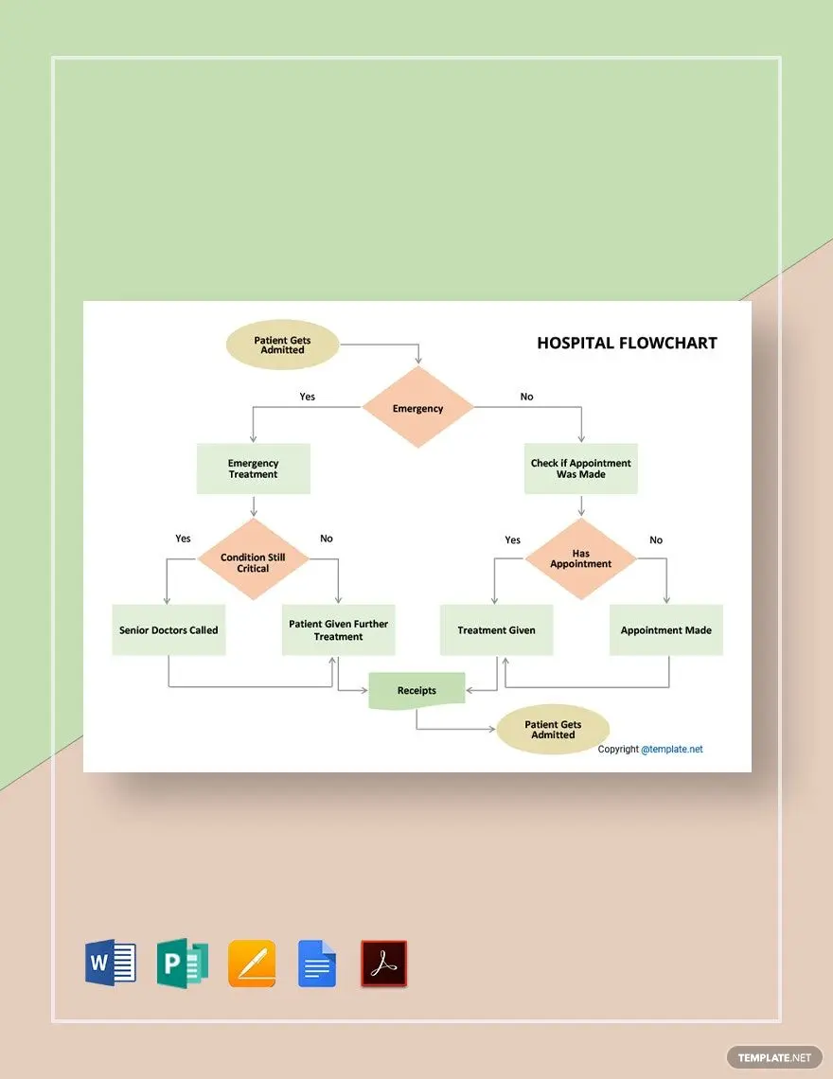

Slide 5
LIST OF CLASSES AND METHODS IN HOSPITAL MANAGEMENT SYSTEM
Four Classes: Patient, Doctor, Hospital And Demo
CLASS : HOSPITAL
METHOD : addDoctor()
:addPatient()
:showDoctors()
:showPatient()
:assignDoctors()
CLASS : PATIENT
METHOD : getDisease()
: toString()
CLASS : DOCTOR
METHOD : getDoctorName()
: getDoctorPatientList()
:getDoctorSpeciality()
:toString()
CLASS : DEMO
METHOD : addDoctor()
:assignDoctor()

Slide 6
INTERFACES(OR)ABSTRATIONS IN HOSPITAL MANGAEMENT:
Humans are attempting to automate manual operations in this technological age in an effort to save time and money.
A solution for hospitals with several employees working alongside doctors, nurses, and staff members is the hospital management system.
This program is a web platform for handling and managing all activity as well as for maintaining and centralizing a database of information that will be quickly accessible with just one click on the internet.
The user, often known as the patient, is another essential component of this application.
The primary goal of creating a hospital management system in Java is to oversee hospital operations online.

Slide 7
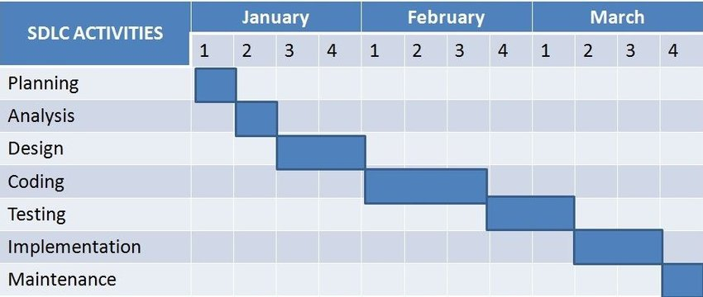

Slide 8
ROLES AND RESPONSIBILITIES OF TEAM MEMBERS:
On a project team, each member has certain responsibilities or specific tasks that help contribute to the success of the project. That’s why it is important to have varying roles on the project team.
DEEKSHITHA(TEAM LEAD):
Create overall project vision.
Create the project plan.
In-depth knowledge of performance metrics.
Assigning tasks to project team members.
Carrying ultimate responsibility for the project.
SRUJITHA:
Communicate with project lead on roadblocks.
Solve project objectives.
Complete tasks in areas of expertise.
Determining the methodology used on the project.
Documenting the process.
LAKSHMI PRASANNA:
Assisting in defining the project.
Gathering the requirements.
Testing the code to validate the objectives.
Completing individual deliverables.

Slide 9
JAHNAVI:
Managing deliverables according to the plan.
Gathering the requirements(like flow chart and related info.).
Executing the code to validate objectives.
Documenting technical requirements.
AMISHA:
Assisting in defining the project.
Gathering the requirements(like Gantt charts and relevant info.).
Ensuring the availability of resources to complete the project.
Finding the methods and classes used in the project.
The project team is responsible for contributing to the overall project objectives and specific team deliverables, by contributing towards the planning of project activities and executing assigned tasks / work with in thee expected quality standards, to ensure the project is success.

Slide 10
NOW LETS MOVE ON TO SOME QUESTION AND ANSWERS

Slide 11

THANK YOU

